Slide 1
Networking Protocols
Applied Computing Slideshows
by Mark Kelly
vcedata.com
mark@vcedata.com
Guess who couldn’t find a funny picture about networking protocols...
<number>
Notes:
<number>

Slide 2
Contents
TCP/IP
Ethernet CSMA/CD
Yep.
You’re already missing the dancing baby.
I understand.
Sorry.
<number>
Notes:
<number>

Slide 3
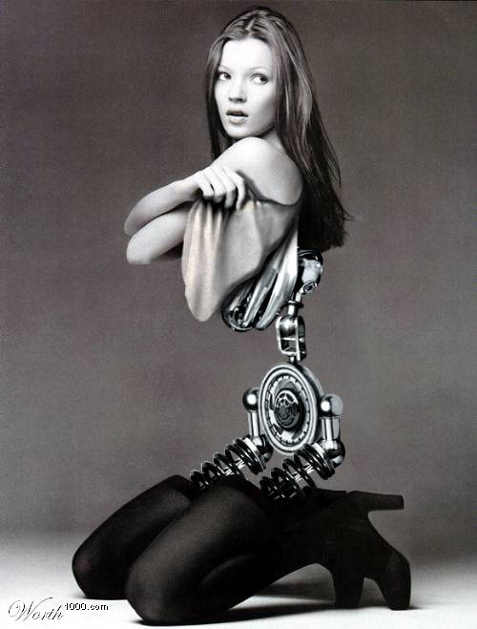
Protocols
Communication protocols are agreed sets of rules and procedures for computers to exchange information.
Like humans agreeing to speak the same language during a conversation.
For two computers to exchange data, they must be using the same protocols.
<number>

Slide 4
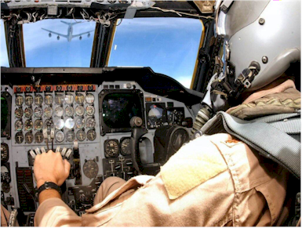
Human Protocols
during a phone call, saying “Uh huh”, “Mmmm” or “Yeah” while the other person speaks
nodding to show understanding
waiting for the other person to stop talking before you start
raising pitch of voice after a question
airline pilots speak English, refer to heights in feet, agree on which direction to turn to avoid collision, pronounce 9 as “niner”, spell out letters with words (Alpha, Bravo, Charlie etc.)
<number>

Slide 5
Network Protocols
There is a standard protocol for each network communication task, such as:
- how to send data over the Internet (TCP/IP)
- how to send and receive email (POP, IMAP)
- how to request and deliver web pages (HTTP)
- how to request and deliver files (FTP)
<number>

Slide 6
Choosing Protocols
Sometimes there is more than one choice of protocol for a task, such as how messages pass across a network (IPX/SPX vs TCP/IP, POP vs IMAP).
As long as all the connected computers use the same protocol, it really does not matter which protocol is used (like diplomats agreeing on a language for negotiations)
The internet only works because TCP/IP, POP, FTP and HTTP are universal standards, used by all shapes and sizes of computers.
<number>

Slide 7
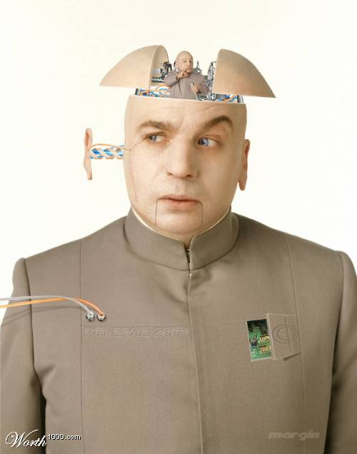
The King of Protocols – TCP/IP
The universal protocol for internet communications.
The backbone of the internet.
Made up of 2 complementary protocols…
TCP (Transport Control Protocol)
and
IP (Internet Protocol)
<number>

Slide 8
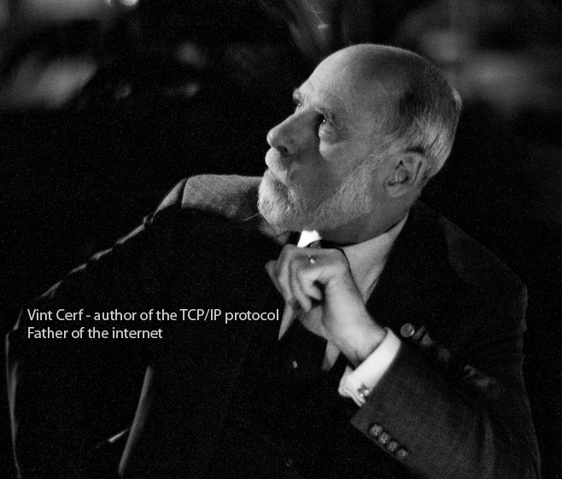
TCP/IP – invented in 1973 by Vint Cerf
<number>

Slide 9

Protocols – TCP
TCP (Transport Communication Protocol)
Breaks files into packets to be sent across the internet or a network. Each packet contains:
the address of the sender
the destination address
error-detecting checksum
a chunk of data (e.g. 1K)
<number>

Slide 10
Protocols – TCP/IP
IP (Internet Protocol)…
Once a file has been chopped into packets, the IP protocol delivers each packet to its destination.
each packet can take a different route from A to B, bouncing from router to router getting more precise with each hop.
the route is dynamically chosen for each packet, based on internet conditions at that time.
<number>

Slide 11
Protocols – TCP/IP
TCP again…
At the packets’ destination the receiving computer’s TCP re-assembles packets back into the original file.
Recalculates checksum to see if packet is OK
If packets are damaged, lost or delayed in transit, TCP will request the server to send the packet again.
<number>

Slide 12
Packet Switching
Any protocol that breaks files into packets (like TCP/IP does) is called packet switching.
(Compare with circuit switching used by telephones where a full-time path is set up for the duration of the communication)
<number>

Slide 13

Packet Switching
Why use packet switching?
A single bad bit in a file can ruin an entire file.
It’s quicker to re-send a portion of the file rather than the whole file.
Important with ‘noisy’ and unreliable communication paths, such as dial-up modem.
Many computers get to transmit some data, rather than 1 PC tying up a channel for ages with a huge transfer.
Imagine mailing a house from Melbourne to Sydney one brick at a time.
<number>

Slide 14
ETHERNET
<number>

Slide 15
NETWORKING TECHNOLOGIES
A “Networking Technology” defines how packets are handled and what the hardware is like.
The only networking technology to know is Ethernet
Used everywhere
Ethernet defines both protocols (CSMA/CD) and cabling (e.g. UTP, thick coax, fibre), speeds etc.
<number>

Slide 16
How Ethernet Works
Network devices compete for attention using Carrier Sense Multiple Access with Collision Detection (CSMA/CD).
Keep in mind: Only one signal can travel down a cable at a time.
CS = Carrier Sense. Before transmitting over the network, a computer first "listens" and waits until there is no activity on the cable. When it sees its chance, it transmits.
<number>

Slide 17
MA = Multiple Access. When one Ethernet station transmits, all the stations on the cable hear the transmission
CD = Collision Detection. Carrier sense does not guarantee that two devices will not sense the same silence and transmit simultaneously, and cause a ‘collision’. CD detects this event.
Each node involved in the collision waits a random number of milliseconds, then repeats the transmission attempt.
The random waiting time prevents endless further collisions.
<number>

Slide 18
A ‘node’ is any device attached to a network that is capable of requesting and sending packets (e.g. Usually a PC, network printer)
<number>

Slide 19
Protocol Question Time
Define a network protocol.
What pair of protocols are the basis of the internet, and what does each do?
Why are checksum used?
What does Ethernet define?
What do CSMA/CD do?
<number>

Slide 20
Protocol Question Time
Define a network protocol.
It’s an agreed-on set of rules that computers use to ensure reliable communications
<number>

Slide 21
2. What pair of protocols are the basis of the internet, and what does each do?
TCP – breaks files into packets and calculates checksums. It also reassembles incoming packets and tests for errors.
IP – Guides packets from source to destination across a network or across the internet.
<number>

Slide 22
3. Why are checksum used?
Checksums are used to detect damage to a packet after it arrives at its destination. If the checksum sent in the packet and the checksum calculated upon arrival do not match, the receiving computer asks for the packet to be sent again.
<number>

Slide 23
4. What does Ethernet define?
The hardware and necessary protocols for networking.
<number>

Slide 24
5. What do CSMA/CD do?
Carrier sense (CS) checks for silence on a cable before trying to transmit onto it.
Collision detection (CD) detects if more than one node transmitted at the same time. It then negotiates for the nodes to try transmitting again.
<number>

Slide 25
Applied Computing Slideshows
by Mark Kelly
vcedata.com
mark@vcedata.com
This slideshow may be freely used in schools in Victoria, Australia.
For other uses, (e.g. publication) please contact me.
It may not be sold.
It must not be redistributed if you modify it.
<number>

