Slide 1

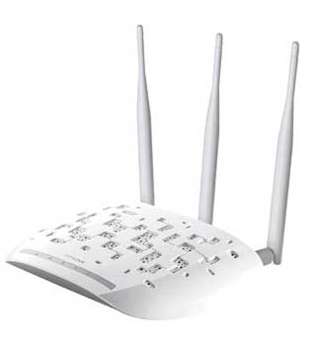
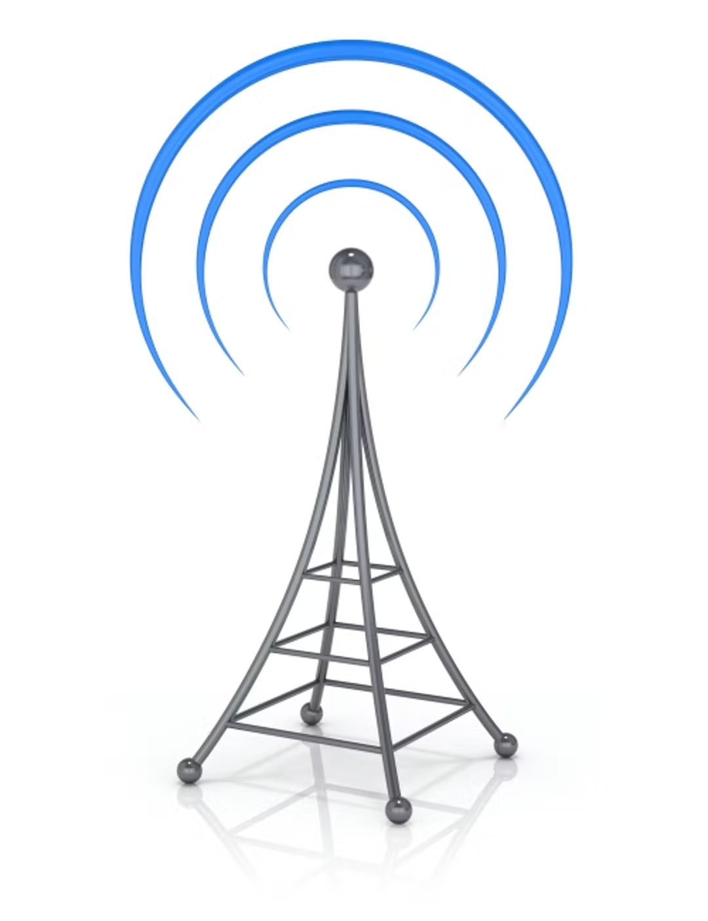
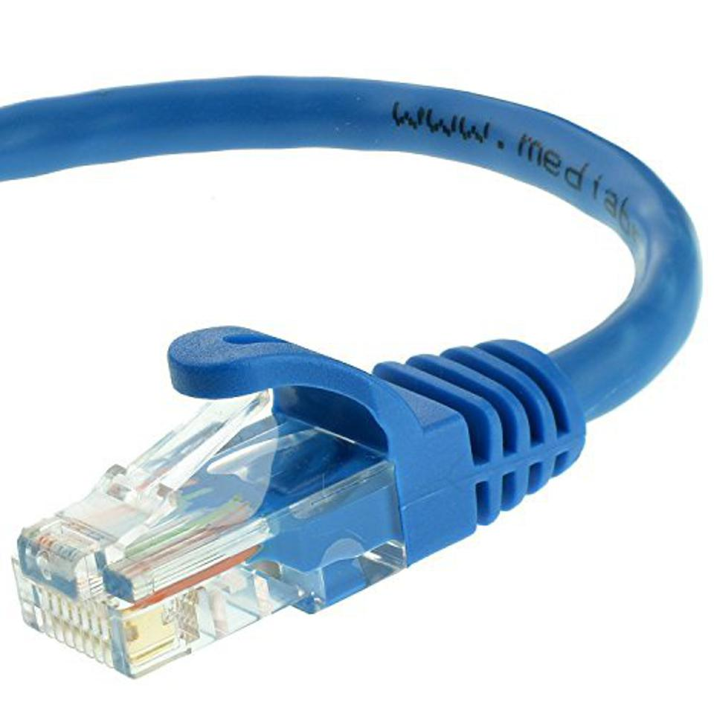
Version 1.1, 2024-02-20
Wired, Wireless, Mobile
communication technology

Slide 2
TL;DR – WIRED 1
Uses Category (e.g CAT6) unshielded twisted pair (UTP) cable plugged into RJ45 sockets.
Range: up to 10m. Signal can be repeated with a switch.
Speed: 1Gbps (1000Mbps). CAT6+ can support 10Gbps.
Pros – very secure, reliable, cheap.
Cons – hard/expensive to install. Hard to relocate. Short distances.
Use for – permanently-positioned high speed devices = Sitting at a computer on a desk.
vcedata.com slideshow © Mark Kelly 2022 - <number>/15

Slide 3
TL;DR – WIRED 1b (2024)
CAT7 – 10Gbps – probably more than most average users need
CAT8 – 25 or 40 Gbps – way more than most internet providers provide.
Of course, to get CAT7 or CAT8, all of your local area network components (switches, routers etc) will need to be upgraded too.
In short, in 2024 Australia, CAT6 is perfectly furry and purry for nearly every user.
vcedata.com slideshow © Mark Kelly 2022 - <number>/15

Slide 4
TL;DR – WIRED 2
Uses Fibre optic cable (FOC)
Range: about 100km
Speed: up to 10Gbps for most users. Big boys like Google get 44Tbps – insanely faster (4400x).
Pros – FAST! Nearly inpossible to physically tap into cables to steal data. Thin cables – can fit a lot of cables into a small hole.
Cons – Expensive. Hard to re-wire and repair.
Use for – Mega-sized corporations sending data internationally.
vcedata.com slideshow © Mark Kelly 2022 - <number>/15

Slide 5
TL;DR Wireless
Wifi
Bluetooth
vcedata.com slideshow © Mark Kelly 2022 - <number>/15

Slide 6
TL;DR Wifi
Uses a wireless access point (WAP) connected to a wired network to provide data via radio signals to mobile devices
Range: very roughly, about 50m indoors, 100m outdoors. It varies greatly based on conditions and equipment. Range can be boosted with wifi extenders.
Speed: Around 33%-50% of a wired connection. 2.4GHz (300Mbps) or 5GHz (450Mbps). Depends greatly on obstacles (walls, windows, etc) between sender and receiver.
Note – all non-wired speeds are theoretical maximum speeds, and will in reality be slower,
vcedata.com slideshow © Mark Kelly 2022 - <number>/15

Slide 7
TL;DR Wifi
PROS – Devices can move anywhere in range – not tied to cable limits. Cheaper, easier, more flexible to install than cabled connections.
CONS – Slower than cable; signals can be detected remotely, requiring encryption.
USE FOR – Casual, unplanned computer use = Sitting on the couch or toilet.
vcedata.com slideshow © Mark Kelly 2022 - <number>/15

Slide 8
TL;DR Bluetooth
WIRELESS (Bluetooth) – A short-range radio direct connection between paired devices.
Uses: Dedicated short-distance connection between specific devices (e.g. phone + wireless headphones, wireless keyboard + PC)
Range: about 10m
Speed: SLOW - about 1Mbps (0.1% of a wired connection)
PROS: Secure (more than wifi) – connected devices must be deliberately paired.
CONS: Very short range. Slow for big data transfers.
USE FOR: Peripheral device connections (e.g. keyboards)
vcedata.com slideshow © Mark Kelly 2022 - <number>/15

Slide 9
Speed Basics
All quoted network data speeds are theoretical maximums, and may rarely if ever be achieved in the real world.
vcedata.com slideshow © Mark Kelly 2022 - 9/15

Slide 10
Speed Basics
Storage is measured in BYTES (B – capital B for Byte)
Network speeds are measured in BITS PER SECOND (bps – note the lowercase b for bit)*
There are 8 bits in a byte
So, 100Mbps = about 12 megabytes per second
*Beware apps like web browsers that report speeds in MBps !
vcedata.com slideshow © Mark Kelly 2022 - <number>/15

Slide 11
Speed Basics
So be careful reading exam questions and giving answers.
In written answers, it’s best for you to spell out speed units fully, e.g.
“if the WAP can provide 54 Mbits/sec...”
Avoids ambiguity and lost marks
Note: Exam questions will be very unlikely to refer to “Mbps”
vcedata.com slideshow © Mark Kelly 2022 - <number>/15

Slide 12
WIRED COMMUNICATIONS
Wired
Ethernet
CAT
Fibre
vcedata.com slideshow © Mark Kelly 2022 - 12/15

Slide 13
WIRELESS - WAP, Bluetooth, Infrared
Wireless is good
No cables to drag across rooms and drill through walls.
Reasonably fast for most needs.
Can only be hacked if someone physically taps your cable.
Wireless is bad.
Pretty slow for BIG, FREQUENT data transfer.
Can be hacked from remote places unless encrypted.
vcedata.com slideshow © Mark Kelly 2022 - 12/15

Slide 14
MOBILE COMMUNICATIONS
Mobile – 3/4/5G
Data is transferred via mobile phone network, independently of your internet supplier.
So, if your home NBN fails, you can use a phone to complain to your internet supplier.
Not too fast, and may not work in remote places.
vcedata.com slideshow © Mark Kelly 2022 - 14/15

Slide 15
These slideshows may be freely used, modified or distributed by teachers and students anywhere.
They may not be sold
You must not change or remove their authorship information or copyright notices.
You must not redistribute them if you modify them.
This is not a VCAA publication and does not speak for VCAA.
Portions (e.g. exam questions, study design extracts, glossary terms) may be copyright Victorian Curriculum and Assessment Authority and are used with permission for educational purposes.

