Slide 1
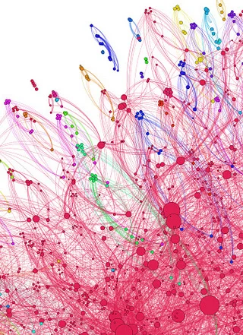
Networking
Applied Computing Slideshows
by Mark Kelly
vcedata.com
mark@vcedata.com
<number>
Notes:
<number>

Slide 2
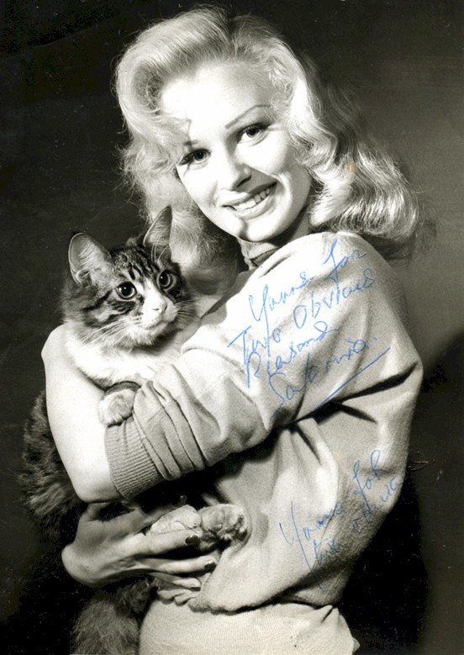
Networking
Several complex issues have been grossly simplified here.
But, to compensate,
here is a picture of a cat
<number>
Notes:
<number>

Slide 3
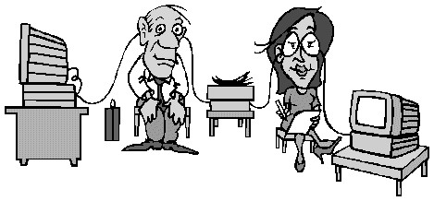
What is a network – should I panic?
At its simplest, a network is two or more computers that are connected so they can exchange information and share resources.
<number>

Slide 4
Types of networks
Networks can be classified by:
Their size
(LAN, WAN, Internet);
Their servers
(Client-Server, P2P);
The rules they use to exchange data
(protocols – TCP/IP).
How they are linked together
(cable, wireless);
Their ‘logical’ shape
(bus, star, tree);
How network messages travel
(Ethernet’s CSMA/CD)
<number>

Slide 5
Why network?
Efficiency – Better, faster communication – email, videoconferencing
Cost savings (email vs phone calls, physical travel),
Staff savings (e.g. networked helpdesk),
Equipment savings: printers, internet connections, internet cache, CD drives
Effectiveness – collaborative work is easier, access to resources is broader, group calendaring
<number>

Slide 6
Why network?
Management - control over internet & printing, staff monitoring
Company image and “reach” – internet visibility makes any company international and accessible and “with it”
Customer service – many more ways to help customers (e.g. FAQ, downloads, online advice, email contact)
<number>

Slide 7
Types of networks
LAN = Local Area Network
Geographically limited in size.
Usually in a single building or on a single site.
Spread limited to a few hundred metres.
e.g. the computers in the McKinnon branch of the Commonwealth bank

Slide 8
Size 2
WAN = Wide Area Network
Geographically widespread (e.g. across cities, states, countries)
Usually made up of interconnected LANs
E.g. the interconnected LANs of every branch of the Commonwealth Bank in Australia.

Slide 9
Size 3
The Internet
What you get when WANs join together
There is nothing that is “the internet” except for the computers that are interconnected at any single moment

Slide 10
A ‘standalone’ computer
PC

Slide 11
A LAN
PC
PC
PC

Slide 12
A WAN
LAN
LAN
PC
PC
PC
PC
PC
PC

Slide 13
An internet
LAN
LAN
LAN
LAN
PC
PC
PC
PC
PC
PC
PC
LAN
PC
LAN
LAN
LAN
LAN
PC
PC
PC
PC
PC
PC
LAN
LAN
LAN
PC
PC
LAN
LAN
PC
PC
PC
PC
PC
PC
PC
PC
PC
PC
PC
PC
PC
PC
LAN
LAN
LAN
PC
PC
PC
PC
PC
PC
LAN
PC
PC
PC
LAN
PC
LAN
LAN
LAN
PC
PC
PC
LAN
PC
PC
LAN
PC
PC
PC
PC
LAN
PC
PC
PC
PC
PC
LAN
PC
PC
PC
PC
LAN
PC
PC
PC
LAN
PC
LAN
PC
PC
PC
PC
PC
PC
PC
PC
PC
PC
PC
PC
PC
PC
PC
PC
PC
PC
PC
PC
PC
PC
PC
PC
LAN
LAN
LAN
LAN
LAN
PC
LAN
PC
LAN
LAN
PC
PC
PC
PC
PC
PC
PC
PC
PC
PC
PC
PC
PC
PC
PC
PC
PC
PC
LAN
PC
PC
PC
PC
PC
PC
PC
PC

Slide 14
The internet
Made up of inter-networked WANs.
No central boss. Users make and enforce rules.
Uses all forms of media
Mesh topology (many possible routes from A to B)
<number>

Slide 15
Server-Based Networks
Client/Server model
Automatically a pretty expensive choice compared to P2P
File server at the heart of the network
Server runs the Network Operating System (NOS)
Controls access to data and equipment
Runs ‘community’ programs
Offers control, security, centralisation, automation
<number>

Slide 16
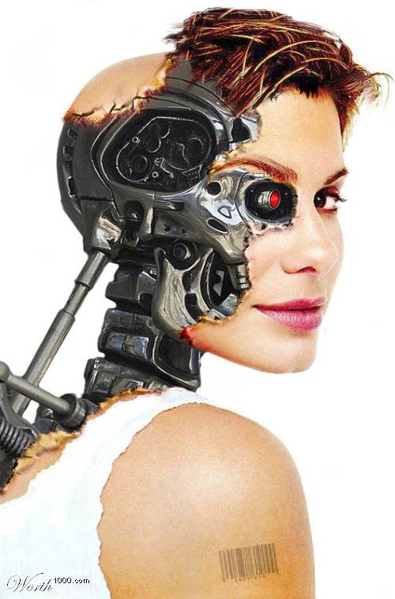
Peer-to-Peer (P2P) networks
No server, cheap, simple, easy to run
All users have equal authority and rights
Little protection from each other
Used at home or in small orgs with trusted users
<number>

Slide 17
Peer-to-Peer (P2P) networks
Share files, internet connection, printer
Torrent sites are P2P - no central computer; data and software are on users’ computers.
P2P built into Win, Linux, Mac
<number>

Slide 18
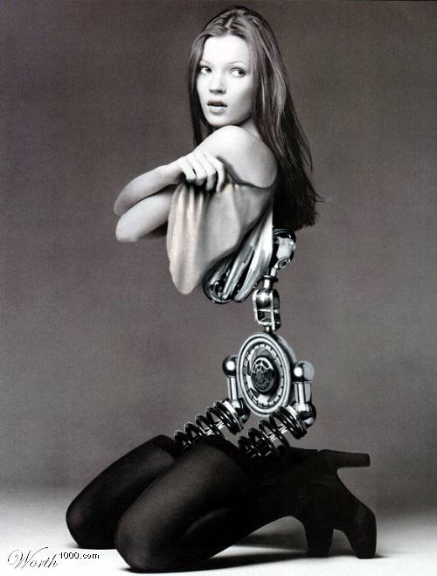
Protocols
See my separate slideshow
<number>

Slide 19
Network
Addressing
<number>

Slide 20
Network Addressing
Like telephones, every node on a network must have a unique identifier so the file server knows who is requesting information, and who is to be sent information.
This unique network address is hardwired into the network card of each computer.
Also, every active node of the internet needs a unique identifying address so TCP/IP knows where packets are to be sent.
This is an Internet Protocol, or IP address.
<number>

Slide 21
Humans like working with names (e.g. www.microsoft.com) but computers use IP numbers (e.g. 10.77.91.19).
IP address has four ‘octets’ separated by dots, each octet can be between 0 and 255.
Remember - all internet communications use IP addresses, not URLs. Only humans use URLs.
<number>

Slide 22
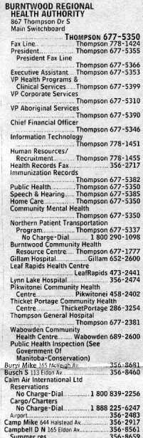
Addressing
Domain name servers (DNS) – a distributed database on thousands of computers across the world - convert URLs into IP addresses.
Like a phone book – look up a name (URL) to get a number (IP address).
<number>

Slide 23
Networking hardware
See the dedicated slideshow
<number>

Slide 24
Network Topologies
A network topology is a logical (idealised) shape of a network’s wiring. The main topologies:
Bus
Star
Tree*
Ring*
Mesh*
Each has its pros and cons: cost, complexity, reliability and susceptibility to congestion.
*not examinable
<number>

Slide 25
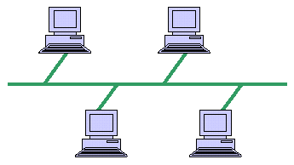
Bus Topology
Many devices connect to a single cable backbone cable as a daisychain. If the backbone breaks, the entire segment fails – like Christmas tree lights.
DO NOT RECOMMEND IT IN THE EXAM!
<number>

Slide 26
Bus Topology
Relatively cheap and easy to install
Don't require much cabling
Gets congested with too many nodes
Not good for schools
OK for small LANs
NEED COAXIAL CABLE AND NICs so is EXTINCT nowadays!
<number>

Slide 27
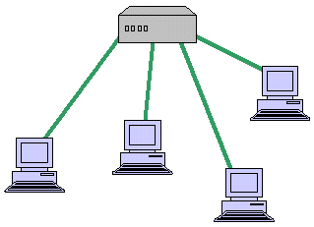
* Star Topology *
central connection point (a switch) with cables branching to many computers.
Not a server with 4 NICs!!!
If a cable fails, only one node will fail.
prone to traffic bottlenecks at the centre of the star
RECOMMEND THIS for small networks!
<number>

Slide 28
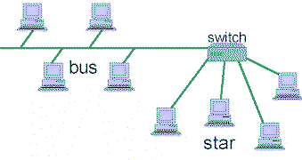
Tree Topology*
Combines bus and star topologies.
It looks like a tree.
Very common in larger networks.
e.g. one cable from a file server leads to a 24 port switch. Many cables branch from this switch to the computers in the computer room. They share the bandwidth of the incoming cable.
<number>
*not examinable

Slide 29
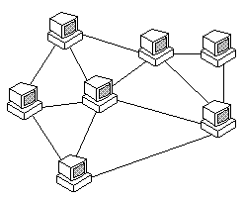
Mesh Topology*
Multiple routes from one node to any other.
Hardly ever found cabled in real-life in real networks: really only appears in The Internet to give near-perfect reliability.
DO NOT RECOMMEND IT IN A TYPICAL CASE STUDY
*not examinable
<number>

Slide 30
Network Physical Security
File server failure can severely affect network users.
Server security:
Locked in air-conditioned, alarmed room with barred windows, restricted keys
No user access to server
Uninterruptible power supply (UPS) protects against blackouts, brownouts and voltage spikes.
Accessible fire fighting equipment.
Locked floppy disk drives
<number>

Slide 31
Network Electronic Security
Passwords are not strong protection – they can be guessed, forgotten or stolen.
<number>

Slide 32
Network Security
Daily backups are vital. Massive cost and effort to recover a single megabyte of lost data.
Organisations need a data disaster recovery plan so they know what to do to recover from catastrophic data loss.
<number>

Slide 33
Encryption
A form of Electronic Security
Makes data unreadable to unauthorised people even if a file is stolen.
Web browsers use encryption to connect to a “Secure” SSL (Secure Socket Layers) site.
<number>

Slide 34
Network Security
TROJAN HORSES attempting to report ‘home’ or start a DOS/DDOS attack - can be blocked by a firewall.
FIREWALLS in hardware (routers) or software (e.g. Zone Alarm) check for unauthorised incoming or outgoing network traffic, e.g. port scanning, being enslaved to help with a distributed denial-of-service (DDOS) or spam attacks.
VIRUSES can disclose user passwords, steal information, destroy data, install “back doors” to let hackers in, clog print queues, disrupt Internet traffic, overload email servers etc. Keep scanners up to date.
<number>

Slide 35
Remember
ITA U4O2 case study will be a small organisation’s LAN.
Choose between P2P or Client-Server
If Client-Server, choose NOS - MS Server
Recommend…
STAR topology, not bus
UTP - CAT5e or CAT6 cable, not coaxial
SWITCHES, not hubs
Wireless is now pretty cheap, reliable and flexible
<number>

Slide 36
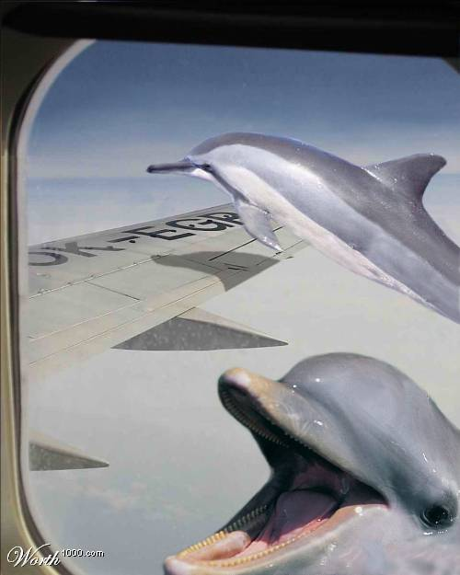
Thanks!
Applied Computing Slideshows
by Mark Kelly
vcedata.com
mark@vcedata.com
<number>

