Slide 1
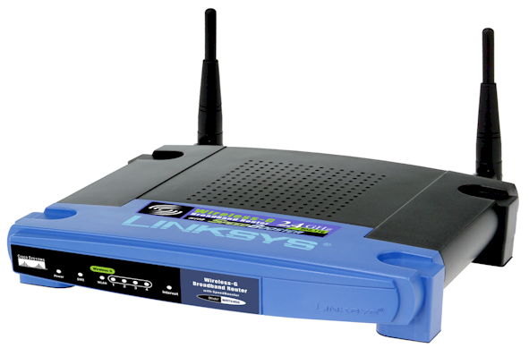
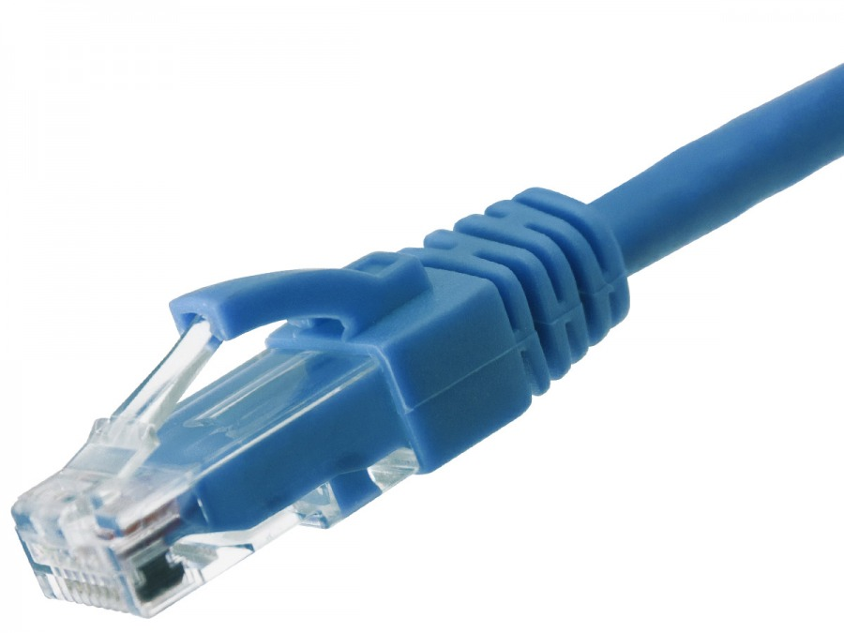
Applied Computing Slideshows
by Mark Kelly
vcedata.com
mark@vcedata.com
Last modified 2024-02-21
Network Hardware
Network Hardware

Slide 2
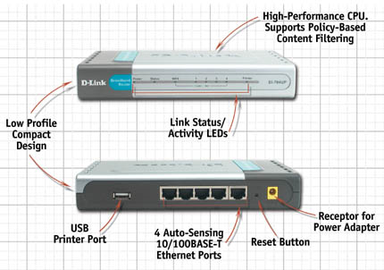
Network Hardware
The main bits:
Modem
Cables
Network interface card (NIC)
Server (e.g. file server, web server)
Switch
Router
Wireless access point (WAP)

Slide 3
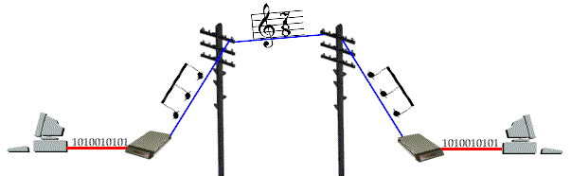
The modem Modulator/demodulator
Modulate (when uploading) = turn digital data into analogue sound for transmission over phone network.
Demodulate (when downloading) = convert sound back to digital data.
(These are now rare since the NBN rollout of digital internet access.)

Slide 4
Note!
Transmission speed is measured in bits per second (not Bytes per second!)
For example, a “56Kbps” modem downloads at a theoretical maximum of approx 56,000 bits per second. In real use, it may only achieve a fraction of that.

Slide 5
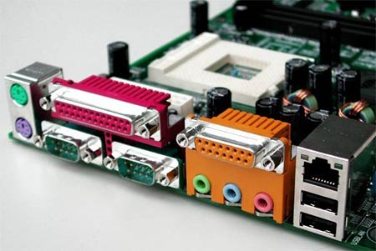
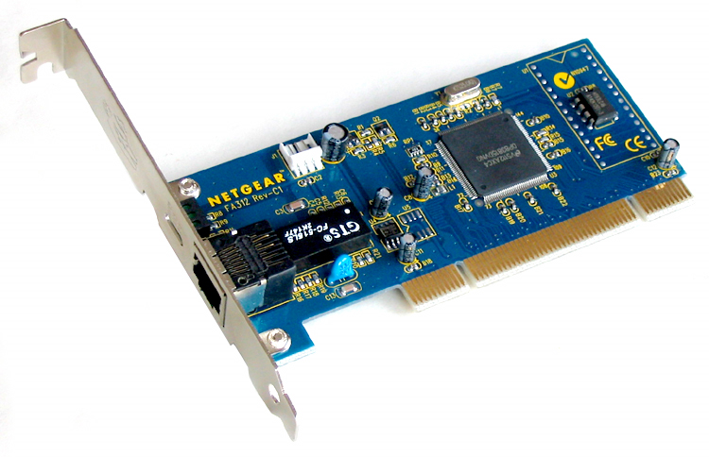
Hardware - NIC
The Network interface card (NIC) allows a stand-alone computer to connect to a network.
Now they are usually built into motherboards.

Slide 6
Internet Choices Not all options are available to everyone
ADSL, ADSL2 – up to 250-1000Mbps
Cable - 10-20Mbps
Satellite - 16-48 Mbps
Mobile phone network – 4G (150Mbps), 5G (180-400Mbps)

Slide 7
Hardware - NIC
Network Interface Card
Rated by speed: usually ‘Gigabit’ 1000Mbps bandwidth
Bandwidth - data-carrying capacity, usually measured in bits per second. Browsers measure speed in Bytes per second, just to be difficult.

Slide 8
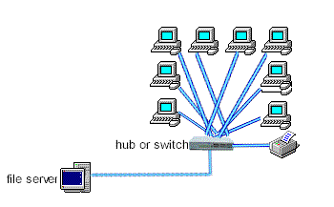
Hardware – Switches
Switches are connection points where cables can join up or be split.
Typically, a single incoming cable is split into multiple outgoing cables.

Slide 9
Hardware – Routers
4 main roles…
Join dissimilar networks together, like a gateway, e.g. connect a home LAN (local area network) to your internet service provider
Guide data packets across networks and internet to their destinations
Guard the connection between a LAN and the outside world (another LAN or a WAN.)
Divide LANs into self-contained, protected areas, e.g. admin / student networks in a school.

Slide 10
Hardware – Routers
Act as a hardware firewall to protect the LAN.
Can be programmed to only allow authorised incoming and outgoing traffic.
Home routers often combine: switch, internet port, modem, WAP

Slide 11
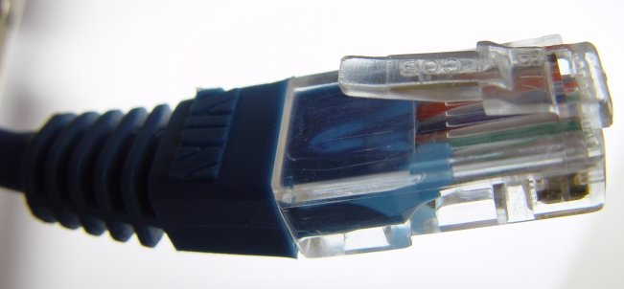
Connections – UTP
UTP (Unshielded Twisted Pair) e.g. CAT6 (‘Category 6’)

Slide 12
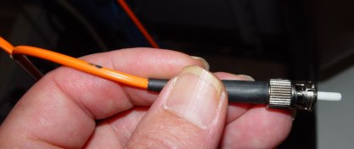
Connections – Fibre optic
Made of glass (or plastic)
Optical, not electrical – little signal fade over long distances
Optical Signals created by LED or laser
Multiple signals on a single fibre
Resists electromagnetic interferences (EMI)
Light signals bounce down Fibre Optic cable using Total Internal Reflection.

Slide 13
Connections – Fibre Optic
Core is as thin as a human hair
Not very flexible – needs thick protective coat
VERY fast
VERY high bandwidth
Very secure (can’t be easily tapped or monitored)
VERY long distance (>2km without repeaters)
Light weight, small size
Needs expensive adaptors to convert digital signals to/from electrical signals

Slide 14
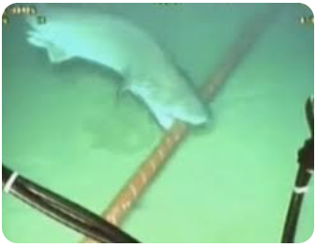
Connections – Cables and wireless
Many fibre optic cable (‘FOC’) threads can be bound into a slim, single cable without their signals interfering with each other, giving massive data throughput.
FOC has largely replaced old, heavy, expensive copper cables to cross oceans.
Warning! Sharks can damage your network!
Sharks get over-excited by the electromagnetic fields radiated by copper cable and attack them. FOC is electromagnetically silent.

Slide 15
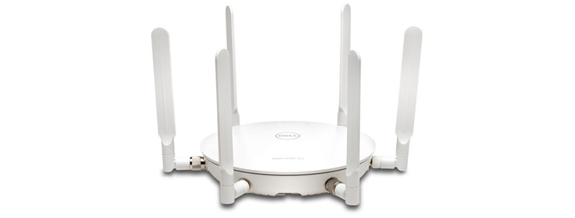
Connections – Wireless
Data sent as radio signals between NICs and base stations (WAP=wireless access point)
short distances (e.g. 80m-200m), reduced by obstacles
Claimed speeds of 54, 150, 300Mbps etc but these are theoretical, maximum laboratory speeds
Encrypted to prevent eavesdropping

Slide 16
Wireless
Many PCs can connect to a base station, share its bandwidth
PCs can “roam” and will automatically connect to the base station that has the strongest signal (like mobile phones)
Wireless NICs and antennae are now built into laptops, tablets, phones

Slide 17
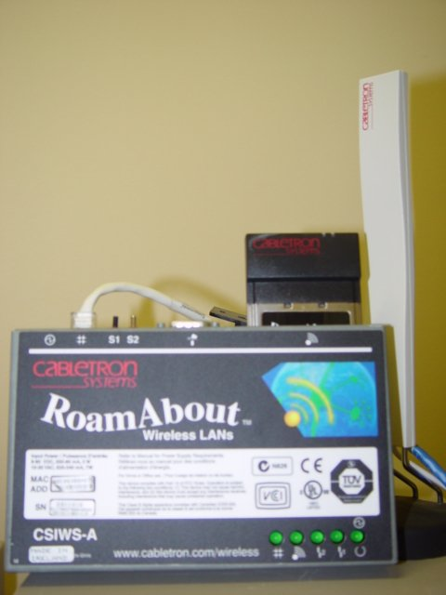
Connections – Wireless
Good for temporary networks, or when PCs rarely needed in a location
Good for laptop-intensive places (e.g. classrooms, staffrooms). Great at home
Relatively expensive compared to cable, but a useful network add-on
Flexible – network devices can be moved in seconds
Security concerns – never run it unsecured!
Ancient wireless base station &
white radio antenna

Slide 18
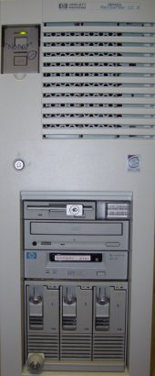
Servers
Robust central computers at the heart of a network.
File servers are the most common server type.
Web servers store web pages for visitors to read.

Slide 19
File Servers
File servers run the Network operating system (NOS) which handles:
authenticating users during login
controlling users’ access to resources based on their rights
managing print queues
doing backups
running centralised software such as virus scanners
running services like DHCP to give out IP addresses to workstations
controlling internet services

Slide 20
Network Operating Systems
‘NOS’
For example Microsoft Server.
A NOS runs a LAN, like an OS runs a PC
Control users’ access to network resources
Apply security - restricts who can access which parts of the LAN
Run community programs for all users, like internet access, backups, virus scanning, caching downloads

Slide 21
File Servers
Servers don’t really have anything special in terms of hardware.
Expensive because of their high-quality components, and “scalability” (expandability).
Memory – servers love lots of RAM.
Storage –need large and fast hard disks – often RAID (discussed soon)

Slide 22
File Servers vs Desktops 1
CPU Processing power – not very important in a file server
Backup – most servers have inbuilt high-capacity backup hardware (e.g. tape drives) or SAN (Storage Area Network)
Servers are the muscle men in the computer world

Slide 23
File Servers vs Desktops 2
Connectivity – servers often have multiple NICs to increase their data throughput.
Robustness - servers run all day for years, and need rugged high-quality components
Scalability –the ability to increase the size and power of equipment and networks as required e.g. add 8 hard disks, two power supplies, two NICs, two CPUs, lots of RAM etc.
Designing and engineering this expandability is expensive.

Slide 24
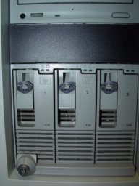
Redundant Array of Independent Disks) arrays for reliability and/or speed.
RAID uses a group of hard disks that work as a single unit.
Flavours of RAID: RAID0 to RAID10 (RAID 1 + RAID 0) offer reliability and/or speed (at ever-increasing cost). Includes ...
mirroring – each disk has its contents copied to an identical duplicated disk
if one disk dies, the other instantly takes over
this is an expensive option, but worth it if data is precious
R.A.I.D.
3-disk RAID array

Slide 25
R.A.I.D.
striping splits each file into chunks that are copied repeatedly to several disks. If any disk fails, lost files can be rebuilt using chunks stored redundantly on the surviving disks.
Striping also allows reading data from several disks at once, so (e.g.) four data reads can occur in one operation.
RAID disks are usually "Hot Swap“ – disks can be replaced without turning off the storage device. No server downtime!
RAID is now common in small business and home NAS (network access storage) devices.
3-disk RAID array

Slide 26
Server farms
On smaller networks, network services are performed by software in a single server.
On busy LANs, multiple servers share the work…
Login servers – authenticate users
Proxy servers – cache downloads
DHCP servers – allocate IP addresses
Print servers –manage print job queues
Web/FTP servers – serve web pages or files
Email servers –handle email

Slide 27
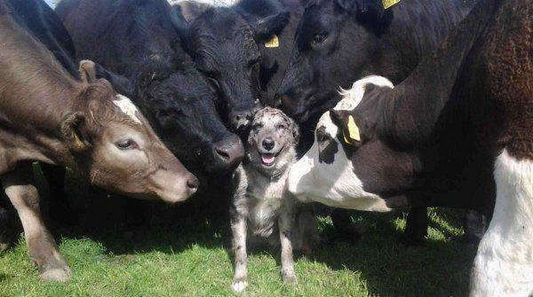
A challenge
At your next party, casually mention the benefits of RAID5.
They be loving you

Slide 28
Thanks!
Applied Computing Slideshows
by Mark Kelly
vcedata.com
mark@vcedata.com

