Slide 1
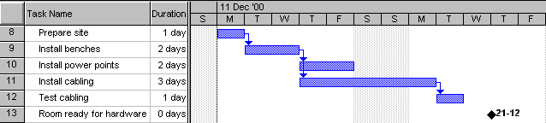
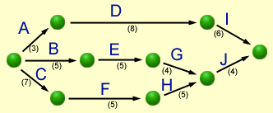
Having Fun with
Gantt
PERT
&
Applied Computing Slideshows
by Mark Kelly
vcedata.com
mark@vcedata.com

Slide 2

Well, “fun” might be optimistic
At least they’re more fun than this…
1

Slide 3
What are they?
Gantt and PERT charts are both “CPM” (Critical Path Method) tools to:
manage the tasks involved in big and complex projects
let project managers organise time, people, equipment and money
ensure the right people and equipment are in the right place and the right time
allow managers to monitor the progress of a project
1

Slide 4
Why should I care?
Project managers get paid big money
They’re needed in Unit 4 Outcome 1
They will be on the exam
And, of course…
Members of the opposite sex will find you irresistible
1

Slide 5

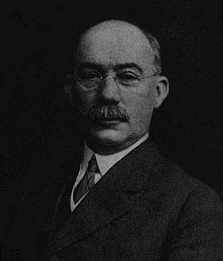
Gantt Charts
Gantt Charts
Henry Laurence Gantt (1861-1919)
1

Slide 6
Gantt Basics
Basically, a timeline with tasks that can be connected to each other
Note the spelling!
It is not all-capitals!
Can be created with simple tools like Excel, but specialised tools like Microsoft Project make life easier
1

Slide 7
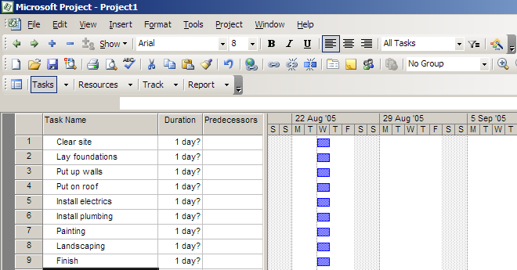
Making a Gantt chart
Step 1 – list the tasks in the project
1

Slide 8
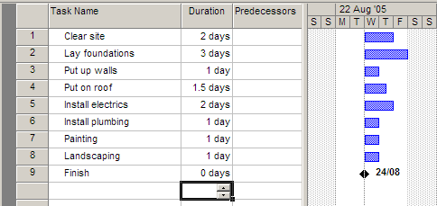
Making a Gantt chart
Step 2 – add task durations
1

Slide 9
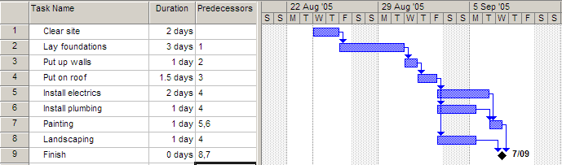
Making a Gantt chart
Step 3 – add dependencies (which tasks cannot start before another task finishes)
1

Slide 10
Notes
The arrows indicate dependencies.
Task 1 is a predecessor of task 2 – i.e. task 2 cannot start before task 1 ends.
Task 3 is dependent on task 2. Task 7 is dependent on two other tasks
Electrics, plumbing and landscaping are concurrent tasks and can happen at the same time, so they overlap on the chart. All 3 can start after task 4 ends.
Painting must wait for both electrics and plumbing to be finished.
Task 9 has zero duration, and is a milestone
1

Slide 11
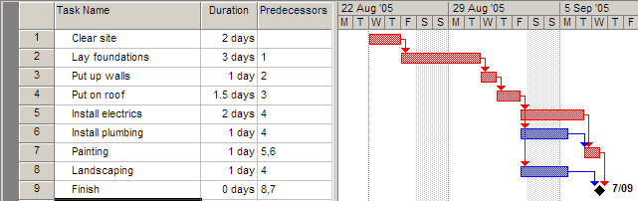
Making a Gantt chart
Step 4 – find the critical path
The critical path is the sequence of tasks from beginning to end that takes the longest time to complete.
It is also the shortest possible time that the project can be finished in.
Any task on the critical path is called a critical task.
No critical task can have its duration changed without affecting the end date of the project.
1

Slide 12
MS Project can work out the critical path for you!
The length of the critical path is the sum of the lengths of all critical tasks (the red tasks 1,2,3,4,5,7) which is 2+3+1+1.5+2+1 = 10.5 days.
In other words, the minimum amount of time required to get all tasks completed is 10.5 days
The other tasks (6,8) can each run over-time before affecting the end date of the project
1

Slide 13
The amount of time a task can be extended before it affects other tasks is called slack (or float).
Task 6 can take an extra day and a half before it affects the project’s end date, so each has 1.5 day’s slack.
1

Slide 14
Critical tasks, by definition, can have NO slack.
Tip:
If ever asked Can task X’s duration be changed without affecting the end date of the project?, if it is a critical task the answer is always NO!
1

Slide 15
PERT Charts
PERT Charts
Not named after Mr Pert!
Stands for Program Evaluation and Review Technique
1

Slide 16
PERT basics
PERT is an acronym so it’s in capital letters
Gantt is a name, so only has an initial capital
In Gantt chart, the length of a task’s bar is proportional to the length of the task. This rarely applies to PERT charts.
There are a few different “flavours” of PERT and Gantt charts…
<number>

Slide 17
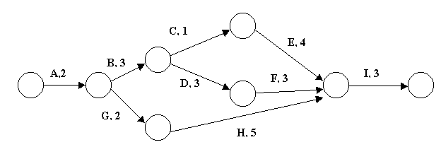
PERT charts
This PERT chart follows the “Activity on Arrow” style.
The tasks are shown by arrows. Task name are shown by letters, in this case.
The circles are called nodes. The nodes indicate the start or end of tasks.
Task durations are the shown by the numbers.
<number>

Slide 18
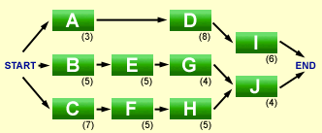
‘Activity on Node’ style PERT
Activity on Node is a different flavour of PERT: this time the nodes are tasks, and the arrows are merely connectors.
The examiners prefer very simple PERT charts – sometimes hybrid beasts that defy categorisation.
<number>

Slide 19
A PERT PROBLEM
A PERT PROBLEM
<number>

Slide 20
1: Which tasks are on the critical path?
2: What is the slack time for tasks C, D and G?
3: Task C is delayed by one day. What impact would this have on the completion date of the project? Why?
4: Task A will be delayed by 2 days because some equipment has arrived late. If the project manager wants to finish the project on time he will need to shorten the duration of one or more of the tasks. How can he achieve this?
5: The project manager reduces the durations of tasks D and F by one day each. How will this affect the finishing date of the project?
<number>

Slide 21
1: Which tasks are on the critical path?
Possible paths:
A,B,C,E,I = 2+3+1+4+3 = 13 days
A,B,D,F,I = 2+3+3+3+3 = 14 days
A,G,H,I = 2+2+5+3 = 12 days
ANSWER: A,B,D,F,I
<number>

Slide 22
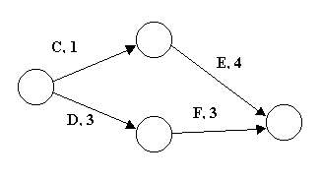
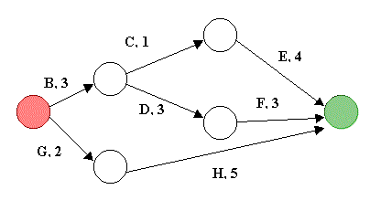
2: What is the slack time for tasks C, D and G?
TASKS C and D…
Path C,E = 5 days, Path D,F = 6 days
Difference (slack) = 1 day for tasks C or E compared to D,F
TASK G…
Path B,C,E = 8 days. Path B, D, F = 9 days
Path G, H = 7 days.
So G & H have 2 days’ slack between them.
B,C or E have 1 day’s slack.
B,D,F have no slack.
<number>

Slide 23
3: Task C starts one day late. What impact would this have on the completion date of the project? Why?
No impact, because task C has one day’s slack (as discovered in previous question!)
<number>

Slide 24
4: Task A will be delayed by 2 days because some equipment has arrived late. If the project manager still wants to finish the project within the original time frame, he will need to shorten the time for one or more of the tasks. What steps can he take to reduce the number of days allocated to a task?
The answer has NOTHING to do with the chart! Just say how jobs can be finished more quickly, e.g. bringing in extra workers from slack tasks, working longer hours, working weekend, streamlining work practices, automating tasks etc.
<number>

Slide 25
5: The project manager decides to reduce the time needed for tasks D and F by one day each. How effective will this reduction be in achieving his aim of maintaining the original finish time for the project?
It is only partially effective. Reducing tasks D and F by one day each means the path A,B,D,F,I is now 12 days long. However, path A,B,C,E,I is still 13 days so it becomes the longest path, and therefore becomes the new critical path.
The project is now 13 days long instead of 14, a saving of only one day.
<number>

Slide 26
Some Gantt / PERT Terms
Lead time
Occurs when a task should theoretically wait for its predecessor to finish, but can actually start a little early. The time that the tasks overlap is lead time. E.g. when replacing computers in a computer lab, you could actually start bringing in the new computers while the old ones were being packed up and moved out.
<number>

Slide 27
Some Gantt / PERT Terms
Lag time
The minimum amount of time that must pass between the finish of one activity and the start of its successor(s).
For example, if task A is laying a house’s concrete slab, and dependent task B is putting up the house walls, there would need to be some lag time between the end of task A and the start of task B to let the concrete set.
Lag time is shown in a PERT chart as an arrow with a duration but no task assigned to it.
<number>

Slide 28
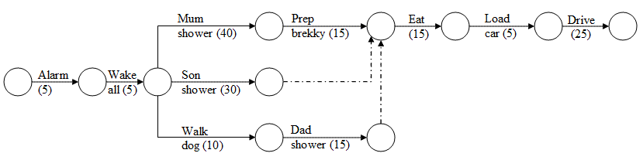
Some Gantt / PERT Terms
Dummy Task
Shown by a dotted arrow on a PERT chart, it shows a dependency but no task. The next example shows this…
<number>

Slide 29
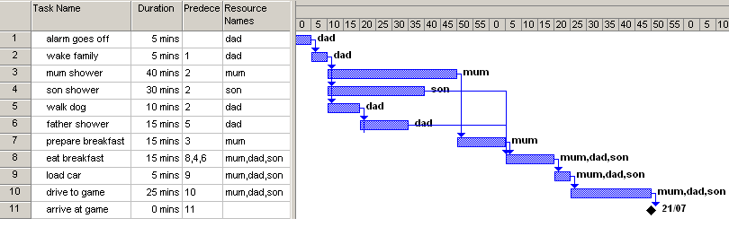
A Family Routine
<number>

Slide 30
Questions
Q1. What tasks are on the critical path?
Q2. What is the minimum time it would take for the family to reach the footy game after the alarm goes off?
Q3. How much more time could dad walk the dog before eating breakfast got delayed? (Note: Mum insists the entire family eats together)
Q4. What is this time called?
Q5. If mum skipped her 40 minute shower, how much earlier would they get to the game?
<number>

Slide 31
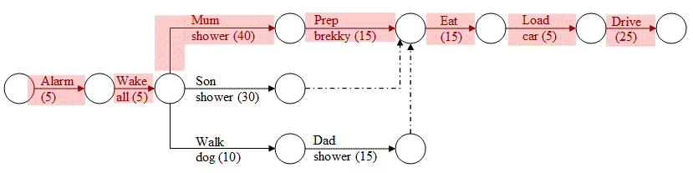
Q1
What is the critical path?
Path 1 = 5+5+40+15+15+5+25 = 110 min
Path 2 = 5+5+30+15+5+25 = 85
Path 3 = 5+5+10+15+15+5+25 = 80
The critical path is the longest path : path 1
<number>

Slide 32
Q2
What is the minimum time it would take for the family to reach the footy game after the alarm starts ringing?
The duration of the critical tasks… 110 minutes
<number>

Slide 33
Q3 & 4
How much more time could dad walk the dog before eating breakfast got delayed?
What is this time called?
30 minutes…
Shower + Prep Brekky = 55 min vs
Walk Dog + Dad Shower = 25 min … 30 min diff
Slack time (or float)
<number>

Slide 34
Q5
If mum skipped her 40 minute shower, how much earlier would they get to the game?
When the critical path is reduced by 40 minutes, it stops being the critical path.
Path 2, at 85 min, becomes the critical path.
Since it is 25 min shorter than the original 110 minute critical path, there is a 25 minute saving.
<number>

Slide 35
Real IPM Exam Questions
Also known as
A collection of dodgy disasters
<number>

Slide 36
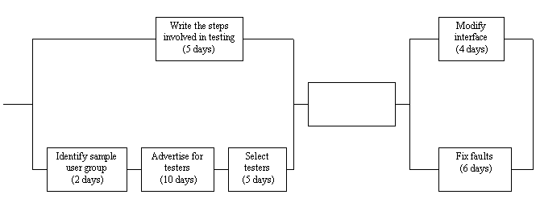
2001 Exam
A college committee organising a VCE social is changing to an online booking and recording system. This diagram shows some tasks and the timeline associated with the development of the online system.
<number>

Slide 37
2001 Exam Q9a
If the design team cannot agree on the steps involved in testing and the task takes two extra days what impact will this have on the critical path of the project?
<number>

Slide 38
2001 Exam Q9a
A) NO IMPACT. The other path is 2+10+5 = 17 days, so the delayed task has 12 days’ slack!
<number>

Slide 39
2001 Exam Q9b
What task would be shown in the empty box?
<number>

Slide 40
2001 Exam Q9b
It's a no-brainer. Everything before the empty box is about setting up testing. Everything after it is about fixing errors that were found by testing. What's missing? TESTING!
<number>

Slide 41
2001 Exam Q9c
What is the maximum number of days the task "select testers" could take if the critical path cannot be changed?
<number>

Slide 42
2001 Exam Q9c
Since "Select testers" is on the critical path, the easy answer is FIVE DAYS (i.e. no change, because any change to the task would change the critical path.)
<number>

Slide 43
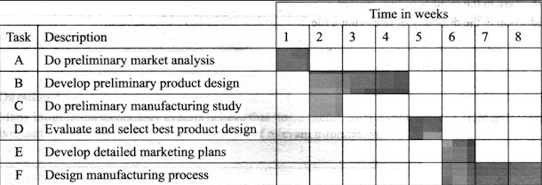
2003 Exam Multichoice Q16
Is Task D is a predecessor for :
(A) Tasks E&F?
(B) Tasks B&C?
(C) Tasks C&F?
(D) Tasks B&E?
<number>

Slide 44
2003 Exam Multichoice Q16
No dependency arrows! Examiners don’t seem to understand them. Assume that a task that does not start on day 1 must be dependent on some other task. Which tasks are dependent on task D? Find the tasks that start as soon as task D has finished… E and F. So the answer is [A].
<number>

Slide 45
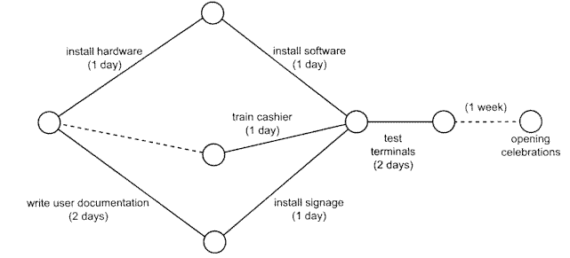
2003 – Section B, Q13b
Note the dummy task before ‘train the cashier’. I think it’s meant to imply that training the cashier is dependent on installing the hardware first… but it should connect to the node after “install hardware” and have a duration attached. Grrr!
Q13b (i) Mark the critical path
<number>

Slide 46
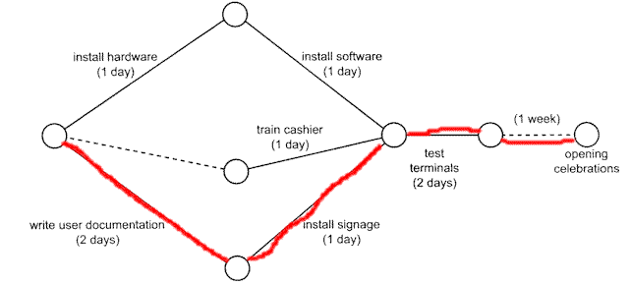
2003 – Section B, Q13b
Path 1 = 1+1+2 = 4 days (excluding last task)
Path 2 = 1+2 = 3 days
*Path 3 = 2+1+2 = 5 days*
<number>

Slide 47
2003 – Section B, Q13b
ii. Explain why the supermarket has allowed a week between the completion of the project and the opening celebrations.
<number>

Slide 48
2003 – Section B, Q13b
One week has been allowed for: • fixing any problems that occur during the testing of the system • allowing for any delays that might occur so that the store meets its opening date.
<number>

Slide 49
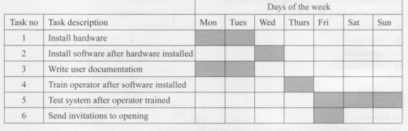
2004 Exam – Q13-14
In the table above the critical path consists of tasks
A. 1,2,4 and 5?
B. 1,3,4 and 5?
C. 1,2,5 and 6?
D. 1,2,4 and 6?
<number>

Slide 50
2004 Exam – Q13
The path from start to end that takes the longest time is <A> 1,2,4,5.
Can't be <B> because tasks 1 and 3 are concurrent.
Can't be <C> because tasks 5 and 6 are concurrent.
Can't be <D> because task 6 does not lead to the longest possible path.
<number>

Slide 51
2004 Exam – Q13
In the table above how many tasks can run over time without affecting the completion date? 1,2,3 or 4?
<number>

Slide 52
2004 Exam – Q13
Only tasks that are NOT on the critical path can possibly run over time without affecting the completion date.
Rule out the 4 tasks on the critical path (1,2,4,5). This leaves 3 & 6, so the answer must be 1 or 2 tasks.
Task 3 can run over time by 5 days. Task 6 can run over time by 2 days. So the answer is <B> two tasks.
<number>

Slide 53

Applied Computing Slideshows
by Mark Kelly
vcedata.com
mark@vcedata.com
These slideshows may be freely used, modified or distributed by teachers and students anywhere on the planet (but not elsewhere).
They may NOT be sold.
They must NOT be redistributed if you modify them.
<number>

