Slide 1

Applied Computing Slideshows by Mark Kelly vcedata.com mark@vcedata.com
Project Management
Overview

Slide 2
Project management overview
identifying tasks, resources, people and time
scheduling tasks, resources, people and time
monitoring tasks, resources, people and time

Slide 3
Project?
A series of tasks worked on by several people within constraints of time, money and resources, to achieve a significant goal.
Projects are ‘one-off’, unique events – they’re not carried out as a matter of habit (e.g. printing pay cheques)

Slide 4
Typically
Projects are large, exensive, time-consuming, resource-hogging, disruptive undertakings.
Big risks of loss, waste or damage if projects are mishandled.

Slide 5
Project Manager
Projects need to be managed
Project Manager organises money, time and resources (equipment, personnel) to ensure project tasks start and finish on time and are not wasteful.

Slide 6
Projects should finish
On time
Within budget

Slide 7
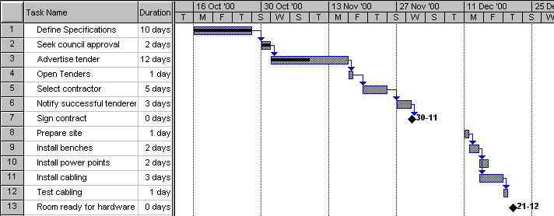
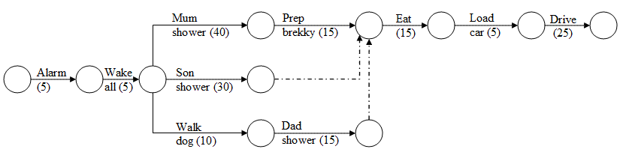
Project Management Tools
Gantt chart
PERT chart (not examinable)
Gantt chart
PERT chart

Slide 8
WBS
A Work Breakdown Structure is a good way of beginning a Gantt (or PERT) chart
In a WBS all the tasks (and subtasks) in the project are identified and put in order of execution.
Ensures necessary jobs are not forgotten!

Slide 9
identifying tasks, resources, people and time
WBS – work breakdown structure
List the tasks and subtasks that need to be done from start to finish
Don’t leave things out!

Slide 10
Sample WBS
WBS number | Task Description
1.0 | Project initiation
1.1 | Draft project plan
2.0 | Analysis phase
2.1 | Plan user interviews
2.2 | Schedule users interviews
3.0 | Examination and test
4.0 | Design
5.0 | Test
6.0 | Implementation
7.0 | Post implementation review
Note how large tasks (e.g. 1 and 2) can be subdivided into subtasks (e.g. 2.1, 2.2). Later, large tasks can be collapsed or expanded to hide or show their subtasks.

Slide 11
scheduling tasks, resources, people and time
Gantt chart (you need to know this in 2022)
PERT chart*
Critical Path Management Software*
* You do not need to know how to use these

Slide 12
monitoring tasks, resources, people and time
The Gantt and PERT chart are modified as necessary as the project proceeds so they accurately reflect real events and progress.
Milestones are major progress landmarks.
Milestones tell you whether the project is running on time.

Slide 13
Gantt, PERT Charts …
Plan necessary tasks in advance.
Monitor progress of a project.
Are used to make predictions.
PERT clearly shows where potential bottlenecks or wasted time/resources are likely.
Gantt clearly shows task dependencies and timing

Slide 14
Applied Computing Slideshows
by Mark Kelly
vcedata.com
mark@vcedata.com
These slideshows may be freely used, modified or distributed by teachers and students anywhere on the planet (but not elsewhere).
They may NOT be sold.
They must NOT be redistributed if you modify them.

