Slide 1

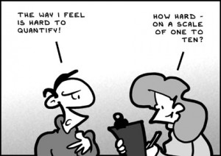
Applied Computing Slideshows by Mark Kelly vcedata.com mark@vcedata.com
Qualitative and Quantitative data
Last changed Sunday, 25 August 2024

Slide 2
Contents
Qualitative data
Quantitative data
Data collection methods
Data purposes
I bet you’re excited now.

Slide 3
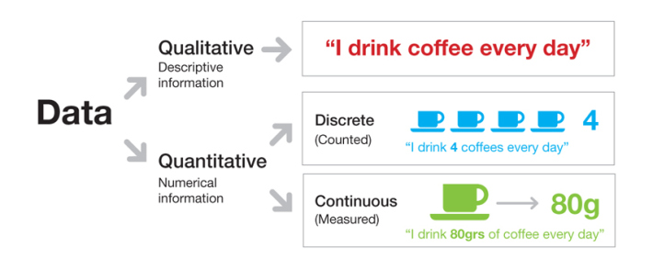
In brief

Slide 4
Quantitative data
Answers “When?” “How often?” “How many?” questions
Numeric or coded
acquired by measurement
can be directly analysed statistically
usually obtained using closed questions
E.g. multiple choice, limited range of answers
gathered in large quantities, without much depth
objective (factual, unemotional)
e.g. “x% of teenagers drink alcohol weekly”
can be used to make comparisons with other places or times
can investigate the current status of an issue.

Slide 5
Quantitative data
Acquired with Likert scales
Graduated scale of values (Very much, Somewhat, Rarely, Never)
Numeric scale – “How strongly do you believe…?”
Multiple choice
Ranking
“Put the numbers 1 to 10 beside these options to rank your favourite modes of public transport.”
May use
Radio buttons - when?
Checkboxes – when?
Combo boxes, drop-down lists of options – when?

Slide 6
Qualitative data
Answers “Why…?” or “How…?”questions
Descriptive answers
expressed in words
concerned with opinions, personal views, feelings
must be encoded to be analysed statistically
looks at the total picture, not tiny details
Investigates motives, reasons, reactions, likes, dislikes
gathered in depth, not quantity
usually acquired using open-ended questions
unstructured, free-form textual answers
subjective (opinion-based)
“Why do you drink alcohol weekly? How does it affect your life?

Slide 7
Which one to use?
Both have their uses.
Use the right type of data for the right occasion.
When little is known about a subject, qualitative research can discover ideas and categories for later large-scale quantitative research.
Examples? Join the VIP club at vceit.com

Slide 8
Pros and cons
Interviews, Observation
Expensive
Slow
Labour-intensive
Processing-intensive
Rich
Detailed
Explanations, reasons, detail
Non-verbal information
Respondents more likely to cooperate

Slide 9
Pros and cons
Surveys, Questionnaires, Sensors
Collect lots of data
Relatively cheap, quick, little labour
Easy to process statistically
Lacks depth, explanation, reasons
No non-verbal cues
pauses, passion, facial expressions, speed of response etc
Less chance of people bothering to respond
Especially with detailed written answers to open questions

Slide 10
Acquiring data
Qualitative
Interviews
Observation
Quantitative
Surveys
Questionnaires (watch the spelling! Two “n”s, one “r”)
Sensors (Examples?)

Slide 11
Coding qualitative data
Unstructured qualitative answers don’t easily fall into neat categories for counting, averaging.
Answers need to be coded (or encoded).
Coding takes human interpretation, judgement
May introduce error, bias
Examples? – join the vceit.com VIP club.
Descriptive coding – reduces original wordiness.
Theoretical coding – replaces ideas with symbols, labels, numbers.

Slide 12
Rubric
A set of performance criteria corresponding with marks, categories, labels.
Guides decisions of people encoding qualitative answers.
E.g. English essays.
VCE IT outcomes.
33-40 marks
Thorough and insightful analysis correctly identifies all the website requirements of an online community and acknowledges all relevant technical and non-technical constraints.
All selected design tools are appropriate.
Correct design techniques are consistently applied to fully represent the functionality and appearance of a website that is feasible and accordant with the analysis.
All manual and electronic validation techniques effectively check the reasonableness of data…

Slide 13
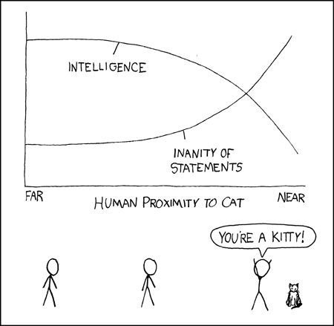
THANKS!
Because you’ve been so good, here’s a picture you can look at while your teacher works out what to do next
http://xkcd.com/231

Slide 14
Applied Computing Slideshows
by Mark Kelly
vcedata.com
mark@vcedata.com
These slideshows may be freely used, modified or distributed by teachers and students anywhere
but
they may NOT be sold.
they must NOT be redistributed if you modify them.
This is not a VCAA publication and does not speak for VCAA.
Portions (e.g. exam questions, study design extracts, glossary terms) may be copyright Victorian Curriculum and Assessment Authority and are used with permission for educational purposes.

