Slide 1
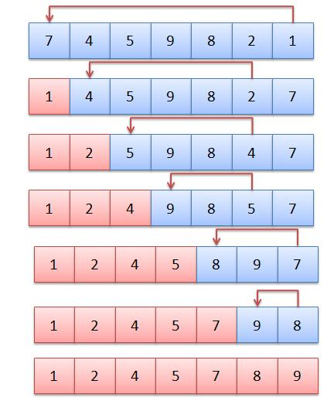
Applied Computing Slideshows by Mark Kelly vcedata.com mark@vcedata.com
Selection Sort
v1.1 - 2022-02-17

Slide 2
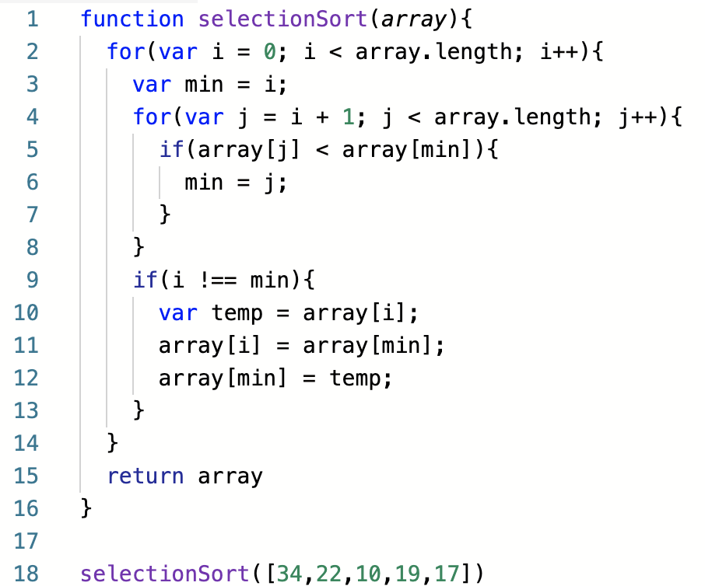
Selection Sort
Pros and cons
How it works
DIY example
https://medium.com/@michellekwong2/selection-sort-algorithm-719a0b9bd6ce

Slide 3

Selection Sort – Pros and Cons
Relatively slow when sorting large lists, compared with more complex sorts like quicksort.
Relatively simple algorithm, easy to implement.

Slide 4

How it works
The data to be sorted is divided into two parts
data items that have already been sorted and moved to the start of the list;
data items that have not yet been sorted.

Slide 5
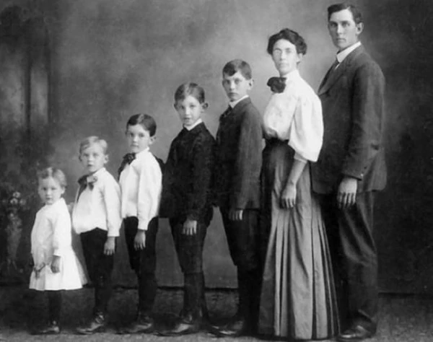
How it works
The selection sort finds the smallest data item* in the unsorted items section.
*or the largest, if sorting in descending order

Slide 6
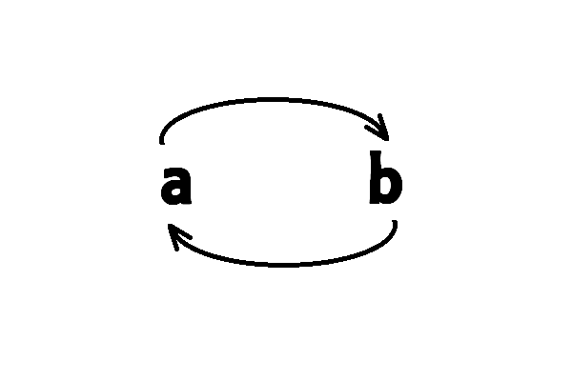
How it works
It swaps that item with the leftmost item in the unsorted list.
It then moves the dividing line between sorted/unsorted items 1 place to the right.
An example, using data from a VCAA SD sample exam...

Slide 7
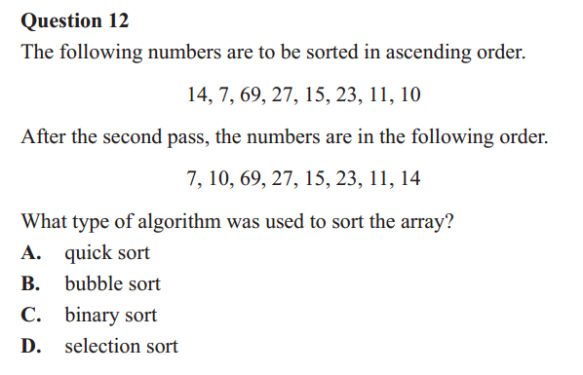
The exam question
Work on it for a minute

Slide 8
How it works
Notes:
In the table that follows, shaded cells are the unsorted items.
In the original data, no items are sorted so the dividing line is at position zero - all items are in the unsorted section.

Slide 9
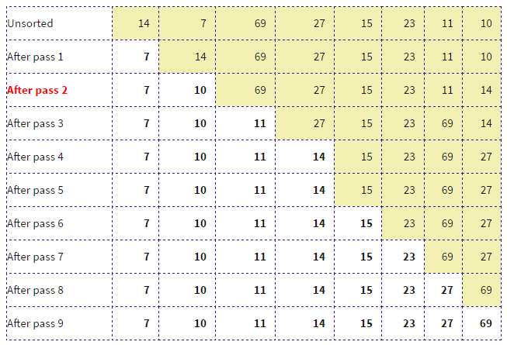

A walkthrough
Unsorted
First, find the smallest value in the the unsorted data section.
Found smallest (7)

Slide 10
A walkthrough
Unsorted
Now swap smallest (7) with the leftmost item in unsorted list (14)

Slide 11
A walkthrough
Unsorted
Swapped! Pass 1 is finished.
Now repeat in pass 2...

Slide 12
A walkthrough
Unsorted
Found smallest (10)

Slide 13
A walkthrough
Unsorted
Swap with leftmost item in unsorted section (14)

Slide 14
A walkthrough
Unsorted
Swapped!

Slide 15
A walkthrough
Unsorted
Swapped!
Look at the exam question again

Slide 16
Question done
Unsorted
Look at the exam question again
BINGO

Slide 17
We’ll finish the sort
Unsorted

Slide 18
We’ll finish the sort
Unsorted
Swapped!

Slide 19
We’ll finish the sort
Unsorted

Slide 20
We’ll finish the sort
Unsorted
Swapped!

Slide 21
We’ll finish the sort
Unsorted

Slide 22
We’ll finish the sort
Unsorted

Slide 23
We’ll finish the sort
Unsorted

Slide 24
We’ll finish the sort
Unsorted
Swapped (with itself again!)

Slide 25
We’ll finish the sort
Unsorted

Slide 26
We’ll finish the sort
Unsorted
Swapped

Slide 27
We’ll finish the sort
Unsorted

Slide 28
We’ll finish the sort
Unsorted
Swap (with itself again)

Slide 29
We’ll finish the sort
Unsorted
No more unsorted data exists – the sort ends

Slide 30
Here’s an animated example
https://stackabuse.com/selection-sort-in-javascript/

Slide 31
Applied Computing Slideshows by Mark Kelly vcedata.com mark@vcedata.com
These slideshows may be freely used, modified or distributed by teachers and students anywhere
but
they may NOT be sold.
they must NOT be redistributed if you modify them.
This is not a VCAA publication and does not speak for VCAA.
Portions (e.g. exam questions, study design extracts, glossary terms) may be copyright Victorian Curriculum and Assessment Authority and are used with permission for educational purposes.

Slide 32
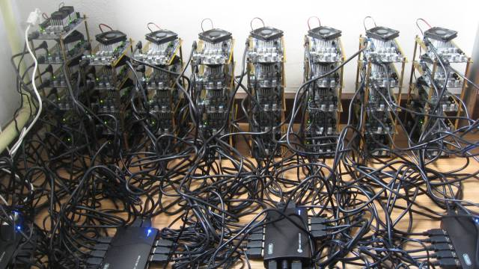
THANKS!
Because you’ve been so good, here’s a picture you can look at
while your teacher works out what to do next
Above: a bitcoin farm.

