Slide 1


NAS and Cloud storage
Last changed 2024-05-07
Advantages and disadvantages of using
network attached storage
and
cloud computing
for storing, communicating and disposing of data and information

Slide 2
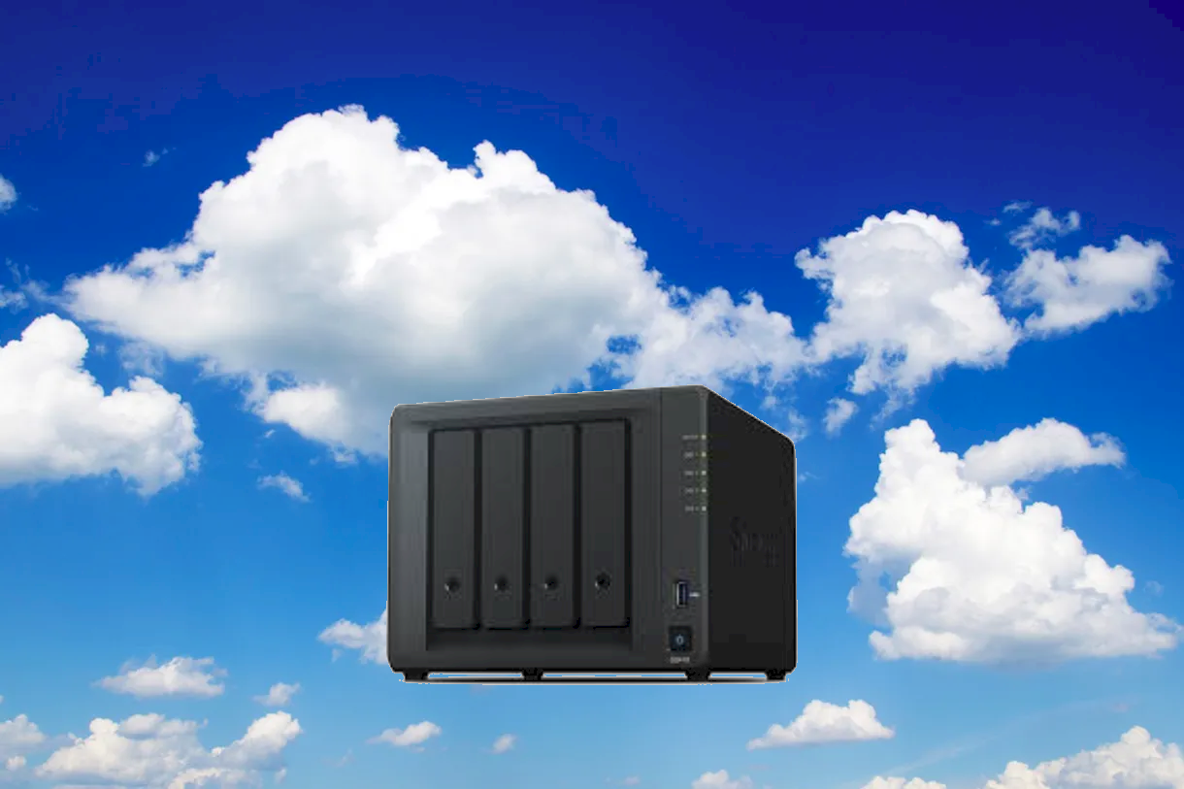
Contents
Network Attached Storage (NAS)
Cloud storage (not ‘cloud computing’)
vcedata.com slideshow © Mark Kelly 2023 - <number>/22

Slide 3
Network Attached Storage (NAS)
What is it?
A NAS is a box containing several hard disks (or SSDs) that operate as a single storage unit
It is attached to a LAN (local area network) and is accessible to all authorised devices on the network
It is a reliable and efficient central storage device
vcedata.com slideshow © Mark Kelly 2022 - <number>/22

Slide 4
Network Attached Storage (NAS)
Hard disks? Why not SSDs?
Yes, SSDs are smaller and faster, but in 2024 are still much more expensive than equivalent HDD.
2TB SSD = $179 = $89 per TB
8TB HDD = $249 = $31 per TB.
And in terms of sheer capacity, HDD still wins the prize in 2024.
Homework: research the cost/capacity of the current biggest SSDs and HDDs.
vcedata.com slideshow © Mark Kelly 2022 - <number>/22

Slide 5
Network Attached Storage (NAS)
NAS Features
Most NAS are set up with a RAID configuration
RAID = Redundant Array of Independent Disks
The most popular RAID format is RAID5
vcedata.com slideshow © Mark Kelly 2022 - <number>/22

Slide 6
Network Attached Storage (NAS)
RAID5
A file is not saved on one particular disk in the array
It is broken into chunks which are saved on all of the available disks. This is called ‘striping’.
The ‘Redundant’ saving feature means that if one disk fails, all the parts of a file can still be retrieved from the surviving disks.
vcedata.com slideshow © Mark Kelly 2022 - <number>/22

Slide 7
Network Attached Storage (NAS)
RAID5
Advantage: good data protection. A dead disk can be easily replaced and the NAS will rebuild all data from the surviving disks onto the replacement disk.
Disadvantage: in a 4 disk NAS, you only get 75% storage space since 25% is used for ‘parity’ (recovery information).
vcedata.com slideshow © Mark Kelly 2022 - <number>/22

Slide 8
Network Attached Storage (NAS)
RAID5
Advantage: Since there are multiple disks containing parts of of a file, each disk can seek and supply different parts of the file simultaneously.
So, access speeds can be much faster than from a single hard disk.
vcedata.com slideshow © Mark Kelly 2022 - <number>/22

Slide 9
Network Attached Storage (NAS)
NAS advantages
Unlike the disk on a workstation, the data stored on a NAS is shared with the entire network.
It it accessible to any (authorised) computer or user on the LAN.
vcedata.com slideshow © Mark Kelly 2022 - <number>/22

Slide 10
Network Attached Storage (NAS)
NAS disadvantages
If more than one disk fails in the array (e.g. lightning strike, theft), data may be lost.
NAS units are not cheap (e.g. $900 with no disks inside), and large disks are expensive (e.g. 4 x 12TB = $2,000)
vcedata.com slideshow © Mark Kelly 2022 - <number>/22

Slide 11

Network Attached Storage (NAS)
NAS disadvantages
If a NAS is not backed up, and it is stolen or damaged, ALL data is lost.
Don’t treat a NAS as a backup device: it’s a primary storage device, like the disk in your PC.
vcedata.com slideshow © Mark Kelly 2022 - <number>/22

Slide 12
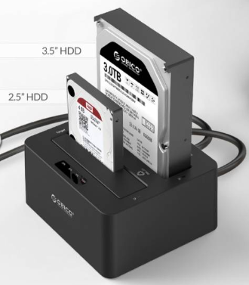
Network Attached Storage (NAS)
NAS disadvantages
You cannot remove a disk from a NAS (formatted as RAID) and try to recover a single file from it.
Its parts are distributed across multiple disks
(Except in “JBOD” where the unit is configured as Just a Bunch of Disks and the NAS acts like a USB drive caddy)
vcedata.com slideshow © Mark Kelly 2022 - <number>/22

Slide 13
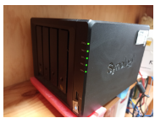
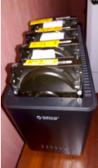
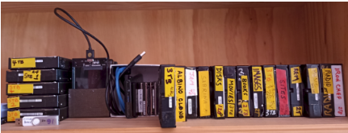
Network Attached Storage (NAS)
My home storage setup
1. A Synology DS418 NAS with 4 x 12TB HDD configured as RAID5, giving 36TB storage.
2. A 5-bay Orico HDD enclosure to back up the NAS.
3. Multiple old HDDs to back up the Orico.
No, I am NOT paranoid. Stop saying that.
And, yes, 12TB of it is backed up to the cloud… I repeat: I AM NOT PARANOID.
vcedata.com slideshow © Mark Kelly 2022 - <number>/22

Slide 14

Cloud Storage
What is it?
It is not ‘Cloud Computing’ as the study design says.
Cloud computing and cloud storage are very different things.
vcedata.com slideshow © Mark Kelly 2022 - <number>/22

Slide 15
Cloud Storage
What is it?
Cloud storage stores your data on unknown computers somewhere on the internet.
Examples: Amazon AWS, Google Cloud,
pCloud, Mega, Degoo – hundreds more.
vcedata.com slideshow © Mark Kelly 2022 - <number>/22

Slide 16
Cloud Storage
Cloud storage advantages
It’s offsite. If your local data is burnt or flooded or stolen, a copy is safely stored elsewhere.
It’s accessible from any location on earth with an internet connection.
Files and data can easily be shared globally.
vcedata.com slideshow © Mark Kelly 2022 - <number>/22

Slide 17
Cloud Storage
Cloud storage disadvantages
If the cloud provider goes out of business, or is hacked, you may lose access to all of your data.
Downloading data (and especially uploading data) is very slow compared with local storage.
It’s relatively expensive
e.g. 200GB storage can cost $5 a month.
Google Drive can cost $US12 per month for 2TB storage
vcedata.com slideshow © Mark Kelly 2022 - <number>/22

Slide 18
Cloud Storage
Cloud storage disadvantages (continued)
The provider may be fussy about storing copyrighted media, even if you own a legal copy.
The provider may decide to cancel your ‘lifetime’ storage contract on such a whim.
vcedata.com slideshow © Mark Kelly 2022 - <number>/22

Slide 19
Cloud Storage
Cloud storage disadvantages (continued)
Who knows what the cloud provider may be doing with your stored personal documents?
Some providers charge you more to guarantee that they have zero knowledge of what you store. Really!
vcedata.com slideshow © Mark Kelly 2022 - <number>/22

Slide 20
Cloud Storage
Cloud storage disadvantages (continued)
If you are sharing files from your cloud storage, there are probably limits to your allowed download traffic.
vcedata.com slideshow © Mark Kelly 2022 - <number>/22

Slide 21
Cloud Storage
Cloud storage disadvantages (continued)
Disposing of data.
Can you be sure that data deleted from the cloud is actually gone forever?
It may be backed up on multiple global servers and may live forever, beyond your knowledge or control.
vcedata.com slideshow © Mark Kelly 2022 - <number>/22

Slide 22
These slideshows may be freely used, modified or distributed by teachers and students anywhere.
They may not be sold
You must not change or remove their authorship information or copyright notices.
You must not redistribute them if you modify them.
This is not a VCAA publication and does not speak for VCAA.
Portions (e.g. exam questions, study design extracts, glossary terms) may be copyright Victorian Curriculum and Assessment Authority and are used with permission for educational purposes.

