Slide 1
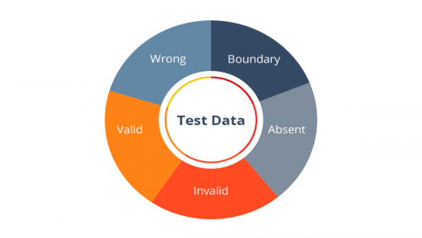
Applied Computing Slideshows
by Mark Kelly
vcedata.com
mark@vcedata.com
Test Data

Slide 2
What is test data?
Artificial data created solely to test that software produces the right results
Real data is not used because
it may be damaged by software bugs
it is not specifically designed to find weaknesses in software.
Test data should act as the ultimate stress test to show up every possible code fault.
VCE IT slideshows © 2015-2019 Mark Kelly, vceit.com
<number>

Slide 3
Good test data
Test data should include every conceivable type of input
Focuses on parts of the software where errors are most likely to occur.
Typically these points are boundary conditions where the behaviour of the code is expected to change. Also called 'tipping points'.
VCE IT slideshows © 2015-2019 Mark Kelly, vceit.com
<number>

Slide 4
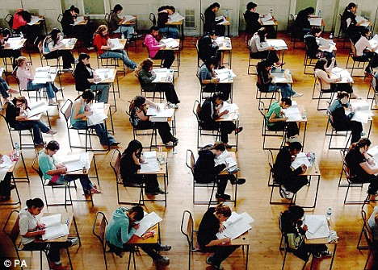
Good test data
Is as brief as possible
Excludes repetitive data that tests things that have already been tested.
VCE IT slideshows © 2015-2019 Mark Kelly, vceit.com
<number>

Slide 5
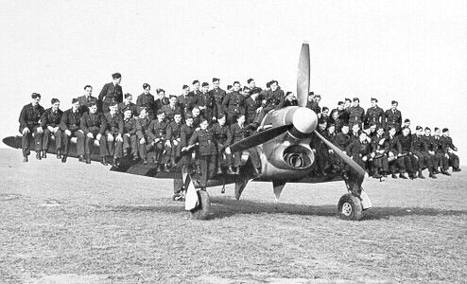
Good test data
Except when load testing software.
Then, huge amounts of data are required to push the code to its performance limits.
Create large amounts of sample data at sites like generatedata.com and mockaroo.com.
VCE IT slideshows © 2015-2019 Mark Kelly, vceit.com
<number>

Slide 6
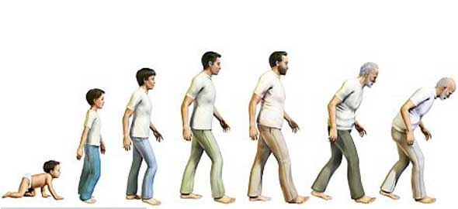
Practice
Imagine some code needs to treat people differently if they are younger than 18. What is good test data?
VCE IT slideshows © 2015-2019 Mark Kelly, vceit.com
<number>

Slide 7

Practice
17.9
18.0
18.1
includes all possible data inputs
just under the tipping point (which is 18)
exactly on the tipping point
just over the tipping point.
VCE IT slideshows © 2015-2019 Mark Kelly, vceit.com
<number>

Slide 8
Practice
Including values like 14 and 24 would just waste time and accomplish nothing
Those cases have already been tested by the values 17.9 and 18.1.
VCE IT slideshows © 2015-2019 Mark Kelly, vceit.com
<number>

Slide 9
Exam Hint
Most logical errors in real life programming, and in exam questions occur on boundaries.
When asked to find a fault in code, look for code like IF x < y THEN...
Often the error is that < should have been <=
VCE IT slideshows © 2015-2019 Mark Kelly, vceit.com
<number>

Slide 10
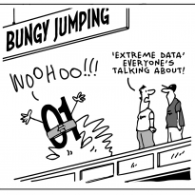
Good test data
Comprehensive test data includes
invalid inputs to test validation code)
valid inputs
inputs that are valid but unusual, unexpected or extraordinary.
VCE IT slideshows © 2015-2019 Mark Kelly, vceit.com
<number>

Slide 11
Audience participation time
A swimming club divides its members into these age groups:
Tadpoles – from 4 to 6 years.
Minnows – 7 to 10 years
Sardines – 11 to 15 years
Piranha – 16 to 20 years
Sharks – 21 to 54 years
Whales – 55 and over
Create a set of test data that is exhaustively tests all possible inputs and also tests validation rules to exclude ineligible applicants.
VCE IT slideshows © 2015-2019 Mark Kelly, vceit.com
<number>

Slide 12
Solution
5 (to test validation code that should reject people who are too young)
6 (exactly on the lower valid boundary)
10 (upper limit for a Sardine)
11 (lower boundary for a Flathead)
19 (upper limit for a Flathead)
20 (lower boundary for a Trout)
110 (an unexpected and unusual but nevertheless valid age)
VCE IT slideshows © 2015-2019 Mark Kelly, vceit.com
<number>

Slide 13
Solution
Notice how the test data gathers around the key tipping points - 6,11,19,20
This is where logical errors will most likely occur.
Every conceivable input is represented in the test data.
VCE IT slideshows © 2015-2019 Mark Kelly, vceit.com
<number>

Slide 14
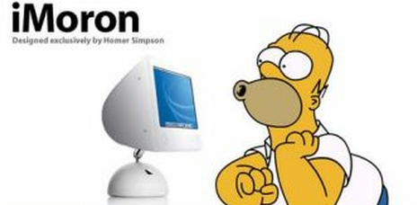
Other data to test validation
Test data may need to include invalid values that only the incredibly-stupid people could invent.
For example
"Fifteen“
"Nearly 7“
"12-13“
Try to anticipate common errors that data enterers may make, and create test data for them.
VCE IT slideshows © 2015-2019 Mark Kelly, vceit.com
<number>

Slide 15
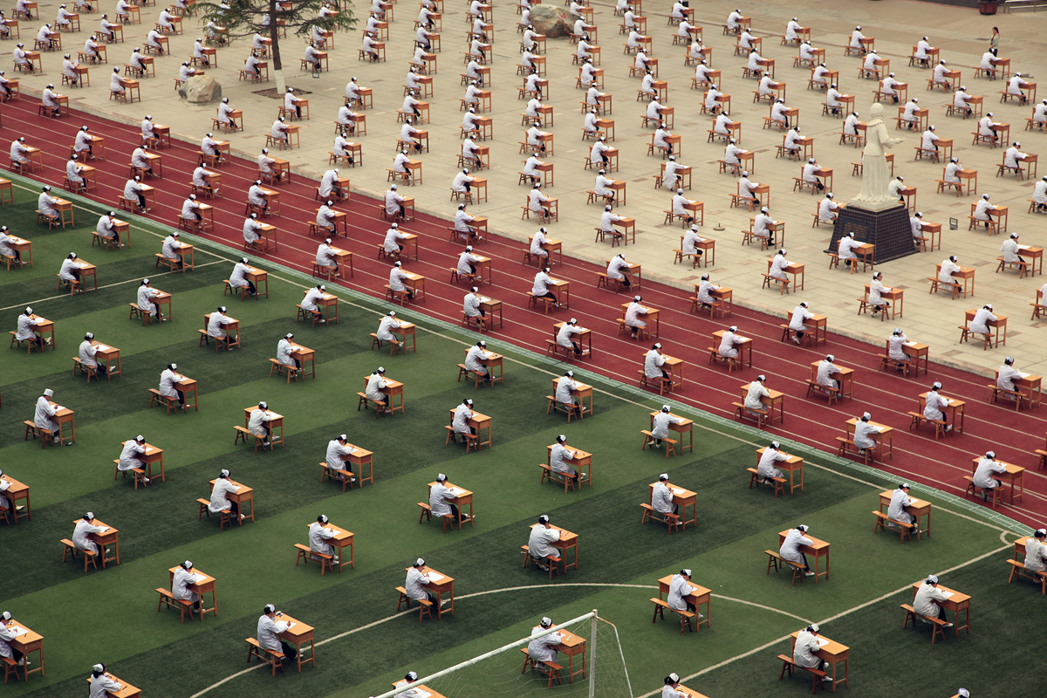
THANKS!
Because you’ve been so good, here’s a picture you can look at
while your teacher works out what to do next
Visit vceit.com for more goodies
<number>

Slide 16
Applied Computing Slideshows
by Mark Kelly
vcedata.com
mark@vcedata.com
These slideshows may be freely used, modified or distributed by teachers and students anywhere
but
they may NOT be sold.
they must NOT be redistributed if you modify them.
This is not a VCAA publication and does not speak for VCAA.
Portions (e.g. exam questions, study design extracts, glossary terms) may be copyright Victorian Curriculum and Assessment Authority and are used with permission for educational purposes.
<number>

