Slide 1

Applied Computing Slideshows by Mark Kelly vcedata.com mark@vcedata.com
Testing
v1.1 – 2022-02-11
v2 - 2024-09-04

Slide 2
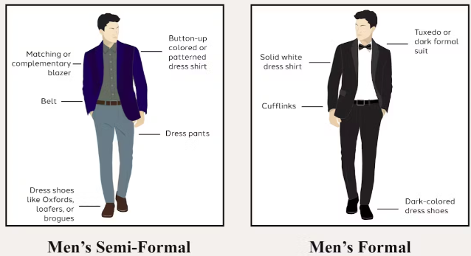
Contents
Informal testing
Recording test results
Test data
Beta testing
Formal testing
User acceptance testing (see the other slideshow)

Slide 3

Testing
Find whether solutions do what is intended, for example correct behaviour when a link is clicked, accurate output by a formula.
Testing is done
during development (informal – alpha - testing, by developers)
to check that the solution meets the needs of a typical user (user acceptance testing)
when development is complete (beta testing, by several external end-users)
to prove to the client that the solution satisfies all necessary functional and non-functional requirements (formal testing)
Is not the same as evaluation!

Slide 4
Other testing types Unit testing (not examinable)
Testing a component of a system (e.g. a subprogram or hardware part) in isolation to see that it does what it’s supposed to do.

Slide 5
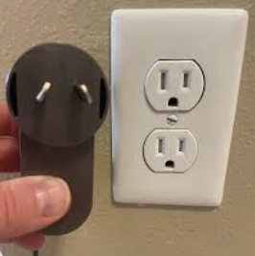
Integration Testing (not examinable)
After adding the component (software or hardware) to see that it behaves properly when joined to related components.
E.g. does a subprogram accept parameters or return values correctly to/from another subprogram?
Is a piece of hardware pin-compatible with the device it plugs into?

Slide 6

System Testing
Finding out whether the entire system with all of its components is working as it should.

Slide 7
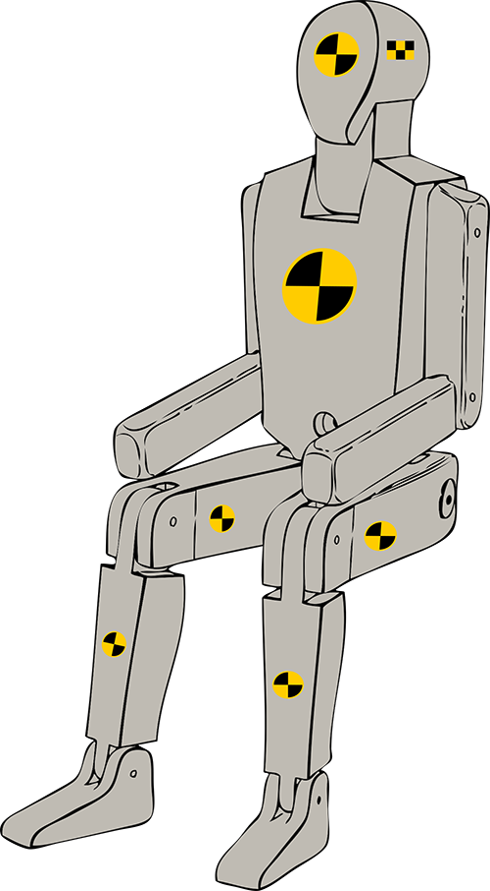
Informal (alpha) testing
Carried out by developers during development to check whether the latest piece of functionality or code works as expected.
Examples:
Test a webpage link by clicking it to see whether the right destination appears.
Test a formula by entering data for which the correct answer is already known, and seeing if the formula produces the same answer.
Timing an operation how long it takes

Slide 8
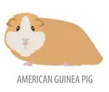
Informal testing
Examples:
Trying to bypass security measures to see if the solution is secure against unauthorised attack.
Testing a program/website on various platforms (computers+operating systems) with different sized displays, amounts of RAM etc.
Test readability by getting subjects to read a solution’s output and then test them on their understanding of it.
Test documentation by giving it to users and observing how many hesitations or errors they show when carrying out the actions described in the documentation.

Slide 9

What needs to be tested?
Everything that the solution is expected to do properly.
Different solutions need to test different things. Each solution has key requirements which need to be tested with special thoroughness.
Missile defence system – speed, accuracy.
Web browser – rendering time, compliance to standards, security.
Encryption – security.
Webpage – readability, ease of navigation, communication of message, compliance to standards
Dog – barking at burglars
Sorting algorithm – correct sorting, speed.

Slide 10
Documenting your testing
Your client will not simply accept you saying “Yeah, I tested it. It works great :-) ”
Evidence is needed – only if you want to be paid.
Create a testing table.
What was tested | How it was tested | Expected result | Actual result | Fix (if needed)
Date of birth calculation | Enter 28 Feb 1994 | 22.4 years (at July 2016) | 22.4 | NA
‘Play video’ button | Clicked button | Play video | Nothing | Added codec for MKV

Slide 11
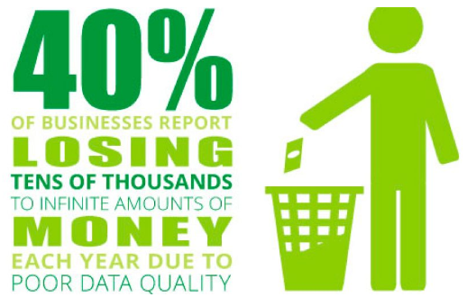
Test data
Also SEE THE TEST DATA SLIDESHOW
In the previous slide, how was the ‘28 Feb 1994’ date chosen as the test data?
Randomly? Test data should not be chosen randomly.
Good test data tests every possible class of inputs –
typical,
unusual but still valid,
borderline conditions,
invalid.

Slide 12
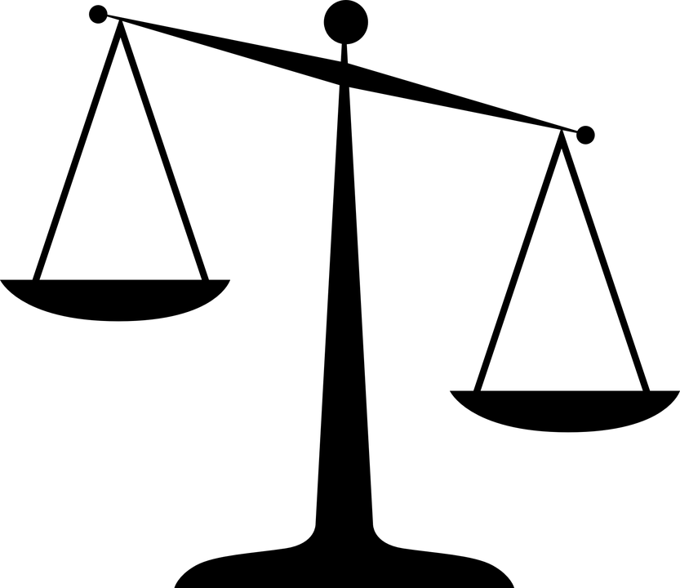
Test data
Also SEE THE TEST DATA SLIDESHOW
e.g. to test code logic that classifies people by voting age (below or above 18) you need data to thoroughly test all possible inputs:
17 (below the cutoff)
18 (exactly on the borderline)
19 (above the cutoff)

Slide 13

Test data
Test data must be thorough but not pointlessly repetitive
There is no point to add tests for people 20, 30, 40, 50, 60 and 67 because the test for “19” already covers all such ages over the cutoff value.

Slide 14
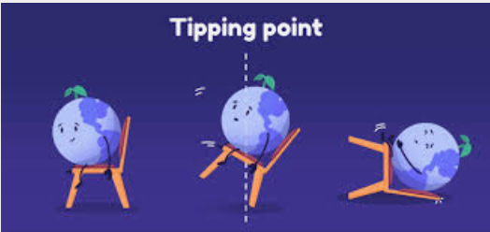
Test data
Focus your test data on boundary conditions – the points at which the behaviour of the solution is expected to change.
Also known as tipping points.
Boundary conditions are where most logical errors occur.
Exams often have questions that rely on testing for boundary conditions.

Slide 15

IN SOFTWARE DEVELOPMENT
Be beware of tests for < > and <= and >=
e.g. a club accepts members who are 55 and over. The code checks an applicant’s eligibility with this code:
If Age > 55 then “Welcome to the club!”
The test fails on the borderline condition because it rejects people who are exactly 55.
It should have used >= (greater than or equal to)
OK. I ran out of ‘tipping point’ pictures, so look at this instead:

Slide 16

Sorry. Come on boys Don’t get distracted
Be beware of tests for < > and <= and >=
e.g. a club accepts members who are 55 and over. The code checks an applicant’s eligibility with this code:
If Age > 55 then “Welcome to the club!”
The test fails on the borderline condition because it rejects people who are exactly 55.
It should have used >= (greater than or equal to)
Look at this instead:

Slide 17
Solution
Minimal test data (and minimal is best)
3 (to test an invalid applicant age)
4, 6 (tadpoles)
7,10 (minnows)
11,15 (sardines)
16,20 (piranha)
21,54 (sharks)
55 (whales)
Note that testing intermediate values (e.g. 30) not really useful, since 21 and 54 already test that range’s limits.

Slide 18

Beta testing
The problem with informal testing by developers is that creators of solutions usually don’t do the really dumb and human things that non-developers might do.
e.g. when you get home, you know there’s a redback spider in the letterbox so you don’t stick your hand in. Your visitors would not know that, and they die.
Developers often cannot anticipate the strange things that other people will do with their product.
Beta testing means giving a developed and in-house-tested product to outsiders to try out and give feedback.

Slide 19
Beta testing Pronounced “beeta” in Oz & UK ”bayta” in the US.
Beta testers (non-developers) can often find problems in
usability,
readability,
completeness,
navigation,
tolerance (the ability of a solution to predict and cope with user error and stupidity)
affordance (see the AFFORDANCE slideshow)
that developers could never have anticipated.
e.g. a developer never questions that everyone knows what an “Upload” button does, but beta testers may not know it means “Send”

Slide 20

Formal testing
Once the solution produces accurate output and works as expected, the client will expect proof that it satisfies the requirements set down during the product’s analysis.
The client may be an external customer, the developers’ boss, a corporate partner etc

Slide 21
Formal testing
e.g. a payroll system must be able to (functional requirements = FRs)
generate summary charts,
email employees and
communicate with the tax office.
It must also be (non-functional requirements = NFRs)
easy to use and
secure from hacking.

Slide 22

Formal testing
During formal testing, the developers demonstrate the achievement of each functional and non-function requirement to the client – the person paying for the solution.
Each successful demonstration gets ticked off.
When all is done, the developers get paid.
HERE’S A TIP: for some students:
You don’t get paid until you have proved that you have done the work, or delivered the goods.
Get used to it.

Slide 23
User acceptance testing
Since the client is often a high-level manager and will not actually ever use the solution, his/her opinion of it may be uninformed or irrelevant.
A typical end-user (who will actually need to use the solution) should judge its suitability.
For example getting the CEO of Coles Australia to try new checkout software is not going to prove much. Ask a real checkout person to use it.
Real users may find issues relating to usability, appropriateness, responsiveness, accuracy, robustness etc.

Slide 24


Testing is not evaluation!
Testing determines whether a solution works as expected and produces accurate output.
Evaluation determines that a deployed system, in use for some time, is achieving the organisational goals for which it was originally created.
Test during development
Evaluate after deployment

Slide 25
Testing is not evaluation!
For example a website is created to increase a company’s profit.
The website is tested and works 100% accurately.
Millions of people visit the site and report their joy.
Three months after the site’s launch, evaluators look at historical records and find profits have not changed.
Conclusions:
the testing showed no problems.
The evaluation showed the website solution to be a complete failure.

Slide 26
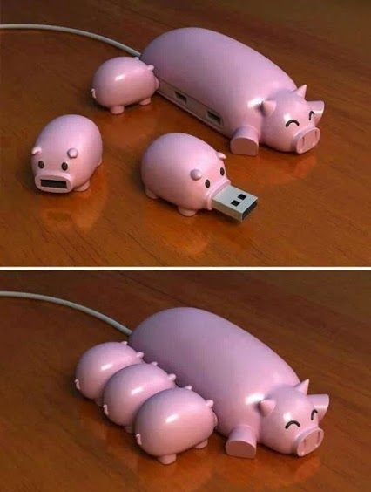
THANKS!
Because you’ve been so good, here’s a picture you can look at
while your teacher works out what to do next

Slide 27
Applied Computing Slideshows by Mark Kelly vcedata.com mark@vcedata.com
These slideshows may be freely used, modified or distributed by teachers and students anywhere
but
they may NOT be sold.
they must NOT be redistributed if you modify them.
This is not a VCAA publication and does not speak for VCAA.
Portions (e.g. exam questions, study design extracts, glossary terms) may be copyright Victorian Curriculum and Assessment Authority and are used with permission for educational purposes. Thanks, guys!

