Slide 1
CSC207 Project
By group_0149:
Guanchun Zhao, Andong Luo, Yeqi Sang

Slide 2
Intro to our New feature.
Based on Phase1, we add following new:
Worker Account
Worker Management
New feature

Slide 3
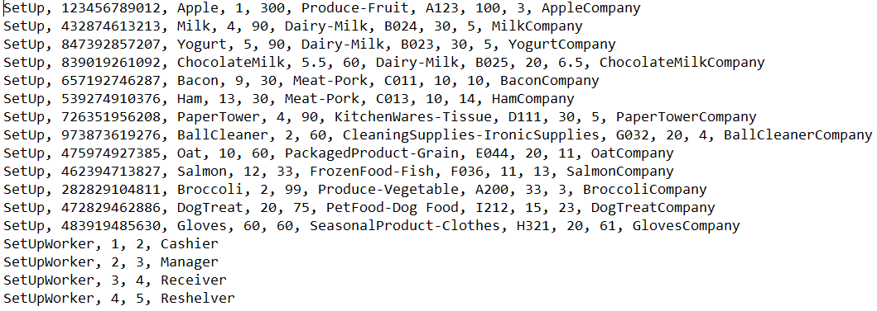
Setup.txt
Format:
SetUp, UPC, name, orderPrice, orderQuantity, section-subsection, aisleNumber, threshold, sellingPrice
SetUpWorker, accountNumber, password, occupation

Slide 4
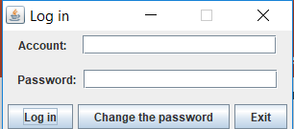
Initial Frame
1. Log in : it would log in to different Gui by different accounts.
2. Change the password: it would change the password by users after you typed the correct account and the password.
3. Exit: exit and save the data for the next day.

Slide 5
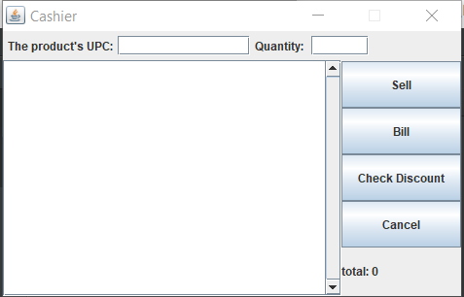
Cashier
What to do
Sell: it would scan the Upc and quantity into the register but no really sell it. Thus, one consumer could buy different products and pay the bill together.
Bill: it would pay the bill and really sell products in the register. Besides, if the remaining quantity is below the threshold, it would automatically generate a message to the manager
Cancel: it would cancel some products in the register before they are payed.
Check Discount: it would allow the cashier to check the discount of the product with the given Upc.

Slide 6
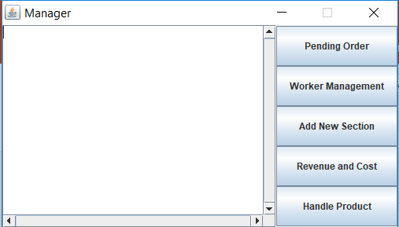
Manager
What to do
Pending Order: it would show all the pending orders, and we could manually change every order and purchase them.
Worker Management: it would dismiss or recruit a new worker with a assigned job.
Add new Section: add new section…
Revenue and Cost: (This is the new feature) it would allow us to get the revenue and cost during a period for all products, or only for a product, and more.
Handel Product: it would allow us to add a new product order, set a price or a discount for an existing product.

Slide 7
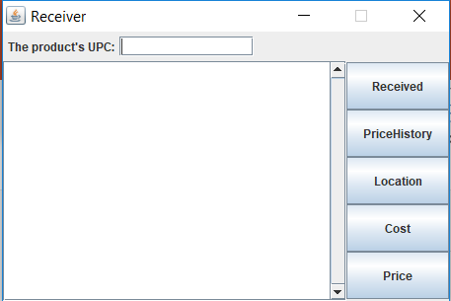
Receiver
What to do
Received: it would show all the orders which have been purchased by the manager, but have not been received by the receiver. Besides, we could select the received order to delete it from the text area and to really add the quantity of the product.
Price History: with a given Upc, it would allow us to check the price history.
Location: with a given Upc, it would allow us to check the location
Cost: with a given Upc, it would allow us to check the cost.
Price: with a given Upc, it would allow us to check the price.

Slide 8
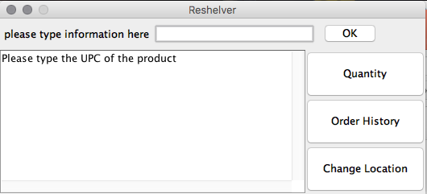
Reshelver
What to do:
1.Upc available
2. Then press button later
3. For location
Use field again
With OK.

Slide 9

Advantage and Shortage
For design pattern:
1. we use MVC and Observer design pattern
2. Deal data over time zone.
Shortage:
Some buttons don’t work pretty well with invalid input.
We try to give another csv file for manager to check, but we commented it.

Slide 10
Thank You

