Slide 1

Fakes, Stubs and Mocks
Mocking frameworks
eleks.com

Slide 2
In previous lessons…
Dummy
objects are passed around but never actually used. Usually they are just used to fill parameter lists. Stubs
provide canned answers to calls made during the test, usually not responding at all to anything outside what's programmed in for the test. Stubs may also record information about calls, such as an email gateway stub that remembers the messages it 'sent', or maybe only how many messages it 'sent'. Spies
mock only part of methods (is recommended to test legacy code).
Fake
objects actually have working implementations, but usually take some shortcut which makes them not suitable for production (an in memory database is a good example).
Mocks objects pre-programmed with expectations which form a specification of the calls they are expected to receive.
By Martin Fowler http://martinfowler.com/articles/mocksArentStubs.html

Slide 3
Mocking is
Mock objects are simulated objects that mimic the behavior of real objects in controlled ways.
A programmer typically creates a mock object to test the behavior of some other object, in much the same way that a car designer uses a crash test dummy to simulate the dynamic behavior of a human in vehicle impacts.

Slide 4
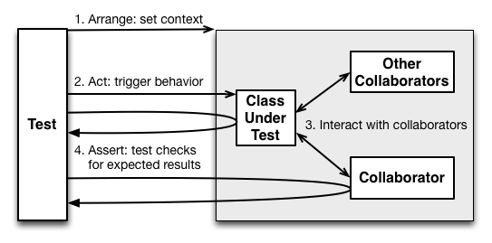
Let’s remind common unit test scenario
Steps:
Arrange – setup test context, initialize an object being tested and its dependent modules/services, connect them together
Act – test triggers behaviour that should be tested in the object under test
Interact – object under test communicates with collborators
Assert – verify that the SUT(object under test and its dependent modules/services) behaves as it has to; checks for expected results

Slide 5
What’s new it has?
Has dependencies and requires setup all of them
May have side effects
Hard to maintain as a result [Ignore] comes to help
If there is a bug in the dependent object - how can you make your test passed?

Slide 6
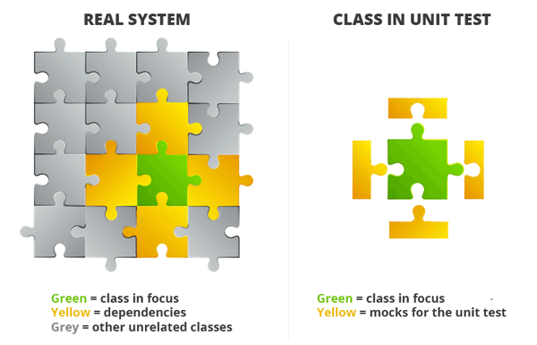
What is mocking?
Mocking is a process used in unit testing when the unit being tested has external dependencies.
In mocking, the dependencies are replaced by closely controlled replacements objects that simulate the behavior of the real ones.

Slide 7
Mocking features
Eliminates dependencies between class under test and modules/services/classes it uses
Isolate class under test
Simplify maintenance and support of such tests
Allow to write test when dependent modules are not implemented

Slide 8
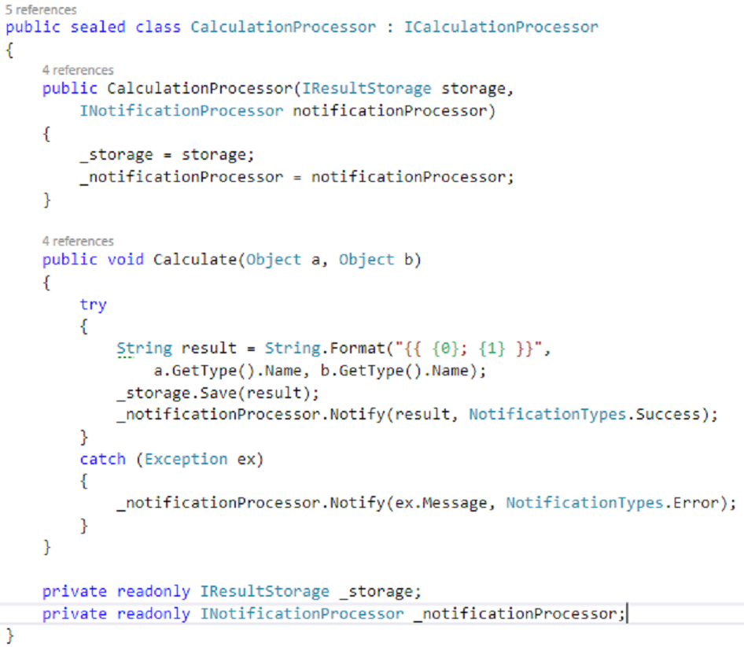
Example of object with dependencies
What should be verified if method under test returns void?
What if we don’t have implementation of dependent object?
External resources usage problem(e.g. not enough disk space, transport level connection problem, etc.)

Slide 9
Mocks Aren’t Stubs
State verification
vs
Behavior verification

Slide 10
Fakes
Fake objects actually have working implementations, but usually take some shortcut which makes them not suitable for production.

Slide 11
Fakes Con’s and Pro’s
Con’s
Hard to maintain
Code duplication
Requires independent implementation
Pro’s
Great for simple test scenarios
Easy to implement

Slide 12
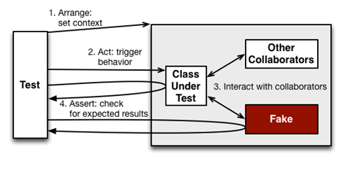
Fakes: unit test scenario
Setup requires implementation of dependent object functionality
Interact with fake object
Asserts on object under test and their dependencies that now represented as fakes

Slide 13
Let's go through the first example!
[nUnit + Fake]

Slide 14
Mocking frameworks
Mocking frameworks simplify the process of isolating object under test and eliminates it dependencies.
Most popular mocking frameworks:
NSubstitute
Rhino Mocks
Moq
FakeItEasy
NMock3

Slide 15
Mocking framework features
Dynamically creates and setup mock objects within test
Allows to setup and simulate methods calls, including input parameters, return values, throws exception on mock object
Built-in method calls verifications – verify method parameters, number of expected method calls etc.

Slide 16
Stubs
Stubs provide canned answers to calls made during the test, usually not responding at all to anything outside what's programmed in for the test. Stubs may also record information about calls, such as an email gateway stub that remembers the messages it 'sent', or maybe only how many messages it 'sent'.

Slide 17
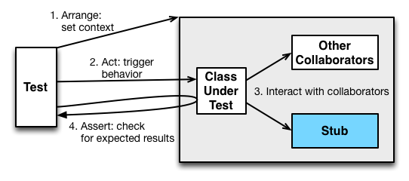
Stubs: unit test scenario
Stubs should be created on the arrange step – setup methods calls inputs and outputs
Stubs don’t take place in the verification step

Slide 18
Mocks
Mocks are what we are talking about here: objects pre-programmed with expectations which form a specification of the calls they are expected to receive.

Slide 19
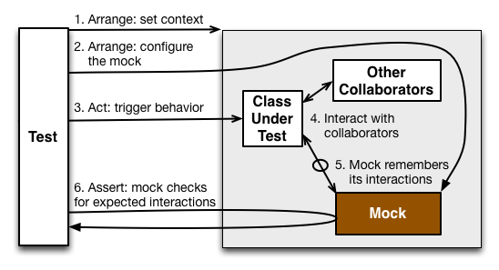
Mocks – typical test scenario
Arrange step now is more complex - setup test context, initialize an object being tested, configure the mock object – setup up return values, excepted method calls and their arguments
Assert step moves to the mock object itself
Can still assert on the object being tested or its other collaborators

Slide 20
Unit test with Mocks and Stubs example
[nUnit + Moq]

Slide 21
Inspired by Technology.
Driven by Value.

