Slide 1

JustDice data analysis report
Seyedmahdi Amin
LinkedIn: https://www.linkedin.com/in/seyedmahdiamin/
Email : seyedmahdiamin1998@gmail.com

Slide 2
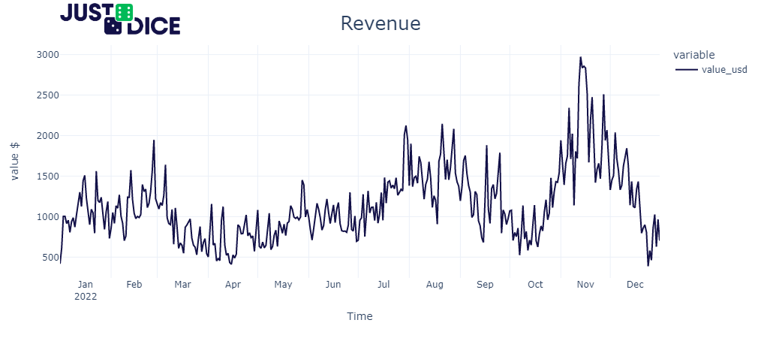
The company's revenue in 2022 is variable and not fixed throughout the year. There are identifiable patterns of revenue growth in February, August, and November, whereas revenue decreases in April, October, and December (around Christmas).
The fluctuations in revenue can be attributed to several factors, including the month of the year, advertising initiatives, and trends in new applications.

Slide 3
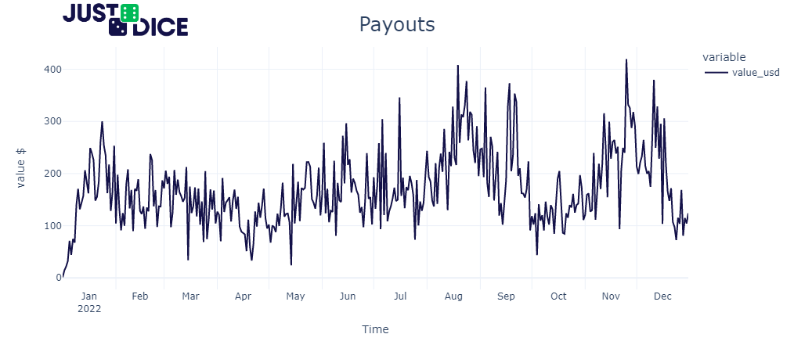
The payouts of the company are relatively stable over time, without significant increases or decreases.

Slide 4
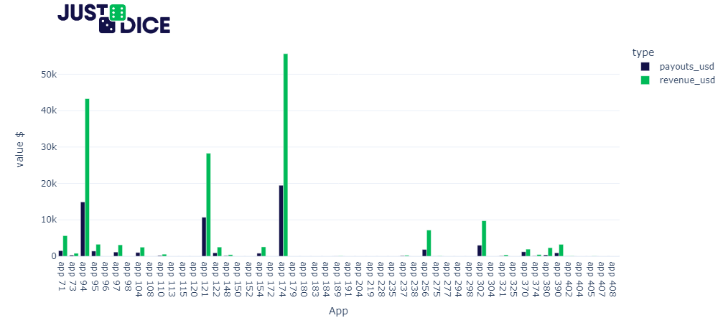
Apps 94, 121, and 174 generate the highest revenue and payouts, making them the top three revenue-generating apps.

Slide 5
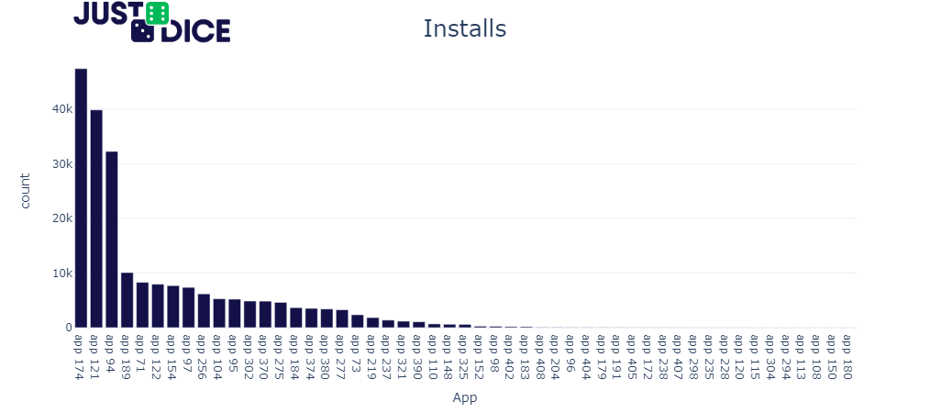
By graphing the number of app installations, we can observe that app 174, 121, and 94 have the highest installation counts.

Slide 6
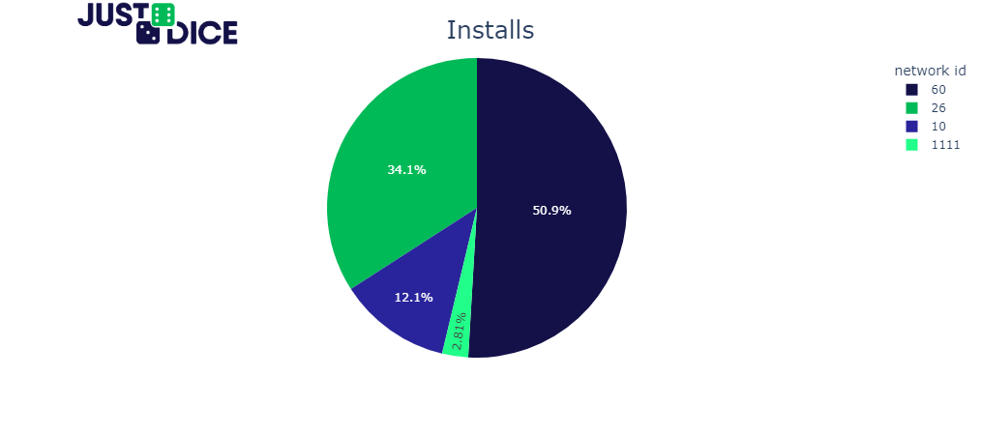
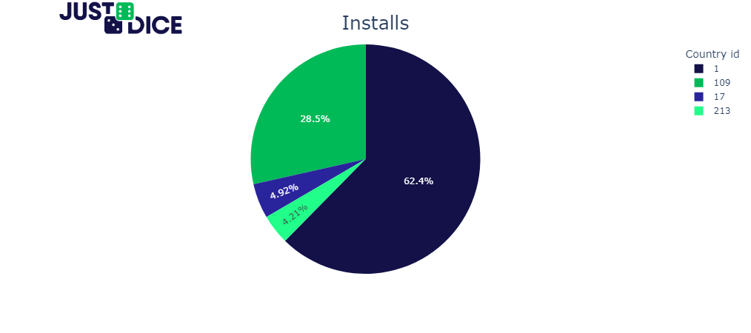

Slide 7
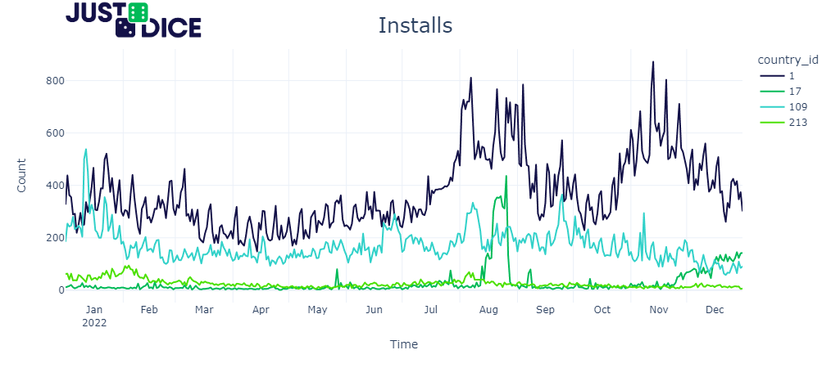
If we visualize the installation counts for each country on a graph, we can determine that country 1 has the highest installation count overall. Additionally, in August, the installation count for country 17 experienced a significant increase. Why?

Slide 8
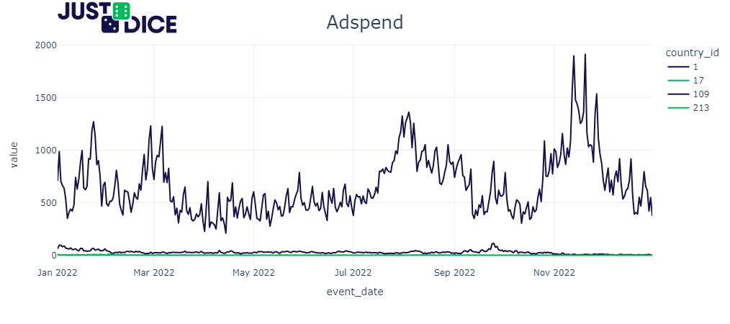
By looking at the ad spend for each country, we can see that the majority of the advertising budget is allocated to country 1, with less being spent on ads for other countries. Though it is worth noting that in August, the company did not spend a lot of money on ads for country 17. So, the reason behind the significant increase in installation count for country 17 during August cannot be solely attributed to the advertising spend.

Slide 9
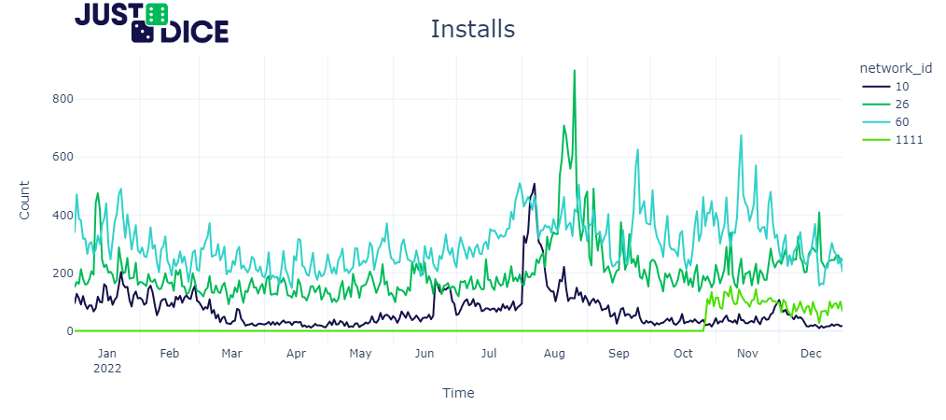

Slide 10
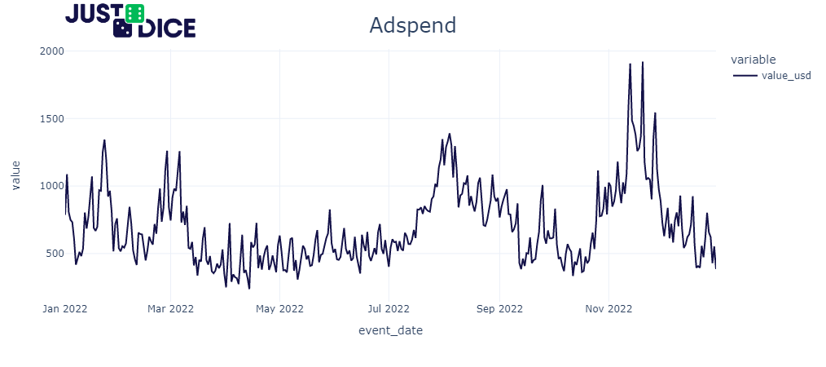

Slide 11
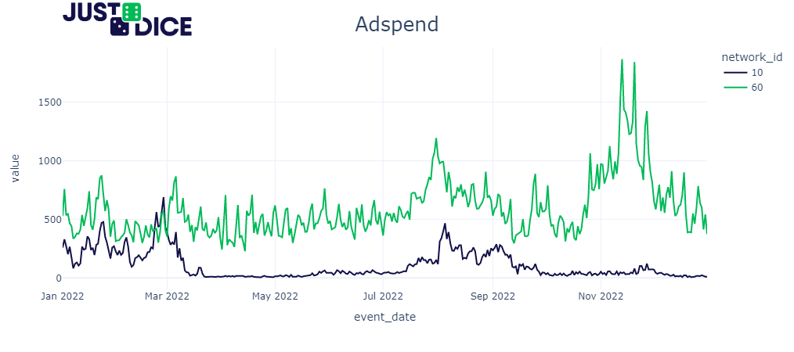

Slide 12
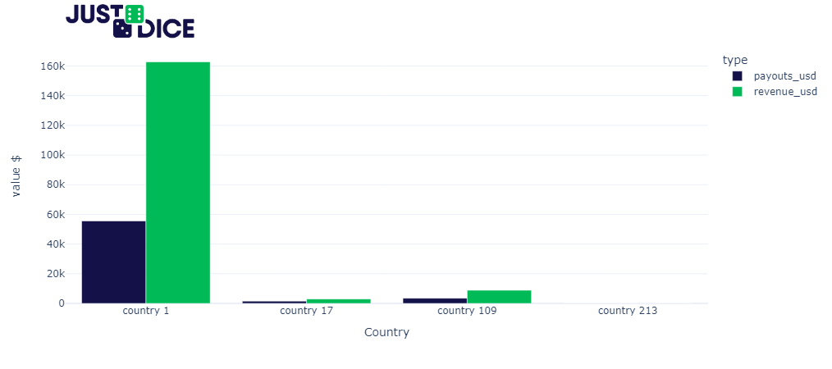

Slide 13
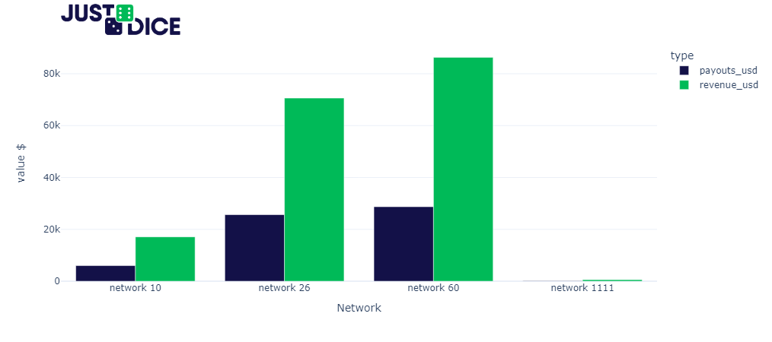

Slide 14
