Slide 1

Data Jobs in the UK
Using NLP to Predict High vs. Low Paying Jobs
By: Seye Sijuwade - Ironhack Data Analytics 2023
Notes:
Natural language processing (NLP) is a branch of artificial intelligence (AI) that enables computers to comprehend, generate, and manipulate human language.

Slide 2
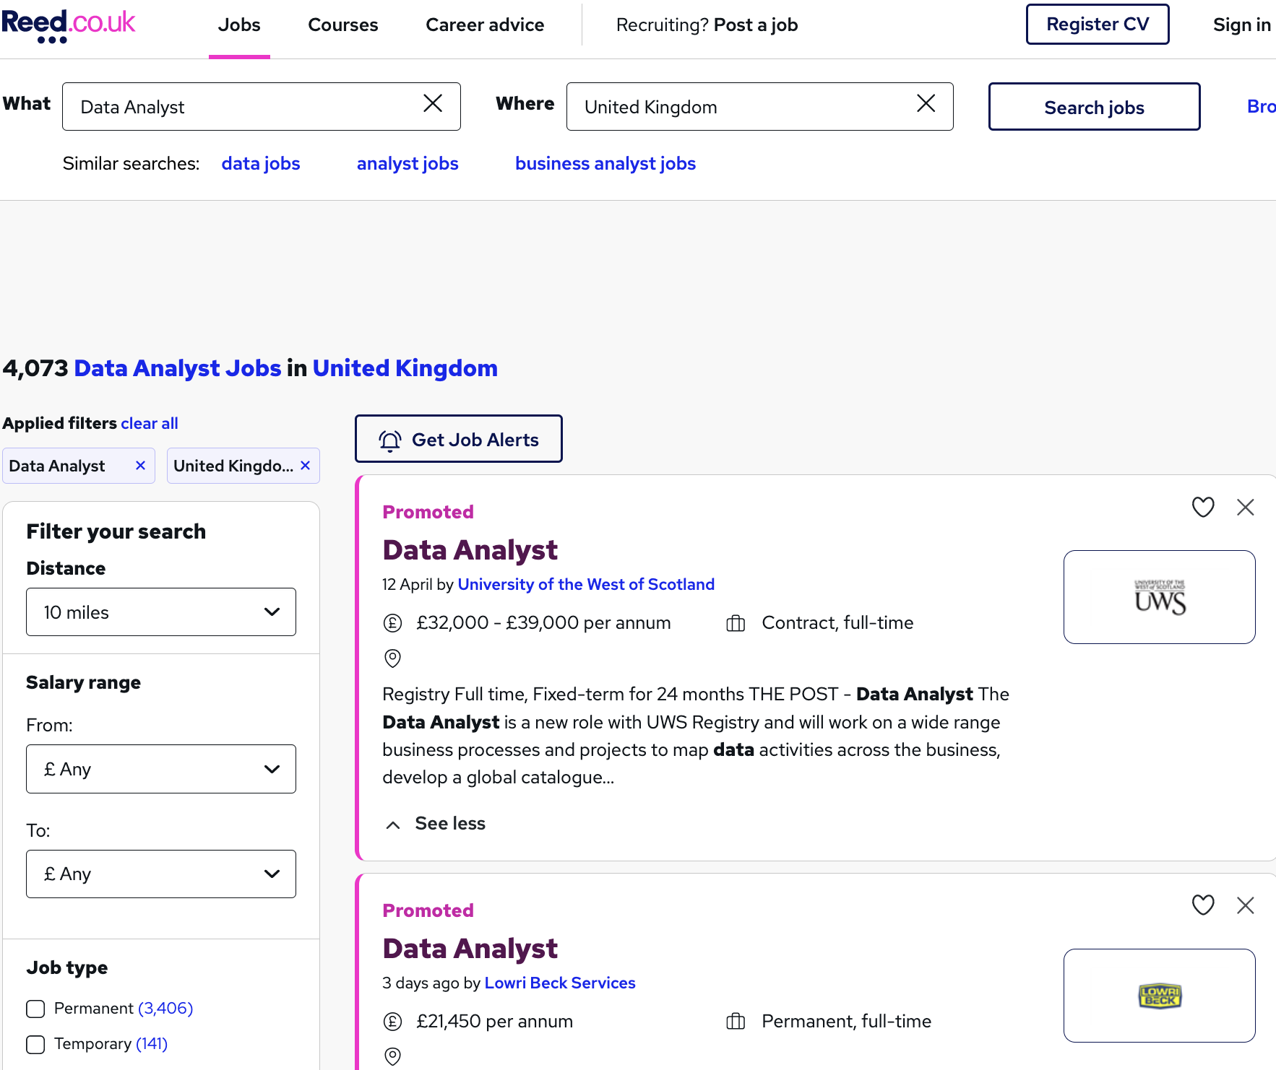
Data Collection
Web Scraping reed.co.uk
Notes:
Web scraping is the process of collecting and parsing raw data from the Web.
Used a python web scraping library called beautiful soup
Information collected on job title, company, location, salary, description, job type etc.

Slide 3
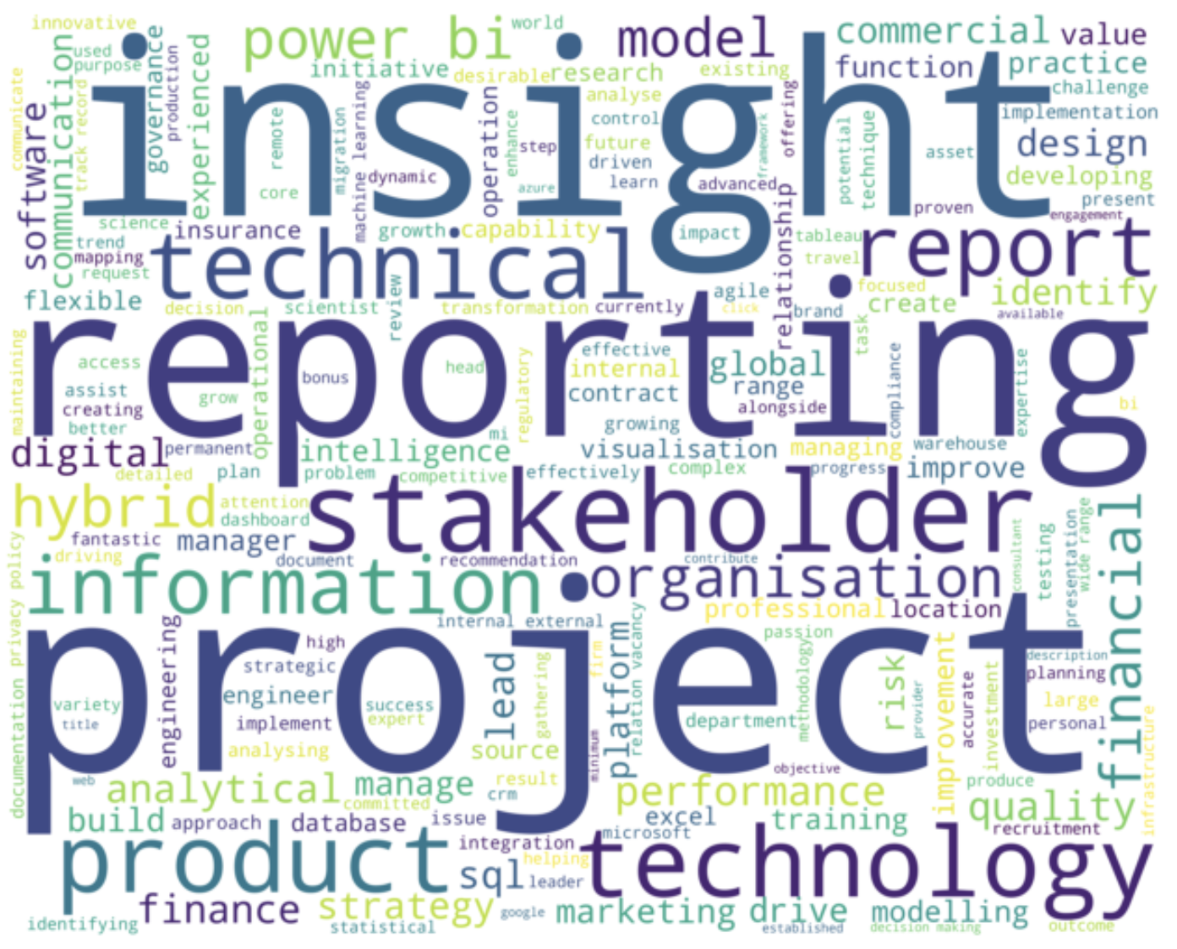
Data Jobs Word Cloud
Notes:
What exactly is a word cloud ?
A word cloud is a visualization technique for text data where the most frequent word is shown in the biggest font size.
Word cloud for most frequent words in all the job descriptions in my dataset.

Slide 4
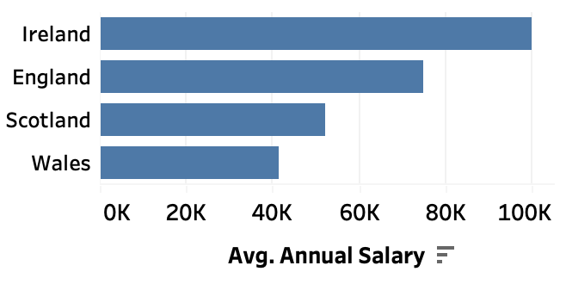
Average Salary in UK Regions

Slide 5
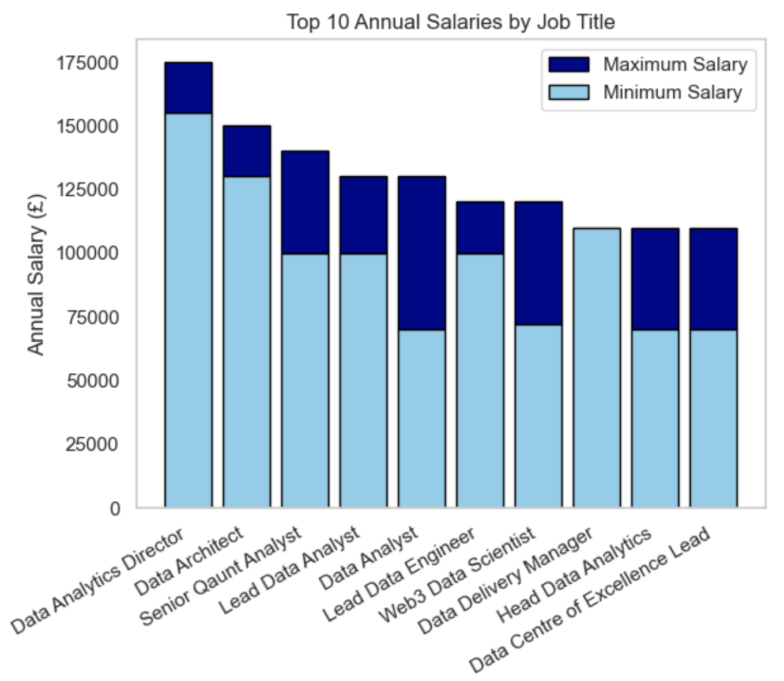
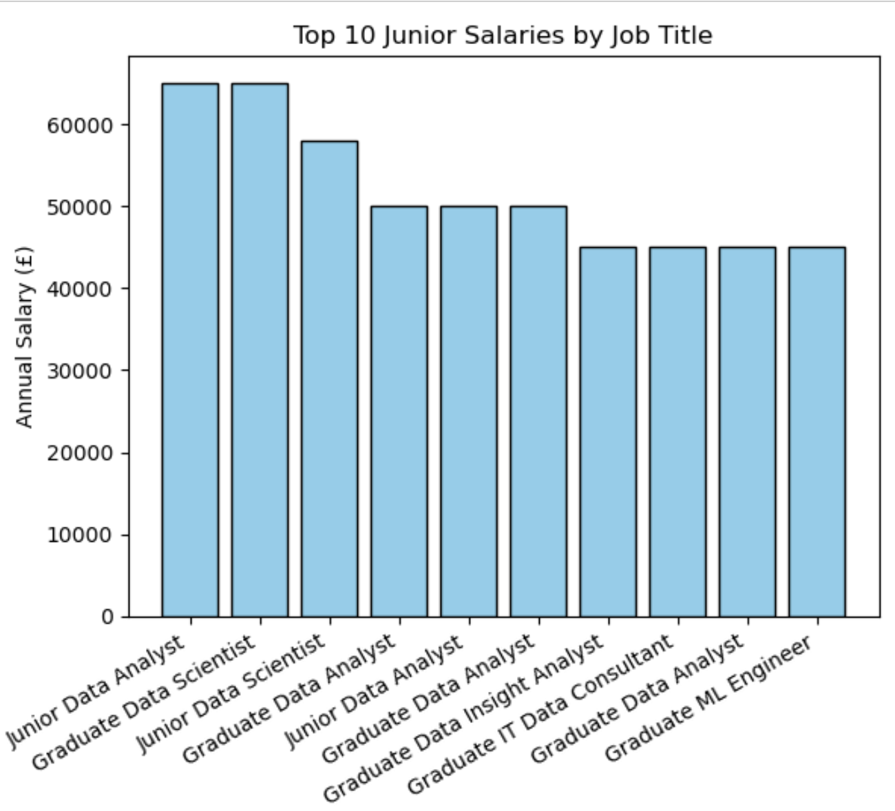
Figure 1
Figure 2

Slide 6
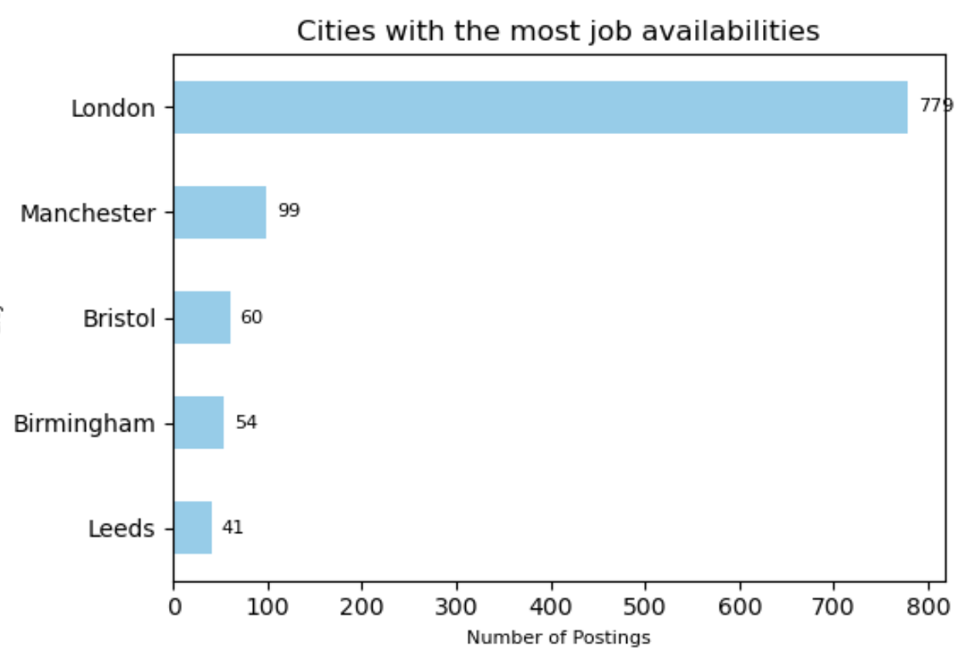

Slide 7
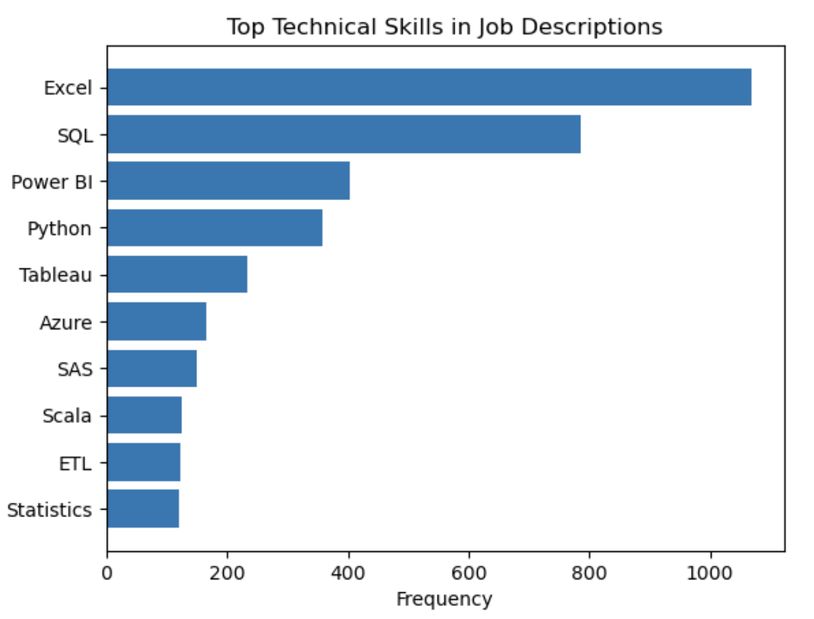
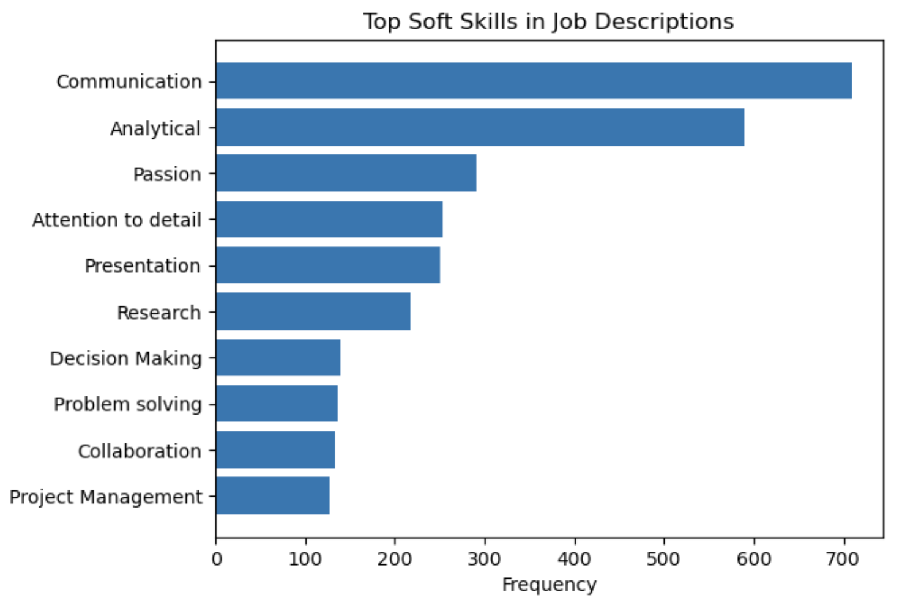
Top Job Skills for Data Roles
Figure 1
Figure 2

Slide 8
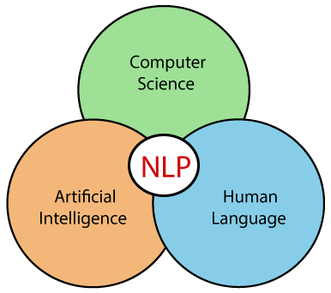
Modeling – Text Classification(NLP)
Aim
Model the relationship between the job description and the target variable high(1) or low(0) salary
Process
Models Tested
Use of Count Vectorizer to convert text data into a matrix of token counts
Use token counts as input to train a machine learning model for text classification
Naive Bayes, Logistic Regression, Support Vector Machines
Notes:
Text Classification is an automated process of classification of text into predefined categories. For example we can classify Emails into spam or non-spam.
This is a text classification problem with two classes, high (1) and low (0). The task involves predicting the class label (high or low) based on the text data (job description). In this case, we are using the text data as input features to make the binary classification prediction.
This can be done with the help of NLP.(Natural Language Processing). NLP allows us to convert the text we want to analyze and preprocess them into features to be put into our model. One of the methods we use to do this is called Count Vectorization. This involves counting the number of occurrences each words appears in a document.

Slide 9
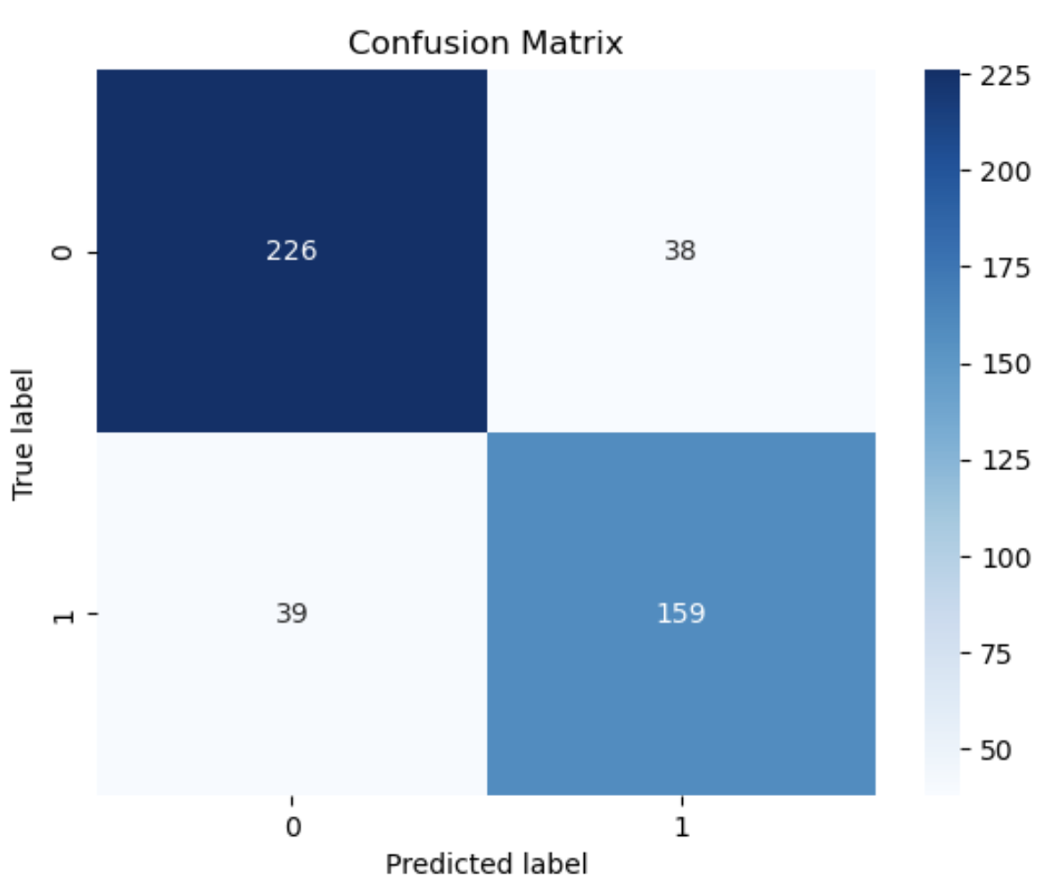
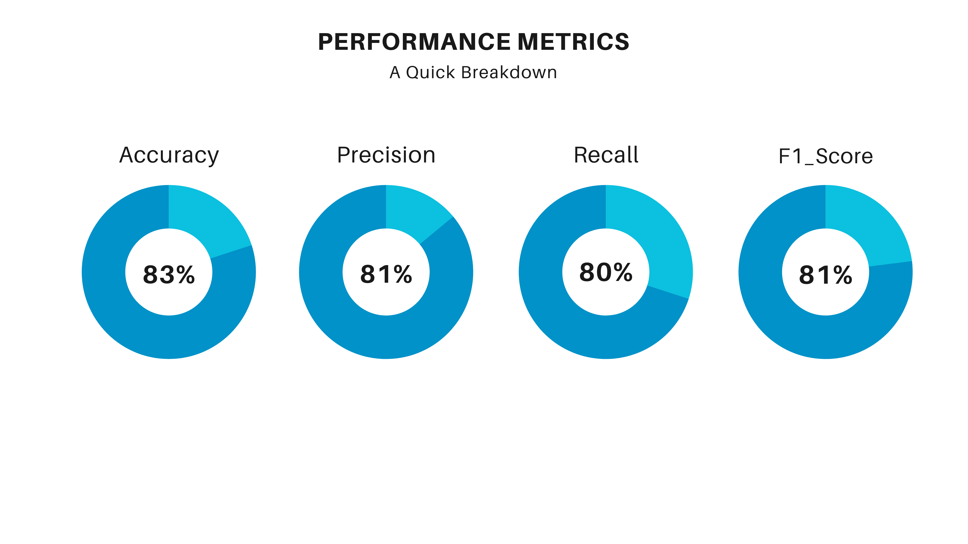
Model Evaluation – SVM High(1) vs Low(0) Salary
Notes:
Support Vector Machines an algorithm that determines the best decision boundary between vectors that belong to a given group (or category) and vectors that do not belong to it.

Slide 10
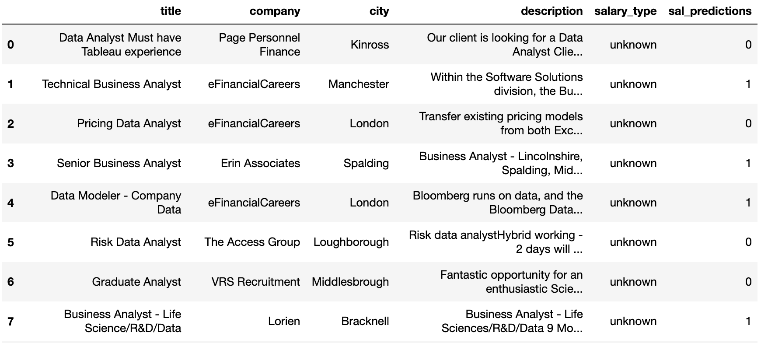
Salary Predictions Example (High 1 – 0 Low)
Notes:
Predicting salaries for unknown salary types.

Slide 11


THE END

