Slide 1


Signals & Systems For Computer Engineering
Prof.Dr. B.Berk ÜSTÜNDAĞ
Istanbul Technical University
Faculty of Computer Engineering and Informatics
BLG354E / CRN: 21615
6th Week Lecture (cont.)
2020
bustundag@itu.edu.tr
BLG354E / CRN: 21162
12th Week Lecture

Slide 2



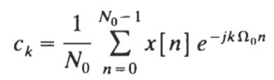
Fourier Analysis of Discrete-Time Signals and Systems
The Fourier analysis plays the same fundamental role in discrete time as in continuous time.
There are many similarities between the discrete-time Fourier analysis techniques and their continuous-time counterparts.
x[n] to be periodic if there is a positive integer N for which
ꓯn
Here, the fundamental period N₀ of x[n] is the smallest positive integer N
For the complex exponential DT signal
This differs between between the discrete-time and
the continuous- time complex exponential
(In contrary to the CT signals where e^{jω0t} are distinct for distinct values of ω₀ , the sequences e^{jΩ0n} are identical for multiples of 2π)
Discrete Fourier series representation of a periodic sequence x[n] with fundamental period N₀ is,
where the DT Fourier coefficients are
BLG354E - İTÜ Faculty of Computer Engineering and Informatics - Üstündağ

Slide 3
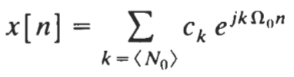
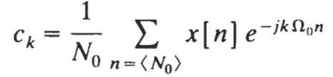
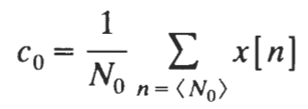
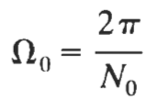

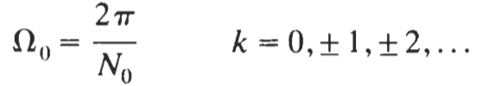
Fourier series representation can be rearranged as
where
since
for m=integer
because if
then
BLG354E - İTÜ Faculty of Computer Engineering and Informatics - Üstündağ

Slide 4

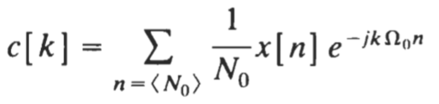

Properties of Discrete Fourier Series:
1- As different from the continuous-time Fourier Series, there are no convergence issues with discrete Fourier series (DFS) since DFS is a finite series
2- Fourier series coefficients c, are periodic with fundamental period N₀ →
3- Since the Fourier coefficients c_{k} form a periodic sequence with fundamental period N₀ , c[k] can be stated as
→
→
→
→ Duality
4- When x[n] is real:
5- If x[n] is real and even, then its Fourier coefficients are real, while if x[n] is odd, its Fourier coefficients are imaginary
→
BLG354E - İTÜ Faculty of Computer Engineering and Informatics - Üstündağ

Slide 5
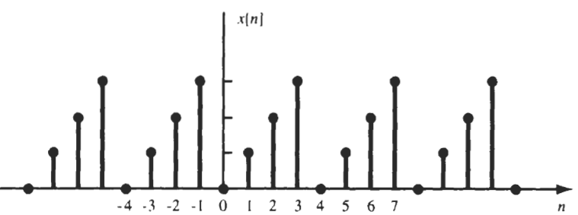


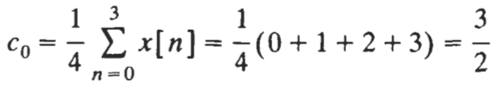

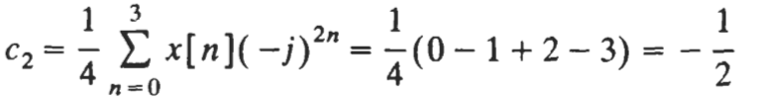
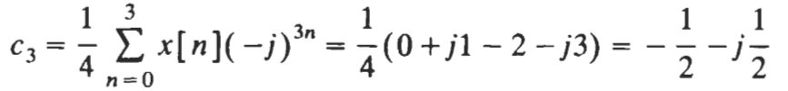

Example:
Find the Fourier coefficients for the periodic sequence x[n] shown below
3
2
1
→
Since x[n] is the periodic extension of {0,1,2,3} the fundamental period N₀= 4
→
BLG354E - İTÜ Faculty of Computer Engineering and Informatics - Üstündağ

Slide 6









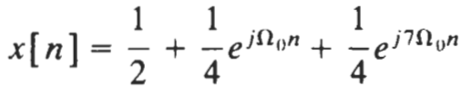
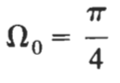
Example:
Determine the discrete Fourier series representation of
The fundamental period of x[n] is N₀= 8, Ω₀=2π/N₀= π/4 .
Reminder:
By the Euler's formula,
due to
→
ꓯ other
Discrete Fourier Series of x[n] :
BLG354E - İTÜ Faculty of Computer Engineering and Informatics - Üstündağ

Slide 7


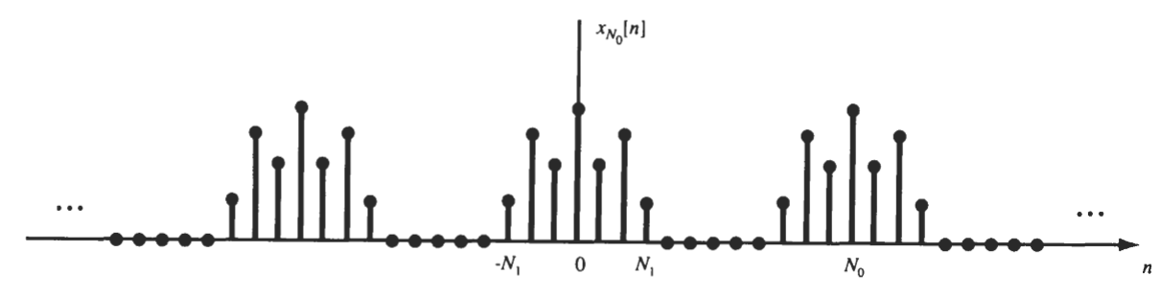
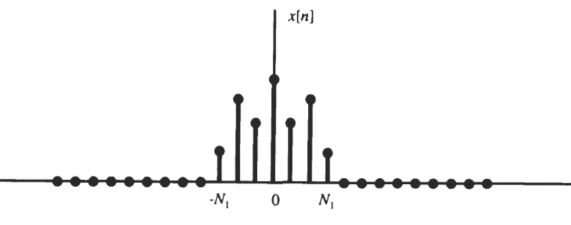

FOURIER TRANSFORM DISCRETE TIME SIGNALS
If x[n] is a periodic sequence then there will be a positive integer N₀ that satisfies x[n]=x[n+N₀]
Let x[n] be a nonperiodic sequence of finite duration.
for some positive integer N₁,
for
N₀→∞
BLG354E - İTÜ Faculty of Computer Engineering and Informatics - Üstündağ

Slide 8
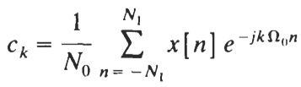
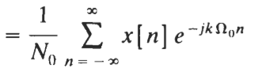
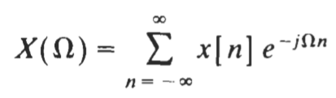
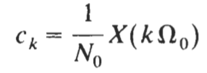
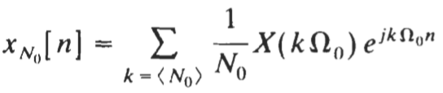
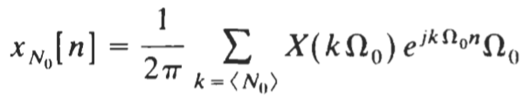
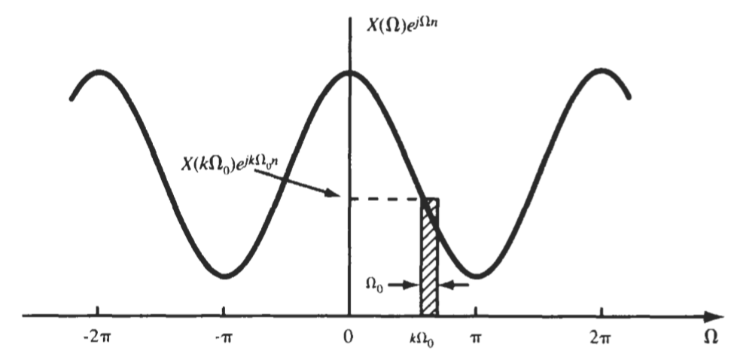


DFS of the periodic signal:
When N₀→∞ since
for
→
Let
then
is periodic with the period 2π
BLG354E - İTÜ Faculty of Computer Engineering and Informatics - Üstündağ

Slide 9
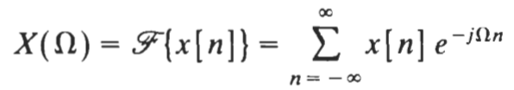
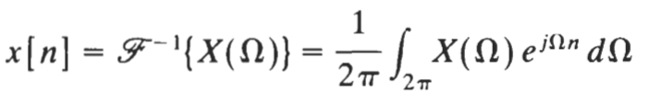

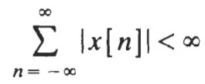

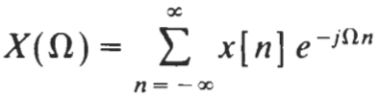


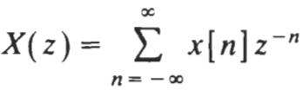




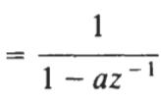
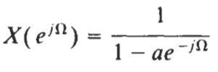





Properties of the Discrete Fourier Transform Pair
FT
Inverse FT
Fourier Spectra:
X(Ω) is convergent if
Magnitude spectrum
Phase spectrum
Z{δ[n]}=1 →
FT:
Z{u[n]}=
→
z-Transform:
Exception for u[n]:
ROC of Z{u[n]} does not
include unit circle
Z{a^{n}u[n]}
→
proof
BLG354E - İTÜ Faculty of Computer Engineering and Informatics - Üstündağ

Slide 10
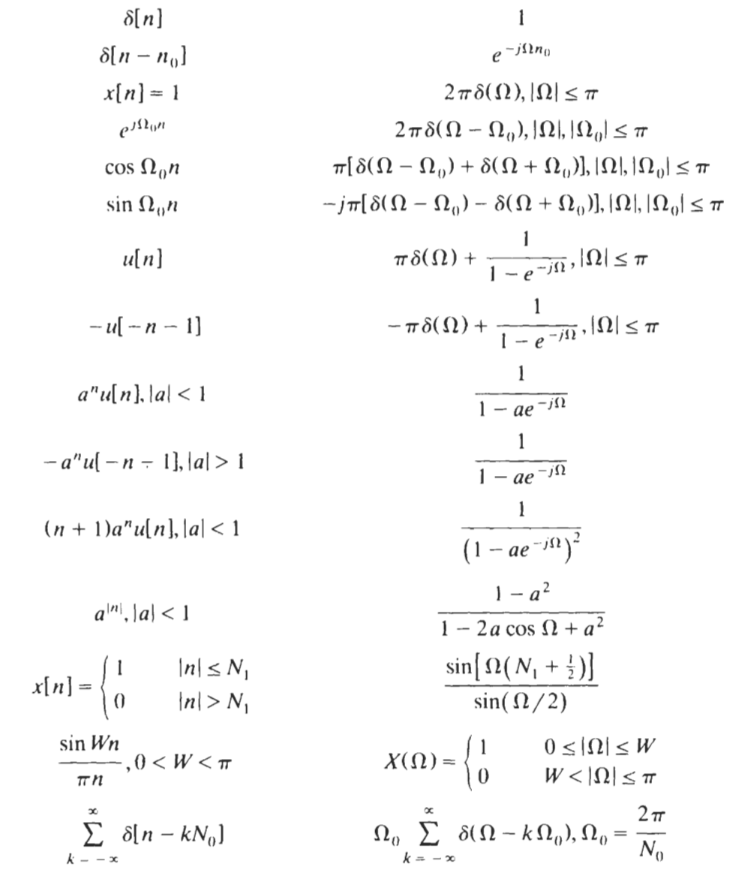
Common Fourier Transform Pairs
x[n]
X[Ω]
BLG354E - İTÜ Faculty of Computer Engineering and Informatics - Üstündağ

Slide 11
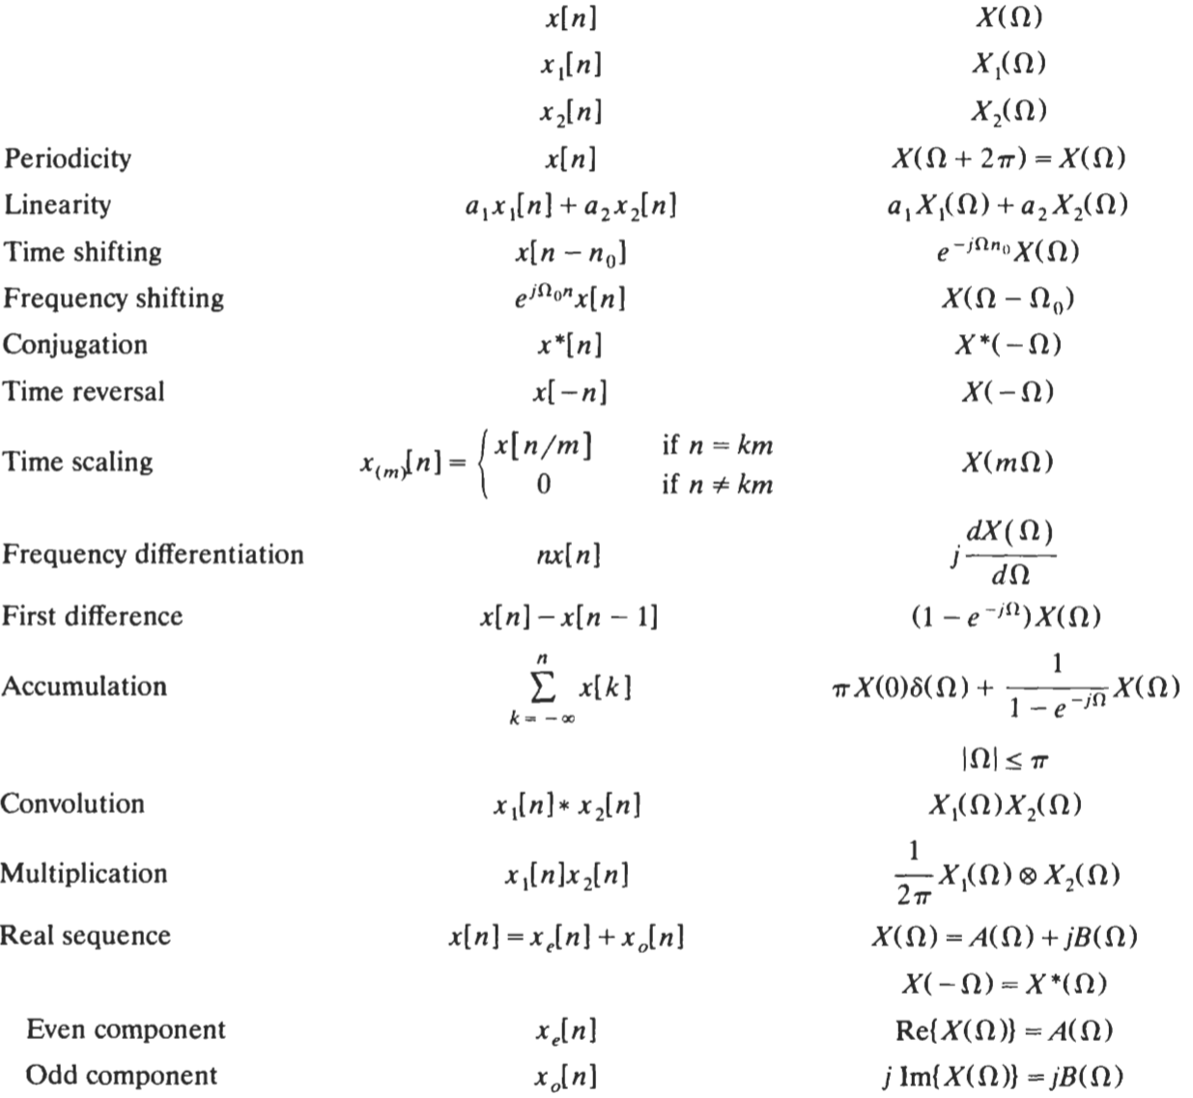
Fourier Transform Properties
Property
Sequence
Fourier Transform
BLG354E - İTÜ Faculty of Computer Engineering and Informatics - Üstündağ

Slide 12

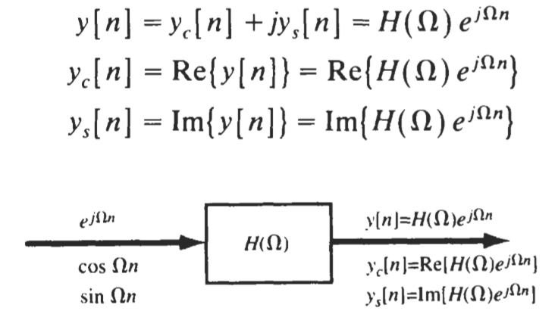

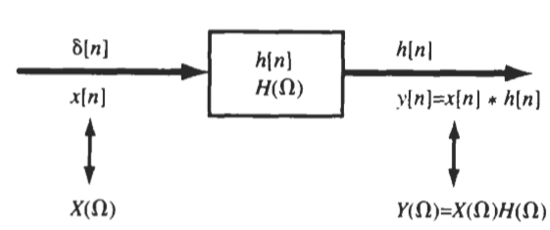





Frequency response of DT LTI systems
where
The complex exponential sequence e^{jΩ0n} is an eigenfunction of the LTI system with corresponding eigenvalue H(Ω₀)
BLG354E - İTÜ Faculty of Computer Engineering and Informatics - Üstündağ

Slide 13
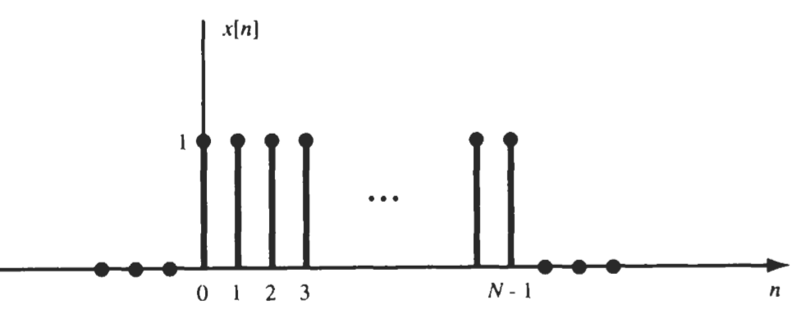

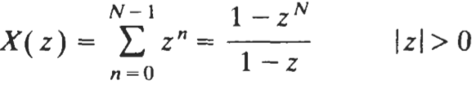
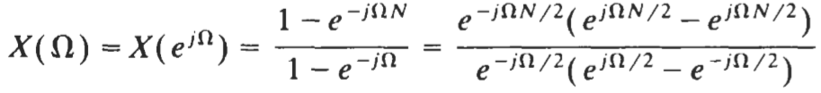
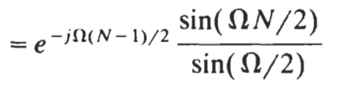
Example:
Find the Fourier transform of the rectangular pulse sequence x[n]
BLG354E - İTÜ Faculty of Computer Engineering and Informatics - Üstündağ

Slide 14

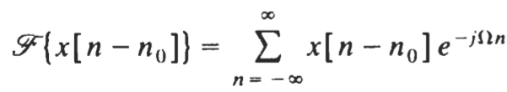
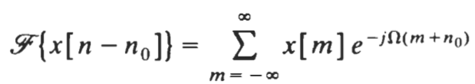
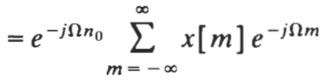


Prove the time-shifting property
By the change of variable m = n – n₀
Hence
BLG354E - İTÜ Faculty of Computer Engineering and Informatics - Üstündağ

Slide 15


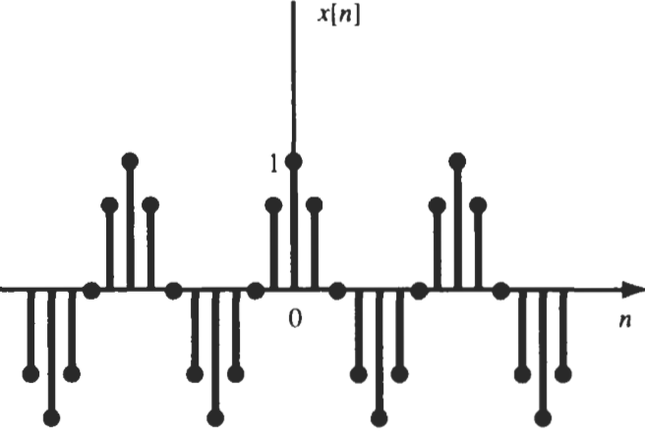


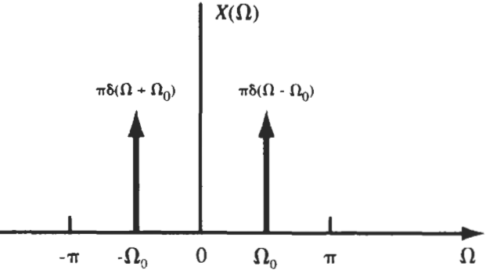

Example:
Find the Fourier transform of the sinusoidal sequence
BLG354E - İTÜ Faculty of Computer Engineering and Informatics - Üstündağ

Slide 16
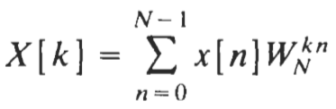


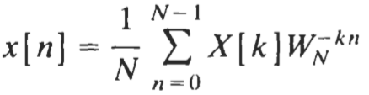


DISCRETE FOURIER TRANSFORM
The DFT is the appropriate Fourier representation for digital computer realization because it is discrete and of finite length in both the time and frequency domains.
Let x[n] be a finite-length sequence of length N, that is, x[n]=0 outside the range 0≤n≤ N-1
The DFT of x[n], denoted as X[k], is defined by
where W_{N} is the Nth root of unity given by
The inverse DFT (IDFT) is given by
DFT
* If x[n] has length N, < N, we want to assume that x[n] has length N by simply adding (N - Nl) samples with a value of 0. This addition of dummy samples is known as zero padding. Then the resultant x[n] is often referred to as an N-point sequence, and X[k] is referred to as an N-point DFT.
* Fast Fourier transform (FFT) is an extremely fast algorithm calculation of the DFT
BLG354E - İTÜ Faculty of Computer Engineering and Informatics - Üstündağ

Slide 17
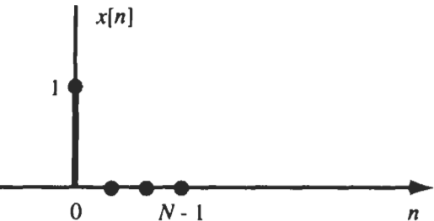

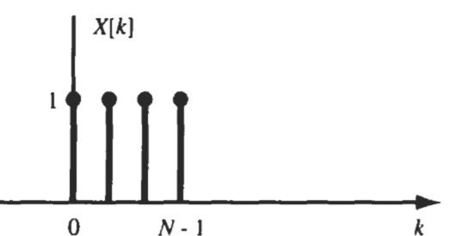
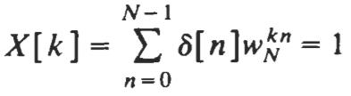


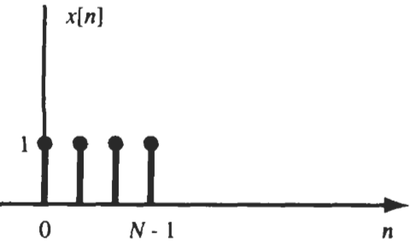
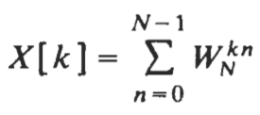
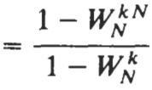







DFT of some common sequences:
By the definition,
BLG354E - İTÜ Faculty of Computer Engineering and Informatics - Üstündağ

Slide 18









Example:
Calculate the convolution
where
and
by using the circular convolution and DFT methods separately
For n=0,1,2,3
x[i] and h[n-i]_{mod4} sequences for n=0,1,2,3 can be plotted as shown below
BLG354E - İTÜ Faculty of Computer Engineering and Informatics - Üstündağ

Slide 19





Hence we get
BLG354E - İTÜ Faculty of Computer Engineering and Informatics - Üstündağ

Slide 20









By the DFT definition,
The DFT of y[n],
BLG354E - İTÜ Faculty of Computer Engineering and Informatics - Üstündağ

Slide 21










Matrix Representation of N-point DFT
The DFT definition
can be expressed in a matrix operation form as
DFT Matrix:
←Inverse DFT
BLG354E - İTÜ Faculty of Computer Engineering and Informatics - Üstündağ

Slide 22








Example:
Find the 4 points DFT of this signal if it is sampled at 4Hz
If we sample f(t) at 4Hz from t=0 to t=¾ then the values of the discrete samples can be given as,
→
BLG354E - İTÜ Faculty of Computer Engineering and Informatics - Üstündağ

Slide 23










Example:
x[n]={0, 1, 2, 3}
Show that IDFT of x[k] recovers DFT of x[k]
DFT of X*[k]
→
W₄
N=4
W₄⁻¹
BLG354E - İTÜ Faculty of Computer Engineering and Informatics - Üstündağ

Slide 24



import numpy as np
import matplotlib.pyplot as plt
def DFT(x): # To calculate DFT of a 1D real-valued signal x
N = len(x)
n = np.arange(N)
k = n.reshape((N, 1))
e = np.exp(-2j * np.pi * k * n / N)
X = np.dot(e, x)
return X
sr = 100 # sampling rate
ts = 1.0/sr # sampling interval
t = np.arange(0,1,ts)
freq = 1.
x = 2*np.sin(2*np.pi*freq*t-np.pi/3)
freq = 4
x += 0.5*np.sin(2*np.pi*freq*t)
freq = 8
x += 0.2*np.sin(2*np.pi*freq*t)
plt.figure(figsize = (8, 6))
plt.plot(t, x, 'r')
plt.ylabel('Amplitude')
plt.show()
Python code for DFT

Slide 25

X = DFT(x)
# calculate the frequency
N = len(X)
n = np.arange(N)
T = N/sr
freq = n/T
n_oneside = N//2
# get the one side frequency
f_oneside = freq[:n_oneside]
# normalize the amplitude
X_oneside =X[:n_oneside]/n_oneside
plt.figure(figsize = (12, 6))
plt.subplot(121)
plt.stem(f_oneside, abs(X_oneside), 'b', \
markerfmt=" ", basefmt="-b")
plt.xlabel('Freq (Hz)')
plt.ylabel('DFT Amplitude |X(freq)|')
plt.subplot(122)
plt.stem(f_oneside, abs(X_oneside), 'b', \
markerfmt=" ", basefmt="-b")
plt.xlabel('Freq (Hz)')
plt.xlim(0, 10)
plt.tight_layout()
plt.show()
For higher order DFT:

