Slide 1
Analysis of Algorithms II Recitation-6
Divide and Conquer Algorithms
Max_Min Algorithm
Time complexity of Max_Min Algorithm
Mergesort algorithm (counting inversions)
Time complexity of Mergesort

Slide 2
Divide-and-Conquer (D&C)
The design paradigm of D&C is that:
a problem is solved by (recursively) solving its smaller subproblems and
using the subsolutions to solve the original problem.
Divide
Conquer

Slide 3
Max_Min Algorithm using D&C approach
23 | 17 | -6 | 34 | 2 | 90 | 56 | 12 | 25 | -9 | 15
i
0 1 2 3 4 5 6 7 8 9 10
j
(i+j)/2
23 | 17 | -6 | 34 | 2 | 90
56 | 12 | 25 | -9 | 15
i
0 1 2 3 4 5
j
i
6 7 8 9 10
j
(i+j)/2
(i+j)/2
23 | 17 | -6
34 | 2 | 90
56 | 12 | 25
-9 | 15
i
9 10
j
23 | 17
-6
34 | 2
90
56 | 12
25
Divide
i
0 1
j
i
2
j
i
3 4
j
i
5
j
i
6 7
j
i
8
j

Slide 4
Max_Min Algorithm using D&C approach
Conquer
23 | 17
-6
34 | 2
90
56 | 12
25
-9 | 15
i
0 1
j
i
2
j
i
3 4
j
i
5
j
i
6 7
j
i
8
j
i
9 10
j
Max = 23
Min = 17
Max = -6
Min = -6
Max = 34
Min = 2
Max = 90
Min = 90
Max = 56
Min = 12
Max = 25
Min = 25
Max = 15
Min = -9
23 | 17 | -6
34 | 2 | 90
56 | 12 | 25
-9 | 15
Max = 23
Min = -6
Max = 90
Min = 2
Max = 56
Min = 12
Max = 15
Min = -9
23 | 17 | -6 | 34 | 2 | 90
56 | 12 | 25 | -9 | 15
Max = 90
Min = -6
Max = 56
Min = -9
23 | 17 | -6 | 34 | 2 | 90 | 56 | 12 | 25 | -9 | 15
Max = 90
Min = -9
Done

Slide 5
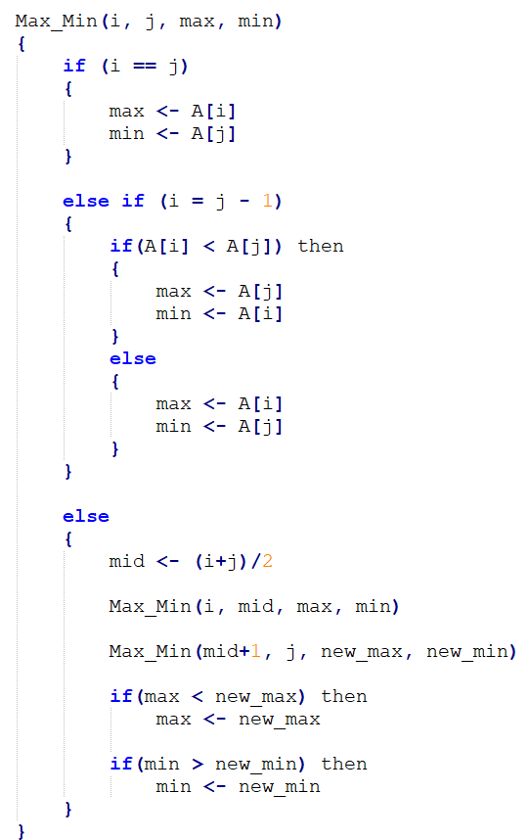
Analysis of the Max_Min Algorithm
What is the time complexity ?

Slide 6
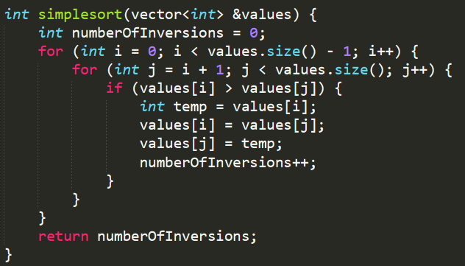
What does the algorithm below do?
What is the time complexity ?
myAlgorithm

Slide 7
Smarter Approach to Counting Inversions
RECAP: Mergesort Algorithm
mergeSort (arr[], l, r)
if l < r
1. Find the middle point to divide the array into two halves
middle m = (l+r)/2
2. Call mergeSort for the first half:
Call mergeSort(arr[], l, m)
3. Call mergeSort for the second half:
Call mergeSort(arr[], m+1, r)
4. Merge the two halves:
Call merge(l, m, r)
We will slightly modify the merge function to obtain the number of inversions.

Slide 8
Smarter Approach to Counting Inversions
1 | 20 | 6 | 7 | 5 | 8 | 11 | 3
Partition step
The numerical example is taken from https://www.youtube.com/watch?v=owZhw-A0yWE

Slide 9
Smarter Approach to Counting Inversions
1 | 20 | 6 | 7 | 5 | 8 | 11 | 3
Partition step
1 | 20 | 6 | 7
5 | 8 | 11 | 3
The numerical example is taken from https://www.youtube.com/watch?v=owZhw-A0yWE

Slide 10
Smarter Approach to Counting Inversions
1 | 20 | 6 | 7 | 5 | 8 | 11 | 3
Partition step
1 | 20 | 6 | 7
5 | 8 | 11 | 3
1 | 20
6 | 7
5 | 8
11 | 3
The numerical example is taken from https://www.youtube.com/watch?v=owZhw-A0yWE

Slide 11
Smarter Approach to Counting Inversions
1 | 20 | 6 | 7 | 5 | 8 | 11 | 3
Partition step
1 | 20 | 6 | 7
5 | 8 | 11 | 3
1 | 20
6 | 7
5 | 8
11 | 3
1
20
6
7
5
8
11
3
The numerical example is taken from https://www.youtube.com/watch?v=owZhw-A0yWE

Slide 12
Smarter Approach to Counting Inversions
1
20
6
7
5
8
11
3
Merging step
inversion_count = 0
i
j
is arr[i] > arr[j] ?
NO → no inversion needed
The numerical example is taken from https://www.youtube.com/watch?v=owZhw-A0yWE

Slide 13
Smarter Approach to Counting Inversions
1
20
6
7
5
8
11
3
Merging step
inversion_count = 0
i
j
is arr[i] > arr[j] ?
NO → no inversion needed
1 | 20
The numerical example is taken from https://www.youtube.com/watch?v=owZhw-A0yWE

Slide 14
Smarter Approach to Counting Inversions
1
20
6
7
5
8
11
3
Merging step
inversion_count = 0
i
j
is arr[i] > arr[j] ?
NO → no inversion needed
1 | 20
The numerical example is taken from https://www.youtube.com/watch?v=owZhw-A0yWE

Slide 15
Smarter Approach to Counting Inversions
1
20
6
7
5
8
11
3
Merging step
inversion_count = 0
i
j
is arr[i] > arr[j] ?
NO → no inversion needed
1 | 20
6 | 7
The numerical example is taken from https://www.youtube.com/watch?v=owZhw-A0yWE

Slide 16
Smarter Approach to Counting Inversions
1
20
6
7
5
8
11
3
Merging step
inversion_count = 0
i
j
is arr[i] > arr[j] ?
NO → no inversion needed
1 | 20
6 | 7
The numerical example is taken from https://www.youtube.com/watch?v=owZhw-A0yWE

Slide 17
Smarter Approach to Counting Inversions
1
20
6
7
5
8
11
3
Merging step
inversion_count = 0
i
j
is arr[i] > arr[j] ?
NO → no inversion needed
1 | 20
6 | 7
5 | 8
The numerical example is taken from https://www.youtube.com/watch?v=owZhw-A0yWE

Slide 18
Smarter Approach to Counting Inversions
1
20
6
7
5
8
11
3
Merging step
inversion_count = 0
i
j
is arr[i] > arr[j] ?
YES → inversion needed!
1 | 20
6 | 7
5 | 8
The numerical example is taken from https://www.youtube.com/watch?v=owZhw-A0yWE

Slide 19
Smarter Approach to Counting Inversions
1
20
6
7
5
8
11
3
Merging step
inversion_count = 1
i
j
is arr[i] > arr[j] ?
Increment this number by how many numbers are there after and including the current value of i.
→ Increment by 1.
YES → inversion needed!
1 | 20
6 | 7
5 | 8
3 | 11
The numerical example is taken from https://www.youtube.com/watch?v=owZhw-A0yWE

Slide 20
Smarter Approach to Counting Inversions
1
20
6
7
5
8
11
3
Merging step
inversion_count = 1
1 | 20
6 | 7
5 | 8
3 | 11
i
j
is arr[i] > arr[j] ?
NO → no inversion needed
The numerical example is taken from https://www.youtube.com/watch?v=owZhw-A0yWE

Slide 21
Smarter Approach to Counting Inversions
1
20
6
7
5
8
11
3
Merging step
inversion_count = 1
1 | 20
6 | 7
5 | 8
3 | 11
i
j
is arr[i] > arr[j] ?
NO → no inversion needed
1
i = i + 1
The numerical example is taken from https://www.youtube.com/watch?v=owZhw-A0yWE

Slide 22
Smarter Approach to Counting Inversions
1
20
6
7
5
8
11
3
Merging step
inversion_count = 1
1 | 20
6 | 7
5 | 8
3 | 11
i
j
is arr[i] > arr[j] ?
YES → inversion needed!
1
The numerical example is taken from https://www.youtube.com/watch?v=owZhw-A0yWE

Slide 23
Smarter Approach to Counting Inversions
1
20
6
7
5
8
11
3
Merging step
inversion_count = 2
1 | 20
6 | 7
5 | 8
3 | 11
i
j
Increment this number by how many numbers are there after and including the current value of i.
→ Increment by 1.
is arr[i] > arr[j] ?
YES → inversion needed!
1 | 6
j = j + 1
The numerical example is taken from https://www.youtube.com/watch?v=owZhw-A0yWE

Slide 24
Smarter Approach to Counting Inversions
1
20
6
7
5
8
11
3
Merging step
inversion_count = 2
1 | 20
6 | 7
5 | 8
3 | 11
i
j
is arr[i] > arr[j] ?
YES → inversion needed!
1 | 6
The numerical example is taken from https://www.youtube.com/watch?v=owZhw-A0yWE

Slide 25
Smarter Approach to Counting Inversions
1
20
6
7
5
8
11
3
Merging step
inversion_count = 3
1 | 20
6 | 7
5 | 8
3 | 11
i
j
Increment this number by how many numbers are there after and including the current value of i.
→ Increment by 1.
is arr[i] > arr[j] ?
YES → inversion needed!
1 | 6 | 7
j = j + 1
The numerical example is taken from https://www.youtube.com/watch?v=owZhw-A0yWE

Slide 26
Smarter Approach to Counting Inversions
1
20
6
7
5
8
11
3
Merging step
inversion_count = 3
1 | 20
6 | 7
5 | 8
3 | 11
i
j
j is in its maximum value, put what is left to i.
1 | 6 | 7
The numerical example is taken from https://www.youtube.com/watch?v=owZhw-A0yWE

Slide 27
Smarter Approach to Counting Inversions
1
20
6
7
5
8
11
3
Merging step
inversion_count = 3
1 | 20
6 | 7
5 | 8
3 | 11
i
j
j is in its maximum value, put what is left to i.
1 | 6 | 7 | 20
The numerical example is taken from https://www.youtube.com/watch?v=owZhw-A0yWE

Slide 28
Smarter Approach to Counting Inversions
1
20
6
7
5
8
11
3
Merging step
inversion_count = 3
1 | 20
6 | 7
5 | 8
3 | 11
i
j
is arr[i] > arr[j] ?
YES → inversion needed!
The numerical example is taken from https://www.youtube.com/watch?v=owZhw-A0yWE

Slide 29
Smarter Approach to Counting Inversions
1
20
6
7
5
8
11
3
Merging step
inversion_count = 5
1 | 20
6 | 7
5 | 8
3 | 11
i
j
Increment this number by how many numbers are there after and including the current value of i.
→ Increment by 2.
is arr[i] > arr[j] ?
YES → inversion needed!
3
j = j + 1
The numerical example is taken from https://www.youtube.com/watch?v=owZhw-A0yWE

Slide 30
Smarter Approach to Counting Inversions
1
20
6
7
5
8
11
3
Merging step
inversion_count = 5
1 | 20
6 | 7
5 | 8
3 | 11
i
j
is arr[i] > arr[j] ?
NO → no inversion needed
3
The numerical example is taken from https://www.youtube.com/watch?v=owZhw-A0yWE

Slide 31
Smarter Approach to Counting Inversions
1
20
6
7
5
8
11
3
Merging step
inversion_count = 5
1 | 20
6 | 7
5 | 8
3 | 11
i
j
is arr[i] > arr[j] ?
NO → no inversion needed
3 | 5
i = i + 1
The numerical example is taken from https://www.youtube.com/watch?v=owZhw-A0yWE

Slide 32
Smarter Approach to Counting Inversions
1
20
6
7
5
8
11
3
Merging step
inversion_count = 5
1 | 20
6 | 7
5 | 8
3 | 11
i
j
is arr[i] > arr[j] ?
NO → no inversion needed
3 | 5
The numerical example is taken from https://www.youtube.com/watch?v=owZhw-A0yWE

Slide 33
Smarter Approach to Counting Inversions
1
20
6
7
5
8
11
3
Merging step
inversion_count = 5
1 | 20
6 | 7
5 | 8
3 | 11
i
j
is arr[i] > arr[j] ?
NO → no inversion needed
3 | 5 | 8
i = i + 1
The numerical example is taken from https://www.youtube.com/watch?v=owZhw-A0yWE

Slide 34
Smarter Approach to Counting Inversions
1
20
6
7
5
8
11
3
Merging step
inversion_count = 5
1 | 20
6 | 7
5 | 8
3 | 11
i
j
i is in its maximum value, put what is left to j.
3 | 5 | 8 | 11
The numerical example is taken from https://www.youtube.com/watch?v=owZhw-A0yWE

Slide 35
Smarter Approach to Counting Inversions
1
20
6
7
5
8
11
3
Merging step
inversion_count = 5
1 | 20
6 | 7
5 | 8
3 | 11
1 | 6 | 7 | 20
3 | 5 | 8 | 11
i
j
is arr[i] > arr[j] ?
NO → no inversion needed
The numerical example is taken from https://www.youtube.com/watch?v=owZhw-A0yWE

Slide 36
Smarter Approach to Counting Inversions
1
20
6
7
5
8
11
3
Merging step
inversion_count = 5
1 | 20
6 | 7
5 | 8
3 | 11
1 | 6 | 7 | 20
3 | 5 | 8 | 11
i
j
is arr[i] > arr[j] ?
NO → no inversion needed
1
i = i + 1
The numerical example is taken from https://www.youtube.com/watch?v=owZhw-A0yWE

Slide 37
Smarter Approach to Counting Inversions
1
20
6
7
5
8
11
3
Merging step
inversion_count = 5
1 | 20
6 | 7
5 | 8
3 | 11
1 | 6 | 7 | 20
3 | 5 | 8 | 11
i
j
is arr[i] > arr[j] ?
YES → inversion needed!
1
The numerical example is taken from https://www.youtube.com/watch?v=owZhw-A0yWE

Slide 38
Smarter Approach to Counting Inversions
1
20
6
7
5
8
11
3
Merging step
inversion_count = 8
1 | 20
6 | 7
5 | 8
3 | 11
1 | 6 | 7 | 20
3 | 5 | 8 | 11
Increment this number by how many numbers are there after and including the current value of i.
→ Increment by 3.
i
j
is arr[i] > arr[j] ?
YES → inversion needed!
1 | 3
j = j + 1
The numerical example is taken from https://www.youtube.com/watch?v=owZhw-A0yWE

Slide 39
Smarter Approach to Counting Inversions
1
20
6
7
5
8
11
3
Merging step
inversion_count = 8
1 | 20
6 | 7
5 | 8
3 | 11
1 | 6 | 7 | 20
3 | 5 | 8 | 11
i
j
is arr[i] > arr[j] ?
YES → inversion needed!
1 | 3
The numerical example is taken from https://www.youtube.com/watch?v=owZhw-A0yWE

Slide 40
Smarter Approach to Counting Inversions
1
20
6
7
5
8
11
3
Merging step
inversion_count = 11
1 | 20
6 | 7
5 | 8
3 | 11
1 | 6 | 7 | 20
3 | 5 | 8 | 11
Increment this number by how many numbers are there after and including the current value of i.
→ Increment by 3.
i
j
is arr[i] > arr[j] ?
YES → inversion needed!
1 | 3 | 5
j = j + 1
The numerical example is taken from https://www.youtube.com/watch?v=owZhw-A0yWE

Slide 41
Smarter Approach to Counting Inversions
1
20
6
7
5
8
11
3
Merging step
inversion_count = 11
1 | 20
6 | 7
5 | 8
3 | 11
1 | 6 | 7 | 20
3 | 5 | 8 | 11
i
j
is arr[i] > arr[j] ?
NO → no inversion needed
1 | 3 | 5
The numerical example is taken from https://www.youtube.com/watch?v=owZhw-A0yWE

Slide 42
Smarter Approach to Counting Inversions
1
20
6
7
5
8
11
3
Merging step
inversion_count = 11
1 | 20
6 | 7
5 | 8
3 | 11
1 | 6 | 7 | 20
3 | 5 | 8 | 11
i
j
is arr[i] > arr[j] ?
NO → no inversion needed
1 | 3 | 5 | 6
i = i + 1
The numerical example is taken from https://www.youtube.com/watch?v=owZhw-A0yWE

Slide 43
Smarter Approach to Counting Inversions
1
20
6
7
5
8
11
3
Merging step
inversion_count = 11
1 | 20
6 | 7
5 | 8
3 | 11
1 | 6 | 7 | 20
3 | 5 | 8 | 11
i
j
is arr[i] > arr[j] ?
NO → no inversion needed
1 | 3 | 5 | 6
The numerical example is taken from https://www.youtube.com/watch?v=owZhw-A0yWE

Slide 44
Smarter Approach to Counting Inversions
1
20
6
7
5
8
11
3
Merging step
inversion_count = 11
1 | 20
6 | 7
5 | 8
3 | 11
1 | 6 | 7 | 20
3 | 5 | 8 | 11
i
j
is arr[i] > arr[j] ?
NO → no inversion needed
1 | 3 | 5 | 6 | 7
i = i + 1
The numerical example is taken from https://www.youtube.com/watch?v=owZhw-A0yWE

Slide 45
Smarter Approach to Counting Inversions
1
20
6
7
5
8
11
3
Merging step
inversion_count = 11
1 | 20
6 | 7
5 | 8
3 | 11
1 | 6 | 7 | 20
3 | 5 | 8 | 11
i
j
is arr[i] > arr[j] ?
YES → inversion needed!
1 | 3 | 5 | 6 | 7
The numerical example is taken from https://www.youtube.com/watch?v=owZhw-A0yWE

Slide 46
Smarter Approach to Counting Inversions
1
20
6
7
5
8
11
3
Merging step
inversion_count = 12
1 | 20
6 | 7
5 | 8
3 | 11
1 | 6 | 7 | 20
3 | 5 | 8 | 11
Increment this number by how many numbers are there after and including the current value of i.
→ Increment by 1.
i
j
is arr[i] > arr[j] ?
YES → inversion needed!
1 | 3 | 5 | 6 | 7 | 8
j = j + 1
The numerical example is taken from https://www.youtube.com/watch?v=owZhw-A0yWE

Slide 47
Smarter Approach to Counting Inversions
1
20
6
7
5
8
11
3
Merging step
inversion_count = 12
1 | 20
6 | 7
5 | 8
3 | 11
1 | 6 | 7 | 20
3 | 5 | 8 | 11
i
j
is arr[i] > arr[j] ?
YES → inversion needed!
1 | 3 | 5 | 6 | 7 | 8
The numerical example is taken from https://www.youtube.com/watch?v=owZhw-A0yWE

Slide 48
Smarter Approach to Counting Inversions
1
20
6
7
5
8
11
3
Merging step
inversion_count = 13
1 | 20
6 | 7
5 | 8
3 | 11
1 | 6 | 7 | 20
3 | 5 | 8 | 11
Increment this number by how many numbers are there after and including the current value of i.
→ Increment by 1.
i
j
is arr[i] > arr[j] ?
YES → inversion needed!
1 | 3 | 5 | 6 | 7 | 8 | 11
j = j + 1
The numerical example is taken from https://www.youtube.com/watch?v=owZhw-A0yWE

Slide 49
Smarter Approach to Counting Inversions
1
20
6
7
5
8
11
3
Merging step
inversion_count = 13
1 | 20
6 | 7
5 | 8
3 | 11
1 | 6 | 7 | 20
3 | 5 | 8 | 11
i
j
is arr[i] > arr[j] ?
j is in its maximum value, put what is left to i.
1 | 3 | 5 | 6 | 7 | 8 | 11 | 20
The numerical example is taken from https://www.youtube.com/watch?v=owZhw-A0yWE

Slide 50
Smarter Approach to Counting Inversions
1
20
6
7
5
8
11
3
Merging step
1 | 20
6 | 7
5 | 8
3 | 11
1 | 6 | 7 | 20
3 | 5 | 8 | 11
1 | 3 | 5 | 6 | 7 | 8 | 11 | 20
inversion_count = 13
The numerical example is taken from https://www.youtube.com/watch?v=owZhw-A0yWE

Slide 51
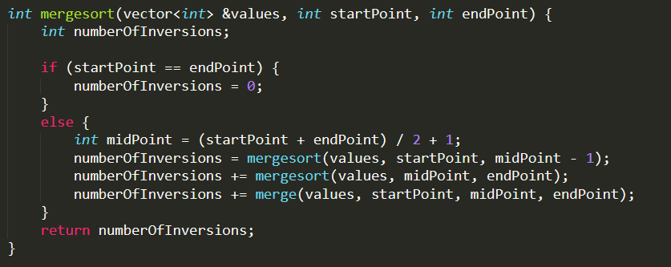

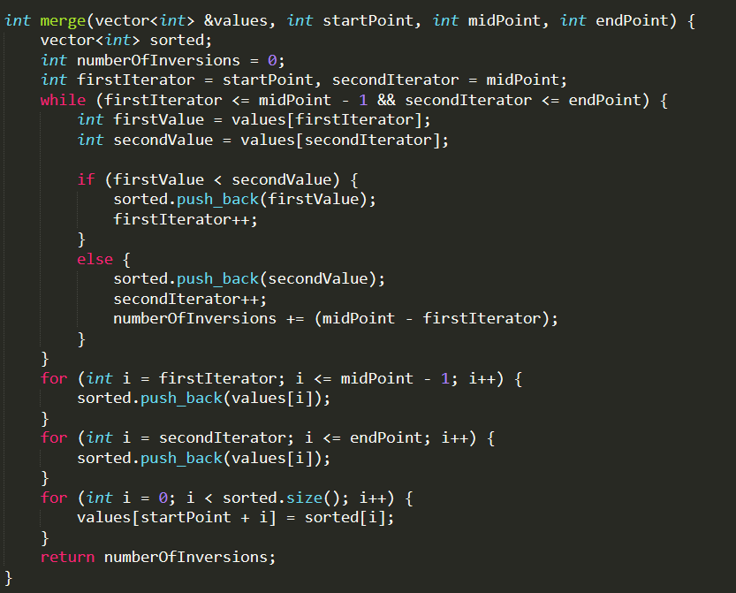
Smarter approach (divide&conquer)
What is the time complexity ?

Slide 52
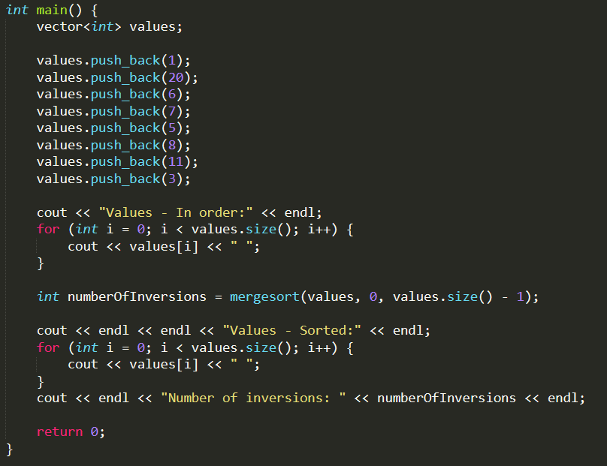
Smarter Approach to Counting Inversions
Let’s see the code.
1 | 20 | 6 | 7 | 5 | 8 | 11 | 3
The array
Starting index
Final index
The numerical example is taken from https://www.youtube.com/watch?v=owZhw-A0yWE

Slide 53
Smarter Approach to Counting Inversions
Let’s see the code.
Base condition of the recursion

Slide 54
Smarter Approach to Counting Inversions
Let’s see the code.
Finding the middle point

Slide 55
Smarter Approach to Counting Inversions
Let’s see the code.
Recursive calls for both halves of the array

Slide 56
Smarter Approach to Counting Inversions
Let’s see the code.
Recursive calls for both halves of the array
This is the partition step.

Slide 57
Smarter Approach to Counting Inversions
Let’s see the code.
Merging two subarrays.

Slide 58
Smarter Approach to Counting Inversions
Let’s see the code.
Temporary array for the sorted values

Slide 59
Smarter Approach to Counting Inversions
Let’s see the code.
firstIterator = i
secondIterator = j

Slide 60
Smarter Approach to Counting Inversions
Let’s see the code.
while:
i <= midpoint
j <= endpoint

Slide 61
Smarter Approach to Counting Inversions
Let’s see the code.
firstValue = arr[i]
secondValue = arr[j]

Slide 62
Smarter Approach to Counting Inversions
Let’s see the code.
if arr[i] < arr[j]:
no inversion needed
i = i +1

Slide 63
Smarter Approach to Counting Inversions
Let’s see the code.
if arr[i] > arr[j]:
inversion needed
j = j +1
numberOfInversions +=
how many numbers are there after and including the current value of i
(=midpoint – i)

Slide 64
Smarter Approach to Counting Inversions
Let’s see the code.
j is in its maximum value, put what is left to i.
i is in its maximum value, put what is left to j.

Slide 65
Smarter Approach to Counting Inversions
Let’s see the code.
Copy the contents of temporary array to the original array

Slide 66
Thank you..
Any questions ?
Contact me ayvaz18@itu.edu.tr

