Slide 1
Processes and Process Management

Slide 2
Processes
multiple jobs may be active at the same time
each job may be a different running program
⇒PROCESS

Slide 3
What is a Process?
Definition:
A process is a sequence of actions resulting from a run of a sequential program written for a specific function.
process ⇔ task

Slide 4
What is a Process?
process = a running program
a process consists of a
  sequential program code,
  program counter,
  register contents,
  and variables.

Slide 5
What is a Process?
more than one process for one program
through system calls, processes
  use system resources
  communicate with each other
  communicate with the world

Slide 6
Program ⇔ Process
Example: A programmer bakes a cake using a recipe.
    recipe → program
    ingredients → inputs
    programmer → processor
  Process → programmer reads recipe, obtains ingredients, performs necessary operations.

Slide 7
Program ⇔ Process
(example cntd.) His son enters the kitchen shouting that a bee has stung him. Programmer marks where he left off on the recipe, stops what he is doing, picks up the first aid book and starts the necessary treatment on his son.
    treatment method → program
    medicines → inputs
    programmer → processor
  Process → applying first aid using the treatment given in the book

Slide 8
Program ⇔ Process
(example cntd.)
Result: processor shared by two processes in time (time-sharing)
the process which will have the processor is determined through an algorithm

Slide 9
Processes
only one processor in system
time-sharing operation
  quantum
only one of each system register
  program counter, stack pointer, condition code register, general purpose registers, index register, ...
⇒ How is time-sharing achieved?

Slide 10
Time-Sharing
processes
D
C
B
A
time

Slide 11
Time-Sharing
cannot predict when a process will have the processor
  no time dependent operations in program code!

Slide 12
Time-Sharing
Example: what can be said about the contents of file_A and file_B?
read
read
Process B
Process A
file
write
write
file_A
file_B

Slide 13
Time-Sharing
process
  RUNNING ⇒ has processor
  NOT RUNNING ⇒ does not have processor
run
not running
running
end
start
wait
Question: Why would a process wait?

Slide 14
Process States
processes are in different states throughout their lifetimes
basic three states
  running: is using processor
  ready: can use processor when it gets it
  suspended: waits for an event; cannot use processor even if it gets it

Slide 15
Process States
end
running
1
3
2
ready
suspended
4
start

Slide 16
Process States
new process
ready queue
processor
end
suspended queue
Question: is ONE queue sufficient?

Slide 17
Process States
new process
ready queue
processor
end
event 1 queue
event 2 queue
event n queue

Slide 18
Implementing Processes
operating system keeps info on all entities it manages
  a different table for each
    I/O tables
    memory tables
    file tables
    proces tables

Slide 19
Implementing Processes
Process Table
image of process 1
Process 1
Process 2
image of process 2
image of process n
Process n

Slide 20
Implementing Processes
Image of Process
process id (pid)
Process
Control
Block
(PCB)
processor state
process control info
user stack
Process
Components
private user address space
(program and data blocks )
shared address space

Slide 21
Implementing Processes
info regarding process in process descriptor field
  process control block – PCB
    data that holds info on process
all operations on process through PCB
  must have fast access to PCB
    in some systems through a hardware register
    in some systems special instructions to access PCB

Slide 22
Process Control Block (PCB)
process identification info
  process id
  id of process’ parent process
  owner of process
current state of process and event it waits for (if any)
priority of process
scheduling info

Slide 23
Process Control Block (PCB)
pointers to resources used by process
  e.g. open files
pointer to virtual memory allocated to process
area where contents of system registers and user accessible (through machine code instructions) processor registers are stored
  general purpose registers, program counter, condition code register, index register, stack pointer, ......
    ⇒ processor context

Slide 24
Operations on Processes
create process
  in UNIX type systems only another process creates a process
  a hierarchy among processes
  creator process: parent proses
  created process: child proses
  a process may create multiple child processes

Slide 25
Operations on Processes
A
B
C
D
E
F
G

Slide 26
Operations on Processes
  when a process is created:
    if process table full, process NOT created
    if process table entry available,
      process is assigned a unique id
      process is assigned initial priorities
      PCB is created and initialized
      initial resources assigned (memory etc)
      process is added to ready queue

Slide 27
Operations on Processes
destroy a process
  process removed from system
  resources returned to system
  pid returned to system
  PCB and process table entry deleted
  necesssary operations on children performed
    either keep entry until all children exit
    or children assigned to another parent
      e.g. in UNIX to the init process (pid=1)

Slide 28
Operations on Processes
suspend a process
  for short term suspension, resources not removed
  for long term suspension, depending on resources, some may be removed
resume a process
  to resume operation of a process from where it left off in its previous execution
change priority of a process

Slide 29
Steps Performed during a Process State Change
processor context saved
PCB of running process updated
running process added to appropriate queue (ready / suspended)
new process to run determined
PCB of selected process updated
info on memory management updated
context of selected process loaded onto registers

Slide 30
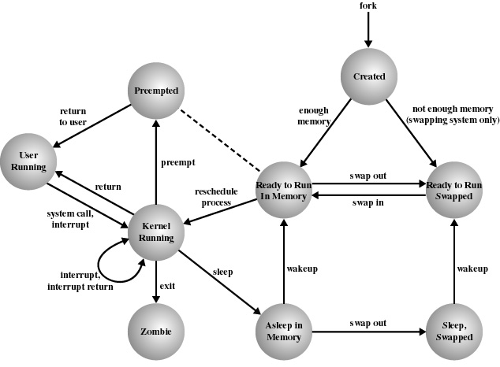
Process States in UNIX

Slide 31
Process Creation in UNIX
fork system call
  parent process
  child process
syntax: pid=fork()
  both processes have same context
  returns pid of child to parent process
  returns 0 to child process
process no. 0 is the only process not created using fork

Slide 32
Process Creation in UNIX
when fork system call is made:
  if possible, reserve entry in process table (max no of processes)
  assign unique pid to child process
  make a copy of the context of the parent process
  file access counters modified
  return child pid to parent process and 0 to child process

Slide 33
Process Hierarchy in UNIX
process 0
process 1 (INIT)
tty1 tty2 …..
other system processes
login
shell
user processes

Slide 34
Exit System Call
ends execution of process
syntax: exit(status)
  “status” returned to parent process
all resources returned
file access counters modified
process table entry deleted
when a parent process exits all its children are assigned the init process as a parent (process no 1)

Slide 35
Sample program code - 1
#include <unistd.h>
#include <stdio.h>
#include <stdlib.h>
int f;
int main (void)
{
printf("\n Program running: PID=%d \n",
getpid());
f=fork();

Slide 36
Sample program code - 2
if (f==0) /*child*/
{
printf("\nChild process: my pid = %d\n",
getpid());
printf(“Child process: my parent pid = %d\n”,
getppid());
sleep(2);
exit(0):
}

Slide 37
Sample program code - 3
else /* parent */
{
printf("\nParent process: my pid = %d\n",
getpid());
printf(“Parent process: my parent pid = %d\n”,
getppid());
printf(“Pranet process: my child’s pid = %d\n”,
f);
sleep(2);
exit(0):
}
return(0);
}

