Slide 1
NUMERICAL METHODS Week-2 19.02.2013 Error Analysis and Number Representations Asst. Prof. Dr. Berk Canberk

Slide 2
Error Analysis
Why do we measure?
What do we measure?
How do we measure?

Slide 3
Why do we measure errors?
1) To determine the accuracy of numerical results.
2) To develop stopping criteria for iterative algorithms.

Slide 4
What do we measure? →Two sources of numerical errors
Round off error
Truncation error
It is caused by representing a number approximately.
Error caused by truncating or approximating a mathematical procedure.

Slide 5
How do we measure errors? →Error Types
True Error
Relative True Error
Approximate Error
Relative Approximate Error

Slide 6
True Error
The difference between the true value in a calculation and the approximate value found using a numerical method.
True Error = True Value – Approximate Value

Slide 7
Example—True Error
The derivative,
of a function
can be
approximated by the equation,
If
and
a) Find the approximate value of
b) True value of
c) True error for part (a)

Slide 8
Example (cont.)
Solution:
a) For
and

Slide 9
Example (cont.)
Solution:
b) The exact value of
can be found by using
our knowledge of differential calculus.
So the true value of
is
True error is calculated as
True Value – Approximate Value

Slide 10
Relative True Error
Defined as the ratio between the true error, and the true value.
True Error
Relative True Error (
) =
True Value

Slide 11
Example—Relative True Error
Following from the previous example for true error,
find the relative true error for
at
with
From the previous example,
Relative True Error is defined as
as a percentage,

Slide 12
Approximate Error
What can be done if true values are not known or are very difficult to obtain?
Approximate error is defined as the difference between the present approximation and the previous approximation.
Approximate Error (
) = Present Approximation – Previous Approximation

Slide 13
Example—Approximate Error
For
at
find the following,
a)
using
b)
using
c) approximate error for the value of
for part b)
Solution:
a) For
and

Slide 14
Example (cont.)
Solution: (cont.)
b) For
and

Slide 15
Example (cont.)
Solution: (cont.)
c) So the approximate error,
is
Present Approximation – Previous Approximation

Slide 16
Relative Approximate Error
Defined as the ratio between the approximate error and the present approximation.
Approximate Error
Relative Approximate Error (
) =
Present Approximation

Slide 17
Example—Relative Approximate Error
For
at
, find the relative approximate
error using values from
and
Solution:
From Example 3, the approximate value of
using
and
using
Present Approximation – Previous Approximation

Slide 18
Example (cont.)
Solution: (cont.)
Approximate Error
Present Approximation
as a percentage,
Absolute relative approximate errors may also need to be calculated,

Slide 19
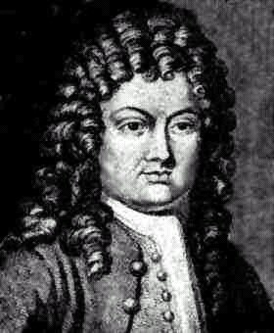
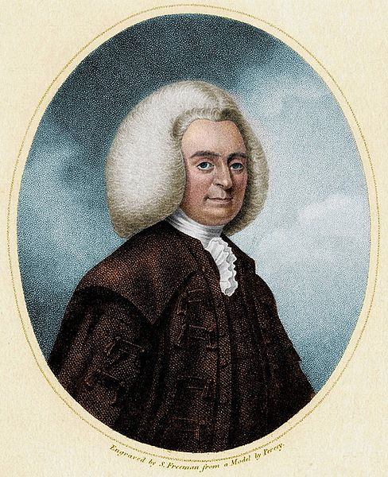
Taylor & Maclaurin Series (Revisited)
Brook Taylor(1685-1731)
Colin Maclaurin (1698–1746)

Slide 20
What is a Taylor series?
Some examples of Taylor series which you must have seen
What does this mean in plain English?
As Archimedes would have said, “Give me the value of the function at a single point, and the value of all (first, second, and so on) its derivatives at that single point, and I can give you the value of the function at any other point”

Slide 21
General Taylor Series
The general form of the Taylor series is given by
provided that all derivatives of f(x) are continuous and exist in the interval [x,x+h]

Slide 22
Example—Taylor Series
Find the value of
given that
and all other higher order derivatives
of
at
are zero.
Solution:

Slide 23
Example (cont.)
Solution: (cont.)
Since the higher order derivatives are zero,
Note that to find
exactly, we only need the value
of the function and all its derivatives at some other point, in this case

Slide 24
Derivation for Maclaurin Series for e^{x}
Derive the Maclaurin series
The Maclaurin series is simply the Taylor series about the point x=0

Slide 25
Derivation (cont.)
Since
and
the Maclaurin series is then
So,

Slide 26
Binary Representation

Slide 27
Two conversion types..
Binary→ Decimal
Decimal→Binary

Slide 28
How a Decimal Number is Represented

Slide 29
Base 2

Slide 30
Convert Base 10 Integer to binary representation
Table 1 Converting a base-10 integer to binary representation.
 | Quotient | Remainder
11/2 | 5
5/2 | 2
2/2 | 1
1/2 | 0
Hence

Slide 31
Start
Input (N)₁₀
Integer N to be converted to binary format
i = 0
Divide N by 2 to get quotient Q & remainder R
i=i+1,N=Q
a_{i} = R
No
Is Q = 0?
Yes
n = i
(N)₁₀ = (a_{n}. . .a₀)₂
STOP

Slide 32
Fractional Decimal Number to Binary
Table 2. Converting a base-10 fraction to binary representation.
 | Number | Number after decimal | Number before decimal
 | 0.375 | 0.375
 | 0.75 | 0.75
 | 1.5 | 0.5
 | 1.0 | 0.0
Hence
Notes:
THG picture

Slide 33
Start
Input (F)₁₀
Fraction F to be converted to binary format
Multiply F by 2 to get number before decimal, S and after decimal, T
a_{i} = R
No
Is T =0?
Yes
n = i
(F)₁₀ = (a₋₁. . .a_{-n})₂
STOP

Slide 34
Decimal Number to Binary
Since
and
we have

Slide 35
Another Way to Look at Conversion
Convert to base 2

Slide 37
All Fractional Decimal Numbers Cannot be Represented Exactly
Table 3. Converting a base-10 fraction to approximate binary representation.
 | Number | Number after decimal | Number before Decimal
 | 0.6 | 0.6
 | 1.2 | 0.2
 | 0.4 | 0.4
 | 0.8 | 0.8
 | 1.6 | 0.6
What is the true error and appx error??

Slide 38
Floating Point Representation

Slide 39
Floating Decimal Point : Scientific Form

Slide 40
Example
The form is
or
Example:

Slide 41
Floating Point Format for Binary Numbers
1 is not stored as it is always given to be 1.

Slide 42
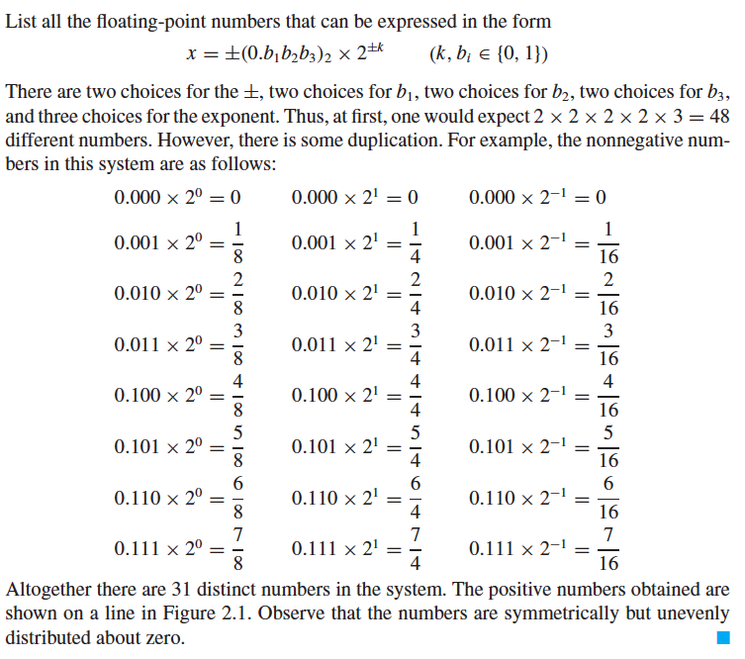

Slide 43
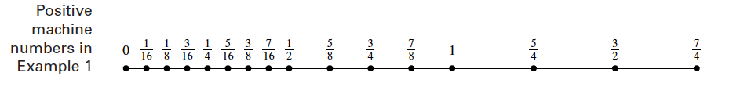
Figure 2.1

Slide 44
Example
9 bit-hypothetical word
the first bit is used for the sign of the number,
the second bit for the sign of the exponent,
the next four bits for the mantissa, and
the next three bits for the exponent
We have the representation as
0 | 0 | 1 | 0 | 1 | 1 | 1 | 0 | 1
mantissa
exponent
Sign of the number
Sign of the exponent

Slide 45
Machine Epsilon
Defined as the measure of accuracy and found by difference between 1 and the next number that can be represented
Notes:
THG picture

Slide 46
Relative Error and Machine Epsilon
The absolute relative true error in representing a number will be less then the machine epsilon
Example
10 bit word (sign, sign of exponent, 4 for exponent, 4 for mantissa)
0 | 1 | 0 | 1 | 1 | 0 | 1 | 1 | 0 | 0
Sign of the number
Sign of the exponent
exponent
mantissa

Slide 47
IEEE 754 Standards for Single Precision Representation (Appendix-C in Textbook)

Slide 48
IEEE-754 Floating Point Standard
Standardizes representation of floating point numbers on different computers in single and double precision.
Standardizes representation of floating point operations on different computers.

Slide 49
IEEE-754 Format Single Precision
32 bits for single precision
0 | 0 | 0 | 0 | 0 | 0 | 0 | 0 | 0 | 0 | 0 | 0 | 0 | 0 | 0 | 0 | 0 | 0 | 0 | 0 | 0 | 0 | 0 | 0 | 0 | 0 | 0 | 0 | 0 | 0 | 0 | 0
Sign
(s)
Biased
Exponent (e’)
Mantissa (m)

Slide 50
Example#1
1 | 1 | 0 | 1 | 0 | 0 | 0 | 1 | 0 | 1 | 0 | 1 | 0 | 0 | 0 | 0 | 0 | 0 | 0 | 0 | 0 | 0 | 0 | 0 | 0 | 0 | 0 | 0 | 0 | 0 | 0 | 0
Sign
(s)
Biased
Exponent (e’)
Mantissa (m)

Slide 51
Example#2
Represent -5.5834x10¹⁰ as a single precision floating point number.
? | ? | ? | ? | ? | ? | ? | ? | ? | ? | ? | ? | ? | ? | ? | ? | ? | ? | ? | ? | ? | ? | ? | ? | ? | ? | ? | ? | ? | ? | ? | ?
Sign
(s)
Biased
Exponent (e’)
Mantissa (m)

Slide 52
Exponent for 32 Bit IEEE-754
8 bits would represent
Bias is 127; so subtract 127 from representation

Slide 53
Exponent for Special Cases
Actual range of
and
are reserved for special numbers
Actual range of

Slide 54
Special Exponents and Numbers
all zeros
all ones
s |  | m | Represents
0 | all zeros | all zeros | 0
1 | all zeros | all zeros | -0
0 | all ones | all zeros
1 | all ones | all zeros
0 or 1 | all ones | non-zero | NaN

Slide 55
IEEE-754 Format
The largest number by magnitude
The smallest number by magnitude
Machine epsilon

