Slide 1
Cambodia University of Technology and Science (CamTech)
AI Integration in Data Analysis Pipeline:
Sentiment Analysis on Customers’ Comments By: Ven Seyhah, PhD

Slide 2
How can AI be integrated in the research, data analysis, data science, and reporting?
Just ask AI to write the whole report for us?
-> Hallucination

Slide 3
Introduction
This session presents a hand-on workflow to analyze customer comments using an AI model (gpt-oss:20b via Ollama).
The pipeline performs the following steps:
Load raw comments data.
Run sentiment classification (Positive, Negative, Neutral).
Visualize the distribution of sentiments.
Generate an AI-powered summary of the results.
Github repository: https://github.com/seyhah/mock_lesson/tree/master#
Source code: https://github.com/seyhah/mock_lesson.git

Slide 4
Step 1 — Import Libraries
We begin by importing the required Python libraries:
pandas for handling and manipulating structured data (tables). matplotlib for plotting and visualizing the results.
ollama to connect and interact with the local AI model (gpt-oss:20b).
great_table to present table in styled format
textwrap to the summary of the results
re to clean text
Markdown, display to allows rendering HTML/Markdown directly in a notebook cell
import pandas as pd import matplotlib.pyplot as plt from ollama import chat import textwrap import re import great_tables as gt from IPython.display import Markdown, display

Slide 5
Step 2 — Load Data
We load customer comments stored in comments.csv. Each row contains one comment.
df = pd.read_csv("comments.csv") df.columns = [col.capitalize() for col in df.columns] # Show the first 5 rows as a styled table gt.GT(df.head()).tab_options( table_font_size="30px", # increase font size data_row_padding="15px", # add more space between rows column_labels_padding="10px" # bigger headers )
Comment
The product quality is amazing and I'm very satisfied!
Customer service was slow and unhelpful.
Delivery was on time, nothing special.
The app keeps crashing and it's frustrating.
Great prices and very fast shipping.

Slide 6
Step 3 — Sentiment Analysis with Ollama
Here we run AI-powered sentiment analysis on each comment.
Explanation of the code:
We loop through every comment in the dataset.
For each comment, we create a prompt asking the AI model to classify it as Positive, Negative, or Neutral.
The AI’s response is captured using chat().
The classified sentiment is stored along with the original comment in a results list.
We convert the results list into a DataFrame and save it to sentiment_results.csv.

Slide 7
Step 3: Code
results = [] for comment in df['Comment']: prompt = f"
You are an expert in Sentiment Analysis on customer’s comments and feedback.
Classify this customer comment as Positive, Negative, or Neutral:
{comment}"
resp = chat(model="gpt-oss:20b", messages=[{"role": "user", "content": prompt}]) sentiment = resp['message']['content'].strip() # --- Cleaning step --- # Remove formatting like **text**, extra spaces, lowercase everything sentiment = re.sub(r"[^a-zA-Z]", "", sentiment).lower() # Normalize variations if "pos" in sentiment: sentiment = "Positive" elif "neg" in sentiment: sentiment = "Negative" elif "neu" in sentiment: sentiment = "Neutral" else: sentiment = "Unknown" results.append({"comment": comment, "sentiment": sentiment}) sentiment_df = pd.DataFrame(results) sentiment_df.to_csv("sentiment_results.csv", index=False)

Slide 8
Step 3: Results
sentiment_df.columns = [col.capitalize() for col in sentiment_df.columns] gt.GT(sentiment_df.head()).tab_options( table_font_size="30px", # increase font size data_row_padding="15px", # add more space between rows column_labels_padding="10px" # bigger headers )
Comment | Sentiment
The product quality is amazing and I'm very satisfied! | Positive
Customer service was slow and unhelpful. | Negative
Delivery was on time, nothing special. | Neutral
The app keeps crashing and it's frustrating. | Negative
Great prices and very fast shipping. | Positive

Slide 9
Step 4 — Reload Processed Sentiment Data
We reload the processed results from sentiment_results.csv. This ensures we always work with the cleaned dataset (comment + sentiment).
df = pd.read_csv("sentiment_results.csv") df.columns = [col.capitalize() for col in df.columns] gt.GT(df.head()).tab_options( table_font_size="30px", # increase font size data_row_padding="15px", # add more space between rows column_labels_padding="10px" # bigger headers )
Comment | Sentiment
The product quality is amazing and I'm very satisfied! | Positive
Customer service was slow and unhelpful. | Negative
Delivery was on time, nothing special. | Neutral
The app keeps crashing and it's frustrating. | Negative
Great prices and very fast shipping. | Positive

Slide 10
Step 5 — Visualize Sentiment Distribution
Now we visualize the sentiment breakdown using a bar chart.
Explanation of the code:
value_counts() counts how many comments fall into each sentiment category.
We create a bar chart with:
Green → Positive
Red → Negative
Gray → Neutral
Labels and titles are added to make the chart more readable.

Slide 11
Step 5: Code, Function for plotting
import matplotlib.pyplot as plt def plot_sentiment_distribution(df, column='Sentiment'): """ Plot the sentiment distribution from a dataframe column. Parameters: df (pd.DataFrame): Input dataframe containing sentiment column. column (str): Name of the column with sentiment labels. """ sentiment_counts = df[column].value_counts() plt.figure(figsize=(30, 20)) sentiment_counts.plot( kind='bar', color=['green', 'red', 'gray'][:len(sentiment_counts)] ) plt.title("Sentiment Distribution", fontsize=50, weight='bold') plt.xlabel("Sentiment", fontsize=44, weight='bold') plt.ylabel("Number of Comments", fontsize=45, weight='bold') plt.xticks(rotation=0, fontsize=45) plt.yticks(fontsize=45) plt.tight_layout() plt.show()

Slide 12
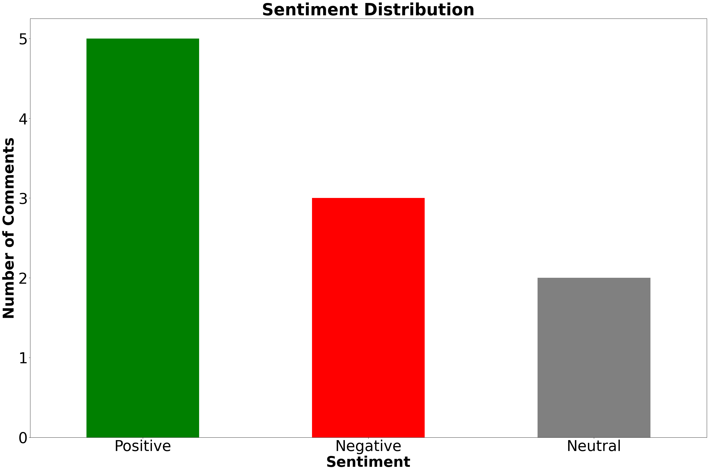
Step 5: Bar Chart
plot_sentiment_distribution(df)

Slide 13
Step 6 — AI Summary of Sentiment Results
We ask the AI model to generate a short natural-language summary of the sentiment analysis results.
Explanation of the code:
We pass the sentiment counts as context to the model.
The model generates a summary describing the overall sentiment distribution.
The result is printed for quick interpretation.

Slide 14
Step 6: Code
sentiment_counts = df['Sentiment'].value_counts() prompt = f"""
You are a research assistant in summarizing the research. Here are the sentiment counts from customer comments: {sentiment_counts.to_dict()} Write a short summary of these results. - Use the exact numbers given (do not approximate). - Mention Positive, Negative, and Neutral counts explicitly. - Keep the explanation concise. - Add an interpretation of each number. - Add a conclusion sentence at the end. """ response = chat(model="gpt-oss:20b", messages=[{"role": "user", "content": prompt}]) summary = response['message']['content'] ''' # --- Clean the summary text --- clean_summary = summary clean_summary = re.sub(r"\*\*(.*?)\*\*", r"\1", clean_summary) # remove bold markdown clean_summary = re.sub(r"[≈~]", "", clean_summary) # remove symbols clean_summary = re.sub(r"\s+", " ", clean_summary).strip() # normalize spaces ''' # Remove common dash variations and extra spaces clean_summary = re.sub(r"[–—-]", " ", summary) # replace -, –, — with space clean_summary = re.sub(r"\s+", " ", clean_summary).strip() # normalize spaces # Wrap for display wrapped_summary = textwrap.fill(clean_summary, width=80)

Slide 15
Step 6: Summary of Results
display(Markdown(wrapped_summary))
The sentiment analysis of customer comments shows 5 Positive, 3 Negative, and 2 Neutral mentions. The 5 Positive comments indicate a strong approval and overall satisfaction among most customers. The 3 Negative comments highlight specific areas where improvements are needed. The 2 Neutral comments suggest that a small portion of customers had no strong opinion or were indifferent. Overall, the feedback is predominantly positive.

Slide 16
Conclusion
This analysis demonstrates how AI + Python + Quarto can be combined to:
Automate text classification (sentiment detection).
Generate visual summaries using charts.
Provide natural-language insights with AI.
Such a workflow can be applied to any text-based and quantitative datasets (e.g., surveys, feedback, reviews) to quickly extract actionable business intelligence.
This workflow can also be automated to produce reports periodically with a single click.

