Slide 1
 | comment | sentiment
0 | The product quality is amazing and I'm very sa... | Positive
1 | Customer service was slow and unhelpful. | Negative
2 | Delivery was on time, nothing special. | Neutral
3 | The app keeps crashing and it's frustrating. | Negative
4 | Great prices and very fast shipping. | Positive
'\n---\ntitle: "Customer Sentiment Analysis"\nauthor: "Your Name"\nformat: html\nexecute:\n echo: false\n warning: false\n message: false\n---\n'
📝 Intro (Markdown)

Slide 2
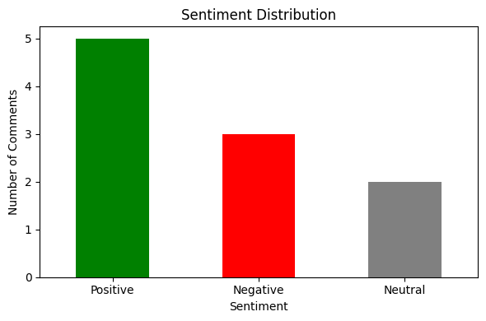

Slide 3
**Sentiment Summary** Out of the customer comments reviewed, the overall tone leans positive: 5 comments expressed a favorable sentiment, 3 were negative, and 2 were neutral. This indicates a generally positive reception, though there is a noticeable minority of concerns that could be addressed in future improvements.

