Slide 1
Economic Impact on Population.
Seyi Aro
M00297457
CIS 663
SPRING 2024

Slide 2
Overview
Introduction
Data
Methodology
Results
Conclusion
References

Slide 3
Introduction
The pandemic of 2021 left lasting economic impacts.
One of the effects of this was increasing rates of migration with the U.S. and rising cost of living.
This project explores the relationship between cost of living and population change using data from 2021 (post lockdown).
Other economic factors employed are employment, income per capita, and personal income.

Slide 4
Data
Data was collected from three sources:
The Bureau of Economic Analysis
Population change, employment, income per capita and personal income
Kaggle
Cost of living indices
Github
State information: FIPS, Name, Abbreviation

Slide 5
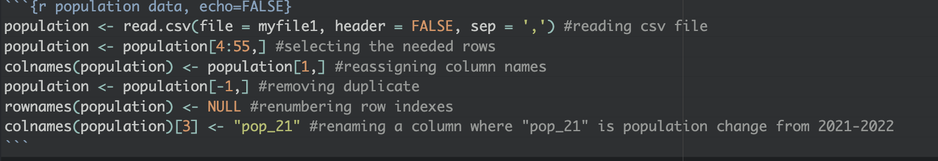
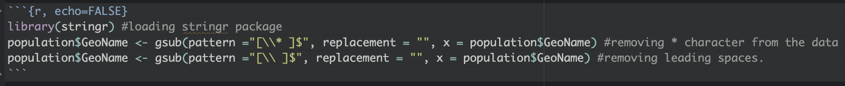
Methodology
Data Collection
Data cleaning and preparation

Slide 6
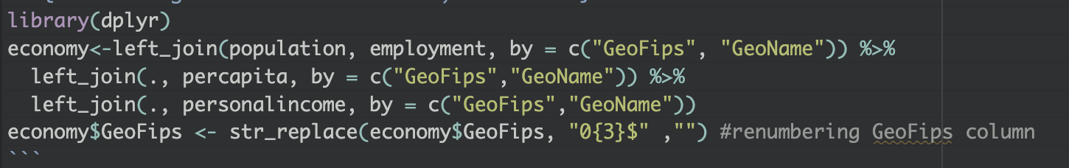
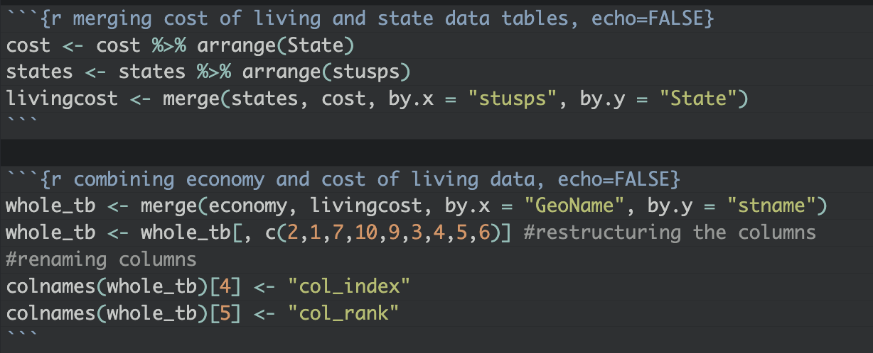
Methodology
Combining data

Slide 7
Analysis

Slide 8
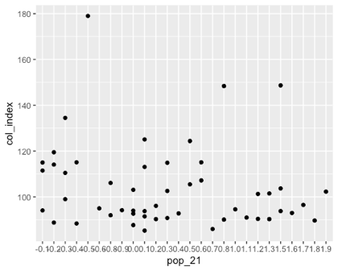
Scatterplot

Slide 9
Simple Regression Result

Slide 10
Multiple Regression Result
The entire model is not statistically significant.

Slide 11
Implication
This study is largely exploratory and therefore, makes no conclusion about the relationship between variables.
An in-depth study of the effect of population and other economic variables will require larger data.
Perhaps a time series data that analyzes the relationships among variables during the periods before the pandemic and after.

Slide 12
Conclusion
This project explores the process of using R to:
collect and clean data,
perform analysis and
interpret simple and linear regression models.

Slide 13
References
Ismail, M. S. (2023, November 21). United States Census Bureau. Retrieved from United States Government: https://www.census.gov/
Johnson, G. D. (1999). Population and Economic Development. China Economic Review, 10(1), 1-16.
Sher, A., Ali, A., & Amin, A. (2013). The Impact of Population Growth on Economic Development in Pakistan. Middle-East Journal of Scientific Research, 18(4), 483-491.
Sinding, S. S. (2009). Population, Poverty and Economic Development. Philosophical TRransactions of the Royal Society, 364(1532), 3023-3030.
Thuku, G. K., Paul, G., & Almadi, O. (2013). The Impact of Population Change on Economic Growth in Kenya. Management Journals, 2(6), 43-60.
United Van Lines. (2021). United Van Lines. Retrieved from United Van Lines Web site: https://www.unitedvanlines.com
World Population Review. (2024). World Population Review. Retrieved from World Population Review Web site: https://worldpopulationreview.com/

