Slide 1
BTK AKADEMİ ÖMER ÇOLAKOĞLU UYGULAMALI SQL DERSLERİ

Slide 2
SQL (STRUCTURED QUERY LANGUAGE)

Slide 3
SELECT
SELECT
ID, CUSTOMERNAME, CITY, BIRTHDATE, DISTRICT, GENDER
FROM CUSTOMERS

Slide 4
INSERT
INSERT INTO CUSTOMERS
(CUSTOMERNAME, CITY, BIRTHDATE, DISTRICT, GENDER)
VALUES
('KAZIM', 'NIJERYA', '1934-07-14', 'KOMOLLI','K' )

Slide 5
UPDATE
UPDATE CUSTOMERS
SET NATION='TR', AGE=DATEDIFF(YEAR, BIRTHDATE, GETDATE())

Slide 6
DELETE
DELETE FROM CUSTOMERS
WHERE CUSTOMERNAME='KAZIM'

Slide 7
TRUNCATE
Tabloyu ilk oluşturulduğu haline dönüştürür!
Delete ile arasındaki fark tabloyu truncate yaparak elemanlarını sileriz ve id kısmı sıfırlanır. Fakat delete ile tablodaki verileri silersek yeni veri eklendiğinde silinmeden önceki id’nin kaldığı sayıdan devam eder.
TRUNCATE TABLE CUSTOMERS

Slide 8
WHERE 1
= eşittir, <> eşit değildir, >= buyuktur ya da eşit, <= kucuk ya da eşit
Between arasindadir, like -> ile baslar, ile biter, içerir.
İn -> içindedir, not like -> ile başlamaz, not in ->içinde değildir.
SELECT *
FROM CUSTOMERS
WHERE GENDER <> ‘E’
SELECT *
FROM CUSTOMERS
WHERE NOT GENDER = 'E'

Slide 9
WHERE 2
SELECT *
FROM CUSTOMERS
WHERE BIRTHDATE < '1990-05-05’
***************************************
SELECT *
FROM CUSTOMERS
WHERE BIRTHDATE < '19900505’
****************************************
SELECT *
FROM CUSTOMERS
WHERE BIRTHDATE BETWEEN '19000225' AND '19900505'

Slide 10
WHERE 3
SELECT *
FROM CUSTOMERS
WHERE CUSTOMERNAME LIKE '%3’
*******************************************
SELECT *
FROM CUSTOMERS
WHERE CUSTOMERNAME IN ('KAZIM','KAZIM3’)
********************************************

Slide 11
DISTINCT
Bir sütundaki aynı değerleri unique hale getirir.
SELECT DISTINCT CITY, DISTRICT
FROM CUSTOMERS
WHERE CUSTOMERNAME='KAZIM'

Slide 12
ORDER BY
Sıralama işlemi yapar.
ASC -> küçükten büyüğe
DESC -> büyükten küçüğe
*************************************
SELECT *
FROM CUSTOMERS
ORDER BY ID DESC
*************************************
SELECT *
FROM CUSTOMERS
ORDER BY CITY DESC, CUSTOMERNAME ASC
***************************************
SELECT *
FROM CUSTOMERS
ORDER BY 2 DESC

Slide 13
TOP
SELECT
TOP 10
* FROM CUSTOMERS
ORDER BY CUSTOMERNAME
*******************************************
***PERCENT: toplam verinin yüzde 10’u kadar veriyi getir.
SELECT
TOP 10 PERCENT
* FROM CUSTOMERS
ORDER BY CUSTOMERNAME

Slide 14
BİR SONRAKİ BÖLÜME GEÇEBİLİRİZ

Slide 15
AGGREGATE FUNCTIONS
SELECT COUNT(*) FROM SALES
SELECT MIN(AMOUNT), MAX(AMOUNT), COUNT(FICHENO), SUM(AMOUNT), AVG(AMOUNT)
FROM SALES
SELECT MIN(AMOUNT), MAX(AMOUNT), COUNT(FICHENO), SUM(TOTALPRICE), AVG(TOTALPRICE)
FROM SALES WHERE CITY='İSTANBUL’

Slide 16
GROUP BY
SELECT CITY, MIN(AMOUNT) AS MINPRICE, MAX(AMOUNT) AS MAXPRICE,
COUNT(FICHENO) AS ROW_COUNT, SUM(TOTALPRICE) AS TOTAL_PRICE,
AVG(TOTALPRICE) AS AVGPRICE
FROM SALES
GROUP BY CITY
****************************************************************
SELECT TOP 10
CITY, SUM(TOTALPRICE) AS TOTAL_PRICE
FROM SALES
GROUP BY CITY
ORDER BY SUM(TOTALPRICE) DESC

Slide 17
GROUP BY 2 (bir mağazanın gün bazlı satış rakamlarını getirme)
Tarih ve saat içeren datayı tarihe dönüştürme
SELECT
CONVERT(DATE,DATE_) AS DATE2
FROM SALES
WHERE CITY='ANKARA'
ORDER BY DATE_
SADECE SAATE DÖNÜŞTÜRME
SELECT CONVERT(TIME, '2019-01-01 08:17:51.000’)
DATE2 ALANI OLUŞTURDUM VE ORAYI DATE ALANININ TARİHİ İLE DOLDURDUM.
UPDATE SALES SET DATE2 = CONVERT(DATE, DATE_)
TARİHE GÖRE KISITLAMA
SELECT *
FROM SALES
WHERE CITY='ANKARA' AND DATE2='2019-01-01'
ORDER BY DATE_

Slide 18
GROUP BY 3
Şehirlerin tarihe göre toplam cirosu
SELECT CITY, DATE2, SUM(TOTALPRICE) AS TOTALPRICE
FROM SALES
WHERE CITY='ANKARA'
GROUP BY CITY, DATE2
ORDER BY CITY, DATE2
Bir günün mağaza bazlı satış rakamlarını getirme!
SELECT DATE2, CITY, SUM(TOTALPRICE) AS TOTALPRICE
FROM SALES
GROUP BY DATE2, CITY
ORDER BY DATE2, SUM(TOTALPRICE) DESC

Slide 19
GROUP BY 4
Mağazaların aylara göre satış rakamlarını getirme
UPDATE SALES SET MONTHNAME_ = '01.OCAK' WHERE DATEPART(MONTH, DATE2)=1
UPDATE SALES SET MONTHNAME_ = '02.ŞUBAT' WHERE DATEPART(MONTH, DATE2)=2
UPDATE SALES SET MONTHNAME_ = '03.MART' WHERE DATEPART(MONTH, DATE2)=3
UPDATE SALES SET MONTHNAME_ = '04.NISAN' WHERE DATEPART(MONTH, DATE2)=4
UPDATE SALES SET MONTHNAME_ = '05.MAYIS' WHERE DATEPART(MONTH, DATE2)=5
UPDATE SALES SET MONTHNAME_ = '06.HAZIRAN' WHERE DATEPART(MONTH, DATE2)=6
UPDATE SALES SET MONTHNAME_ = '07.TEMMUZ' WHERE DATEPART(MONTH, DATE2)=7
UPDATE SALES SET MONTHNAME_ = '08.AGUSTOS' WHERE DATEPART(MONTH, DATE2)=8
UPDATE SALES SET MONTHNAME_ = '09.EYLUL' WHERE DATEPART(MONTH, DATE2)=9
UPDATE SALES SET MONTHNAME_ = '10.EKIM' WHERE DATEPART(MONTH, DATE2)=10
UPDATE SALES SET MONTHNAME_ = '11.KASIM' WHERE DATEPART(MONTH, DATE2)=11
UPDATE SALES SET MONTHNAME_ = '12.ARALIK' WHERE DATEPART(MONTH, DATE2)=12

Slide 20
GROUP BY 4.1
SELECT CITY,MONTHNAME_, SUM(TOTALPRICE) AS TOTALPRICE
FROM SALES
GROUP BY CITY, MONTHNAME_
ORDER BY MONTHNAME_, SUM(TOTALPRICE) DESC

Slide 21
GROUP BY 5
Ürün kategorilerine göre satış rakamlarını getirme
SELECT CATEGORY1, CATEGORY2,CATEGORY3,CATEGORY4,
SUM(TOTALPRICE) AS TOTALPRICE,
COUNT(*) AS ROWCOUNT_,
SUM(AMOUNT) AS TOTALAMOUNT
FROM SALES
GROUP BY CATEGORY1, CATEGORY2,CATEGORY3,CATEGORY4
ORDER BY CATEGORY1, CATEGORY2,CATEGORY3,CATEGORY4
**DENEME ÖRNEĞİM
SELECT CITY, CATEGORY1, COUNT(FICHENO) AS SALESNUM
FROM SALES
GROUP BY CITY, CATEGORY1
ORDER BY CITY, SALESNUM DESC

Slide 22
GROUP BY 6
Mağazaların müşteri sayılarını getirme
SELECT
CITY,
MONTHNAME_,
COUNT(DISTINCT CUSTOMERNAME) AS UNIQUECUSTOMER,
COUNT(DISTINCT FICHENO),
COUNT(*) ITEMCOUNT
FROM SALES
GROUP BY CITY, MONTHNAME_
ORDER BY CITY, MONTHNAME_

Slide 23
GROUP BY 7
Belli bir cironun üzerinde satış yapan mağazaları getirme
SELECT
CITY,
SUM(TOTALPRICE) AS TOTAL_PRICE
FROM SALES
GROUP BY CITY
HAVING SUM(TOTALPRICE) < 40000
ORDER BY SUM(TOTALPRICE) DESC

Slide 24
GROUP BY 7.1
SELECT
CITY,
SUM(TOTALPRICE) AS TOTAL_PRICE,
COUNT(DISTINCT CUSTOMERNAME) CUSTOMERCOUNT
FROM SALES
GROUP BY CITY
HAVING COUNT(DISTINCT CUSTOMERNAME) > 500 AND SUM(TOTALPRICE) > 300000
ORDER BY SUM(TOTALPRICE) DESC

Slide 25
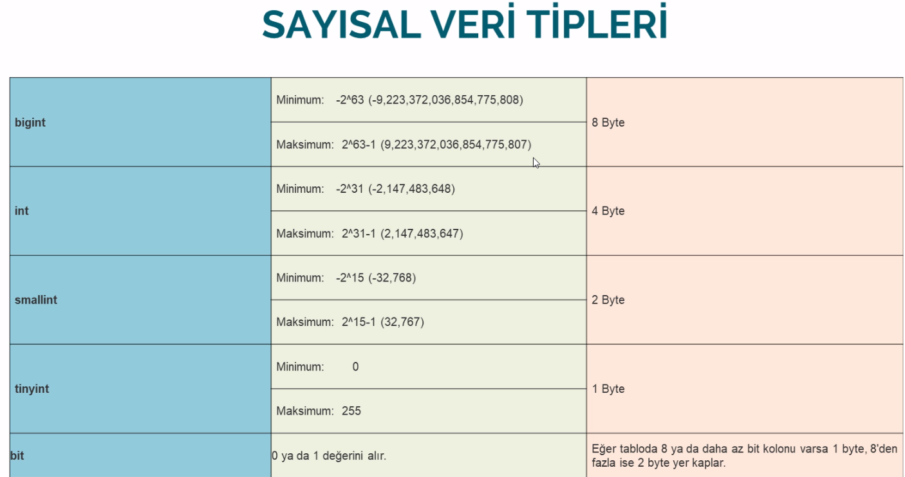

Slide 26
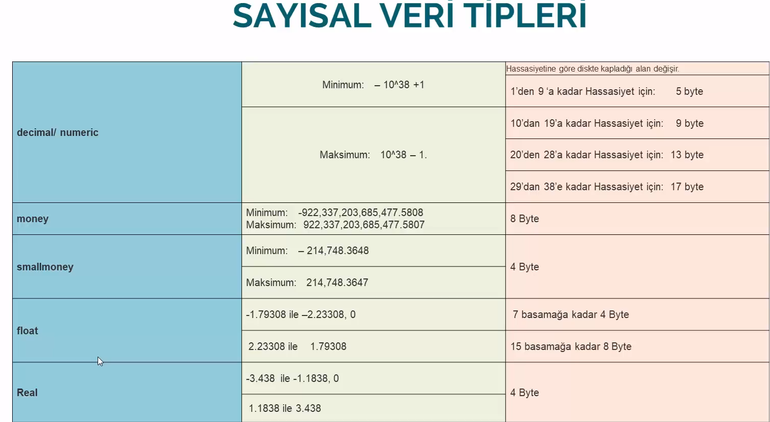

Slide 27
STRİNG 1
char -> her karakter 1 byte. karakter(max digit sayısı neyse o kadar yer kaplar. Çok sıkıntılı bir kullanıma sahip!) burada uzunluk sabit tutulur!!! Yani şöyle ki 50 eleman olsun istiyorsan stringin, sen 50den az karakter girsen bile boşluklar ile birlikte o 50 karakter tamamlanır! Fakat arama çok kolaydır. Sabit uzunluktaki stringler için bunu kullanabilirsin. Mesela tc…
Varchar -> her karakter 1 byte. bu da çok avantajlıdır. Çoğunlukla bunu kullan.
Ntext -> yazdığın text kadar. Burada herhangi bir uzunluk sınırı koymuyoruz.

Slide 28
STRİNG 2
Nvarchar -> n in anlamı Unicode dur. Ascii kodu 0-255 karakterin içerisinde olmayan bir bilgiyi saklamamıza olanak verir. Mesela arapça harfler, japon harflerini algılar. Her karakter 2 byte’dır.

Slide 29
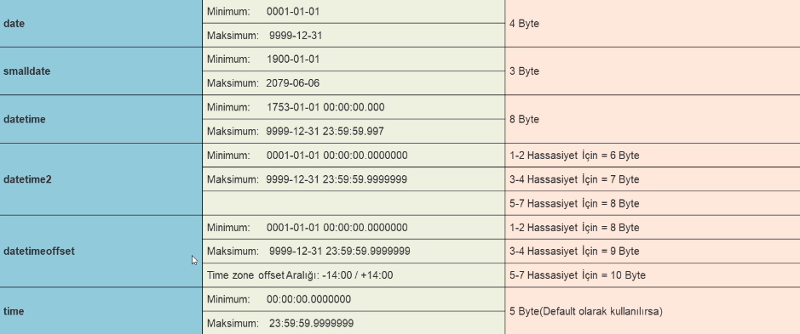
TARİH

Slide 30
İLİŞKİSEL VERİ TABANI

Slide 31
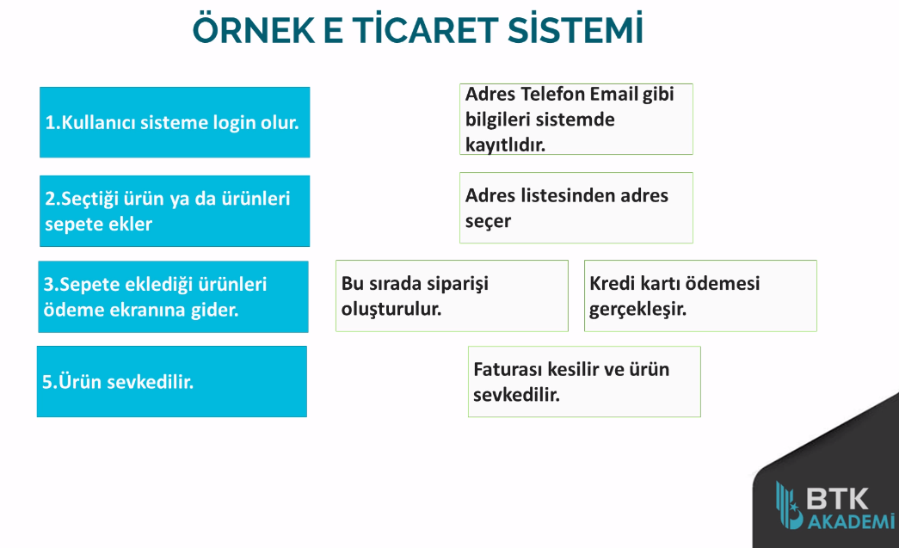

Slide 32
ALIAS KULLANIMI
SELECT USERNAME ADSOYAD,
BIRTHDATE AS ‘‘DOGUM TARIHI’’
**as anahtar sözcüğünü boşluksuz yazılacak basliklar için kullanabiliriz.

Slide 33
İKİDEN FAZLA TABLO KULLANIMI
SELECT
U.ID, U.NAMESURNAME AS ADSOYAD, U.EMAIL MAILADRESI, U.BIRTHDATE DOGUMTARIHI,
C.COUNTRY AS ULKE,
CT.CITY AS SEHIR,
T.TOWN AS ILCE,
D.DISTRICT AS SEMT,
A.POSTALCODE AS POSTAKODU,
A.ADDRESSTEXT AS ACIKADRES
FROM USERS U, ADDRESS A, COUNTRIES C, CITIES CT, TOWNS T, DISTRICTS D
WHERE
U.ID = A.USERID
--AND U.ID=4
AND C.ID=A.COUNTRYID
AND CT.ID=A.CITYID
AND T.ID=A.TOWNID
AND D.ID=A.DISTRICTID
AND CT.CITY LIKE 'DENİZLİ'
ORDER BY U.NAMESURNAME

Slide 34
İLİŞKİSEL VERİTABANI ÜZERİNDE GROUPBY KULLANIMI-1
İlk örnek
SELECT
U.NAMESURNAME, COUNT(A.USERID) AS ADRESSAYISI, COUNT(DISTINCT C.COUNTRY),
COUNT(DISTINCT CT.ID) SEHIRSAYISI
FROM USERS U, ADDRESS A, COUNTRIES C, CITIES CT, TOWNS T, DISTRICTS D
WHERE
U.ID = A.USERID
--AND U.ID=4
AND C.ID=A.COUNTRYID
AND CT.ID=A.CITYID
AND T.ID=A.TOWNID
AND D.ID=A.DISTRICTID
GROUP BY U.NAMESURNAME
HAVING COUNT(A.ID)>2

Slide 35
İLİŞKİSEL VERİTABANI ÜZERİNDE GROUPBY KULLANIMI-2
ŞEHİRLER VE İLÇELERİNDEKİ KULLANICI SAYISI
SELECT
CT.CITY, COUNT(U.ID) AS KULLANICISAYISI, COUNT(DISTINCT D.DISTRICT) AS ILCESAYISI
FROM USERS U, ADDRESS A, COUNTRIES C, CITIES CT, TOWNS T, DISTRICTS D
WHERE
U.ID = A.USERID
--AND U.ID=4
AND C.ID=A.COUNTRYID
AND CT.ID=A.CITYID
AND T.ID=A.TOWNID
AND D.ID=A.DISTRICTID
GROUP BY CT.CITY

Slide 36
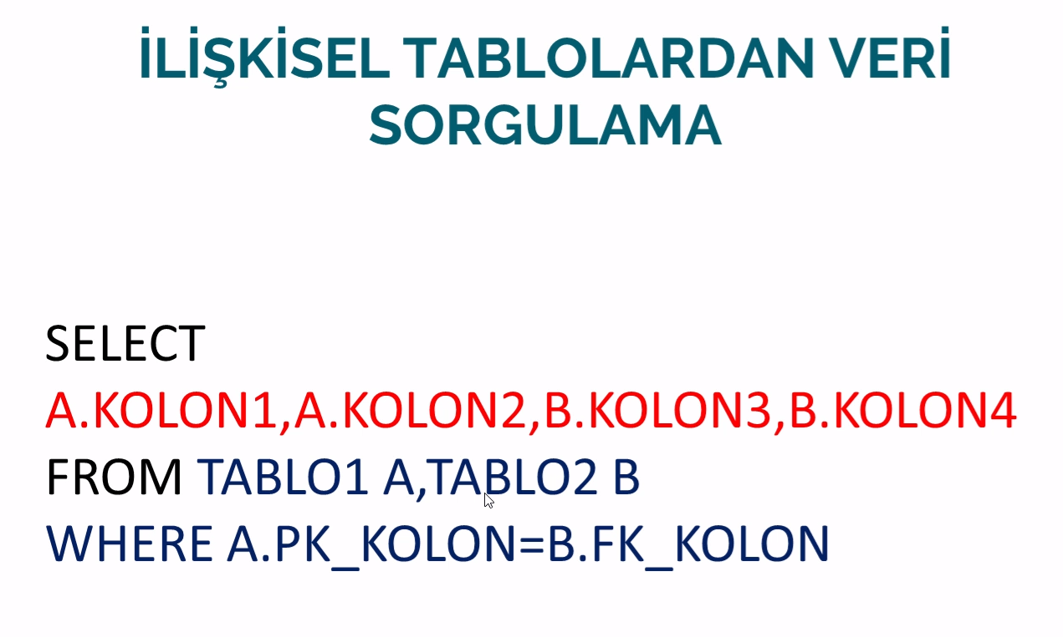

Slide 37
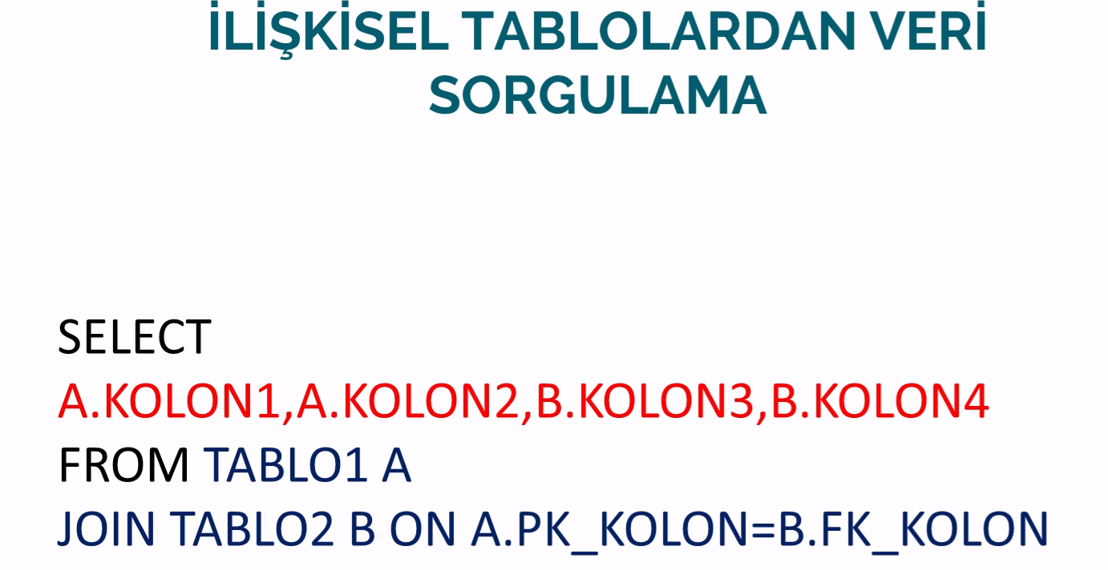
ÖNCEKİ TABLODAKİ YÖNTEM İLKELDİR.BUNUN YERİNE JOIN’LERİ KULLANIRIZ

Slide 38
JOIN GİRİS
SELECT
U.NAMESURNAME, U.EMAIL,
A.ADDRESSTEXT, C.COUNTRY, D.DISTRICT
FROM USERS U
JOIN ADDRESS A ON A.USERID=U.ID
JOIN COUNTRIES C ON C.ID=A.COUNTRYID
JOIN CITIES CT ON CT.ID = A.CITYID
JOIN TOWNS T ON T.ID=A.TOWNID
JOIN DISTRICTS D ON D.ID = A.DISTRICTID

Slide 39
JOIN GİRİS-2(GROUP BY)
SELECT
CT.CITY, COUNT(U.ID) AS KULLANICISAYISI
FROM USERS U
JOIN ADDRESS A ON A.USERID=U.ID
JOIN COUNTRIES C ON C.ID=A.COUNTRYID
JOIN CITIES CT ON CT.ID = A.CITYID
JOIN TOWNS T ON T.ID=A.TOWNID
JOIN DISTRICTS D ON D.ID = A.DISTRICTID
GROUP BY CT.CITY

Slide 40
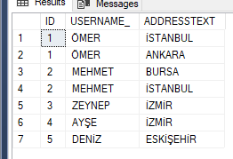
INNER JOIN
İki tablodaki karşılaştırılan sütunlar için ortak eleman bulunan kayıtlar gelir. Default olarak inner join kullanılır…
ÖRNEK:
SELECT
U.ID, U.USERNAME_, A.ADDRESSTEXT
FROM USERS U
JOIN ADDRESS A ON A.USERID=U.ID

Slide 41
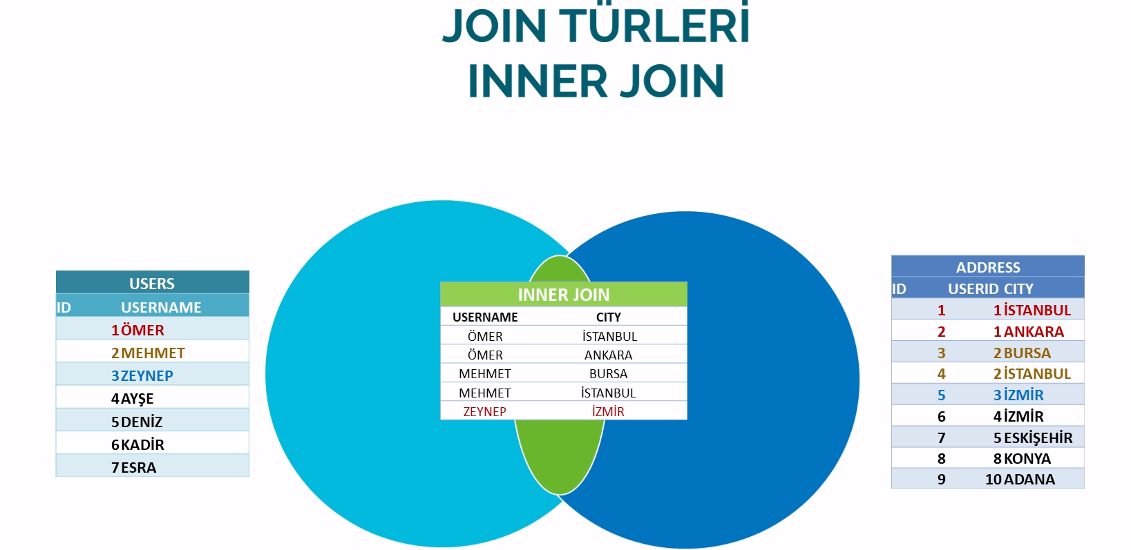

Slide 42
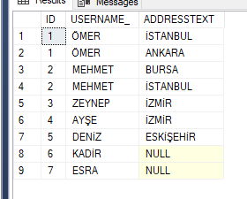
LEFT(OUTER) JOIN
SELECT
U.ID, U.USERNAME_, A.ADDRESSTEXT
FROM USERS U
LEFT JOIN ADDRESS A ON A.USERID=U.ID

Slide 43
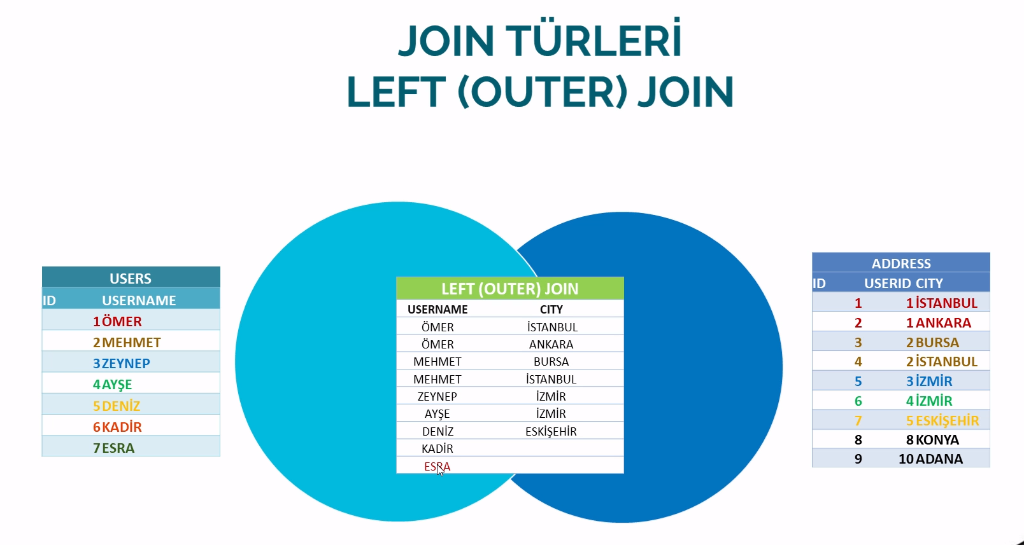

Slide 44
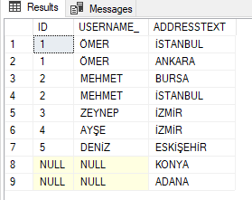
SELECT
U.ID, U.USERNAME_, A.ADDRESSTEXT
FROM USERS U
RIGHT JOIN ADDRESS A ON A.USERID=U.ID

Slide 45
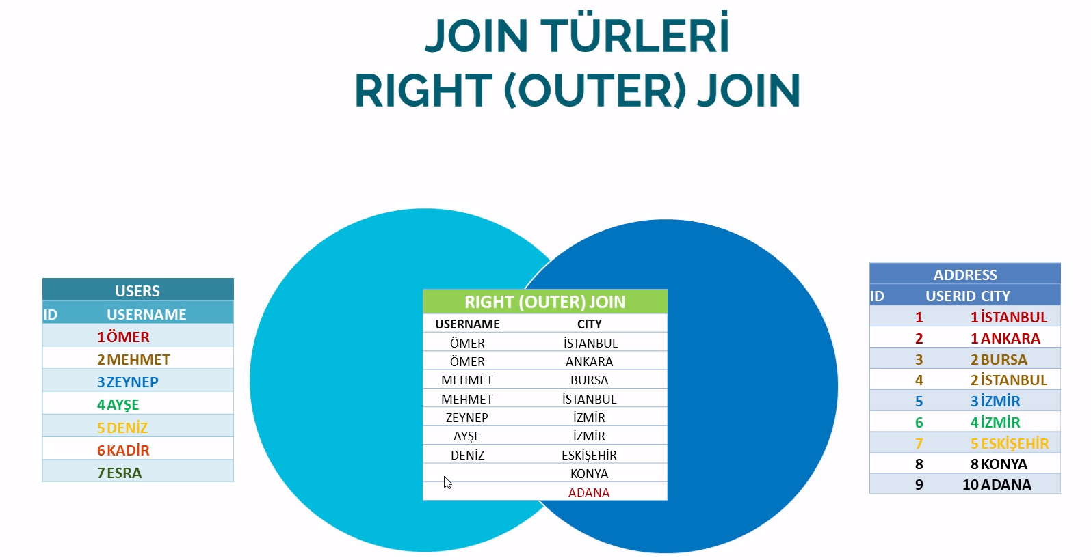

Slide 46
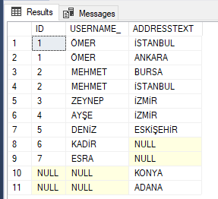
SELECT
U.ID, U.USERNAME_, A.ADDRESSTEXT
FROM USERS U
FULL JOIN ADDRESS A ON A.USERID=U.ID

Slide 47
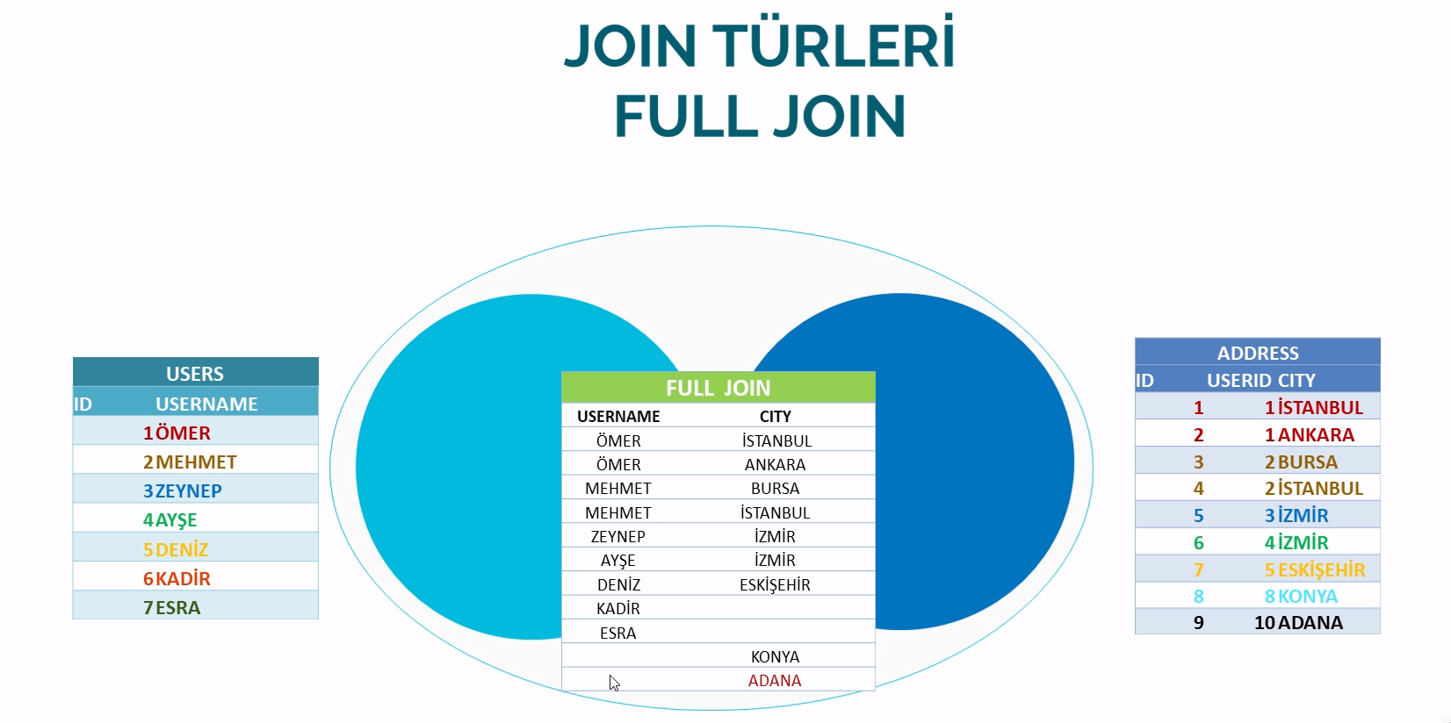

Slide 48

GERÇEK UYGULAMALARORNEK-1

Slide 49
Önceki sayfada istenilen bilgileri join’ler ile tabloları birbirine bağlayarak, farklı tablolardaki verileri tek bir tabloda toplayan sql kodu.
SELECT
U.USERNAME_ AS KULLANICIADI, U.NAMESURNAME AS ADSOYAD,
CT.CITY IL, T.TOWN AS ILCE, D.DISTRICT SEMT, A.ADDRESSTEXT AS ACIKADRES,
O.ID AS SIPARISID, O.DATE_ AS TARIH, O.TOTALPRICE AS TOPLAMTUTAR,
P.DATE_ AS ODEMETARIHI, P.APPROVECODE AS BANKAONAYKODU,
I.DATE_ AS FATURATARIHI,I.CARGOFICHENO AS KARGOFISNO
FROM ORDERS O
INNER JOIN USERS U ON U.ID=O.USERID
INNER JOIN ADDRESS A ON A.ID=O.ADDRESSID
INNER JOIN CITIES CT ON CT.ID=A.CITYID
INNER JOIN TOWNS T ON T.ID=A.TOWNID
INNER JOIN DISTRICTS D ON D.ID=A.DISTRICTID
INNER JOIN PAYMENTS P ON P.ORDERID=O.ID
INNER JOIN INVOICES I ON I.ORDERID=O.ID
WHERE U.NAMESURNAME='Hayrunnisa KALMUK'

Slide 50
GERÇEK UYGULAMALARORNEK-2
SELECT
U.USERNAME_ AS KULLANICIADI, U.NAMESURNAME AS ADSOYAD,
CT.CITY IL, T.TOWN AS ILCE, D.DISTRICT SEMT, A.ADDRESSTEXT AS ACIKADRES,
O.ID AS SIPARISID, O.DATE_ AS TARIH, O.TOTALPRICE AS TOPLAMTUTAR,
P.DATE_ AS ODEMETARIHI, P.APPROVECODE AS BANKAONAYKODU,
I.DATE_ AS FATURATARIHI,I.CARGOFICHENO AS KARGOFISNO,
ITM.ITEMCODE AS URUNKODU, ITM.ITEMNAME AS URUNADI,
OD.AMOUNT AS MIKTAR, OD.UNITPRICE AS BIRIMFIYAT, OD.LINETOTAL AS SATIRTOPLAMI
FROM ORDERS O
INNER JOIN USERS U ON U.ID=O.USERID
INNER JOIN ADDRESS A ON A.ID=O.ADDRESSID
INNER JOIN CITIES CT ON CT.ID=A.CITYID
INNER JOIN TOWNS T ON T.ID=A.TOWNID
INNER JOIN DISTRICTS D ON D.ID=A.DISTRICTID
INNER JOIN PAYMENTS P ON P.ORDERID=O.ID
INNER JOIN INVOICES I ON I.ORDERID=O.ID
INNER JOIN ORDERDETAILS OD ON OD.ORDERID=O.ID
INNER JOIN ITEMS ITM ON ITM.ID=OD.ITEMID
WHERE O.ID=26121
--U.NAMESURNAME='CEYDA GEZGİNCİ'
--U.NAMESURNAME='Hayrunnisa KALMUK'

Slide 51
GERÇEK UYGULAMALARORNEK-3 (şehirlere göre verilen siparişleri toplam olarak listeleme)
SELECT
CT.CITY SEHIRADI,
SUM(OD.LINETOTAL) TOPLAMSIPARIS_TUTARI,
SUM(OD.AMOUNT) AS TOPLAMSIPARIS_ADEDI,
COUNT(OD.ID) AS TOPLAMSIPARIS_SAYISI
FROM ORDERS O
INNER JOIN USERS U ON U.ID=O.USERID
INNER JOIN ADDRESS A ON A.ID=O.ADDRESSID
INNER JOIN CITIES CT ON CT.ID=A.CITYID
INNER JOIN TOWNS T ON T.ID=A.TOWNID
INNER JOIN DISTRICTS D ON D.ID=A.DISTRICTID
INNER JOIN PAYMENTS P ON P.ORDERID=O.ID
INNER JOIN INVOICES I ON I.ORDERID=O.ID
INNER JOIN ORDERDETAILS OD ON OD.ORDERID=O.ID
INNER JOIN ITEMS ITM ON ITM.ID=OD.ITEMID
GROUP BY CT.CITY
ORDER BY 2 DESC
--COUNT(OD.ID) DESC
--SUM(OD.LINETOTAL) DESC

Slide 52
GERÇEK UYGULAMALARORNEK-3 (ürün kategorilerine göre sipariş dağılımı)
SELECT
ITM.CATEGORY1 KATEGORI,
ITM.CATEGORY2 KATEGORI2,
SUM(OD.LINETOTAL) TOPLAMSIPARIS_TUTARI,
SUM(OD.AMOUNT) AS TOPLAMSIPARIS_ADEDI,
COUNT(OD.ID) AS TOPLAMSIPARIS_SAYISI
FROM ORDERS O
INNER JOIN USERS U ON U.ID=O.USERID
INNER JOIN ADDRESS A ON A.ID=O.ADDRESSID
INNER JOIN CITIES CT ON CT.ID=A.CITYID
INNER JOIN TOWNS T ON T.ID=A.TOWNID
INNER JOIN DISTRICTS D ON D.ID=A.DISTRICTID
INNER JOIN PAYMENTS P ON P.ORDERID=O.ID
INNER JOIN INVOICES I ON I.ORDERID=O.ID
INNER JOIN ORDERDETAILS OD ON OD.ORDERID=O.ID
INNER JOIN ITEMS ITM ON ITM.ID=OD.ITEMID
WHERE ITM.CATEGORY1='EV'
GROUP BY ITM.CATEGORY1, ITM.CATEGORY2
ORDER BY 3 DESC
--COUNT(OD.ID) DESC
--SUM(OD.LINETOTAL) DESC

Slide 53
SUBQUERY-1
SELECT ITM.ITEMCODE AS URUNKODU,
ITM.ITEMNAME AS URUNADI,
(SELECT MIN(UNITPRICE) FROM ORDERDETAILS WHERE ITEMID=ITM.ID) AS ENDUSUKFIYAT,
(SELECT MAX(UNITPRICE) FROM ORDERDETAILS WHERE ITEMID=ITM.ID) AS ENYUKSEKFIYAT,
(SELECT MAX(UNITPRICE) FROM ORDERDETAILS WHERE ITEMID=ITM.ID) AS ORTALAMAFIYAT,
(SELECT SUM(AMOUNT) FROM ORDERDETAILS WHERE ITEMID=ITM.ID) AS TOPLAMADET,
(
SELECT TOP 1 DATEPART(MONTH,O.DATE_) AS AY
FROM ORDERDETAILS OD
INNER JOIN ORDERS O ON OD.ORDERID=O.ID
WHERE OD.ITEMID=ITM.ID
GROUP BY DATEPART(MONTH,O.DATE_)
ORDER BY SUM(AMOUNT) DESC
) AS ENCOKSATILANAY
FROM ITEMS ITM
ORDER BY ITM.ITEMNAME

Slide 54
SUBQUERY-2
--kullanıcının son adresini bulma
SELECT U.*,
(SELECT TOP 1 ADDRESSTEXT FROM ADDRESS WHERE USERID=U.ID ORDER BY ID DESC) SONADRES,
(SELECT TOP 1 ADDRESSTEXT FROM ADDRESS WHERE USERID=U.ID ORDER BY ID) ILKADRES,
(SELECT COUNT(ADDRESSTEXT) FROM ADDRESS WHERE USERID=U.ID ) ADRESSAYISI
FROM USERS U

Slide 55
STRING ISLEMLERI
ASCİİ -> karakterlerin ascii olarak karşılığını verir.
Char ->byte cinsinden verilen girdinin asciideki karşılıklarını verir.
SELECT ASCII('?')
SELECT ASCII(CHAR(49))

Slide 56
SUBSTRING
Bir stringin içerisinde bir noktadan bir noktaya kadar parçalar.
SELECT SUBSTRING('SEYİT AHMET', 2,2) ->> EY
SELECT SUBSTRING('SEYİT AHMET', 6,4)
->> O ile biten username’ler
SELECT * FROM USERS WHERE USERNAME_ LIKE '%O'
SELECT * FROM USERS WHERE SUBSTRING(USERNAME_, LEN(USERNAME_), 1) = 'O'

Slide 57
CHARINDEX
SELECT CHARINDEX ('FAR', 'OMER FARUK’,2)
->> ARAMAK İSTEDİĞİMİZ İFADENİN BAŞLANGIÇ INDEXINI VERİR.

Slide 58
CONCAT
SELECT 'OMER ' + 'FARUK' + ' COLAKOGLU'
SELECT CONCAT('OMER', ' ','FARUK', ' ','COLAKOGLU')
SELECT CONCAT_WS(' ','OMER', 'FARUK' ,'COLAKOGLU’)
************************************************************************
SELECT USERNAME_ + ' ' + PASSWORD_ + ' ' + NAMESURNAME ,
CONCAT(USERNAME_ ,' ' ,PASSWORD_ ,' ' ,NAMESURNAME),
CONCAT_WS(' ',USERNAME_ ,PASSWORD_ )
FROM USERS

Slide 59
FORMAT
SELECT FORMAT(GETDATE(),'d', 'en-us'),
FORMAT(GETDATE(),'D', 'en-us')

Slide 60
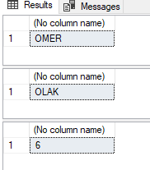
LEFT, RIGHT, LEN
SELECT LEFT('OMER COLAK',4)
SELECT RIGHT('OMER COLAK',4)
SELECT LEN('123456’)

Slide 61
DEVAM- İSİM VE SOYİSİM’İ PARÇALADIK!
SELECT
LEFT(NAMESURNAME, CHARINDEX(' ', NAMESURNAME)),
RIGHT(NAMESURNAME, LEN(NAMESURNAME) - CHARINDEX(' ',NAMESURNAME))
FROM USERS

