Slide 1

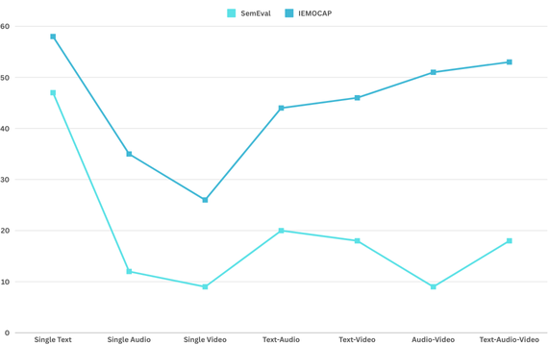
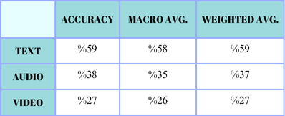
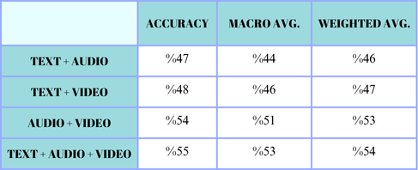
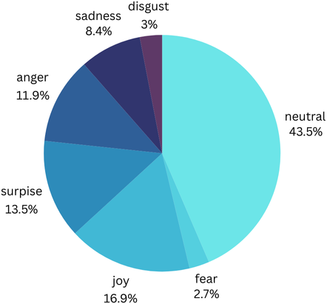
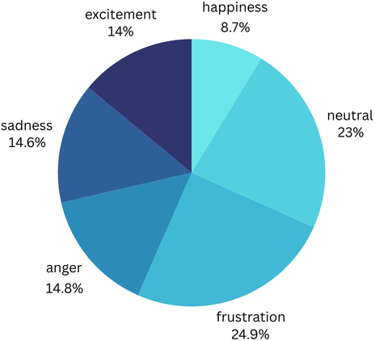
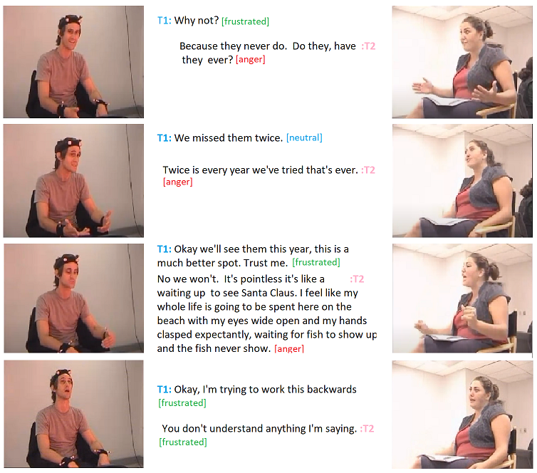
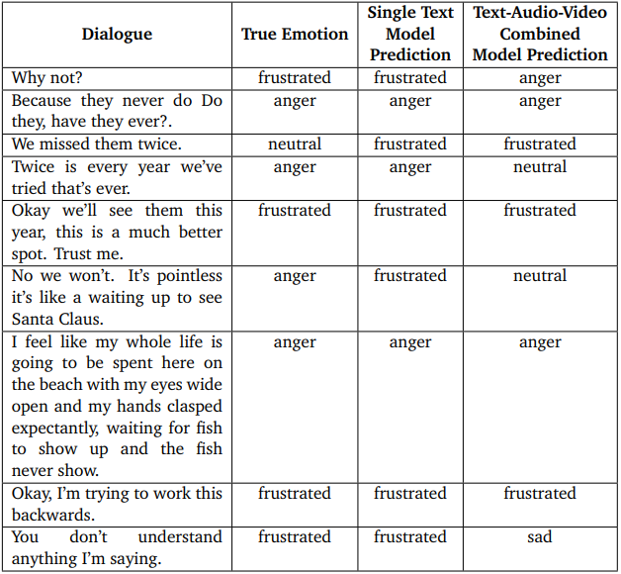
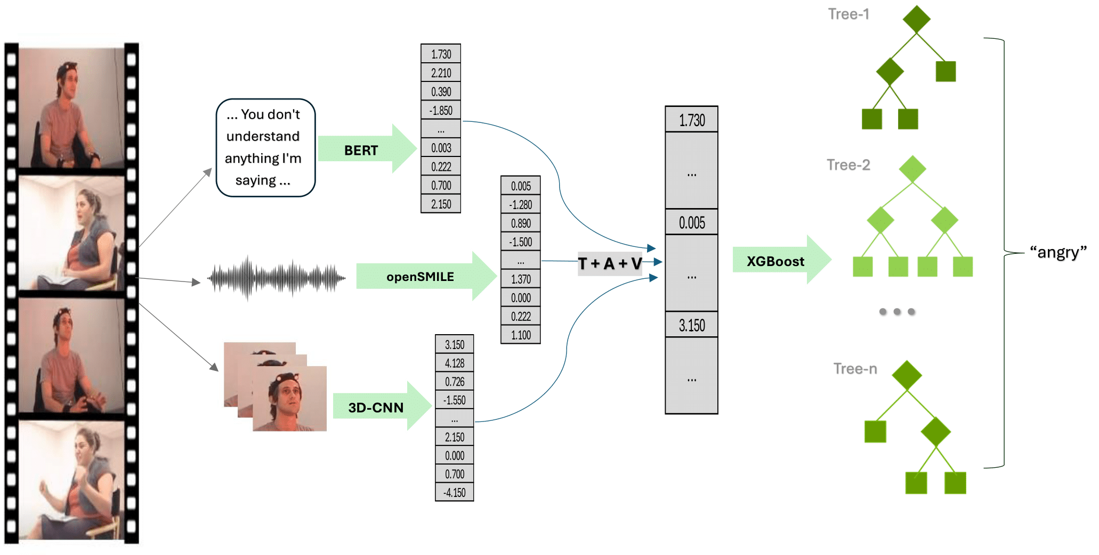
MULTIMODAL EMOTION TRACKING FROM VIDEOS USING IMAGE, AUDIO AND TEXT
YILDIZ TECHNICAL UNIVERSITY
FACULTY OF ELECTRICAL AND ELECTRONICS
DEPARTMENT OF COMPUTER ENGINEERING
Şeymanur Korkmaz, Beyda Güler, Assoc. Dr. Ali Can Karaca
seymanur.korkmaz@std.yildiz.edu.tr, beyda.guler@std.yildiz.edu.tr, ackaraca@yildiz.edu.tr
Özet
Bu çalışmada, farklı veri türlerinin birleşimiyle çok modlu duygu takibi incelenmiştir. Metin verileri dil bilgisi ve bağlam, ses verileri tonlama ve ritim, video verileri jest ve mimikler gibi bilgiler sunmaktadır. Bu verilerin entegrasyonu, daha zengin bilgi edinimi sağlamaktadır. İki farklı veri seti kullanılarak çok modlu duygu tespiti yapılmıştır: biri dengesiz, diğeri nispeten dengelidir. Metin, ses ve video verileri ayrı ayrı modellenmiş ve sonra birleştirilerek çok modlu modeller oluşturulmuştur. Sonuçlar, çok modlu çalışmanın bilgi edinimine katkısını göstermektedir.
Anahtar Kelimeler: duygu tespiti, çok modlu, metin, ses, video
III. Experimental/Application Results
Before combining the models, the features were given one by one and the outputs were obtained. The purpose of this is to provide a baseline to see how the combination affects emotion detection.
After obtaining results from single models, outputs were obtained by combining features with different combinations (text-audio, text-audio-video, etc.).
The achievements obtained for single and combined models from SemEval and IEMOCAP data sets are shown comparatively in Figure 4. In all cases, it can be seen that the IEMOCAP dataset achieves higher success than the SemEval dataset.
Single model successes obtained using the IEMOCAP data set are shown in detail in Table 1, and combined model successes are shown in detail in Table 2.
Abstract
In this study, multimodal emotion tracking was examined with the combination of different data types. Text data provides information such as grammar and context, audio data provides information such as intonation and rhythm, and video data provides information such as gestures and facial expressions. Integration of this data provides richer information. Multimodal emotion detection was performed using two different data sets: one unbalanced and the other relatively balanced. Text, audio, and video data were modeled separately and then combined to create multimodal models. The results demonstrate the contribution of multimodal study to knowledge acquisition.
Keywords: emotion detection, multimodal, text, audio, video
Figure 4. SemEval vs. IEMOCAP Macro F-1 Score Comparison
I. Introduction
The main purpose of our study is to perform sentiment analysis on unclassified inputs. In this regard, first of all, the audio, text and visual inputs we have will be given to the model separately. Various combinations of inputs will then be given to the models and the most appropriate model will be used to perform sentiment analysis. Thus, it will be determined which factor is more prominent in emotion detection.
While early research in the field of emotion recognition involved visual and auditory processing, later studies revealed the role of text in emotional analysis [1]. Multimodal learning is widely used in current research in this field [2].
Table 1. IEMOCAP Single Models
Table 2. IEMOCAP Combined Models
II. System Design
In this study, two datasets are used: SemEval & IEMOCAP. SemEval has less distinctive audio and video features and a more unbalanced data distribution compared to IEMOCAP, as shown in Figures 1 and 2.
The methods and steps used for this study are given below.
Feature extraction is applied to text, audio and video features by using BERT, openSMILE and 3D-CNN respectively. The feature sizes obtained after feature extraction are; text: 128, audio: 6373, video: 4096.
Dimension reduction is applied to reduce the size of audio and video features and to obtain more noise-free information. The size of the audio feature vector is reduced from 6373 to 100 with PCA, and the size of the video feature vector is reduced from 4096 to 512 with Max Pooling method.
The features were initially classified individually, with BERT for text and XGBoost for audio and video. Afterwards, all feature combinations underwent classification using XGBoost.
BERT is utilized for text classification because it comprehends text by considering both context aspects (pre and post), capturing word meanings and relationships accurately for enhanced performance and accuracy.
Using XGBoost for classifying audio, video, and combined features leads to high performance and accuracy due to its effectiveness on complex data and fast training process. XGBoost's powerful gradient boosting algorithm prevents overfitting and its parallel processing capability further enhances efficiency.
Figure 5 shows an example dialogue from the IEMOCAP dataset. Figure 6 shows the sentiment predictions of the single text model and the combined text-audio-video model trained with IEMOCAP.
Figure 1. SemEval Data Distribution
Figure 2. IEMOCAP Data Distribution
Figure 5. Sample Dialogue
Figure 6. Sample Dialogue Emotion Predictions
Figure 6 shows that, models most frequently predicts the labels "fru" and "ang" interchangeably which corresponding to the emotions frustrated and angry in real life. The reason for this inaccuracy in the predictions can be interpreted as the fact that these two emotions have common points with each other and may contain similar verbal expressions
Conclusion
In this study, emotion detection from text, audio, and video features is examined. Text, audio, and video features were combined in various ways to observe their impact on emotion detection using two data sets: SemEval and IEMOCAP. Feature extraction was conducted with BERT for text, OpenSMILE for audio, and 3D-CNN for video.The BERT model was used for text classification, while the XGB model was used for audio and video.
Results showed that text-based emotion detection was more successful than using audio or video alone.When combining features, the text-audio-video model achieved the highest success among combined models but did not surpass the text-only model. The inclusion of potentially misleading gestures, facial expressions, and tones in some videos and audios might have negatively impacted the model's predictions. It can be stated that this result is robust because the study was tested on two distinct datasets, and the same circumstances applied to both.
References
[1] Ekman, P. (1993). Facial expression and emotion. American Psychologist, 48(4), 384.
[2] Baltrusaitis, T., Ahuja, C., & Morency, L.-P. (2018). Multimodal machine learning: A survey and taxonomy. IEEE Transactions on Pattern Analysis and Machine Intelligence.
Figure 3. System Architecture

