Slide 1
Project 4: Car Plate Recognition and Reconstruction with Deep Learning
Computer Vision (Cod:1052229)
Şeyma Durak
2222116
23/07/2025

Slide 2
Workflow
Problem Statement
State of the Art
Proposed Method
Dataset
Experimental Setup
Model Evaluation
Conclusions
References

Slide 3
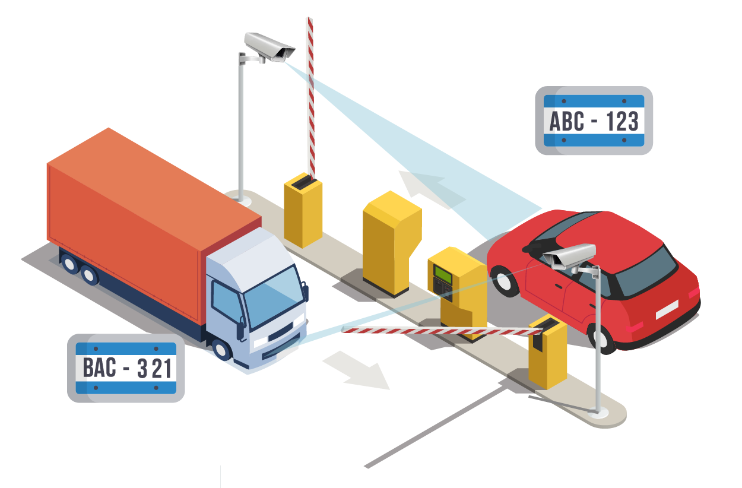
Problem Statement
Automatic license plate recognition (ALPR) is crucial in intelligent transportation systems, including traffic law enforcement, vehicle access control, and automated toll collection.
However, designing an effective ALPR system is challenging due to the diverse and unpredictable real-world conditions, plate designs, image quality, and complex backgrounds.
The project aims to develop a robust, fully automatic system capable of accurately detecting and recognizing license plates in diverse, unconstrained images using modern deep learning methods for object detection and optical character recognition.

Slide 4
State of the Art
Li and others, introduced a unified deep neural network that can detect and recognize car license plates at the same time, in one step, from natural scene images. The method integrates CNNs for plate localization and feature extraction, with RNNs (LSTM) for character sequence recognition, allowing for fully end-to-end training and inference. Unlike previous methods that treat detection and recognition separately, this approach is faster and reduces errors. Experiments on various datasets show the method is both effective and efficient [1].
Montazzolli and others, presented a real-time, end-to-end license plate detection and recognition system for Brazilian plates, based on advanced Convolutional Neural Network (CNN) architectures. The proposed method uses deep CNNs to both detect plates and recognize their characters in natural images. Experiments on a public Brazilian dataset show the system achieves 63.18% accuracy for full plate recognition, 97.39% partial accuracy (at least five correct characters), and 93% character recognition accuracy, demonstrating the effectiveness of deep CNNs for automatic license plate recognition [2].

Slide 5
State of the Art
Tom and others, introduced an automatic license plate detection and recognition system for smart cities, based on a modified U-Net deep learning model. The proposed method uses a single, end-to-end neural network to perform both license plate localization and character recognition simultaneously from surveillance camera images, offering faster and more reliable results compared to traditional multi-stage approaches.[3].
Silva and others, proposed a real-time license plate detection and recognition system based on hierarchical deep convolutional neural networks (CNNs). The system uses CNNs for both plate localization and character recognition, enhanced by data augmentation and a technique for stable video OCR. Tests on Brazilian and European datasets show high accuracy [4].

Slide 6
Dataset
In this study, we used the open-source License Plate Recognition dataset available on Kaggle.
The dataset contains images of vehicles with annotated bounding boxes indicating the locations of license plates. This publicly available dataset includes 7,357 training images, 2,195 validation images, and 1,085 test images.
All annotations, including bounding box coordinates and class labels, are provided in a CSV file. The data was split into training, validation, and test sets to enable objective evaluation of the model’s learning and performance.

Slide 7
Experimental Setup
In the experimental setup, a license plate detection and recognition pipeline was developed using Python and the PyTorch deep learning framework. Colab Framework, GPU A100.
The object detection model used was Faster R-CNN with a ResNet50 backbone, initialized with pretrained weights (transfer learning).
The model predicts bounding boxes and class labels (license plate/background) for input images.
The dataset was split into training, validation, and test sets with 7,357, 2,195, and 1,085 images, respectively.

Slide 8
Experimental Setup
Data loading was handled with the PyTorch DataLoader, using a batch size of 4 and shuffle enabled for training. Data augmentation, such as random horizontal flipping, was applied to the training images.
Stochastic Gradient Descent (SGD) was used for model optimization. Hyperparameter tuning was performed to select the best learning rate. During the training and validation loops, loss values were monitored to evaluate model performance.
For result evaluation and visualization, detected plates were read using the EasyOCR library, and the results were visualized with matplotlib, including both detection bounding boxes and recognized text.

Slide 9
Model Evaluation
In order for the model to learn in the best possible way, different learning rate and batch size values were tested using the random search method. The model was trained for each combination in five separate trials, and the training loss and validation loss values were recorded as follows:
Trial | Learning Rate | Batch Size | Epoch 1 Loss | Epoch 2 Loss | Validation Loss
1 | 5e-05 | 4 | 355.16 | 268.23 | 0.1236
2 | 1e-05 | 4 | 427.64 | 344.55 | 0.2043
3 | 0.001 | 4 | 215.62 | 197.60 | 0.0790
4 | 5e-05 | 4 | 332.03 | 241.18 | 0.1040
5 | 0.001 | 4 | 216.83 | 197.28 | 0.0802

Slide 10
Model Evaluation
The training loss of the final model selected with the best hyperparameters (learning rate = 0.001) decreased over 5 epochs as follows:
Epoch | Training Loss
1 | 218.46
2 | 197.04
3 | 196.09
4 | 191.66
5 | 189.01
The training loss has steadily decreased in each epoch, indicating that the model has adapted to the data and that the learning process is progressing successfully.
The low validation loss indicates that there is no overfitting and that the model has high generalisation ability.

Slide 11
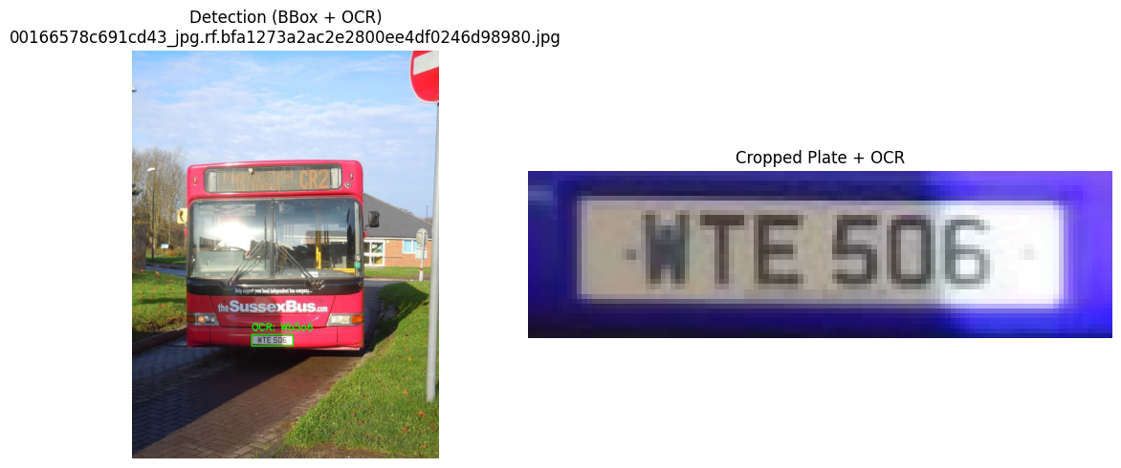

Model Evaluation
As depicted in the following image, the car plate was succefully recognized
Görsel: 00166578c691cd43_jpg.rf.bfa1273a2ac2e2800ee4df0246d98980.jpg
Plate 1 BBox: [299.35095 712.06384 402.54654 741.5603 ]
OCR: [‘Wt5o6']

Slide 12
Conclusions
In this study, vehicle license plates were detected on an open-source dataset using a Faster R-CNN-based deep learning model, and the plate region was accurately cropped. Then, the characters on the plate were read with EasyOCR. While plate detection and cropping were successful, further improvements are needed for character recognition.

Slide 13
References
H. Li, P. Wang, and C. Shen, “Toward End-to-End Car License Plate Detection and Recognition With Deep Neural Networks,” IEEE Transactions on Intelligent Transportation Systems, vol. 20, no. 3, pp. 1126–1136, Mar. 2019, doi: 10.1109/TITS.2018.2847291.
S. Montazzolli and C. Jung, “Real-Time Brazilian License Plate Detection and Recognition Using Deep Convolutional Neural Networks,” in 2017 30th SIBGRAPI Conference on Graphics, Patterns and Images (SIBGRAPI), Niterói, Brazil, 2017, pp. 55–62, doi: 10.1109/SIBGRAPI.2017.18.
R. J. Tom, A. Kumar, S. B. Shaik, L. D. Isaac, V. Tripathi, and P. Pareek, "Car License Plate Detection and Recognition Using Modified U-Net Deep Learning Model," International Journal of Innovative Technology and Exploring Engineering (IJITEE), vol. 9, no. 6, pp. 2326-2332, 2020.
S. M. Silva and C. R. Jung, “Real-time license plate detection and recognition using deep convolutional neural networks,” Pattern Recognition Letters, vol. 131, pp. 132–139, 2020, doi: 10.1016/j.patrec.2020.02.028.

