Slide 1
Error Detection/Correction,
Şeyma Kayıkcı
Istanbul Technical University
Electronic and Communication Engineering
September 2026
1

Slide 2
Content
Binary Symmetric Channel
Error Detection Algorithm - Parity Check Bit
Error Correction Algorithm - Repetition
Hamming Code
Future Work
References
2

Slide 3
Content
Binary Symmetric Channel
Error Detection Algorithm - Parity Check Bit
Error Correction Algorithm - Repetition
Hamming Code
Future Work
References
3

Slide 4
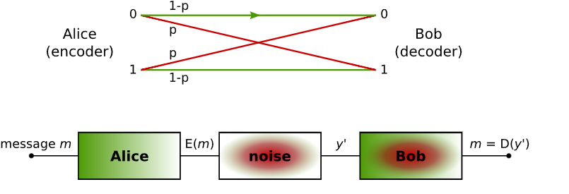
Binary Symmetric Channel
Figure 1. Binary Symmetric Channel (BSC) model. Source: Wikipedia, “Binary Symmetric Channel.”
4

Slide 5
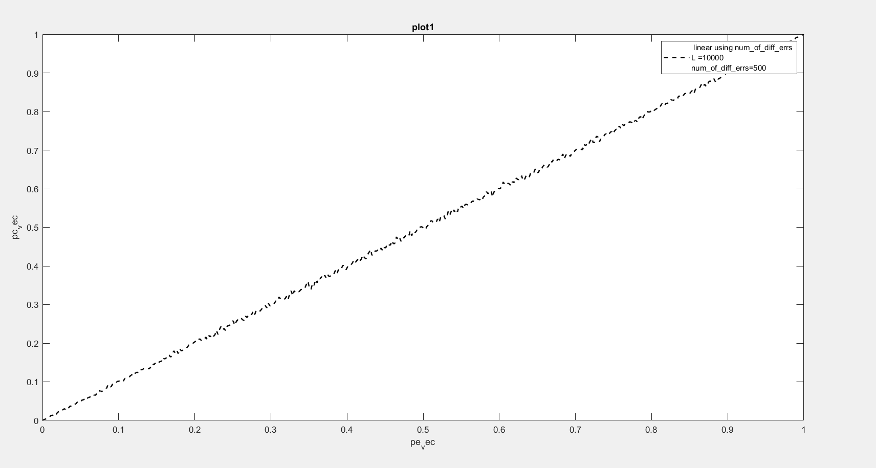
Graph 1-bsc_graph1.m
Figure 2. Linear relationship between $p_{e,ec}$and $p_{c,ec}$for $L=10,000$and $\text{num}\text{_}\text{of}\text{_}\text{diff}\text{_}\text{errs}=500$.
7

Slide 6
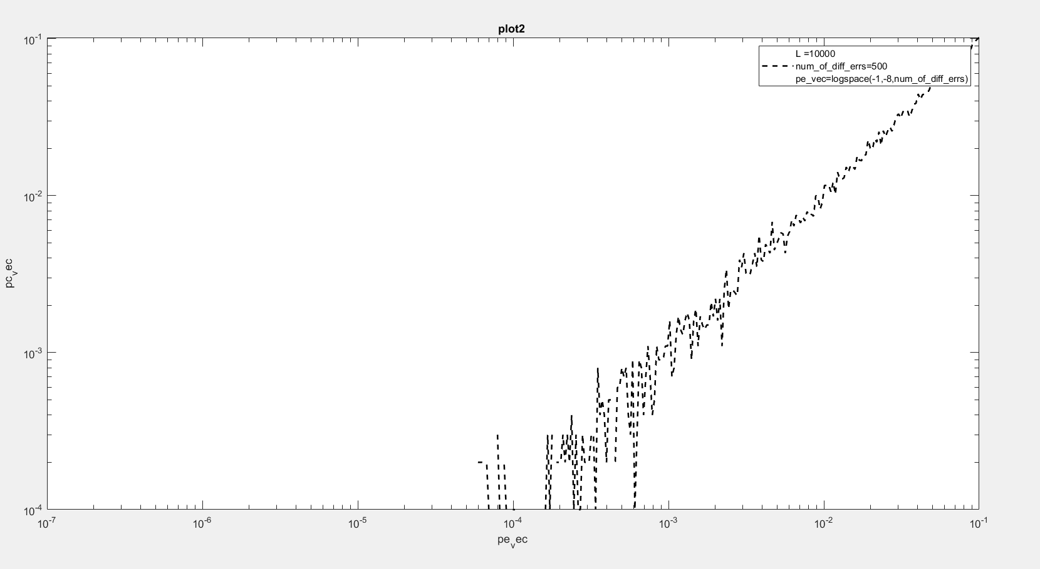
Graph 2-bsc_graph2.m
Figure X. Logarithmic-scale relationship between $p_{e,ec}$and $p_{c,ec}$for $L=10,000$and $\text{num}\text{_}\text{of}\text{_}\text{diff}\text{_}\text{errs}=500$.
Figure 3. Linear-scale relationship between p_e,ec and p_c,ec for L = 10,000 and num_of_diff_errs = 500.
8

Slide 7
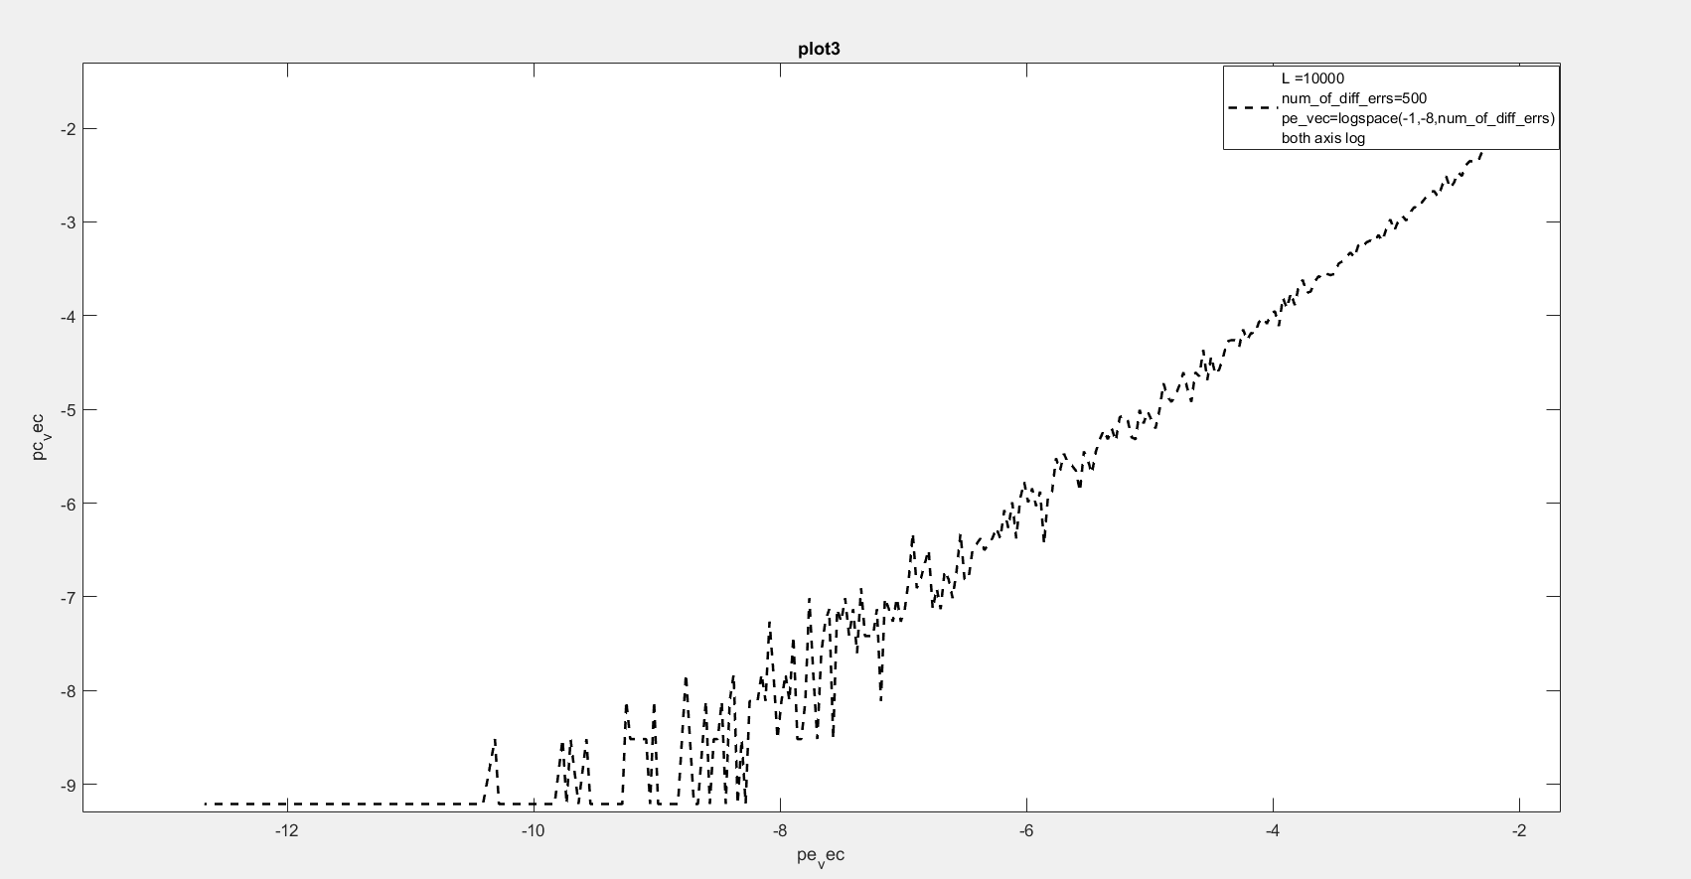
Graph 3-bsc_graph3.m
Figure X. Logarithmic-scale relationship between $p_{e,ec}$and $p_{c,ec}$for $L=10,000$and $\text{num}\text{_}\text{of}\text{_}\text{diff}\text{_}\text{errs}=500$.
Figure 3. Logarithmic-scale relationship between p_e,ec and p_c,ec for L = 10,000 and num_of_diff_errs = 500.
9

Slide 8
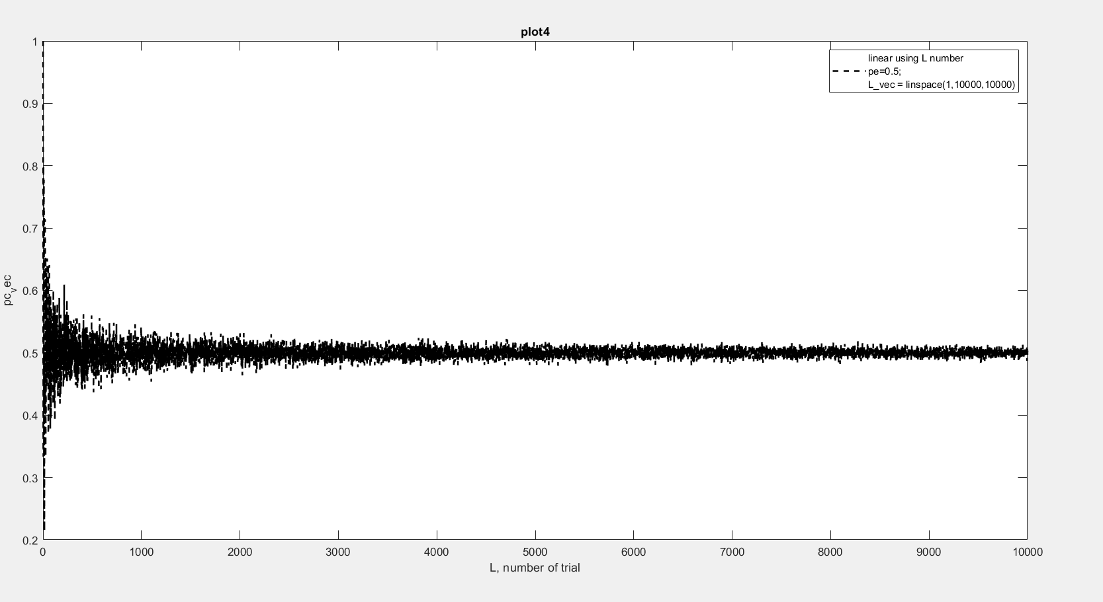
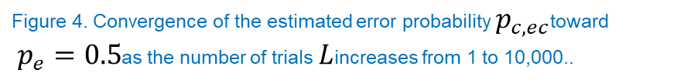
Graph 4 - bsc_graph4.m
Figure 4. Convergence of the estimated error probability $p_{c,ec}$toward
$p_{e}=0.5$as the number of trials $L$increases from 1 to 10,000..
10

Slide 9
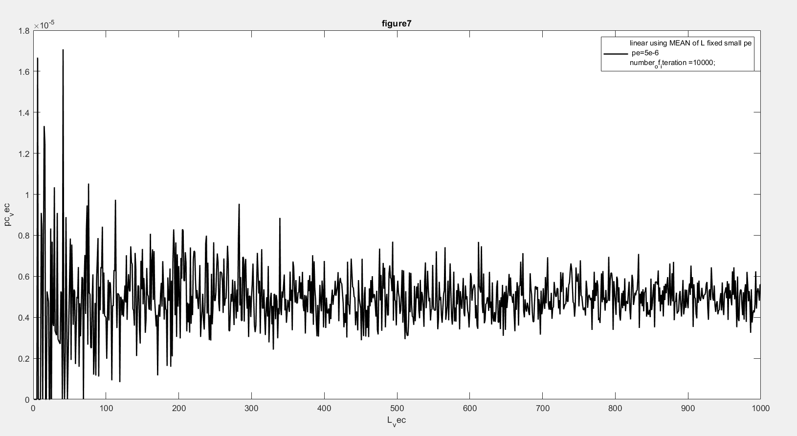
Graph 5- bsc_graph5.m
Figure 5. Mean estimated error probability $p_{c_vec}$for a fixed low channel error probability $p_{e}=5×{10}^{−6}$, evaluated over $10,000$iterations as $L_{vec}$increases.
11

Slide 10
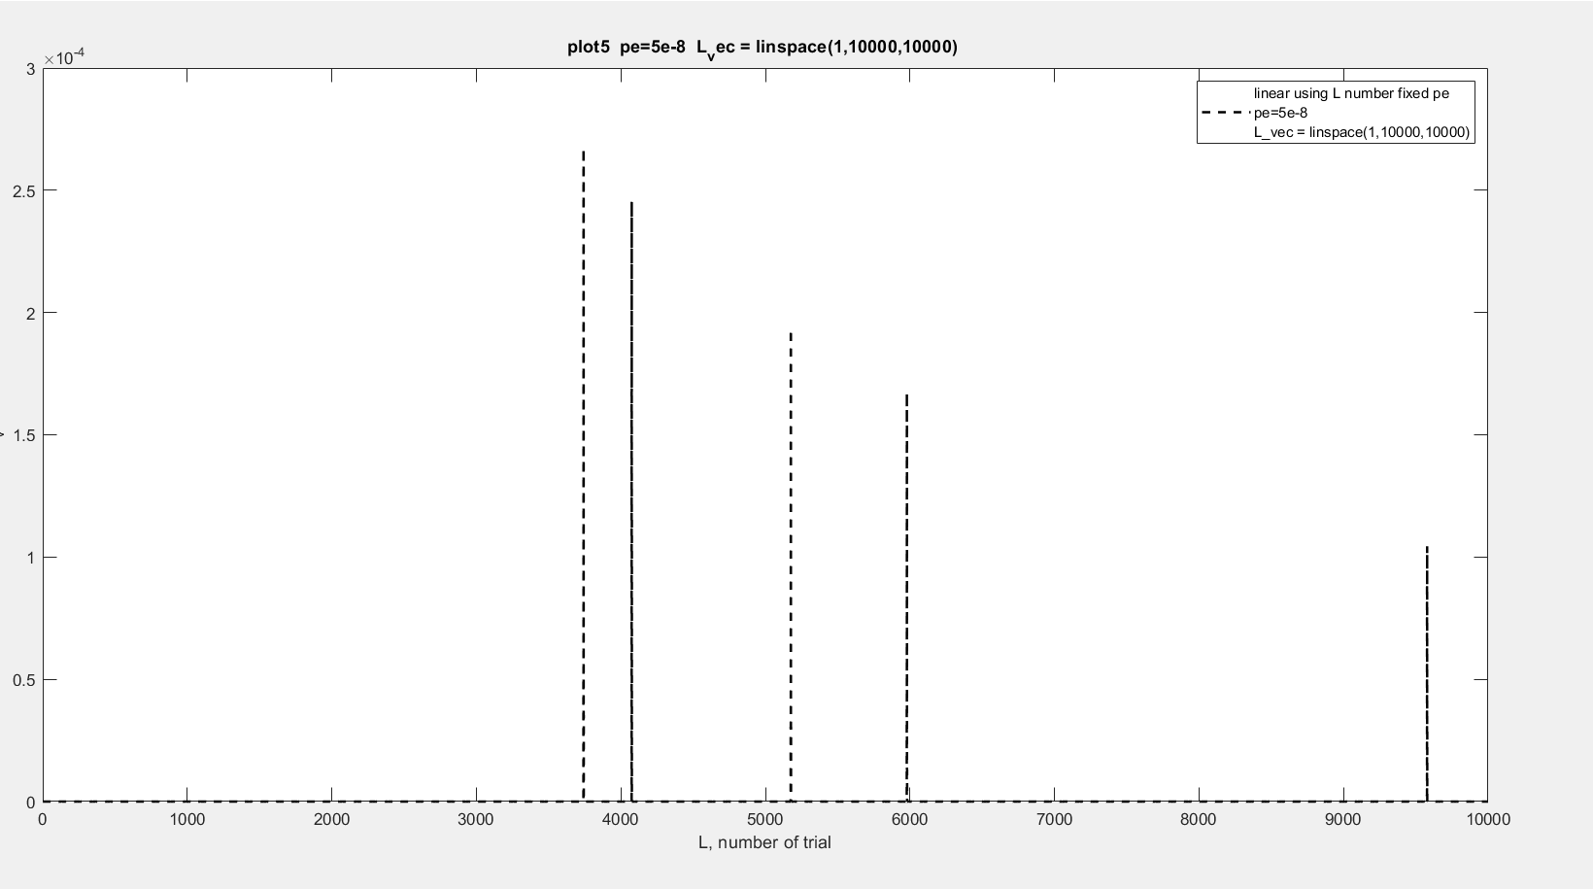
Graph 6 -bsc_graph6.m
Figure 6. Variation of the estimated error probability for a very low channel error probability of $p_{e}=5×{10}^{−8}$as the number of trials $L$increases from 1 to 10,000.
12

Slide 11
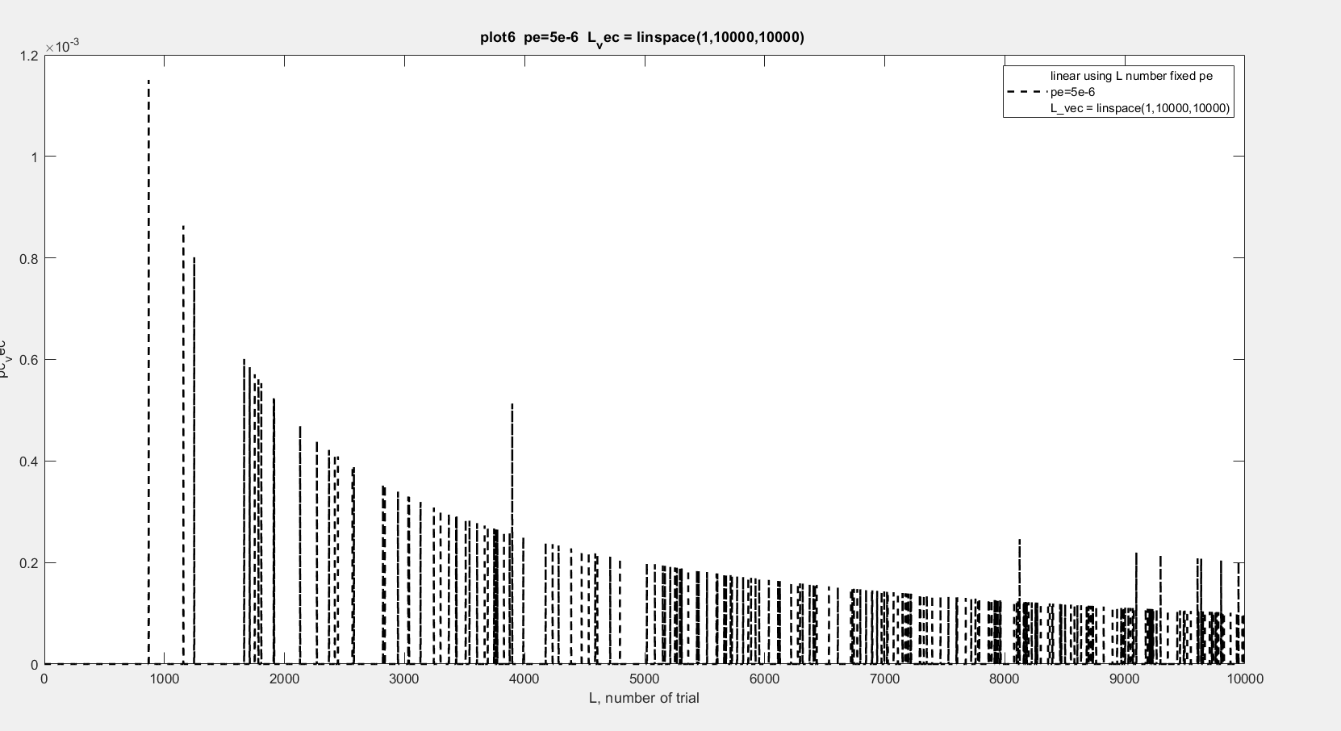
Graph 7- bsc_graph7.m
Figure 7. Estimated error probability for $p_{e}=5×{10}^{−6}$as the number of trials $L$increases from 1 to 10,000, showing decreasing fluctuations and gradual convergence with increasing $L$.
13

Slide 12
Content
Binary Symmetric Channel
Error Detection Algorithm - Parity Check Bit
Error Correction Algorithm - Repetition
Hamming Code
Future Work
References
14

Slide 13
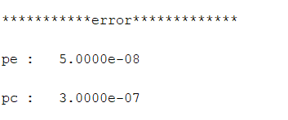
Error Detection Algorithm - Parity Check Bit
15

Slide 14
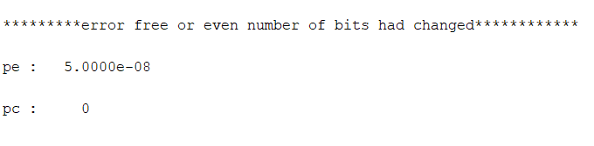
Error Detection Algorithm - Parity Check Bit
16

Slide 15
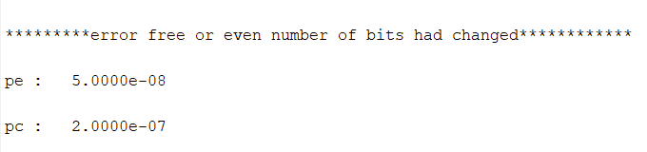
Error Detection Algorithm - Parity Check Bit
17

Slide 16
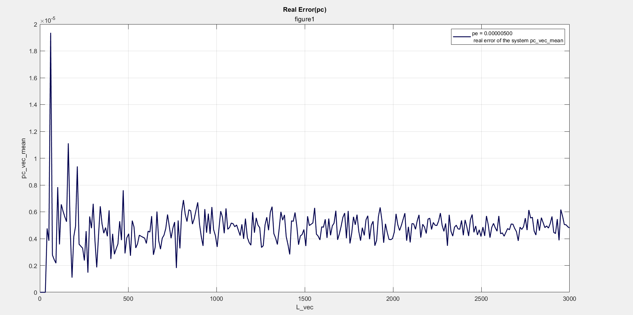
Graph 1- parity_graph1.m
Figure 10. Simulated bit error rate versus data length, showing convergence toward the theoretical error probability of 5 × 10⁻⁶.
18

Slide 17
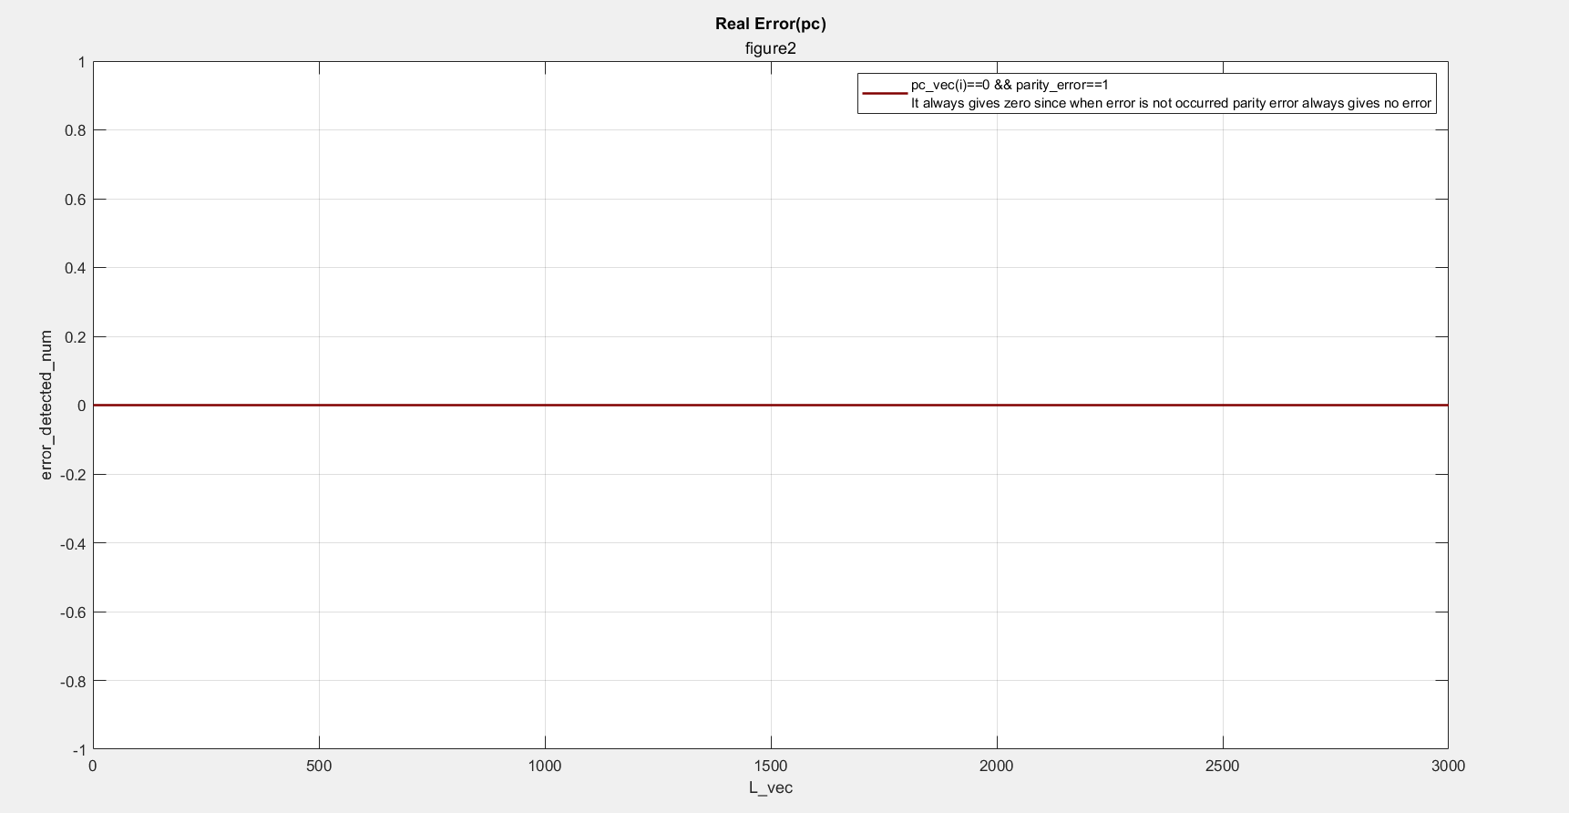
Graph 2 - parity_graph2.m
Figure 10. Number of detected errors versus data length, showing zero for all cases because parity cannot indicate an error when no actual error is present.
18

Slide 18
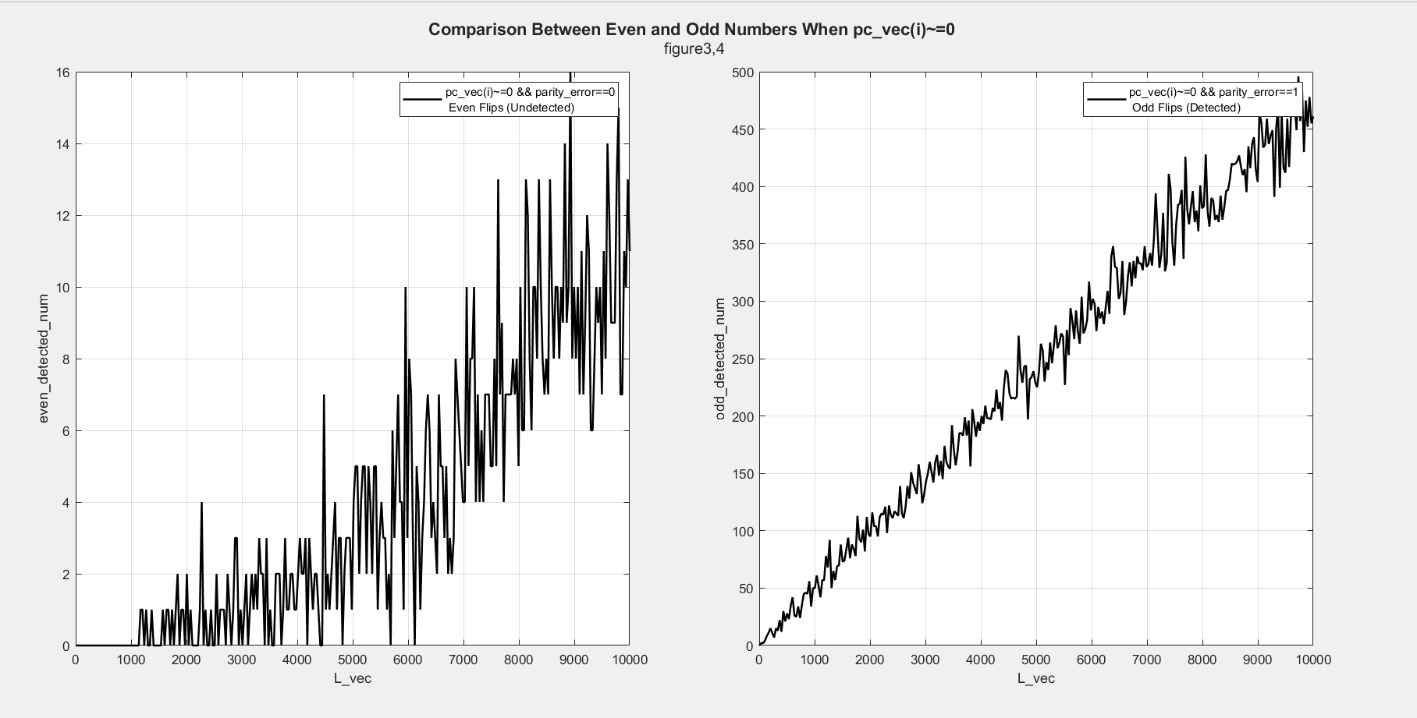
Graph 3,4- parity_graph3.m
pe = 5e-6;
L = 10000;
num_of_trial = 10000;
L_vec = linspace(1,L,300);
L_vec = unique(round(L_vec));
Figure 10. Comparison of parity detection for even and odd bit flips, showing that even-numbered errors may remain undetected while odd-numbered errors are detected as $L$increases.
19

Slide 19
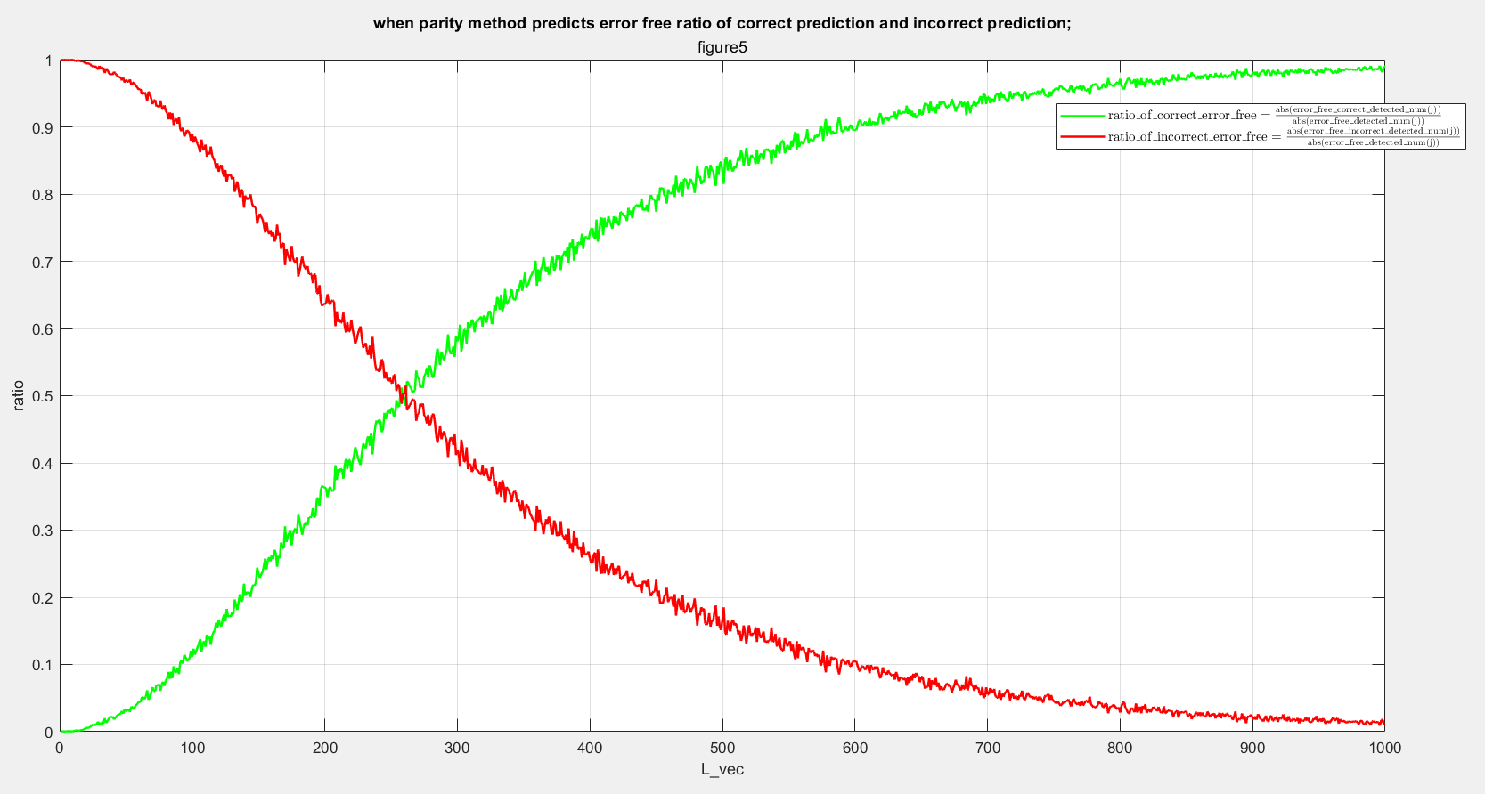
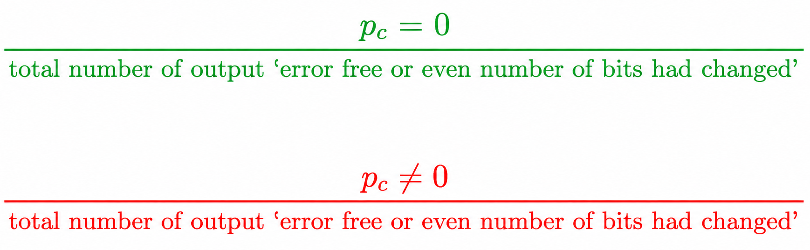
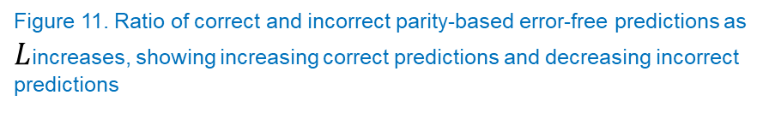
Graph 4 - parity_graph3.m
Figure 11. Ratio of correct and incorrect parity-based error-free predictions as $L$increases, showing increasing correct predictions and decreasing incorrect predictions
20

Slide 20
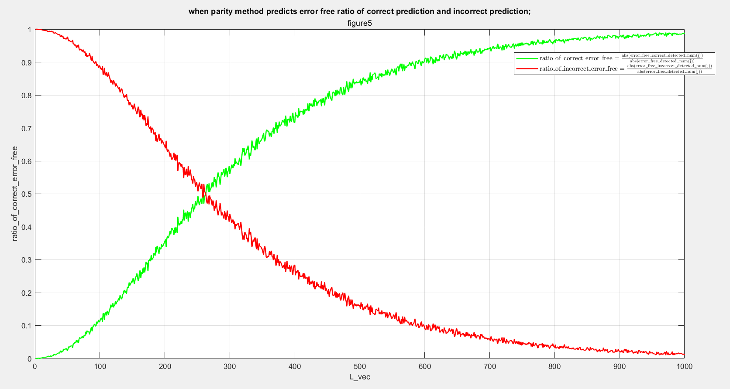
Graph 4-Interpretation
Since we choose pe = 5e-3 while L increasing the number of pc=0 should increase therefore the ratio of correct prediction increases and while L increases error number decreases therefore incorrect number of error decreases.
21

Slide 21
Content
Binary Symmetric Channel
Error Detection Algorithm - Parity Check Bit
Error Correction Algorithm - Repetition
Hamming Code
Future Work
References
22

Slide 22
Error Correction Algorithm
Repetition code
Hamming code
Reed–Solomon code
Convolutional code
LDPC code
Polar code
Golay code
Reed–Muller code
Fountain codes
Raptor codes
23

Slide 23
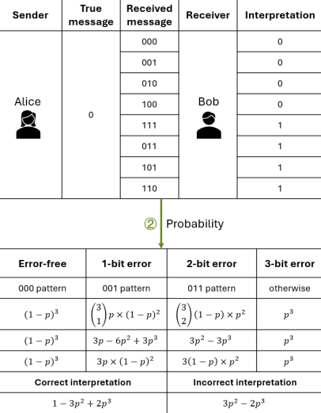
Error Correction Algorithm - Repetition
Figure 12. Repetition-code interpretation and error probabilities for a three-bit redundant encoding. Adapted from Sun and Cribbs (2025), licensed under CC BY 4.0.
24

Slide 24
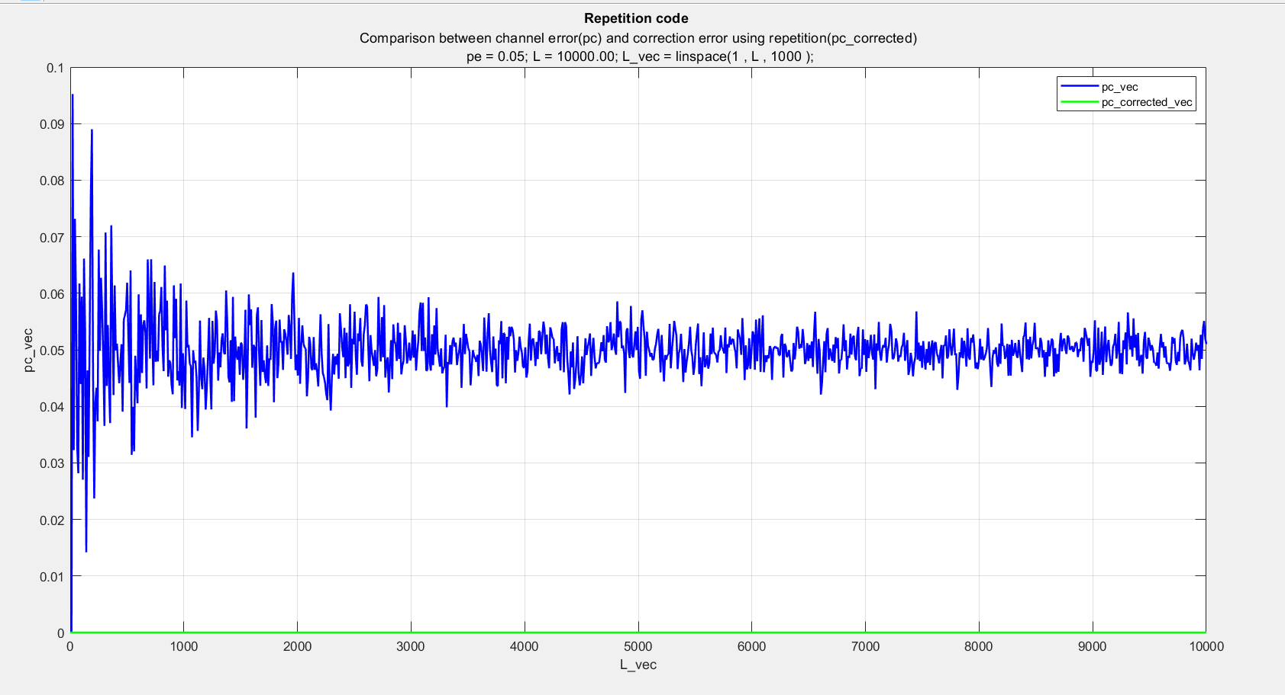
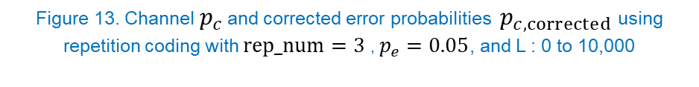
Graph 1- repetition_graph1.m
Figure 13. Channel${ p}_{c}$ and corrected error probabilities $p_{c,corrected}$using repetition coding with $rep_num=3$, $p_{e}=0.05$, and L : 0 to 10,000
26

Slide 25
Graph 1-Interpretation
The reason to extract this graph is we want to see if pe(real channel error)=0.05 are we gonna see the convergence behaviour again and which number is it gonna approach. As we can see calculated non corrected error still converge 0.05 but corrected line oscilates between 0.009 and 0.005.
27

Slide 26
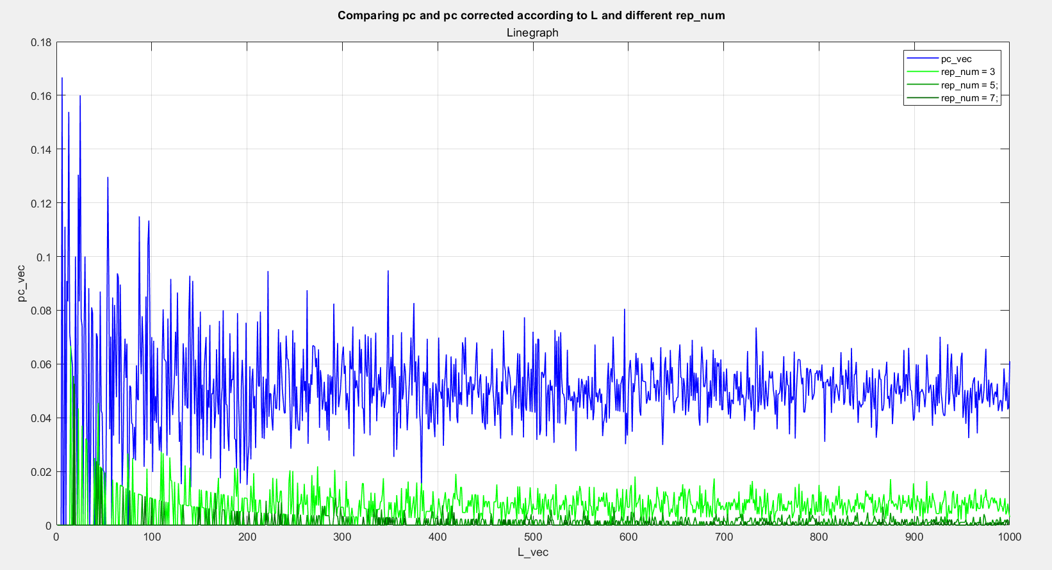
Graph 2- repetition_graph2.m
Figure 12. Comparison of channel and corrected error probabilities for different repetition numbers as L increases to 1000.
Figure X. Comparison of channel and corrected error probabilities for $rep_num=3,5,7$as $L$increases to 1000.
31

Slide 27
Graph 2-Interpretation
The reason to extract this graph is we want to see if pe(real channel error)=0.05 are we gonna see the convergence behaviour again and which number is it gonna approach the lines of rep_num = 3, rep_num = 5, rep_num = 7
32

Slide 28
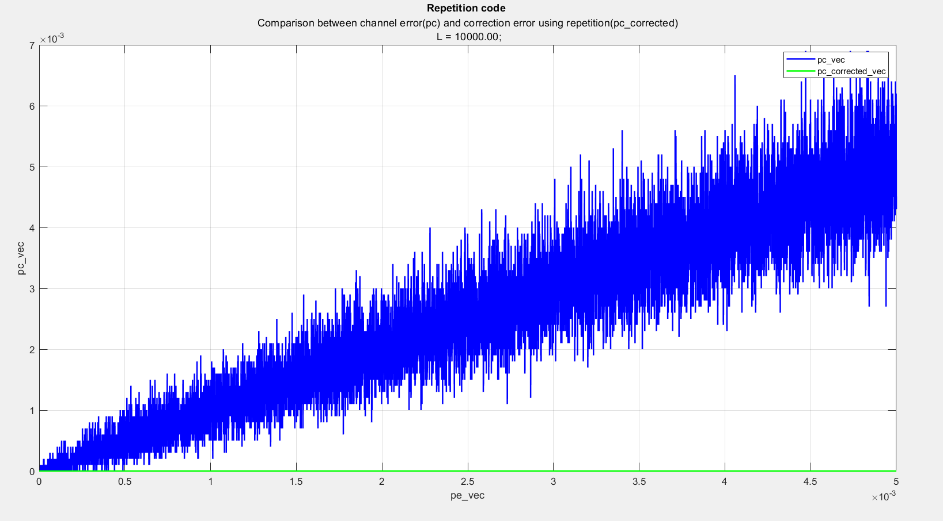
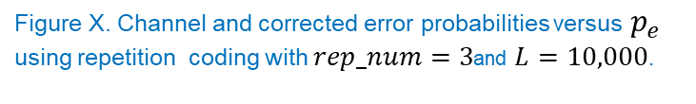
Graph 3 - repetition_graph3.m
Figure 10. Channel and corrected error probabilities versus p_e using repetition coding.
Figure X. Channel and corrected error probabilities versus $p_{e}$
using repetition coding with $rep_num=3$and $L=10,000$.
34

Slide 29
Graph 3-Interpretation
The reason to extract this graph is observing relation between pe, pc_vec, pc_corrected in linear scale.
35

Slide 30
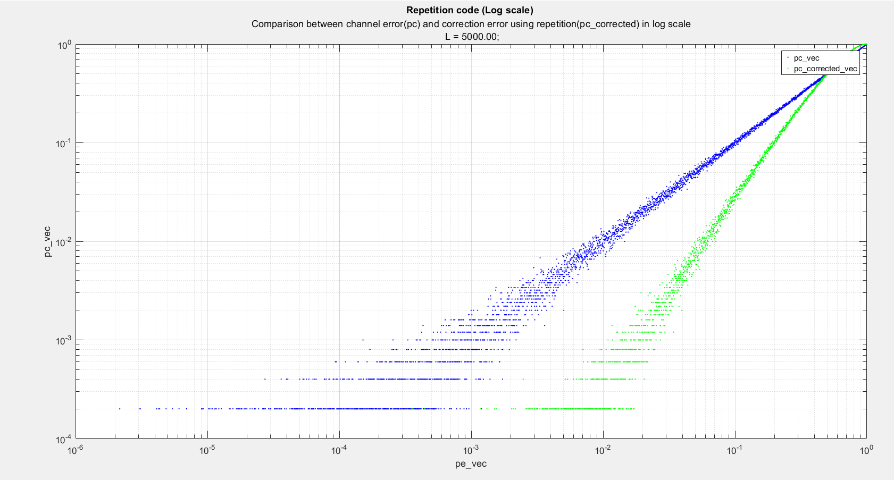
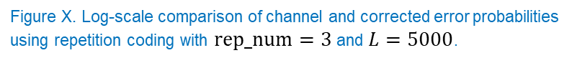
Graph 4 - repetition_graph4.m
Figure 11. Log-scale comparison of channel and corrected error probabilities using repetition coding.
Figure X. Log-scale comparison of channel and corrected error probabilities
using repetition coding with $rep_num=3$ and $L=5000$.
37

Slide 31
Graph 3-Interpretation
The reason to extract this graph is observing relation between pe, pc_vec, pc_corrected in logarithmic scale.
38

Slide 32
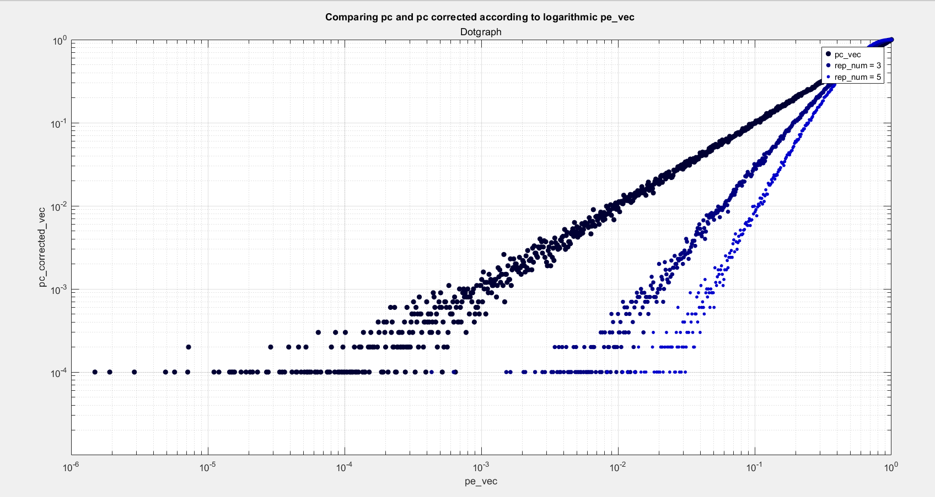
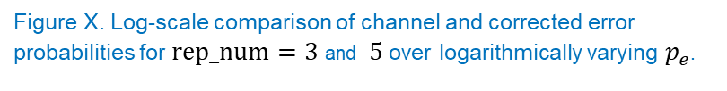
Graph 5 - repetition_graph5.m
Figure 14. Log-scale comparison of channel and corrected error probabilities over logarithmically varying p_e.
Figure X. Log-scale comparison of channel and corrected error probabilities for $rep_num=3$and $5$over logarithmically varying $p_{e}$.
40

Slide 33
Graph 4-Interpretation
The reason to extract this graph is observing relation between pe, pc_vec, pc_corrected(with rep_num=3), pc_corrected(with rep_num=5), pc_corrected(with rep_num=7) in logarithmic scale. As it can be seen while rep_num increasing the line are becoming orthogonal. If it gets infinity we will see line parallel with y axis.
41

Slide 34
Content
Binary Symmetric Channel
Error Detection Algorithm - Parity Check Bit
Error Correction Algorithm - Repetition
Hamming Code
Future Work
References
42

Slide 35
Hamming Code
43

Slide 36
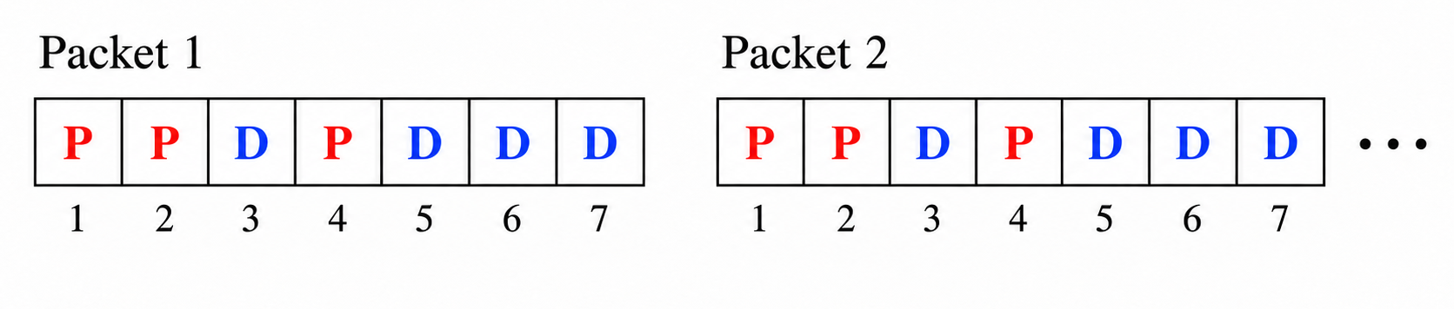
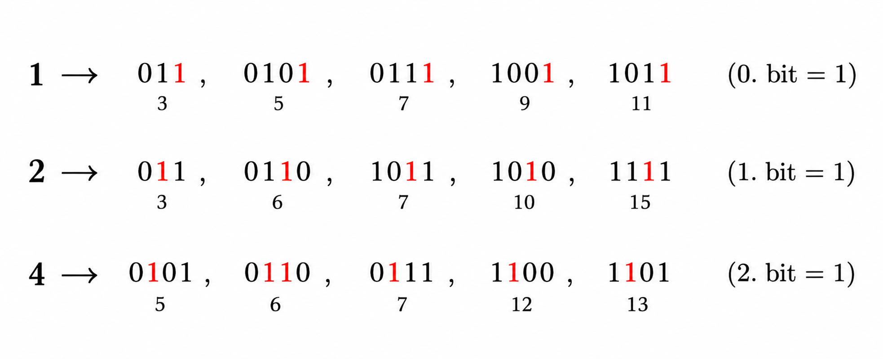
Hamming Code
44

Slide 37
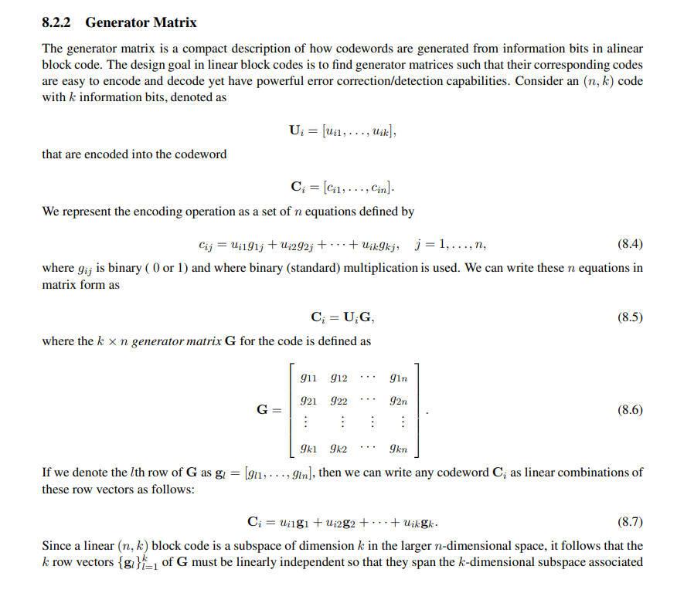
Hamming Code
45

Slide 38
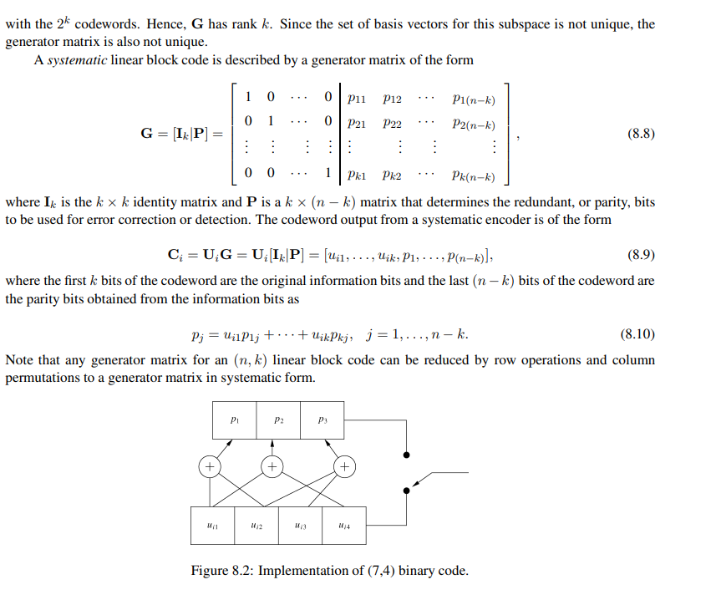
Hamming Code
https://web.stanford.edu/class/ee359/doc/
WirelessComm_Chp1-16_March32020.pdf
46

Slide 39
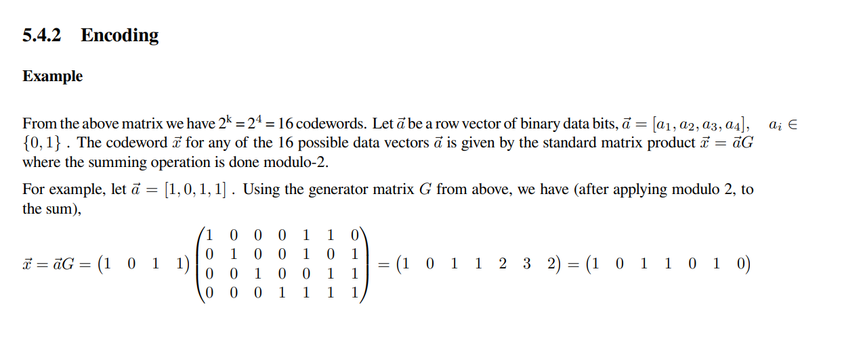
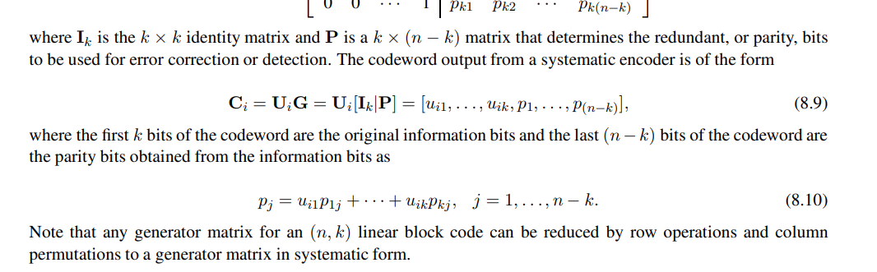
Hamming Code
47

Slide 40
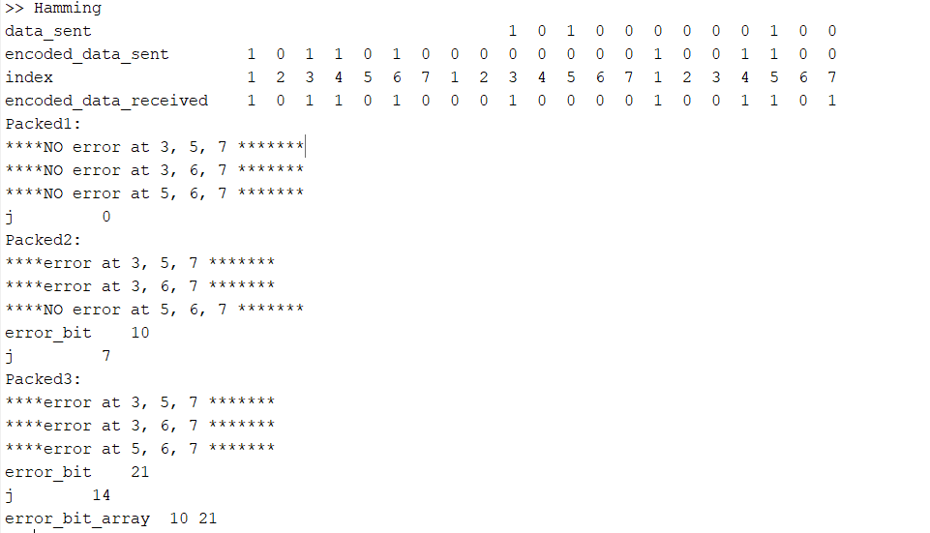
Output 1
48

Slide 41
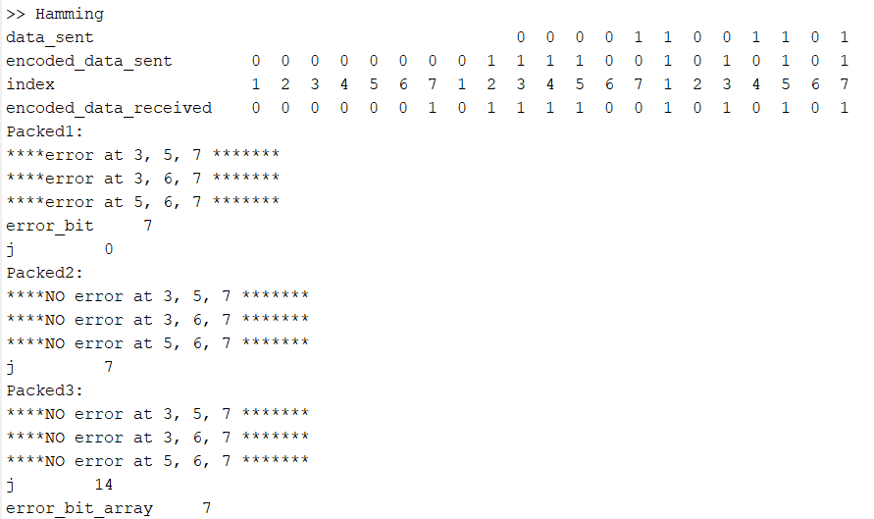
Output 1
49

Slide 42
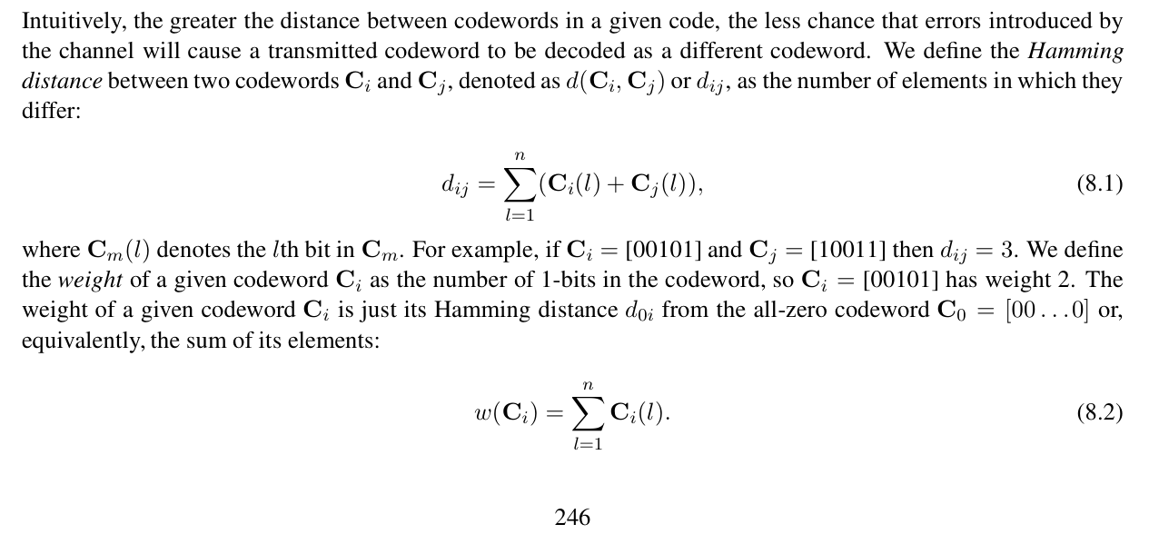
Finding the smallest weight among its nonzero codewords
50

Slide 43
Content
Binary Symmetric Channel
Error Detection Algorithm - Parity Check Bit
Error Correction Algorithm - Repetition
Hamming Code
Future Work
References
51

Slide 44
References
Wikipedia articles
Wikipedia contributors. (n.d.). Binary symmetric channel. In Wikipedia. Retrieved September 6, 2026, from https://en.wikipedia.org/w/index.php?title=Binary_symmetric_channel&oldid=782889856
Wikipedia contributors. (n.d.). Error detection and correction. In Wikipedia. Retrieved September 6, 2026, from https://en.wikipedia.org/w/index.php?title=Error_detection_and_correction&oldid=786170916
Wikipedia contributors. (n.d.). Repetition code. In Wikipedia. Retrieved September 6, 2026, from https://en.wikipedia.org/w/index.php?title=Repetition_code&oldid=776315753
Wikipedia contributors. (n.d.). Hamming code. In Wikipedia. Retrieved September 6, 2026, from https://en.wikipedia.org/w/index.php?title=Hamming_code&oldid=786872328
ResearchGate paper:
Sequencing meets cryptography: Quadratic substitution error suppression through homotrimer redundancy. (n.d.). ResearchGate. Retrieved September 6, 2026, from https://www.researchgate.net/publication/392014884_Sequencing_meets_cryptography_quadratic_substitution_error_suppression_through_homotrimer_redundancy
Wireless Communications Andrea Goldsmith Draft of Second Edition
Chapters 1-16, Appendices A-C Chapter 8
Emilio Sanvicente Understanding Error Control Coding
52

Slide 45
THANK YOU
53

