Slide 1
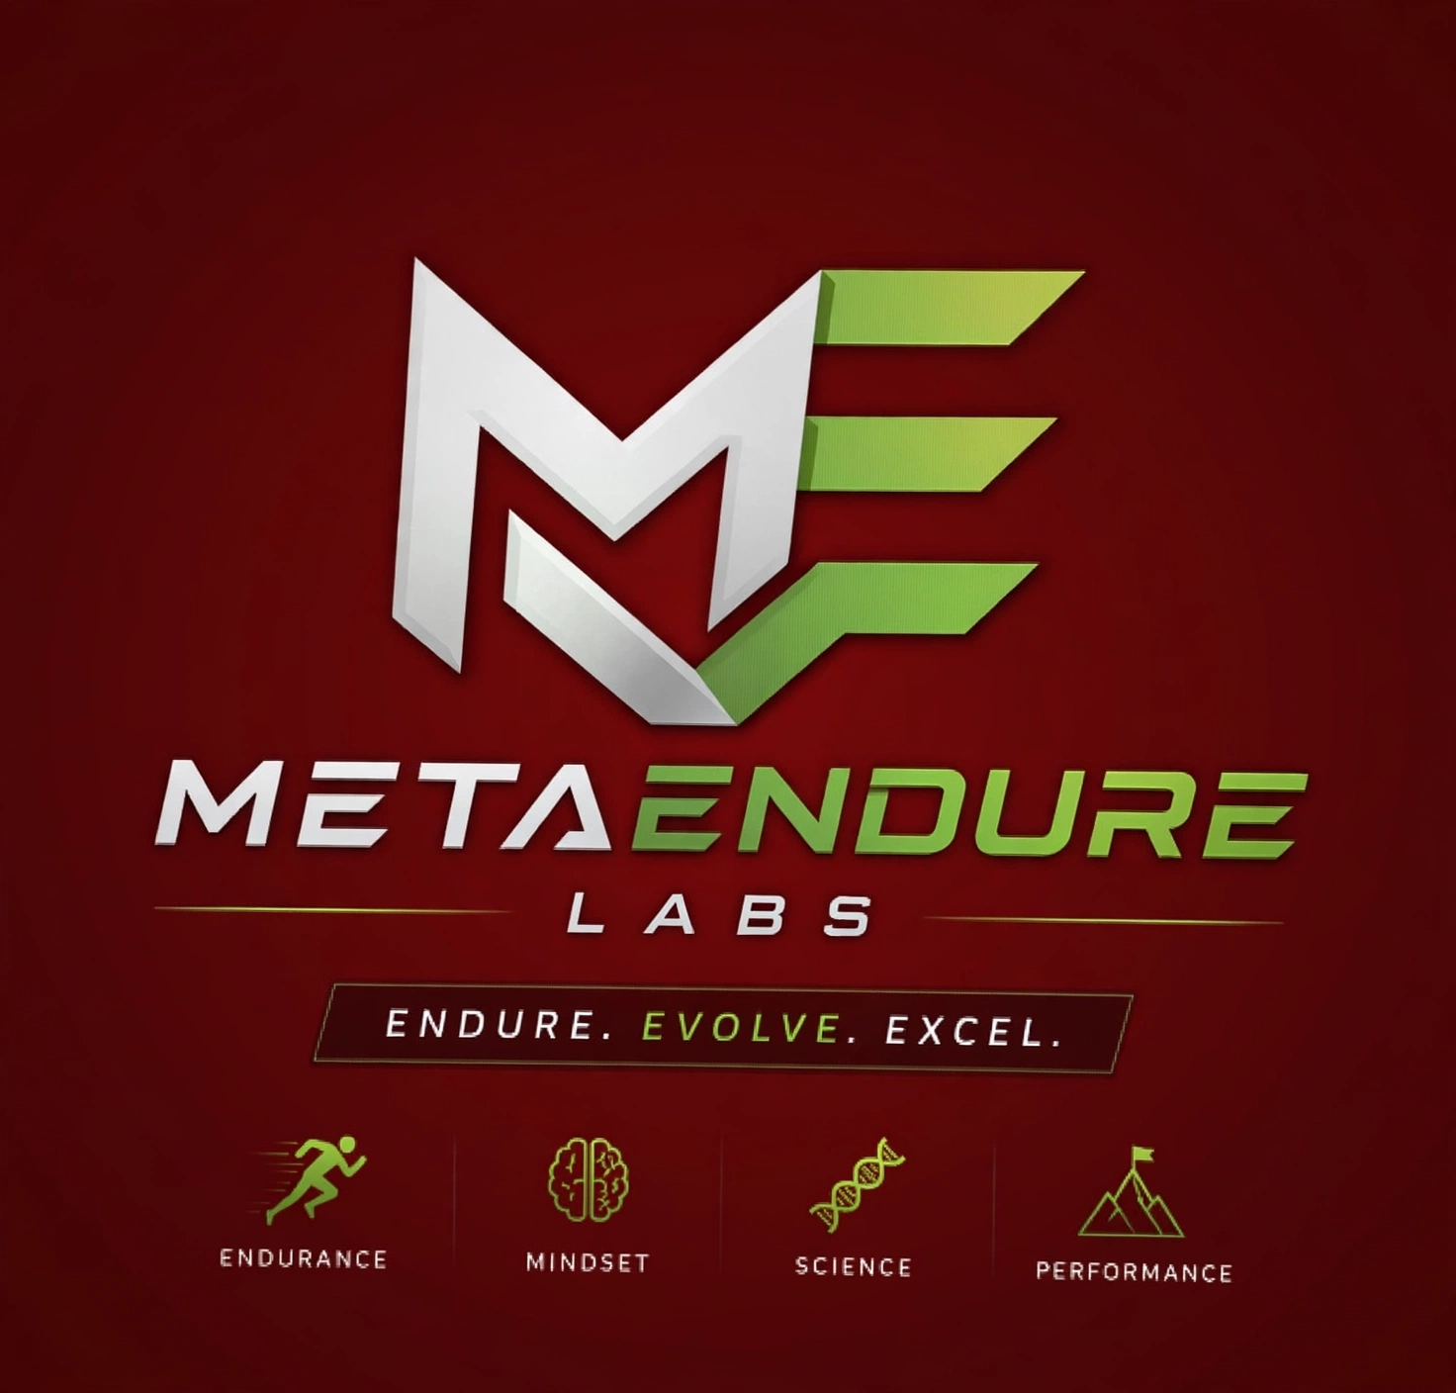
www.metaendurelabs.com

Slide 2
METAENDURE LABS – FOUNDER
Sujai Sivan
Founder, METAENDURE LABS
Endure. Evolve. Excel.
Endurance Athlete | IRONMAN 70.3 Finisher
Sujai S embodies the philosophy of METAENDURE LABS: Endure. Evolve. Excel.
What began in 2015 as a self-trained runner weighing 84 kg, completing a 10K in 1:08:36 without structured coaching, nutrition, or a training plan, evolved into a decade-long journey of transformation.
Through science-backed training, disciplined nutrition, systematic coaching, and relentless consistency, Sujai transformed both physical and mental resilience, reducing body weight by over 18 kg and achieving significant performance improvements across endurance sports.
www.metaendurelabs.com

Slide 3
METAENDURE LABS – FOUNDER
The Turning Point
Between 2015 and 2018, Sujai relied primarily on self-training with minimal focus on nutrition, recovery, or performance systems. While this period built mental toughness, progress was often inconsistent.
The breakthrough came when he embraced a holistic performance approach through structured coaching, personalized nutrition, calibrated training plans, and disciplined execution. The results were transformational:
✅ Faster race times
✅ Significant body composition improvements
✅ Better energy and recovery
✅ Enhanced resilience and consistency
✅ Sustainable long-term performance
This experience became the foundation for METAENDURE LABS.
www.metaendurelabs.com

Slide 4
METAENDURE LABS – ACHIEVEMENTS
Milestone Achievements (2015 to till date)
🏃 10K improved from 1:08:36 → 43:06
🏅 Half Marathon improved from 1:57:55 → 1:40:45
🏃‍♂️ Marathon Finisher
⛰️ Ultra Marathon Finisher (50K & 43K)
🚴 Multiple Triathlon Finisher (BMF & BERGMAN)
🥉 5K Podium Finish (2023)
🔱 IRONMAN Goa 70.3 Finisher (2025)
www.metaendurelabs.com

Slide 5
METAENDURE LABS – WHY ?
METAENDURE LABS was born from a simple realization:
Most people do not fail because they lack potential. They fail because they lack a proven system.
Having personally experienced the difference that science-backed training, performance nutrition, mindset development, and accountability can make, Sujai founded METAENDURE LABS to help recreational athletes, professionals, and everyday individuals unlock their highest potential.
Today, METAENDURE LABS combines endurance training principles, mindset mastery, habit formation, and performance optimization frameworks to help individuals build resilience and achieve lasting excellence in sport, work, and life.
Founder Philosophy
"My journey proves that extraordinary results are not reserved for elite athletes. With the right mindset, structure, and consistency, anyone can transform their performance and redefine their limits. METAENDURE LABS exists to help people do exactly that."
www.metaendurelabs.com

Slide 6
METAENDURE LABS – VISION & MISSION STATEMENT
VISION STATEMENT
Empower recreational athletes, professionals, and everyday individuals to achieve extraordinary levels of endurance, resilience, and performance. Through evidence-based training, mindset transformation, and continuous self-improvement, we aim to create a global community that embraces challenges, pushes beyond limits, and unlocks its fullest human potential.
MISSION STATEMENT
Empower individuals to build enduring physical, mental, and professional resilience through structured endurance training, mindset development, and science-backed performance strategies. We inspire people to push beyond perceived limits, embrace challenges with confidence, and achieve sustainable excellence in sport, career, and life.
www.metaendurelabs.com

Slide 7

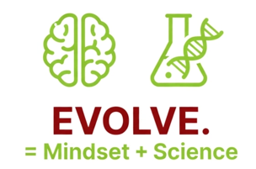
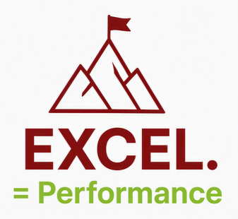
METAENDURE LABS - PILLARS
The foundational phase of resilience, grit, and survival. It represents the capacity to withstand hardships, absorb pressure, maintain discipline, and persist through setbacks or unfavourable conditions without quitting.
The intermediate phase of adaptation and growth. Once you survive the initial pressure, you must learn, shift your mindset, update your strategies, and transform your capabilities to align with a changing environment rather than remaining stagnant.
The ultimate phase of high performance and achievement. By successfully withstanding adversity (enduring) and adapting to new demands (evolving), you ultimately surpass previous limitations, outperform peers, and achieve mastery or market leadership.
www.metaendurelabs.com

Slide 8
METAENDURE LABS
METAENDURE is a combination of two words:
Meta = beyond, higher level, transformation, self-improvement, future-focused.
Endure = persistence, resilience, stamina, the ability to keep going despite difficulty.
Brand Meaning
METAENDURE = "Going beyond endurance."
The white part forms the letter M.
The green part forms the letter E.
M (white) = clarity, discipline, mindset, performance.
E (green) = energy, endurance, growth, evolution.
Together which stands for METAENDURE.
The connected shape suggests forward movement and progression, fitting the idea of "Outlast Your Yesterday."
www.metaendurelabs.com

Slide 9
METAENDURE LABS – FRAME WORK
E = Endurance
The ability to keep going when others stop.
Physical stamina
Recovery
Consistency
Long-term discipline
Brand Message
Endurance is not about speed. It's about staying in the game.
M = Mindset
The engine behind endurance.
Mental resilience
Focus
Self-belief
Grit
Brand Message
The body follows where the mind leads.
S = Science
The differentiator.
Data-driven training
Sports science
Biometrics
Performance testing
Evidence-based coaching
Brand Message
We don't guess. We measure.
P = Performance
The outcome.
Faster
Stronger
Healthier
More resilient
Brand Message
Performance is the result of endurance, mindset, and
science working together.
www.metaendurelabs.com

Slide 10
METAENDURE LABS – WHO WE SERVE
Endurance Athletes
Runners
Cyclists
Triathletes
Ultra-distance athletes
Working Professionals
Busy individuals seeking sustainable fitness
Leaders wanting increased resilience and energy
Professionals managing stress and performance
Transformation Seekers
Weight loss journeys
Lifestyle optimization
Habit-building and consistency development
High Performers
Entrepreneurs
Executives
Competitive athletes
Individuals pursuing excellence
MetaEndure Labs helps anyone committed to becoming a better version of themselves.
www.metaendurelabs.com

Slide 11
METAENDURE LABS – WHAT WE OFFER
Endurance Coaching
5K, 10K, Half Marathon, Marathon
Race preparation plans
Personalized coaching
Triathlon Coaching
Swim, Bike, Run integration
Structured training plans
Race strategy guidance
Performance Nutrition
Sports nutrition fundamentals
Race fuelling strategies
Weight management
Mindset Development
Resilience coaching
Goal achievement framework
Performance psychology principles
www.metaendurelabs.com

Slide 12
METAENDURE LABS – OUR PERFORMANCE SYSTEM
STEP 1: ASSESS
Understand current fitness, habits, lifestyle, and goals.
STEP 2: PLAN
Build a science-backed roadmap tailored to the individual.
STEP 3: EXECUTE
Apply structured training, nutrition, and recovery strategies.
STEP 4: ADAPT
Review performance data and refine the plan continuously.
STEP 5: ACHIEVE
Deliver measurable improvements and sustainable results.
STEP 6: EVOLVE
Create lifelong habits that drive continuous growth.
Endure → Evolve → Excel
www.metaendurelabs.com

Slide 13
METAENDURE LABS – WHAT MAKES US DIFFERENT
Real Experience
Built from a decade-long personal transformation journey.
Science-Backed Approach
Training decisions driven by evidence, not guess work.
Holistic Development
Fitness, nutrition, mindset, recovery, and habits integrated into one system.
Sustainable Results
Focus on long-term performance rather than short-term motivation.
Community & Accountability
Support systems designed to keep individuals progressing.
www.metaendurelabs.com

Slide 14
METAENDURE LABS – TEAM STRENGTH
Menon Fitness System / Race Craft Labs – Coach Sunil Menon
Dr Physio clinic (Therapeutic Sports Massage) – Dr Prince Jacob
Wefityogaandfitness – Coach Rashmi
Strength Training – Coach Suchitra
www.metaendurelabs.com

Slide 15
METAENDURE LABS – OUTLAST YOUR YESTERDAY
METAENDURE LABS exists to help individuals unlock their highest potential through endurance, mindset, science, and performance.
Are you ready to transform?
🌐 www.metaendurelabs.com
📧 sujaisivan@metaendurelabs.com
📱 Connect with METAENDURE LABS
Sujai Sivan
Founder, METAENDURE LABS
"Extraordinary results come from extraordinary consistency."
www.metaendurelabs.com

Slide 16
METAENDURE LABS – HYROX PERFORMANCE PROGRAM
1. HYROX Structured Training
Beginner HYROX Foundation Program (12 weeks)
Intermediate Performance Program (16 weeks)
Advanced/Race Ready Program
Personalized programming
Performance assessments every 4-6 weeks
2. HYROX Simulation Lab
Create a dedicated race simulation zone featuring:
SkiErg
RowErg
Sled Push
Sled Pull
Burpee Broad Jump lanes
Sandbag Lunges
Farmers Carry
Wall Balls
www.metaendurelabs.com

Slide 17
METAENDURE LABS – HYROX PERFORMANCE PROGRAM
Athletes can regularly complete:
Half HYROX simulations
Full HYROX simulations
Station-specific benchmarking
Race pacing drills
3. Pro Athlete Coaching
Weekly masterclasses with HYROX athletes
Race strategy workshops
Technique analysis sessions
Competition preparation camps
4. Recovery & Rehabilitation Lab
METAENDURE Recovery Lab
Ice Baths
Infrared Sauna
Mobility Sessions
Sports Massage Partnerships
Recovery Tracking
www.metaendurelabs.com

Slide 18
METAENDURE LABS – HYROX PERFORMANCE PROGRAM
5. Race Nutrition Lab
Provide:
Pre-race fuelling plans
During-race hydration strategies
Carb-loading protocols
Recovery nutrition guidance
Supplement education
6. Community & Competition
Build a strong HYROX community through:
Monthly Simulation Race Days
Partner HYROX Events
In-House Leaderboards
Team Competitions
HYROX Training Camps
www.metaendurelabs.com

Slide 19
HOME
ABOUT
YOUR SPORTS
WE OFFER
PERFORMANCE COACHES
PERFORMANCE PARTNERS
COMMUNITY
NUTRITION PARTNERS
CONTACT US
FOUNDER
Refer slide 2, 3 & 4
WHY METAENURE LABS
Refer slide 4
VISION
Refer slide 6
MISION
Refer slide 6
PILLARS
ENDURE = ENDURANCE
Refer slide 8
EVOLVE = MINDSET + SCIENCE
Refer slide 8
OUR PERFORMANCE SYSTEM
Refer slide 12
EXCEL = PERFORMANCE
Refer slide 8
WHAT MAKES US DIFFERENT
Refer slide 13

Slide 20
YOUR SPORTS
MARATHON
ROAD RACING
10K / HM / FM / ULTRA
TRAIL RACING
10K / HM / FM / ULTRA
HALF IRONMAN 70.3
TRIATHLON
FULL IRONMAN 140.6
ULTRAMAN
PRO CATEGORY
SOLO
DOUBLES
TEAM RELAY
HYROX
OPEN CATEGORY
SOLO
DOUBLES
TEAM RELAY

Slide 21
WE OFFER
ENDURANCE PERFORMANCE COACHING
TRIATHLON PERFORMANCE COACHING
HYROX PERFORMANCE COACHING
PERFORMANCE NUTRITION
REHABILITATION
CHAMPION MINDSET COACHING

Slide 22
PERFORMANCE COACHES
SUNIL MENON
CEO & Founder MFS , PERFORMACNE NEURO SCIENCE COACH
RASHMI
Founder WefitYoga
SUCHARITA UDAY KARELIA
Strength Training Coach
Marimuthu Sathasivam
Strength & conditioning coach
Mudit kohli
Pro Athlete Endurance Cyclist & Triathlon
SUJAI S
Tri Athlete & Coach (Triathlon)

Slide 23
www.metaendurelabs.com

Slide 24
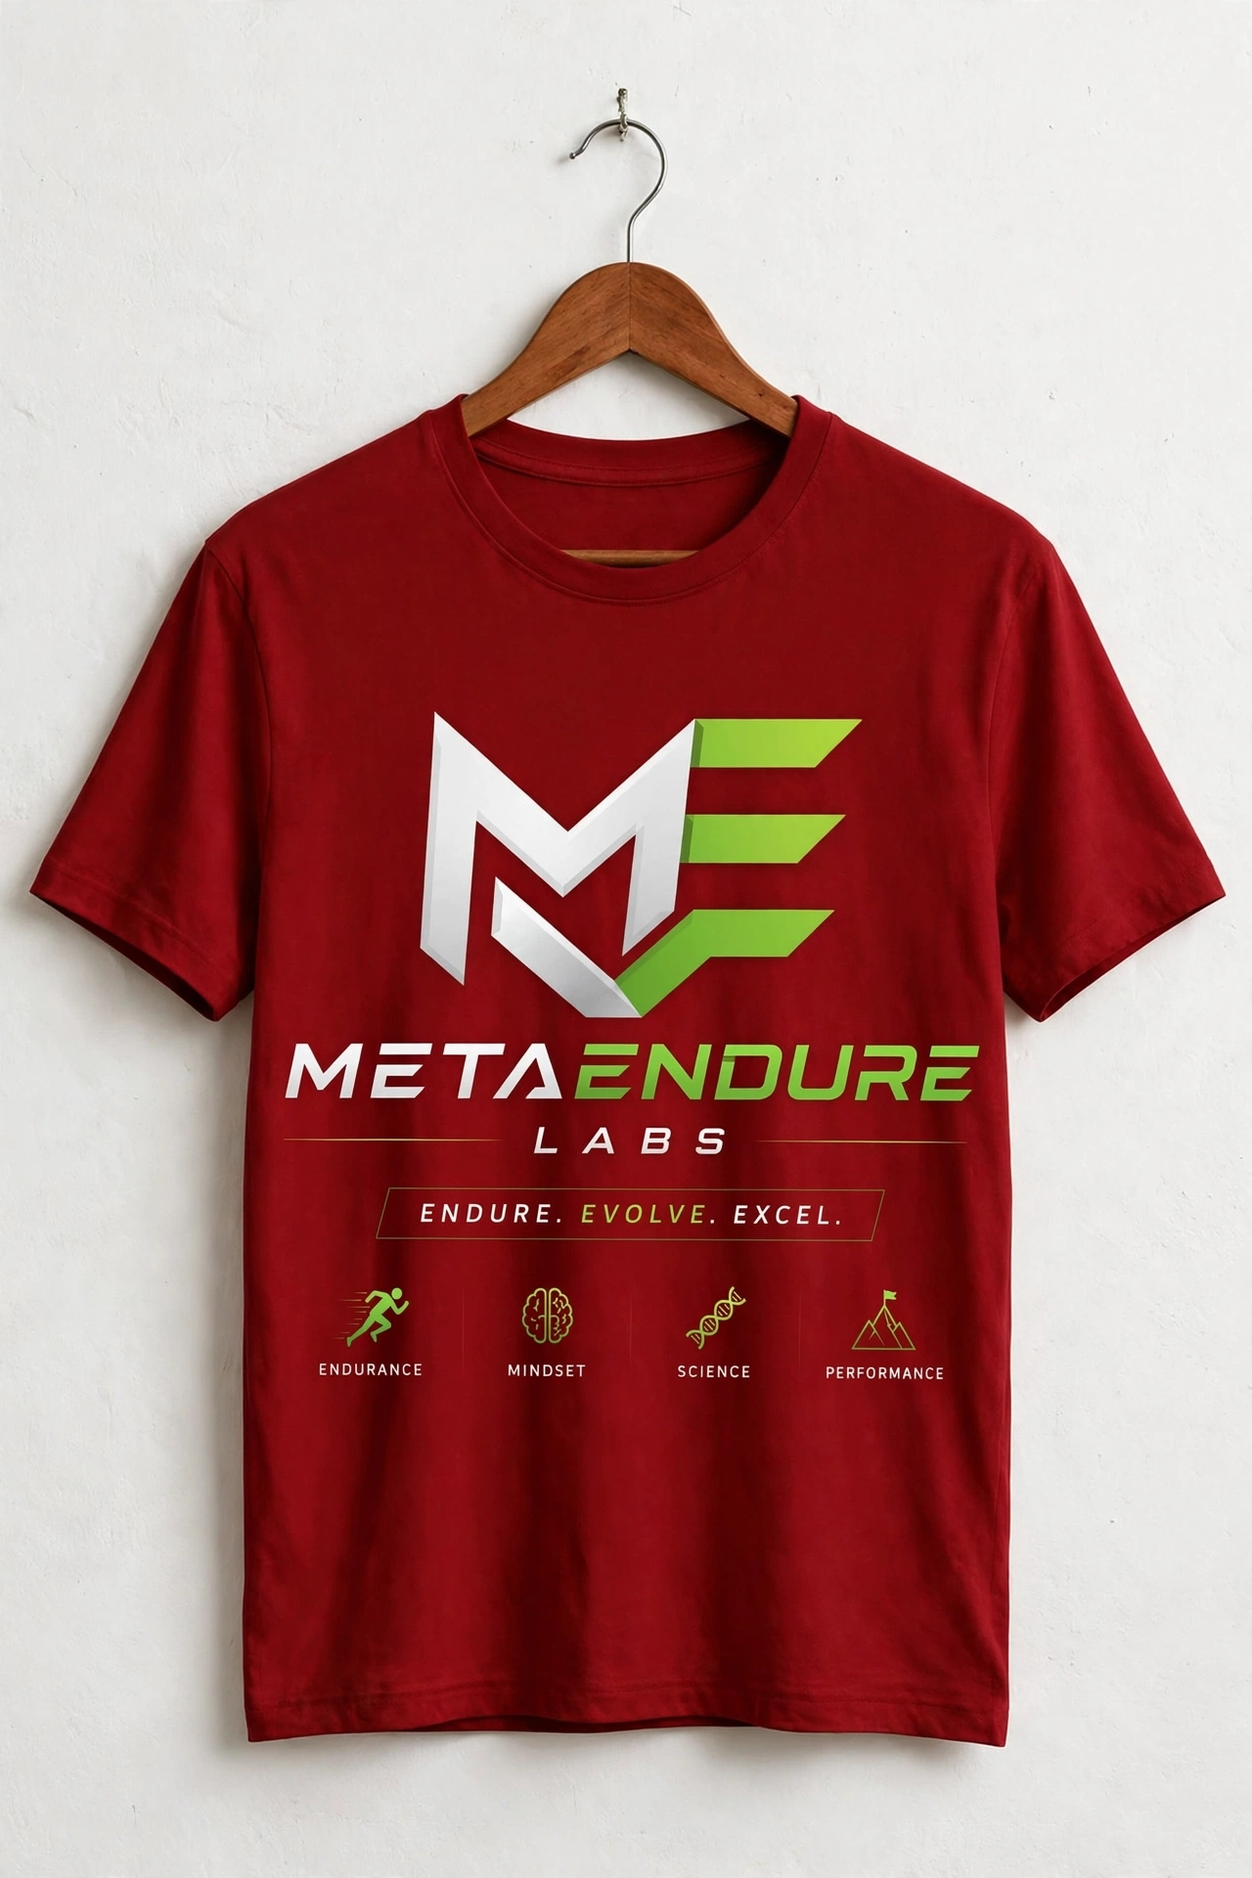
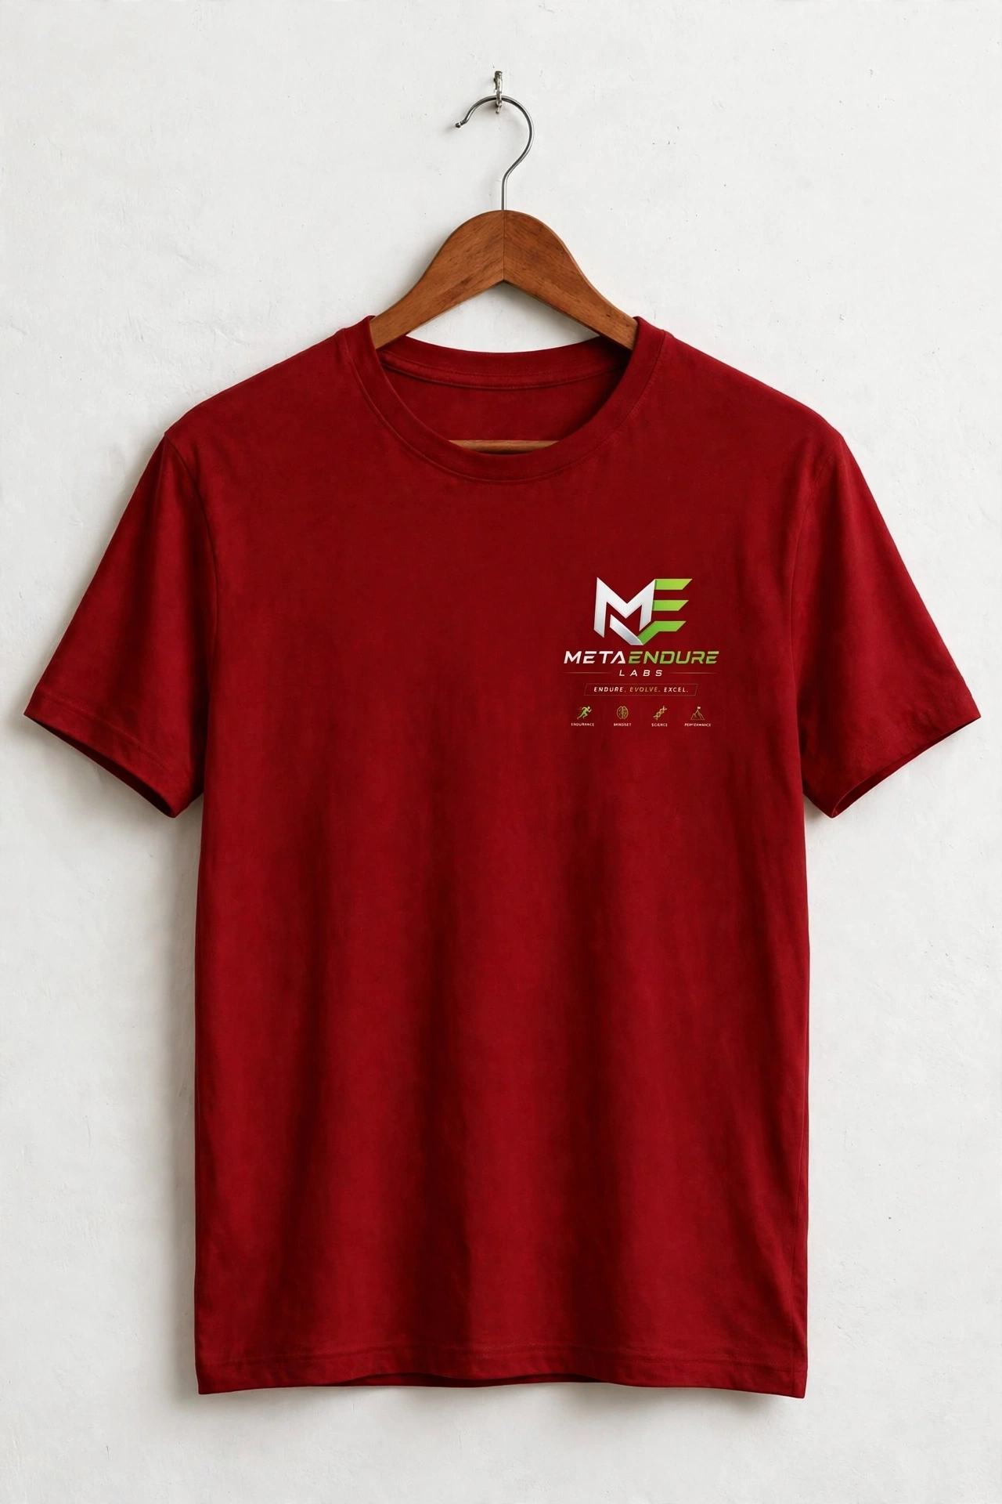
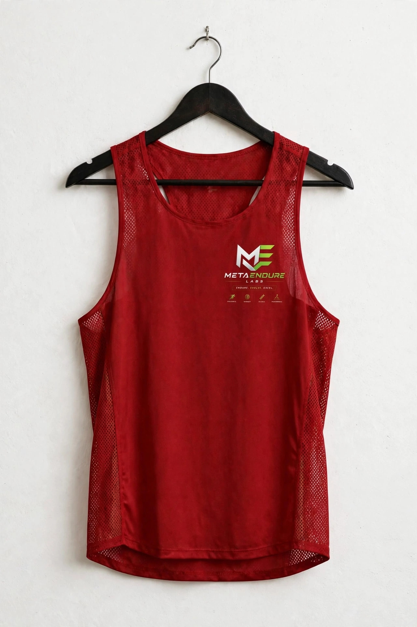
METAENDURE LABS – T-SHIRT
www.metaendurelabs.com

