Slide 1
Docker & Docker Compose

Slide 2


Slide 3
1. Installation
$ sudo yum install -y docker
$ sudo service docker start
$ sudo usermod -a -G docker ec2-user
Logout & Login
$ docker info

Slide 4
2. Docker Search / Pull
$ docker search ubuntu
NAME DESCRIPTION STARS OFFICIAL AUTOMATED
ubuntu Ubuntu is a Debian-based Linux operating s... 3680 [OK]
ubuntu-upstart Upstart is an event-based replacement for ... 61 [OK]
torusware/speedus-ubuntu Always updated official Ubuntu docker imag... 25 [OK]
rastasheep/ubuntu-sshd Dockerized SSH service, built on top of of... 24 [OK]
ubuntu-debootstrap debootstrap --variant=minbase --components... 24 [OK]
nickistre/ubuntu-lamp LAMP server on Ubuntu 6 [OK]
nickistre/ubuntu-lamp-wordpress LAMP on Ubuntu with wp-cli installed 5 [OK]
nimmis/ubuntu This is a docker images different LTS vers... 4 [OK]
nuagebec/ubuntu Simple always updated Ubuntu docker images... 4 [OK]
sylvainlasnier/ubuntu Ubuntu 15.10 root docker images with commo... 2 [OK]
maxexcloo/ubuntu Docker base image built on Ubuntu with Sup... 2 [OK]
$ docker pull ubuntu:latest
$ docker images
REPOSITORY TAG IMAGE ID CREATED SIZE
ubuntu latest b72889fa879c 5 days ago 188 MB

Slide 5
3. Docker Run
$ docker run -i -t --name hello ubuntu /bin/bash
root@d9a798235a76:/# hostname
d9a798235a76
root@d9a798235a76:/# pwd
/
root@d9a798235a76:/# ls
bin boot dev etc home lib lib64 media mnt opt proc root run sbin srv sys tmp usr var
root@d9a798235a76:/# ifconfig
eth0 Link encap:Ethernet HWaddr 02:42:ac:11:00:06
inet addr:172.17.0.6 Bcast:0.0.0.0 Mask:255.255.0.0
inet6 addr: fe80::42:acff:fe11:6/64 Scope:Link
UP BROADCAST RUNNING MULTICAST MTU:1500 Metric:1
RX packets:8 errors:0 dropped:0 overruns:0 frame:0
TX packets:8 errors:0 dropped:0 overruns:0 carrier:0
collisions:0 txqueuelen:0
RX bytes:648 (648.0 B) TX bytes:648 (648.0 B)
lo Link encap:Local Loopback
inet addr:127.0.0.1 Mask:255.0.0.0
inet6 addr: ::1/128 Scope:Host
…

Slide 6
4. Docker Start/Stop/RM/RMI
$ docker ps –a
CONTAINER ID IMAGE COMMAND CREATED STATUS PORTS NAMES
9034a1da6c0d ubuntu "/bin/bash" 12 minutes ago Exited (127) 1 second ago hello
$ docker start hello
$ docker stop hello
$ docker restart hello
$ docker exec hello echo “hello docker”
$ docker attach hello
$ docker rm hello
$ docker images
REPOSITORY TAG IMAGE ID CREATED SIZE
ubuntu latest 20c44cd7596f 5 days ago 123MB
$ docker rmi ubuntu

Slide 7
* clean.sh
$ vi clean.sh
#!/bin/bash
SWARM=`docker ps -a | grep swarm | awk '{print $1}'`
if [ -z $SWARM ]; then
docker stop $(docker ps -q)
docker rm $(docker ps -qa)
else
docker stop $(docker ps -q | grep -v $SWARM)
docker rm $(docker ps -qa | grep -v $SWARM)
fi

Slide 8
5. Create Sample Image
$ docker run -i -t -p 80:80 ubuntu
root@030f2048ad03:/# apt-get -qq update
root@030f2048ad03:/# apt-get install -y apache2
root@030f2048ad03:/# service apache2 start
root@030f2048ad03:/# ps -ef | grep apache2
$ docker ps -a
CONTAINER ID IMAGE COMMAND CREATED STATUS PORTS NAMES
9dfe46045c81 ubuntu "/bin/bash" 3 minutes ago Exited (0) 44 seconds ago pensive_bose
$ docker commit 9dfe46045c81 ubuntu:apache
$ docker images
$ docker run -d -p 80:80 ubuntu:apache /bin/bash -c '/usr/sbin/apache2ctl -D FOREGROUND’
$ docker ps
$ curl http://localhost
$ sh ./clean.sh

Slide 9
6. DockerFile
$ vi dockerfile
FROM ubuntu:14.04
MAINTAINER Foo Bar <foo@bar.com>
RUN apt-get update
RUN apt-get install -y nginx
RUN echo "\ndaemon off;" >> /etc/nginx/nginx.conf
RUN chown -R www-data:www-data /var/lib/nginx
VOLUME ["/data", "/etc/nginx/site-enabled", "/var/log/nginx"]
WORKDIR /etc/nginx
CMD ["nginx"]
EXPOSE 80
EXPOSE 443
$ docker build --tag hello:0.1 .
$ docker images
$ docker run --name hello-nginx -d -p 80:80 -v /home/ec2-user/data:/data hello:0.1
$ docker ps
$ curl http://localhost

Slide 10
7. Docker CP/Commit
$ docker cp hello-nginx:/etc/nginx/nginx.conf ./
$ docker commit -a “Foo Bar <foo@bar.com>” -m “some changes” hello-nginx hello:0.2
$ docker images
REPOSITORY TAG IMAGE ID CREATED VIRTUAL SIZE
hello 0.2 d2e8c352b303 About a minute ago 298.4 MB
hello 0.1 2031ee0736e8 44 minutes ago 298.4 MB
$ docker diff hello-nginx
$ sh ./clean.sh

Slide 11
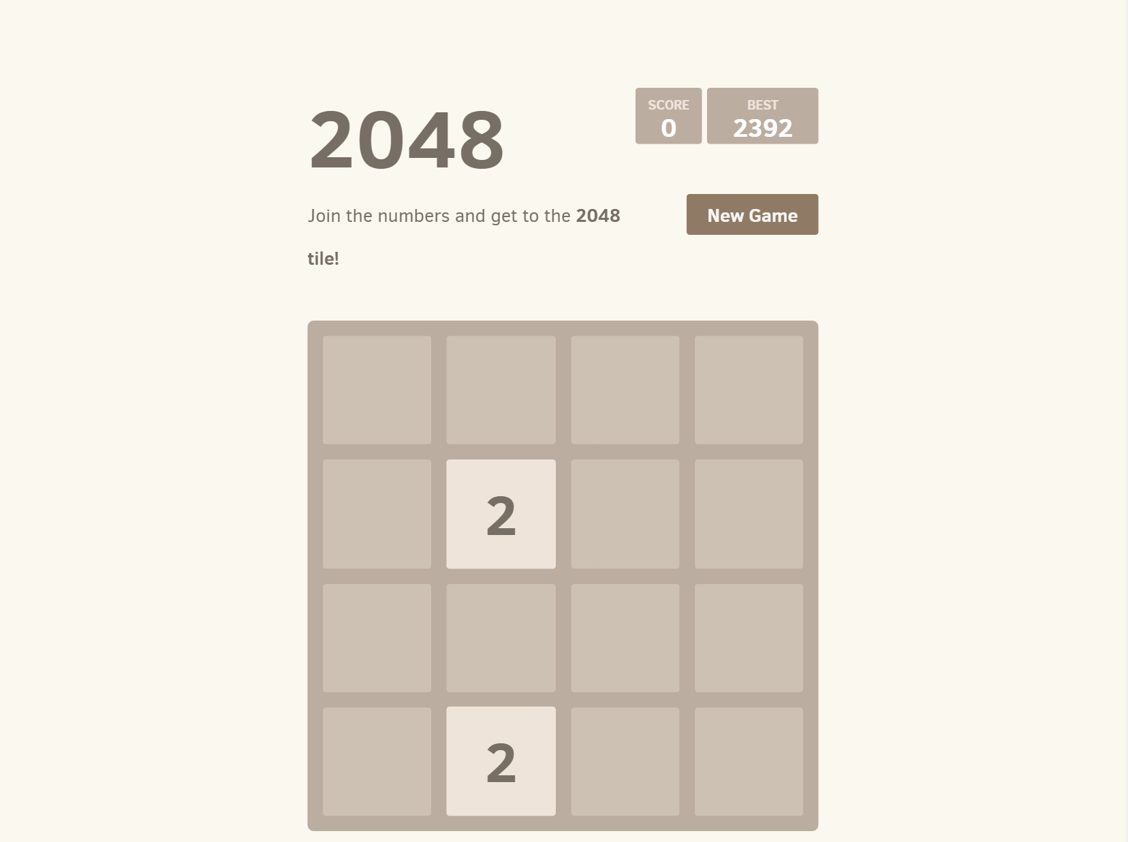
8. Docker 2048 Sample
$ vi dockerfile
FROM tutum/lamp:latest
RUN rm -fr /app && git clone https://github.com/gabrielecirulli/2048.git /app
EXPOSE 80 3306
CMD ["/run.sh"]
$ docker build --tag 2048 .
$ docker run -d -p 80:80 -p 3306:3306 2048

Slide 12
9. Docker Wordpress Sample
$ vi dockerfile
FROM ubuntu:14.04
RUN apt-get update
RUN apt-get install -y apache2 php5 php5-mysql mysql-client wget
WORKDIR /var/www
RUN wget http://ko.wordpress.org/wordpress-4.0-ko_KR.tar.gz -O - | tar -xz
WORKDIR /etc/apache2/sites-enabled
RUN sed -i "s/\/var\/www\/html/\/var\/www\/wordpress/g" 000-default.conf
WORKDIR /var/www/wordpress
RUN mv wp-config-sample.php wp-config.php
RUN sed -i "s/'database_name_here'/'wp'/g" wp-config.php && \
sed -i "s/'username_here'/'root'/g" wp-config.php && \
sed -i "s/'password_here'/getenv('DB_ENV_MYSQL_ROOT_PASSWORD')/g" wp-config.php && \
sed -i "s/'localhost'/'db'/g" wp-config.php
ADD entrypoint.sh /entrypoint.sh
RUN chmod +x /entrypoint.sh
ENTRYPOINT /entrypoint.sh

Slide 13
9. Docker Wordpress Sample
$ vi entrypoint.sh
#!/bin/sh
mysql -h db -uroot -p$DB_ENV_MYSQL_ROOT_PASSWORD -e "create database wp"
apachectl -DFOREGROUND
$ docker build --tag wp-www .

Slide 14
9. Docker Wordpress Sample - DB
$ vi dockerfile
FROM ubuntu:14.04
ENV DEBIAN_FRONTEND noninteractive
RUN apt-get update
RUN echo "mysql-server mysql-server/root_password password" | debconf-set-selections
RUN echo "mysql-server mysql-server/root_password_again password" | debconf-set-selections
RUN apt-get install -y mysql-server
WORKDIR /etc/mysql
RUN sed -i "s/127.0.0.1/0.0.0.0/g" my.cnf
ADD entrypoint.sh /entrypoint.sh
RUN chmod +x /entrypoint.sh
EXPOSE 3306
ENTRYPOINT /entrypoint.sh

Slide 15
9. Docker Wordpress Sample - DB
$ vi entrypoint.sh
#!/bin/bash
if [ -z $MYSQL_ROOT_PASSWORD ]; then
exit 1
fi
mysql_install_db --user mysql > /dev/null
cat > /tmp/sql <<EOF
USE mysql;
FLUSH PRIVILEGES;
GRANT ALL PRIVILEGES ON *.* TO 'root'@'%' WITH GRANT OPTION;
UPDATE user SET password=PASSWORD("$MYSQL_ROOT_PASSWORD") WHERE user='root';
EOF
mysqld --bootstrap --verbose=0 < /tmp/sql
rm -rf /tmp/sql
mysqld
$ docker build --tag wp-sql .

Slide 16
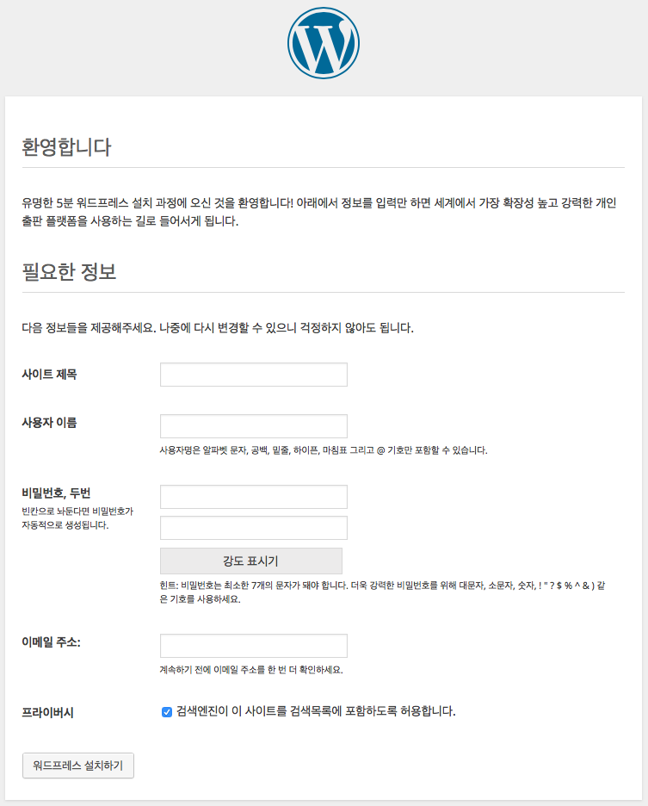
9. Docker Wordpress Sample
$ docker run -d --name db -e MYSQL_ROOT_PASSWORD=examplepassword mysql:5.5
$ docker run -d --name wp -p 80:80 --link db:db wp-www

Slide 17
10. Docker Compose
Docker Compose allows you to define your multi-container application with all of its dependencies in a single file, then spin your application up in a single command
$ sudo curl -L https://github.com/docker/compose/releases/download/1.17.1/docker-compose-`uname -s`-`uname -m` -o /usr/local/bin/docker-compose
$ sudo chmod +x /usr/local/bin/docker-compose
$ docker-compose --version

Slide 18

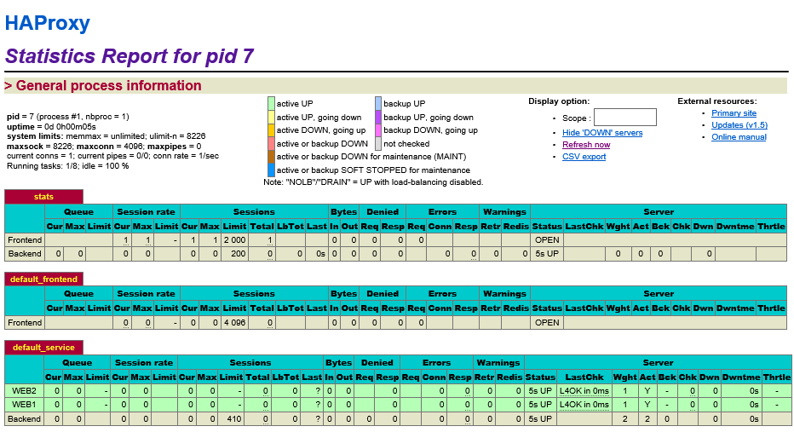

10. Docker Compose : HAProxy
$ docker run -d --name web1 tutum/hello- world
$ docker run -d --name web2 tutum/hello-world
$ docker run -d -p 80:80 --link web1:web1 --link web2:web2 tutum/haproxy
$ vi docker-compose.yml
proxy:
image: tutum/haproxy
links:
- webapp
ports:
- "80:80"
- "1936:1936"
webapp:
image: tutum/hello-world
$ docker-compose up -d
$ docker-compose scale webapp=3
$ docker-compose ps
$ docker-compose stop
$ docker-compose rm

Slide 19
10. Docker Compose : Redis
$ vi docker-compose.yml
web:
build: .
command: python app.py
ports:
- "80:5000"
volumes:
- .:/code
links:
- redis
redis:
image: redis
$ vi dockerfile
FROM python:2.7
ADD . /code
WORKDIR /code
RUN pip install -r requirements.txt
$ vi app.py
from flask import Flask
from redis import Redis
import os
app = Flask(__name__)
redis = Redis(host='redis', port=6379)
@app.route('/')
def hello():
redis.incr('hits')
return 'Hello World! I have been seen %s times.' % redis.get('hits')
if __name__ == "__main__":
app.run(host="0.0.0.0", debug=True)
$ vi requirements.txt
flask
redis

Slide 20
10. Docker Compose : Redis
$ docker-compose up -d
$ docker-compose ps
Name Command State Ports
-----------------------------------------------------------------------------
redis_redis_1 docker-entrypoint.sh redis ... Up 6379/tcp
redis_web_1 python app.py Up 0.0.0.0:80->5000/tcp
$ for i in `seq 1 5`; do curl http://localhost; done
Hello World! I have been seen 1 times.
Hello World! I have been seen 2 times.
Hello World! I have been seen 3 times.
Hello World! I have been seen 4times.
Hello World! I have been seen 5 times.
$ docker-compose stop
$ docker-compose rm

Slide 21

10. Docker Compose : ELKR
$ curl -L http://bit.ly/2BgFJho -o elk.zip
$ unzip elk.zip
launch test EC2 which has more than 4GB memory : > t2.medium

Slide 22
10. Docker Compose : ELKR
$ vi nginx-logcollector.yml
nginx:
image: nginx
ports:
- 80
volumes:
- /home/ec2-user/elk/nginx/nginx.conf:/etc/nginx/nginx.conf
- /home/ec2-user/elk/nginx/log:/var/log/nginx
- /home/ec2-user/elk/nginx/content:/usr/share/nginx/html
logcollector:
image: logstash
external_links:
- elk_redis_1:redis
volumes:
- /home/ec2-user/elk/nginx/log:/nginx/log
- /home/ec2-user/elk/logstash:/config-dir
command: logstash -f /config-dir/log-collector.conf
$ vi log-collector.conf
input {
file {
path => "/nginx/log/access.log"
type => nginx
codec => json
}
}
filter {
geoip {
source => "[@fields][ip]"
}
}
output {
redis {
host => "redis"
port => "6379"
data_type => "list"
key => "logstash"
}
stdout {}
}

Slide 23
10. Docker Compose : ELKR
$ vi log-indexer.yml
logindexer:
image: logstash
external_links:
- elk_redis_1:redis
- elk_elasticsearch_1:elasticsearch
volumes:
- /home/ec2-user/elk/logstash:/config-dir
command: logstash -f /config-dir/log-indexer.conf
$ vi log-indexer.conf
input {
redis {
host => "redis"
port => "6379"
data_type => "list"
key => "logstash"
}
}
output {
elasticsearch {
hosts => ["elasticsearch"]
}
stdout {}
}
$ vi elkr.yml
elasticsearch:
image: elasticsearch
ports:
- 9200:9200
kibana:
image: kibana
ports:
- 5601:5601
links:
- elasticsearch:elasticsearch
redis:
image: redis
ports:
- 6379:6379

Slide 24
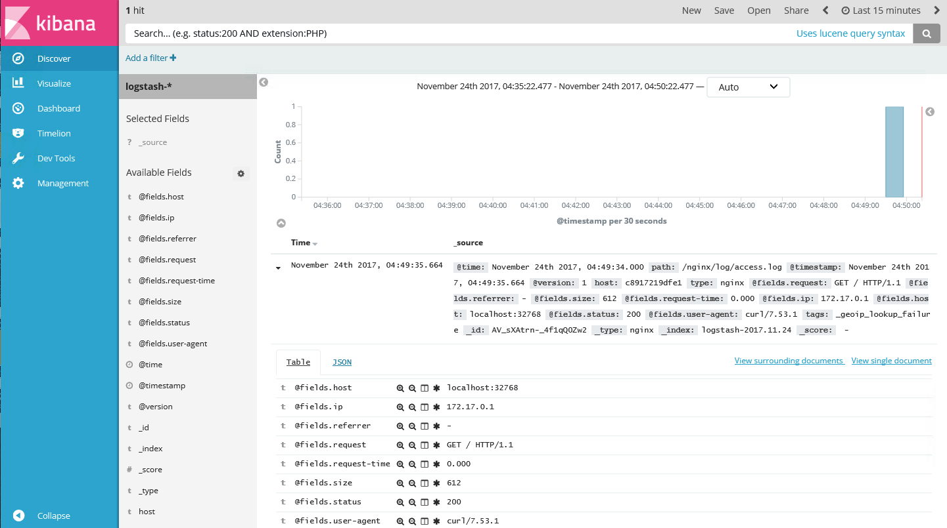





10. Docker Compose : ELKR
$ docker-compose -f elkr.yml up -d
$ docker-compose -f log-indexer.yml up -d
$ docker-compose -f nginx-logcollector.yml up –d
$ docker ps | egrep “nginx|kibana”
3986bff282b6 nginx "nginx -g 'daemon ..." 12 minutes ago Up 12 minutes 0.0.0.0:32768->80/tcp elk_nginx_1
1269ac496855 kibana "/docker-entrypoin..." About an hour ago Up 13 minutes 0.0.0.0:5601->5601/tcp elk_kibana_1
$ curl http://localhost:32768
HTTP:80

Slide 25
Thank you!

