Slide 1

Secure Network Access Options
Overview: To ensure the security of our product and app, which involve managing a motorized gate or altering the database, we propose two secure network access options. These options leverage a MikroTik router and a Python Flask application.
Option 1: MAC Address Filtering: Network access is restricted to specific mobile devices or tablets by using their MAC addresses.
Option 2: Static IP Configuration without DHCP: Allows any device to connect to the network without needing specific models by manually configuring network settings.
Conclusion: Both options offer unique advantages and are suited to different user needs and security requirements.
Photo by Maria Ziegler on Unsplash

Slide 2
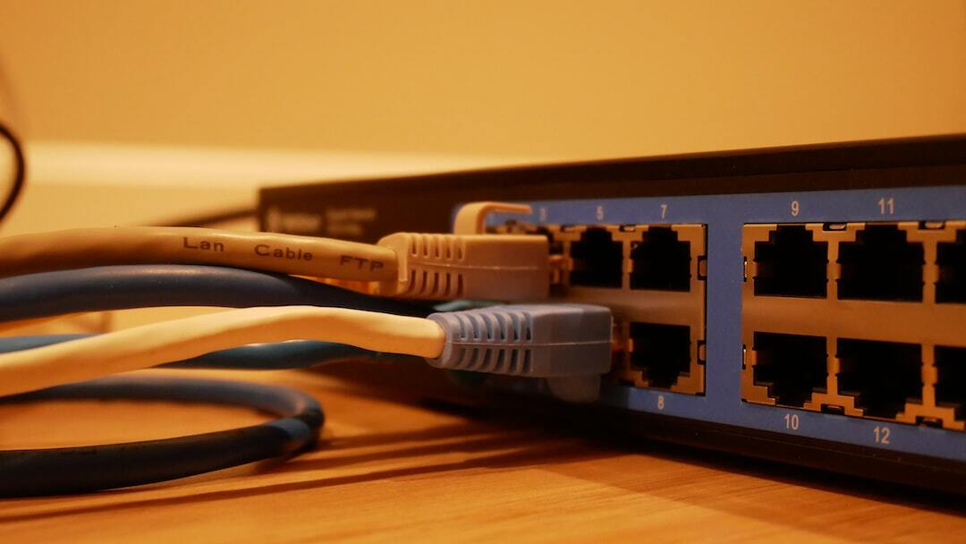
Secure Network Access Options
Overview: To ensure the security of our product and app, which involve managing a motorized gate or altering the database, we propose two secure network access options. These options leverage a MikroTik router and a Python Flask application.
Photo by Jonathan on Unsplash

Slide 3
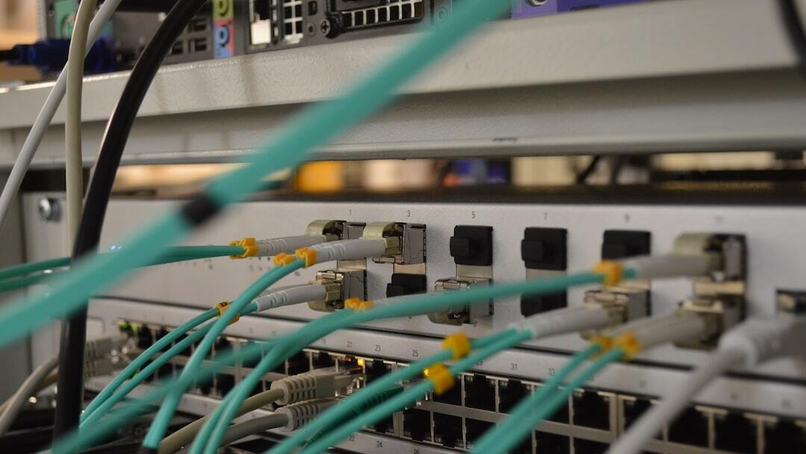
Option 1: MAC Address Filtering
Description: Network access is restricted to specific mobile devices or tablets by using their MAC addresses. These approved devices will connect to the network through the MikroTik router, ensuring that only authorized devices can handle the motorized gate or change the database.
Pros: 1. High Security: Limits network access strictly to pre-approved devices, significantly reducing the risk of unauthorized access. 2. Ease of Use: Devices connect automatically without the need for manual IP configuration. 3. Convenience: Simplifies the setup process for end-users since no manual IP configuration is needed.
Cons: 1. Device Restriction: Only specified devices can access the network, which may limit flexibility. 2. Management Overhead: Requires maintaining and updating the list of approved MAC addresses.
Photo by Thomas Jensen on Unsplash

Slide 4
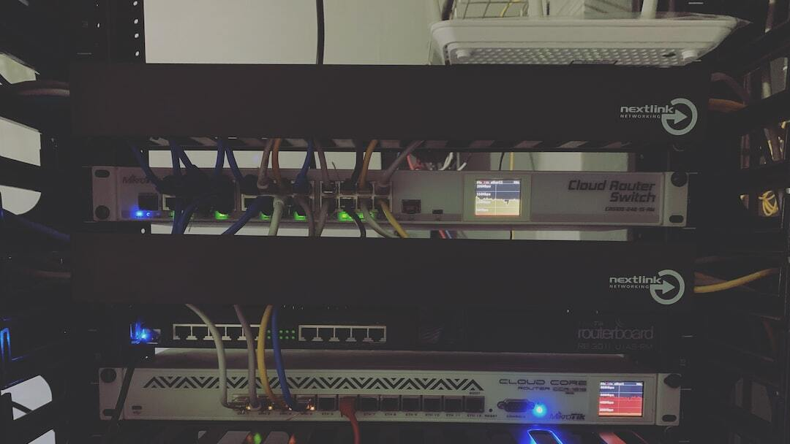
Option 2: Static IP Configuration without DHCP
Description: This option allows any device to connect to the network without needing specific models. Instead of using DHCP, each user must manually configure their network settings. This includes entering the router's user credentials, a static IP address, subnet mask, and gateway.
Pros: 1. Device Flexibility: Any device can connect to the network, increasing accessibility. 2. Scalability: Easier to scale as it doesn’t require maintaining a list of approved devices.
Cons: 1. Complex Setup: Users need to manually configure network settings, which requires technical knowledge. 2. Increased Process Steps: More steps are involved in connecting to the network, which may be cumbersome for some users. 3. Potential for Configuration Errors: Users may incorrectly enter network settings, leading to connection issues.
Photo by Denny Bú on Unsplash

Slide 5

Conclusion
Conclusion: Both options offer unique advantages and are suited to different user needs and security requirements. Option 1 provides enhanced security and ease of use by restricting access to specific devices, making it ideal for environments where device control is paramount. Option 2 offers greater flexibility by allowing any device to connect, though it requires more technical setup and knowledge. Choose the option that best aligns with your security needs and user capabilities.
Photo by Belinda Fewings on Unsplash

Slide 6

Contact Information
Support Email: support@example.com
Support Phone: +1 (123) 456-7890
Website: www.example.com/support
Photo by Melinda Gimpel on Unsplash

