Slide 1
AMIRKABIR UNIVERSITY OF TECHNOLOGY
Department of Computer Engineering
Comparison of Frame-Based
and Event-Based
Computer Vision Models
on Real-Time Embedded Systems
Seyed Sina Negahban
Supervisor: Dr. Hamed Farbeh
SEPTEMBER 2026

Slide 2
BACKGROUND · CAMERAS
Frame and event cameras: two ways to observe a scene
Frame camera
Event camera
Measures light during an exposure.
Outputs complete images at regular intervals.
Each pixel reports when its log-brightness
change crosses a threshold.
t
t + Δt
t + 2Δt
+ brighter − darker time →
Output: I(x, y) per frame
Output: e = (x, y, t, p)
scene appearance · grayscale or RGB
pixel location · timestamp · polarity
Frames record appearance and events report local changes. Both need a model for processing.
02 / 28

Slide 3
BACKGROUND · NEURAL NETWORKS
ANNs and SNNs represent information differently
ANN
SNN
Artificial Neural Network
Spiking Neural Network
y = f(Wx + b)
input + state → spike / no spike
Learned weighted sums + activation functions
produce numerical outputs.
Stateful neurons integrate input and
communicate discrete spikes over time.
A dense feed-forward model processes each
frame independently.
Binary spikes (0 / 1); membrane state persists
between windows.
CNN = Convolutional Neural Network: an ANN using shared local filters to build feature maps.
ANN outputs may also be zero; the difference is the representation and how execution handles it.
03 / 28

Slide 4
BACKGROUND · SPIKING NEURONS
LIF Neuron: integrate, leak, fire, and reset
Spiking Neural Network (SNN) · Leaky Integrate-and-Fire (LIF)
INTEGRATE
LEAK
FIRE
RESET
Accumulate inputs
Decay toward rest
Reach the threshold
Restart after a spike
Membrane potential over time
Fixed time constant τ
Spike
Spike
Firing threshold
Controls how quickly membrane
memory decays.
Larger τ → slower decay
Smaller τ → faster decay
Reset
Standard LIF: choose τ in advance. The neuron retains state between inputs.
04 / 28

Slide 5
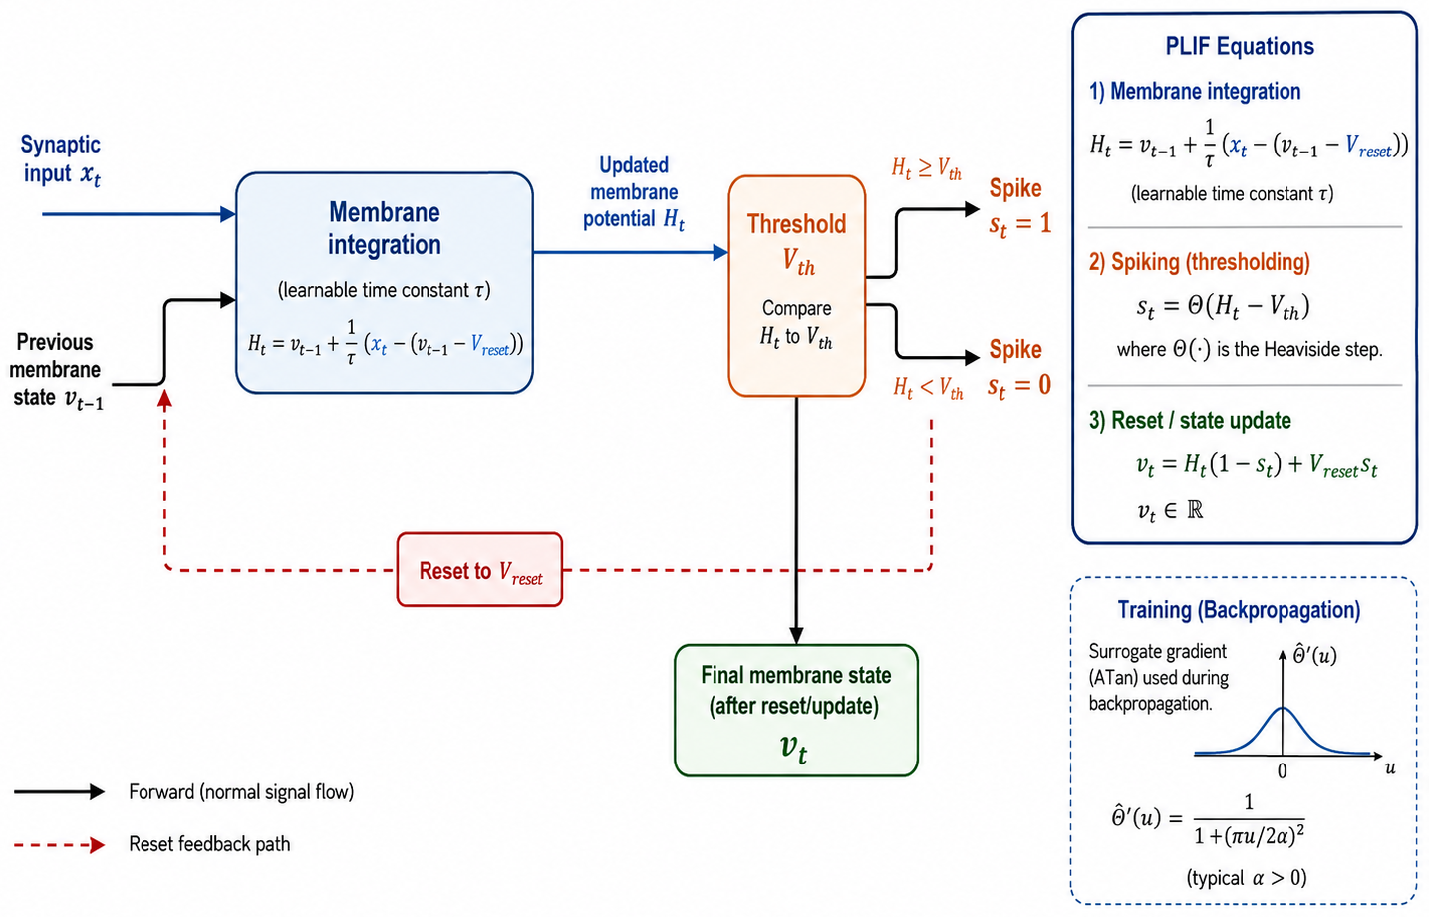
BACKGROUND · SPIKING NEURONS
From LIF to PLIF: learn the time constant
Parametric Leaky Integrate-and-Fire: the same neuron mechanism, with learnable τ
LIF: fixed τ
The time constant is selected before
training.
PLIF: learned τ
Training adapts how the neuron
retains temporal information.
05 / 28

Slide 6
BACKGROUND · COMPUTATION
Why can spikes make computation activity-dependent?
Dense ANN execution
Spike-driven synaptic work
0.2
0
0.8
0
0
1
0
1
Σ
Σ
All 4 input-weight pairs are scheduled
Only w2 and w4 are accumulated
Even a zero can pass through a dense kernel
No spike → no event-triggered accumulation
Fewer spikes → fewer active synaptic accumulations, if execution skips silent connections.
Neuron-state updates, memory, routing, and dense output heads still have costs.
06 / 28

Slide 7
BACKGROUND · EXECUTION PLATFORMS
Neuromorphic hardware is built around neural computation
Computing hardware inspired by nervous systems; processors that execute spiking networks.
Loihi-like spiking processor
What changes in execution?
Cores on the chip
Inside one neural core
Local memory stores neural state.
Arriving spikes trigger synaptic work.
Communication follows spike traffic.
Core 1
Core 2
1 Synaptic memory
Read connected weights
route
2 Neuron state + update
Accumulate · leak · threshold
Core 3
Core 4
State stays local
A GPU can run an SNN too but dense kernels can
not skip inactive entries.
3 Fire + reset at threshold
Gold dots = routed spikes
Output spike → routed to other cores
07 / 28

Slide 8
MOTIVATION · THE DEPLOYMENT PROBLEM
Real-time embedded vision must be efficient
A system must turn sensor data into an action within a limited onboard budget.
Sensor readout
Preprocess
Detect objects
Act / control
The deadline applies to the whole path; delayed output can mean stale decisions.
RESPONSE DEADLINE
POWER & HEAT
MEMORY & BANDWIDTH
Finish in time to react. Falling
behind the input stream delays
decisions.
Battery energy and cooling limit
operating time and sustained
processing.
Weights, features, buffers, and
states must fit; moving data also
costs energy.
Opportunity: events and spikes may reduce work when scene activity is low.
Research gap: Do fewer operations guarantee lower latency or energy on real hardware?
08 / 28

Slide 9
MOTIVATION · RESEARCH QUESTION
Can event-based vision ease these resource limits?
Does Event-SNN reduce computation, memory,
latency, and energy relative to RGB-ANN?
01
02
03
BUILD
CONTROL
EVALUATE
18 matched detector variants
Paired inputs and similar structure
Activity, GPU, analytical, projection
Scope: execution-cost comparison - accuracy and full embedded deployment remain future work.
09 / 28

Slide 10
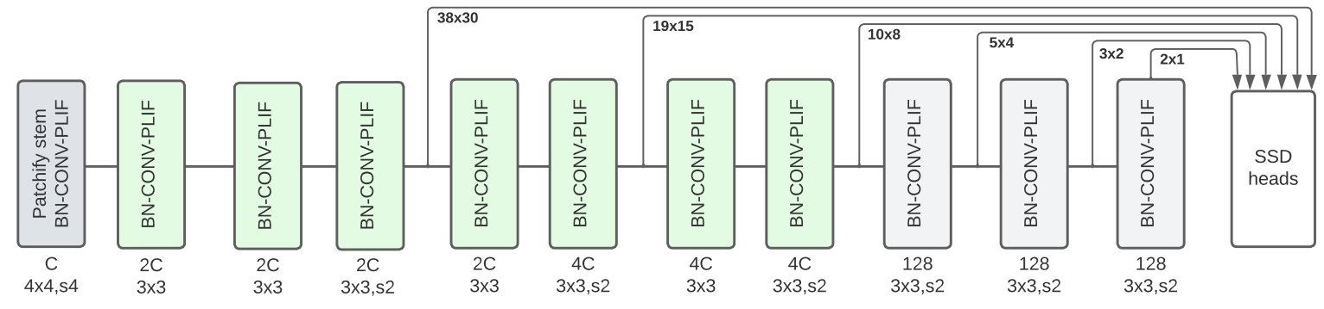
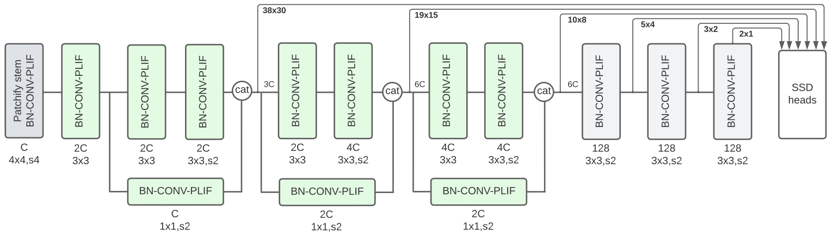
WHAT WE BUILT
Two base architectures form the 18-model matrix
ST-VGG + SSD
Sequential feature blocks
Strided spatial downsampling
ResCat + SSD
Multiple feature paths
Channel concatenation
SSD: multi-scale features → dense class and bounding-box predictions
10 / 28

Slide 11
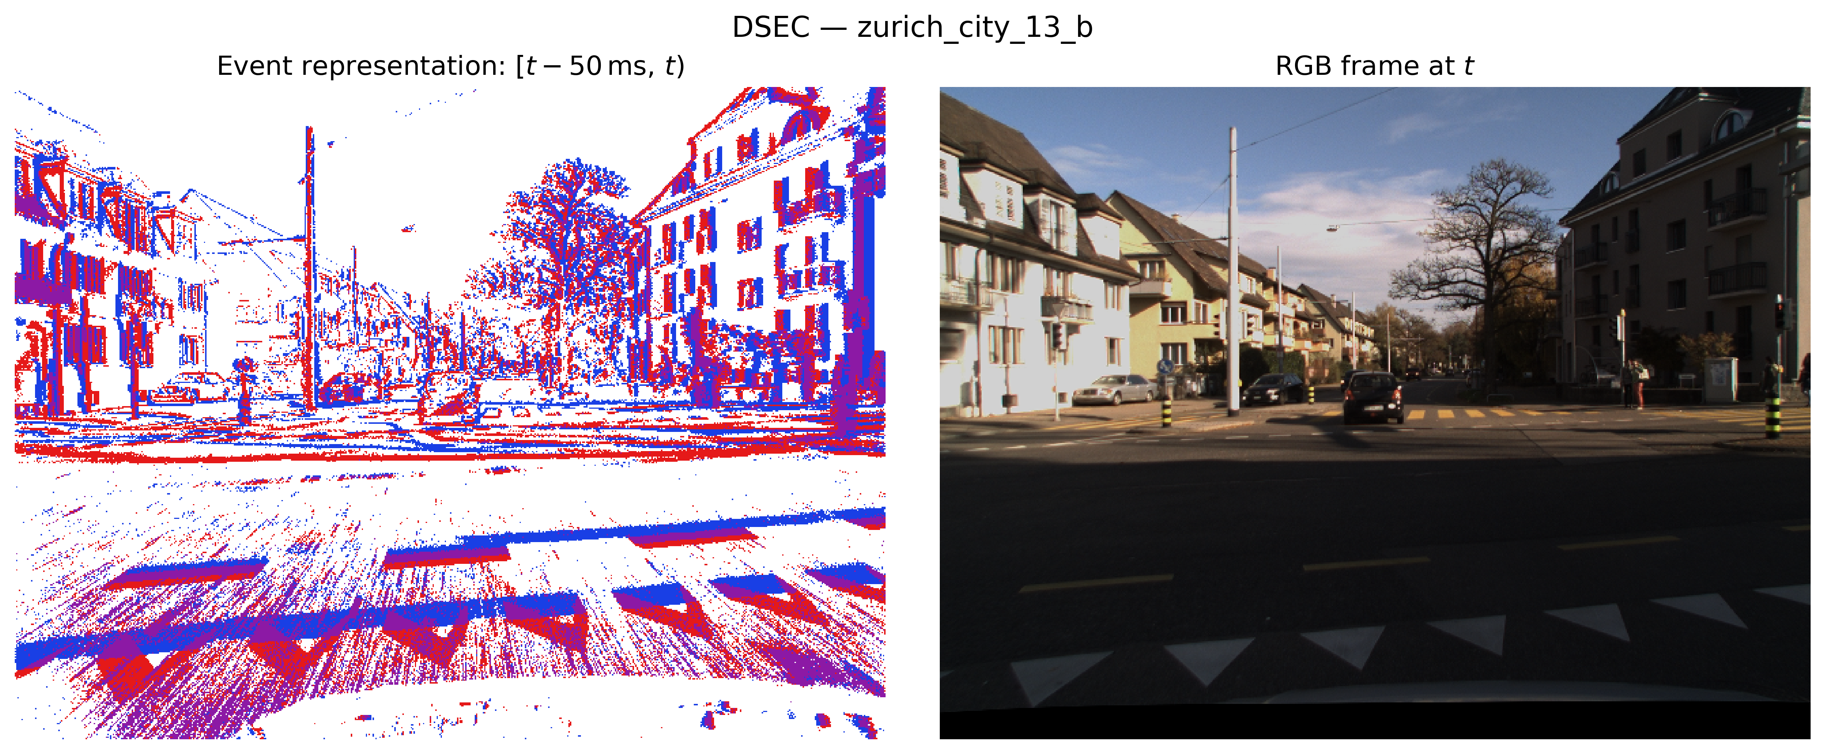
WHAT WE BUILT
The same driving sequence, two input representations
DSEC · zurich_city_13_b
39 consecutive observations
50 ms per event window
480 × 640 resolution
Events: 2 binary channels
RGB: 3 color channels
Matched reference times and scene, but different information representations
11 / 28

Slide 12
WHAT WE BUILT
Three matched pipelines, shown side by side
VARIANT
INPUT
BACKBONE
SSD EXTRAS
OUTPUT HEADS
Event-SNN
Events
BN → Conv → PLIF
PLIF
Dense
Stateful
2 channels
ST-VGG or ResCat
Spiking features
Class + box
Strict RGB-ANN
RGB frame
BN → Conv → ReLU
ReLU
Dense
Per-frame
3 channels
ST-VGG or ResCat
Dense features
Class + box
ANN-native RGB
RGB frame
Conv → BN → ReLU
ReLU
Dense
Per-frame
3 channels
ST-VGG or ResCat
Dense features
Class + box
Matched family and scale: similar topology and parameter count across all three rows.
2 families × 3 channel scales (16 / 32 / 64) × 3 variants = 18 matched models
12 / 28

Slide 13
EVALUATION
Four kinds of evidence answer different questions
ACTIVITY
GPU MEASUREMENT
18 full detectors
18 full detectors
Parameters, MACs, spike rates
T4 · PyTorch/CUDA · NVML
ANALYTICAL MODEL
ARCHITECTURAL PROJECTION
18 full detectors
6 spiking subnetworks
Lemaire · fixed energy assumptions
SANA-FE · Loihi-1-like mapping
Full detector includes dense heads. SANA-FE excludes those heads.
13 / 28

Slide 14
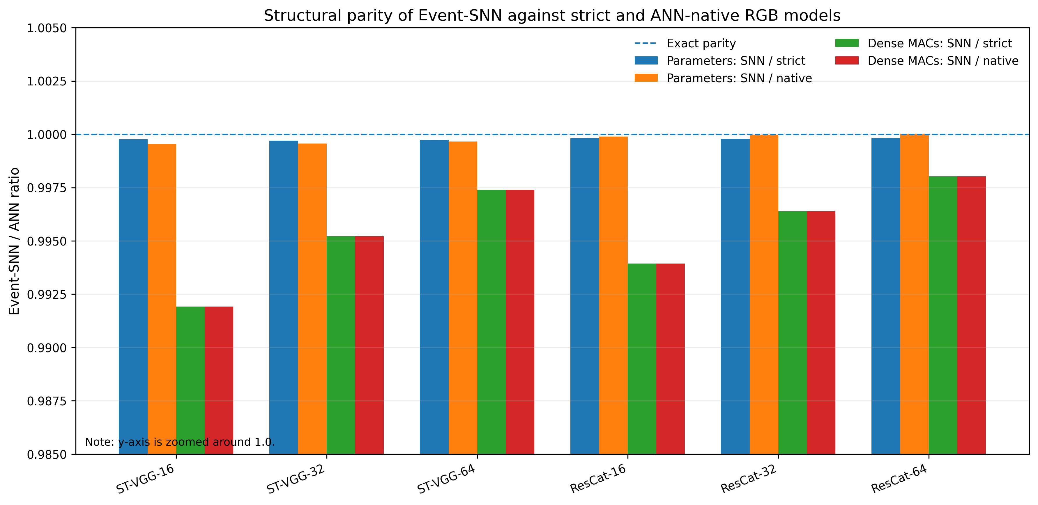
RESULTS · STRUCTURAL PARITY
Matched models have nearly identical structural size
PARAMETERS + DENSE MACS
0.9995–1.00003
Parameter-count ratio
0.9919–0.9980
Dense-MAC ratio
SNN / each ANN baseline
All six configurations
1.0 = exact parity
Axis zoomed around 1.0.
Later cost differences are not explained by differences in structural complexity.
14 / 28

Slide 15
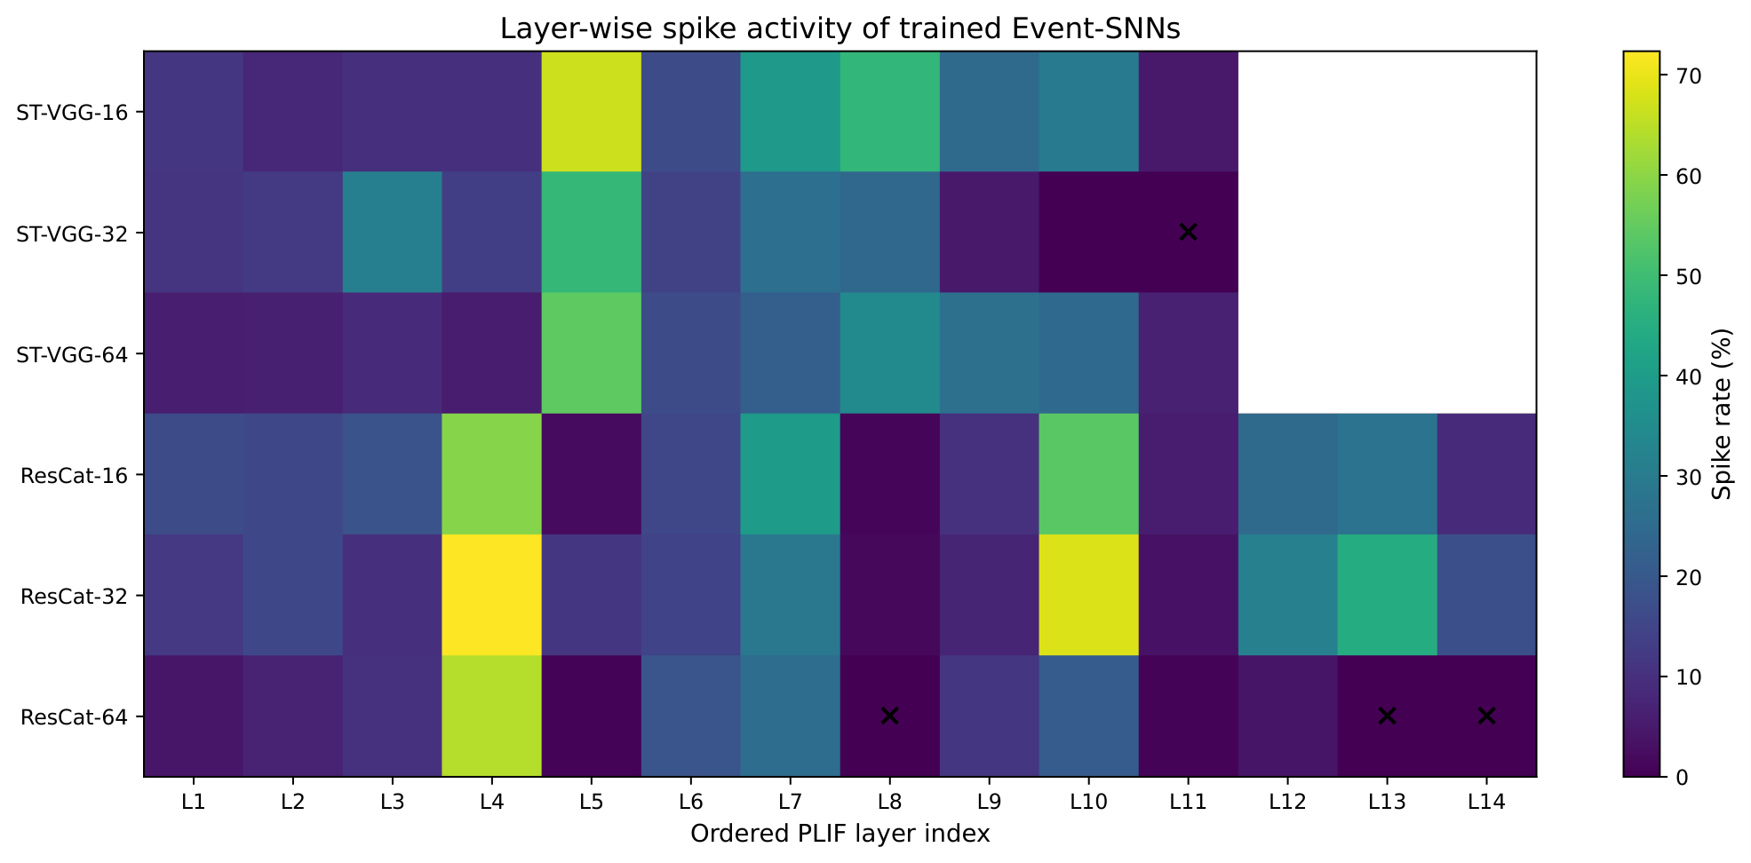
RESULTS · SPIKE ACTIVITY
Spike activity is sparse and varies across layers
Layer-wise spike rate
Overall activity · 39 windows
Model | Spike rate (%) | Sparsity (%) | Dead | Near- dead
ST-VGG-16 | 15.78 | 84.22 | 0 | 0
ST-VGG-32 | 21.33 | 78.67 | 1 | 0
ST-VGG-64 | 11.95 | 88.05 | 0 | 0
ResCat-16 | 19.70 | 80.30 | 0 | 0
ResCat-32 | 17.41 | 82.59 | 0 | 0
ResCat-64 | 13.25 | 86.75 | 2 | 1
15 / 28

Slide 16
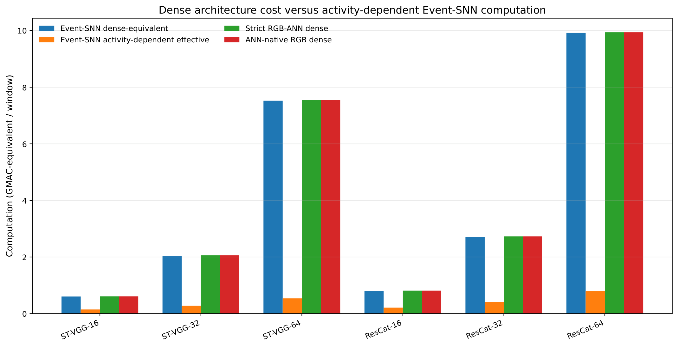
RESULTS · ACTIVITY
Sparse activity cuts the estimated effective computation
ACTIVITY-WEIGHTED ESTIMATE
74–93%
less effective
computation
SNN/ANN: 0.071–0.259
Dense prediction heads
remain in the count.
Effective GMAC is a workload metric and it is not an executed CUDA-instruction count.
16 / 28

Slide 17
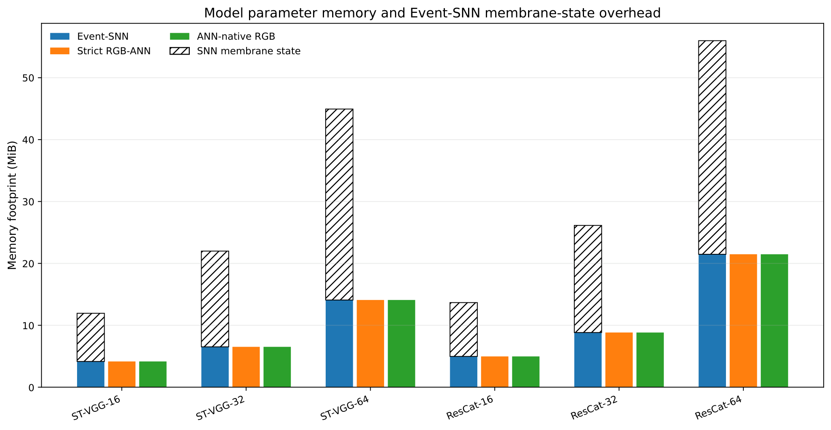
RESULTS · MEMORY
Temporal memory adds a real storage cost
MODEL SIZE + MEMBRANE STATE
7.78–34.51
MiB of extra FP32 state
Membrane state exceeds
weight storage in all 6 SNNs.
Similar weights, but additional temporal state
17 / 28

Slide 18
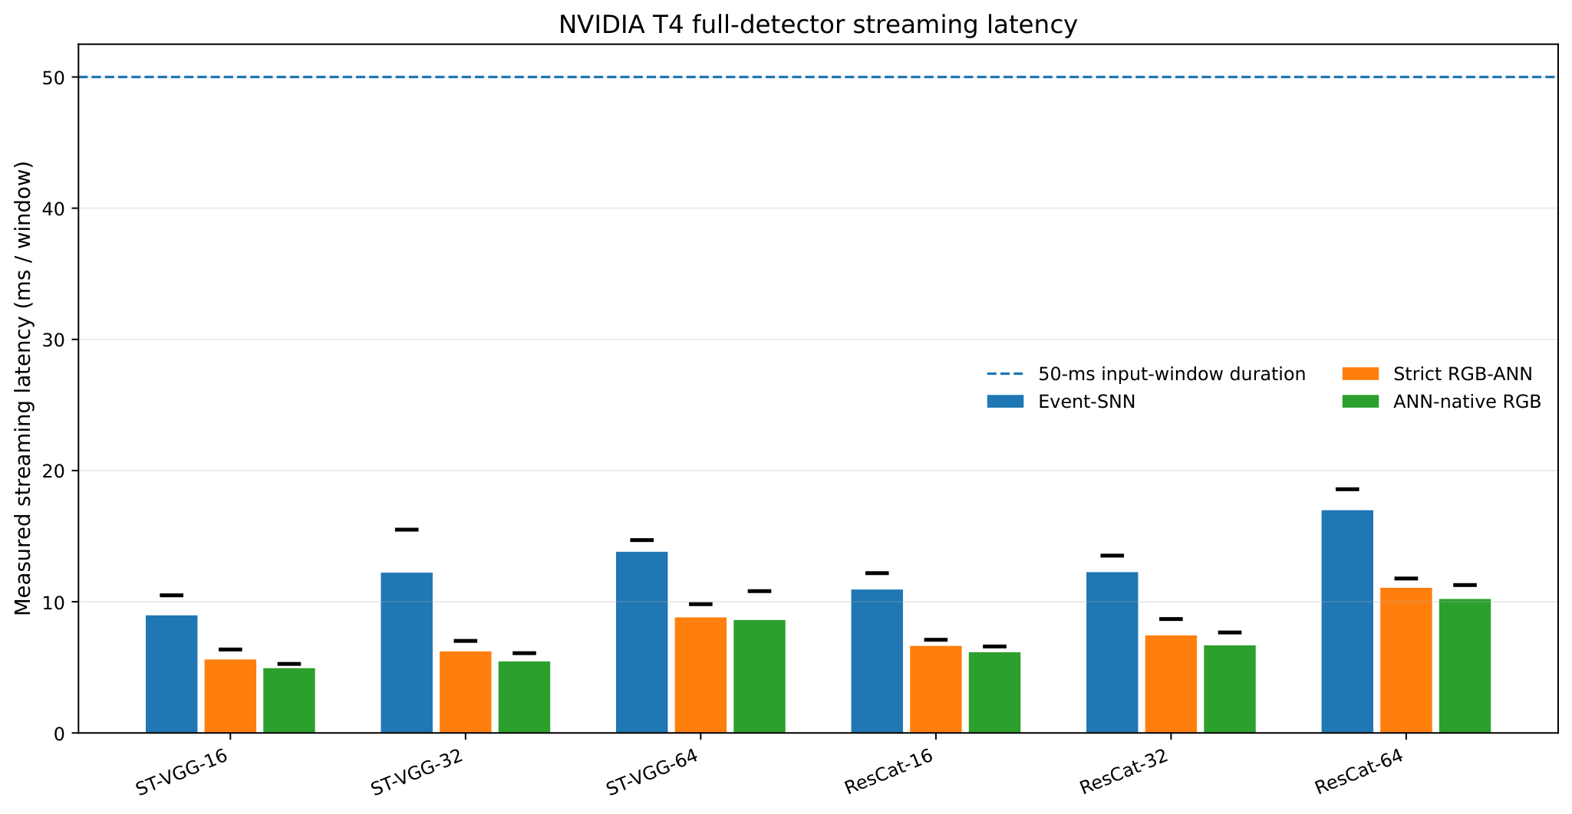
RESULTS · MEASURED GPU
On the T4, every SNN variant runs more slowly
MEASURED · FULL DETECTOR
1.53–1.96×
versus strict-ANN latency
1.60–2.24×
versus ANN-native latency
All measured p95 values are
below 50 ms.
The 50 ms line is an input interval. Timing covers the model forward pass only.
18 / 28

Slide 19
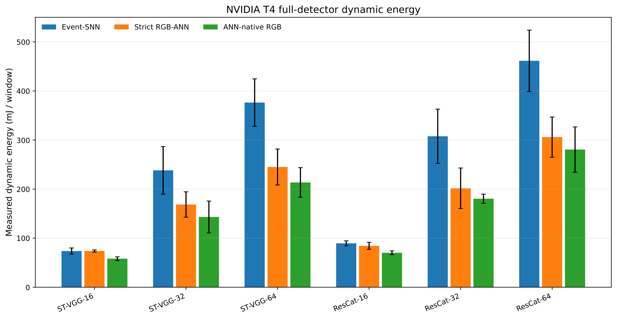
RESULTS · MEASURED GPU
SNNs are not more energy-efficient on the T4
MEASURED · DYNAMIC BOARD ENERGY
1.00–1.54×
versus strict-ANN energy
1.27–1.76×
versus ANN-native energy
Bars: mean of 5 repeats
Error bars: 95% CI
Higher mean energy in 5/6 strict and all 6 native comparisons
19 / 28

Slide 20
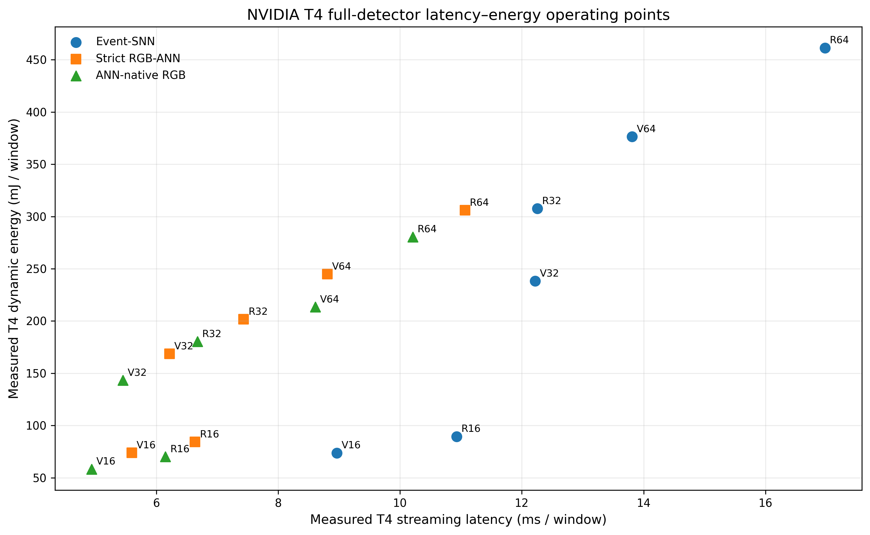
RESULTS · GPU LATENCY AND ENERGY
On the T4, SNNs offer no joint latency–energy benefit
Lower-left is better
Left: lower latency
Down: lower energy
All 6 SNNs perform worse
than their ANN counterparts
V = ST-VGG; R = ResCat
In this T4 implementation, sparse activity does not yield a better latency–energy operating point.
20 / 28

Slide 21
METHOD · ANALYTICAL ENERGY
What does the Lemaire analytical model estimate?
Count operations and memory accesses, then apply reference energy costs.
Total energy = memory + synaptic computation + addressing
Memory
Synaptic computation
Addressing
Read / write weights, features,
and neuron states.
Dense MACs or
activity-dependent
accumulations.
Locate and manage active
synaptic connections.
Fixed reference: 45 nm CMOS · 32-bit values · size-dependent SRAM access cost
Example operation costs: ADD = 0.1 pJ; MUL = 3.1 pJ (same assumptions for all models)
Estimates full-detector energy under stated assumptions.
21 / 28

Slide 22
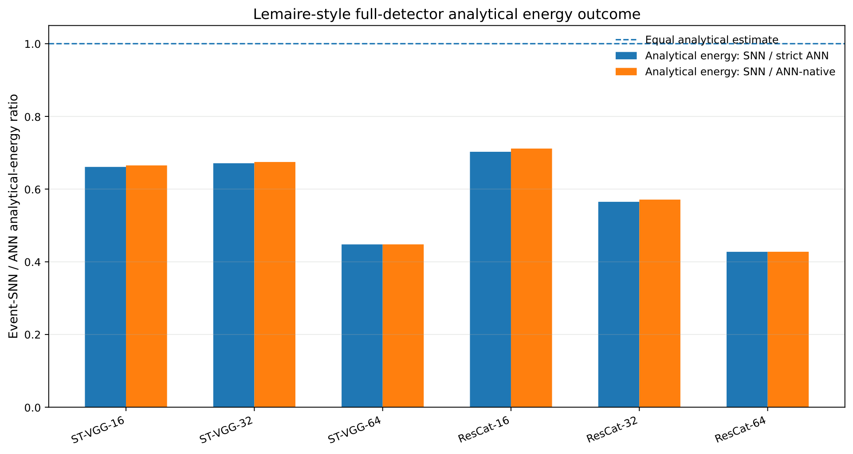
RESULTS · ANALYTICAL ESTIMATE
The analytical model predicts an energy benefit
ANALYTICAL · FULL DETECTOR
30–57%
less estimated energy
22 / 28

Slide 23
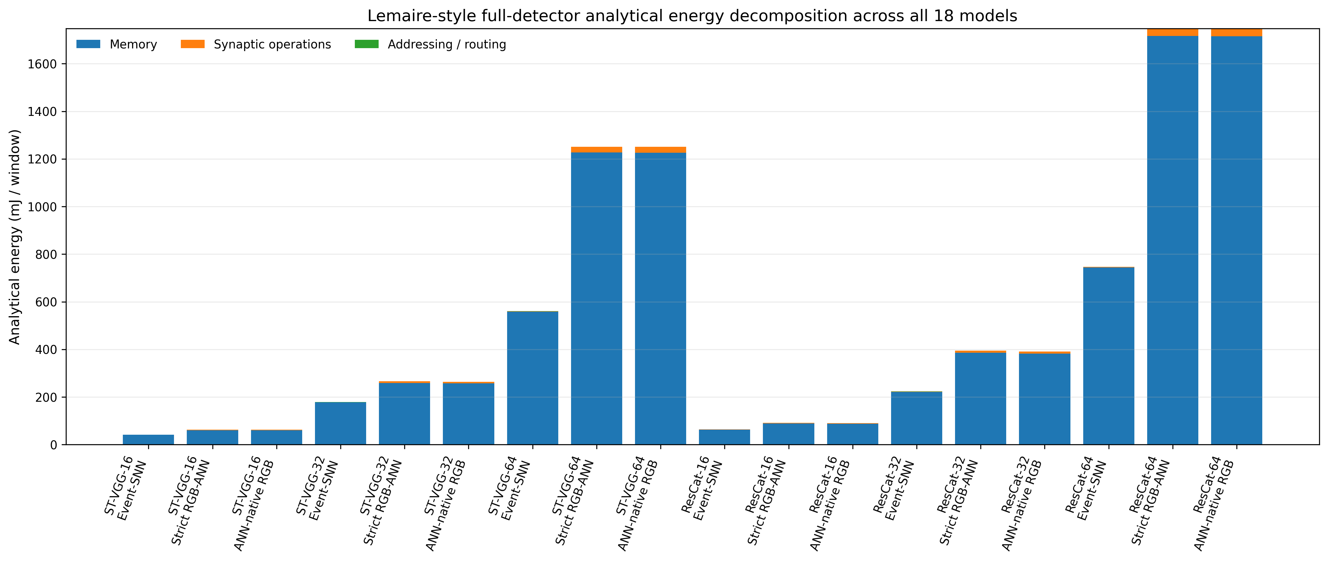
RESULTS · ANALYTICAL ENERGY BREAKDOWN
Memory dominates the analytical energy estimate
Memory: 96.89–99.64% of total estimated energy across all 18 models.
Memory access dominates, but synaptic computation and addressing contribute much less.
23 / 28

Slide 24
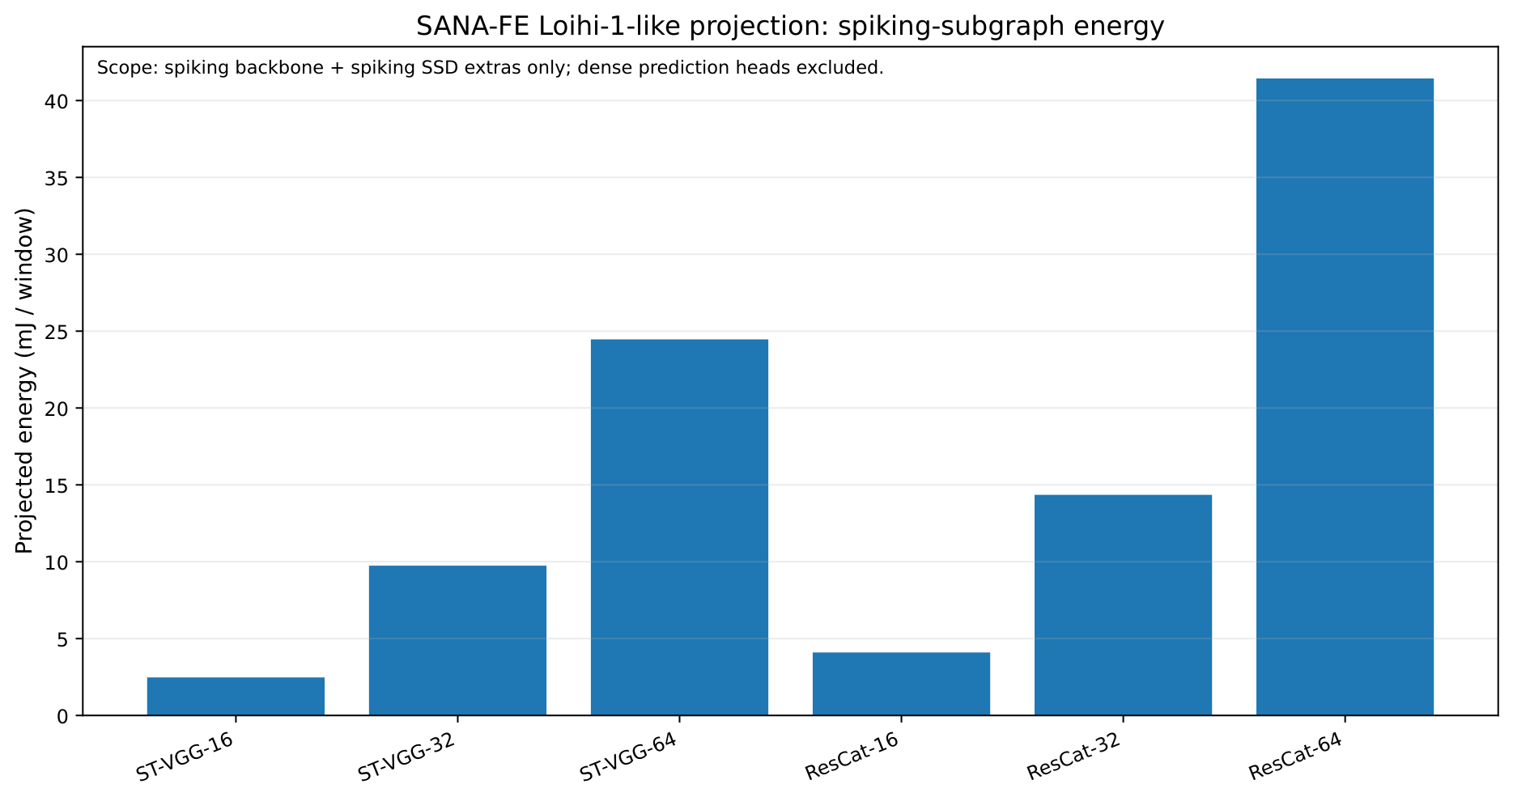
RESULTS · ARCHITECTURAL PROJECTION
Neuromorphic projection explores a different execution model
PROJECTION · SPIKING SUBNETWORK
2.47–41.44
mJ/window projected
6 spiking subnetworks
Layer-aggregated mapping
Loihi-1-like target
Dense heads excluded.
This is not a physical-chip measurement.
24 / 28

Slide 25
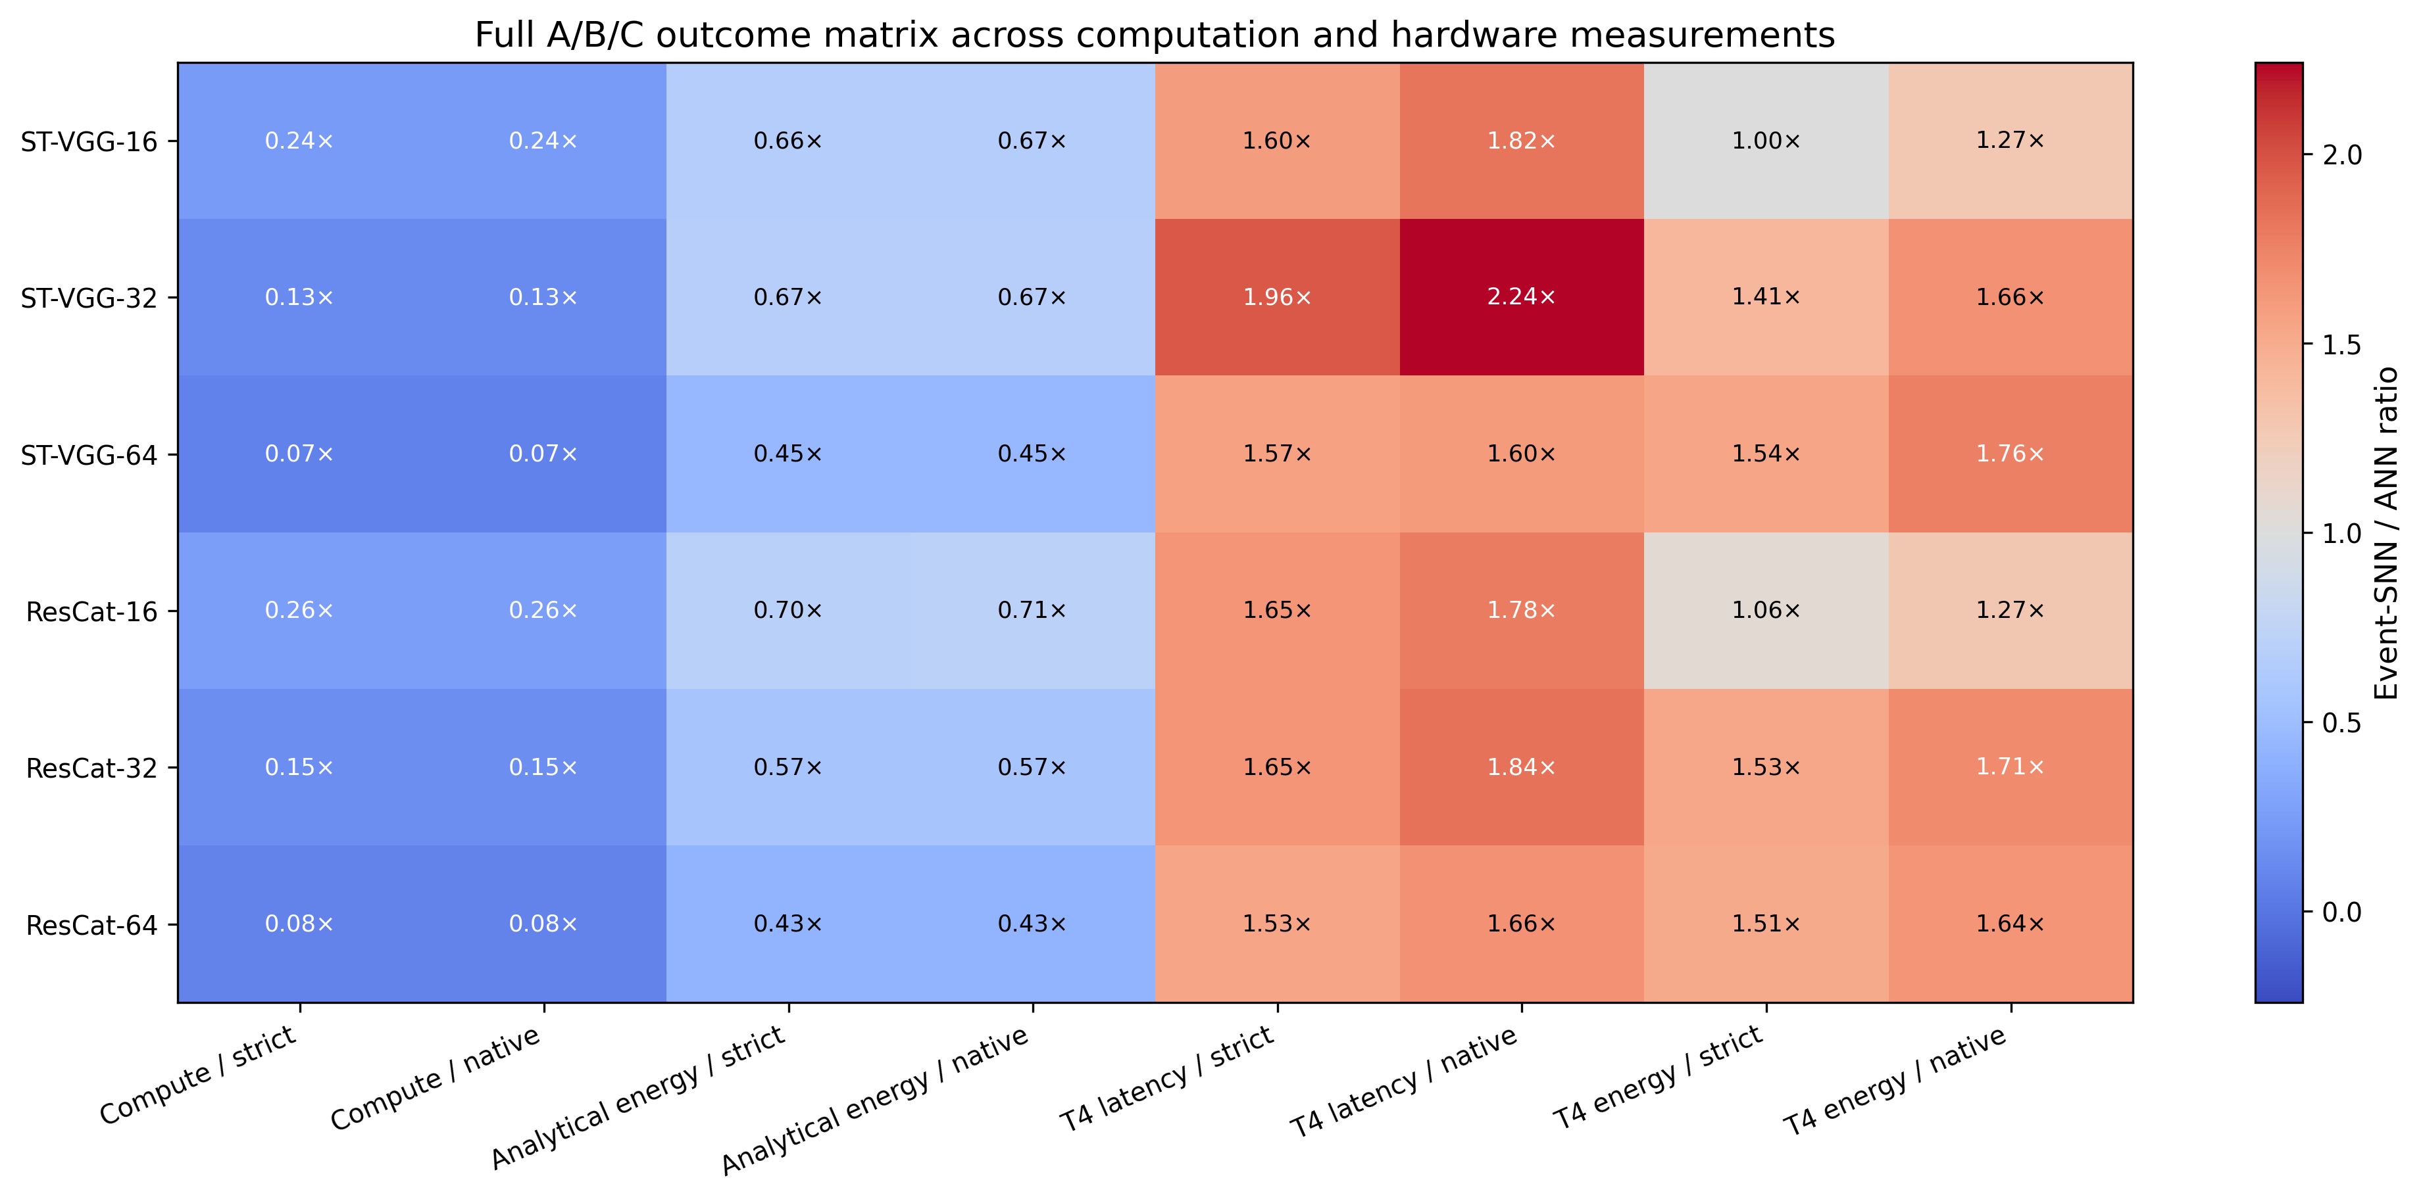
CONCLUSION
Overall comparison: efficiency depends on execution
SNN / ANN within each metric: <1 = lower cost; >1 = higher cost. Hardware determines the benefit.
25 / 28

Slide 26
FUTURE WORK · 1–4 OF 8
Future work: validate across data and hardware
1 Full training and accuracy
2 Broader evaluation data
Train all 18 models to convergence, tune
hyperparameters, and evaluate detection accuracy
on independent held-out data.
Repeat spike-activity and execution measurements
on diverse, independent DSEC sequences to test
stability across scenes.
3 Real neuromorphic hardware
4 More embedded platforms
Complete placement and routing of the spiking
subnetwork on hardware such as Loihi, then
measure power directly.
Repeat benchmarks on NVIDIA Jetson and
sparsity-aware accelerators such as Eyeriss to test
whether T4 findings generalize.
26 / 28

Slide 27
FUTURE WORK · 5–8 OF 8
Future work: explore temporal and model choices
5 Time windows and encoding
6 Sensing-to-decision latency
Vary the 50 ms input window and event-to-spike
encoding; measure the trade-off between accuracy,
sparsity, and energy.
Measure the complete raw-sensor-to-decision
pipeline, including input construction and
preprocessing, beyond the network forward pass.
7 Other embedded architectures
8 TinyML compression methods
Apply the comparison to MobileNet, EfficientNet, and
lightweight transformers to test dependence on
ST-VGG and ResCat.
Evaluate pruning, quantization, and knowledge
distillation; check whether compression changes the
SNN–ANN efficiency gap.
27 / 28

Slide 28
Thank You For Your Attention
Questions?

Slide 29
EVALUATION
A fixed protocol, with a deliberately limited claim
Training scope
Runtime
GPU energy
6 SNNs: 5 epochs
ANNs: untrained baselines
Same short DSEC sequence
No held-out mAP comparison
Warm up + synchronize
Full forward pass
Stateful streaming
Mean, p95
NVML every 20 ms
5 repeats, ≥10 s active
Idle before and after
Dynamic mJ/window + CI
Dynamic energy = integrated (active power − idle power) / processed windows.

Slide 30
RESULTS · SANA-FE ARCHITECTURAL ESTIMATES
SANA-FE estimates: energy, timing, and capacity
Loihi-1-like target · six spiking backbones + SSD extras · dense heads excluded
Model | Energy (mJ/window) | Proxy latency (ms/window) | Critical path (ms) | Core equivalents | Chip equivalents
ST-VGG-16 | 2.47 | 2.77 | 8.80 | 1,993 | 16
ST-VGG-32 | 9.74 | 1.74 | 7.72 | 3,962 | 31
ST-VGG-64 | 24.46 | 4.22 | 17.13 | 7,899 | 62
ResCat-16 | 4.10 | 2.76 | 8.61 | 2,229 | 18
ResCat-32 | 14.35 | 4.32 | 14.60 | 4,431 | 35
ResCat-64 | 41.44 | 2.64 | 12.73 | 8,837 | 70
Core/chip equivalents estimate capacity and they are not a completed placement-and-routing result.

