Slide 1

Sezai Ufuk Oral Emre Çorbacı
Machine Learning Met. And App. Final Project
Predicting Result of Shots in La Liga
Dr. Mustafa Çavuş

Slide 2

Problem
Our problem is a classification problem, our target is whether a shot is goal or not.
Where Can We Use This Model in Real World ?
We can use this model to analyze player performances, understand player habits on the field, determining which players to change in game or find out in advance whether a new player will be compatible with the team or not during transfer seasons.

Slide 3
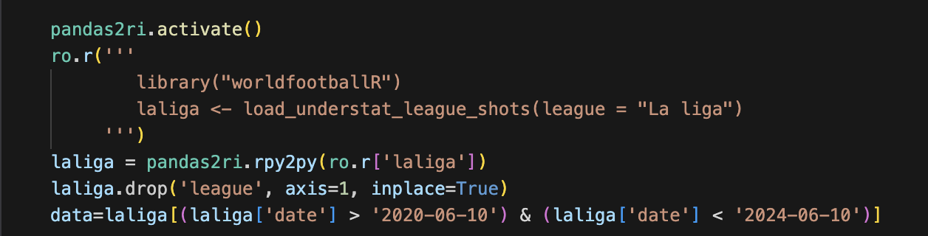

Slide 4
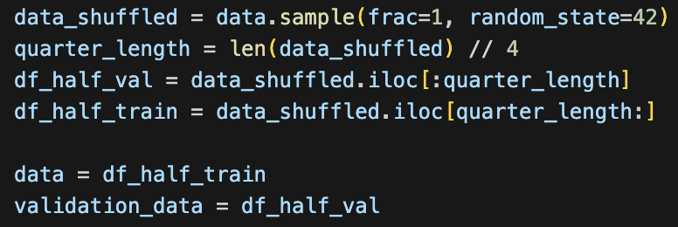

Slide 5
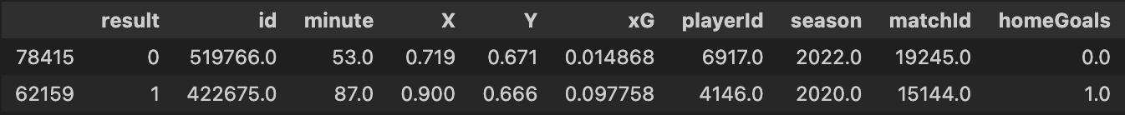
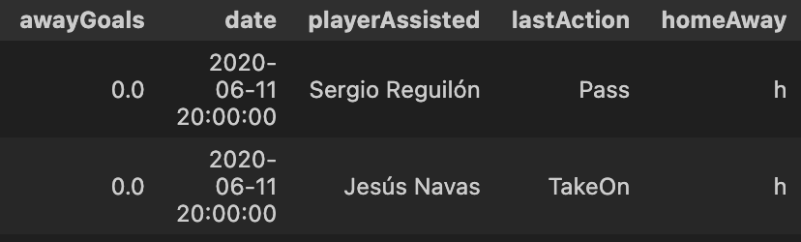
Exploring Data (Understat – La Liga)
Target Variable
Our target variable is "result", this feature represents whether a shot is a goal or not.
Features
Our features are going to help our model to learn and predict the target variable.

Slide 6
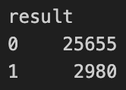
Imbalancedness
Our data has imbalancedness problem which might cause our model to learn features of majority target variables better than the minority target variables, it might cause inaccurate predictions.

Slide 7

SMOTE Synthetic Minority Over-Sampling Technique
We tried to use SMOTE method for oversampling to fix the gap between minority and majority target variables. This method uses clustering methods to create new observations based on original ones.
But SMOTE did not work efficient on our data, it caused overfitting problem because synthetic generated minority observations did not represent our minority class well.

Slide 8
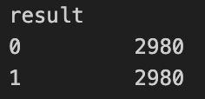
Undersampling
We used undersampling method to solve imbalancedness problem by decreasing majority count with sampling.

Slide 9
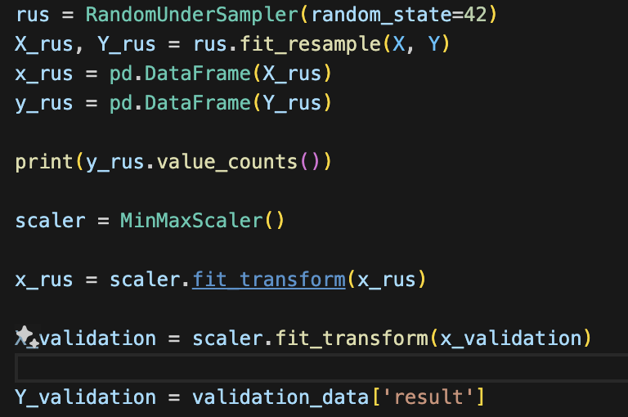

Slide 10
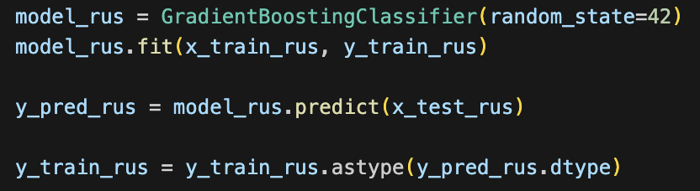
Gradient Boosting Machines Model

Slide 11
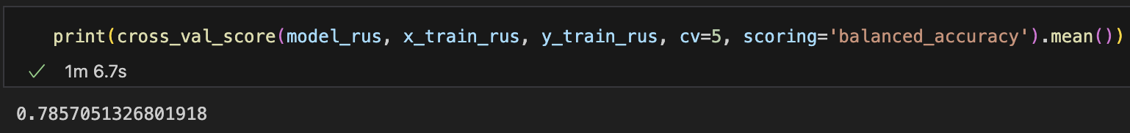

Slide 12
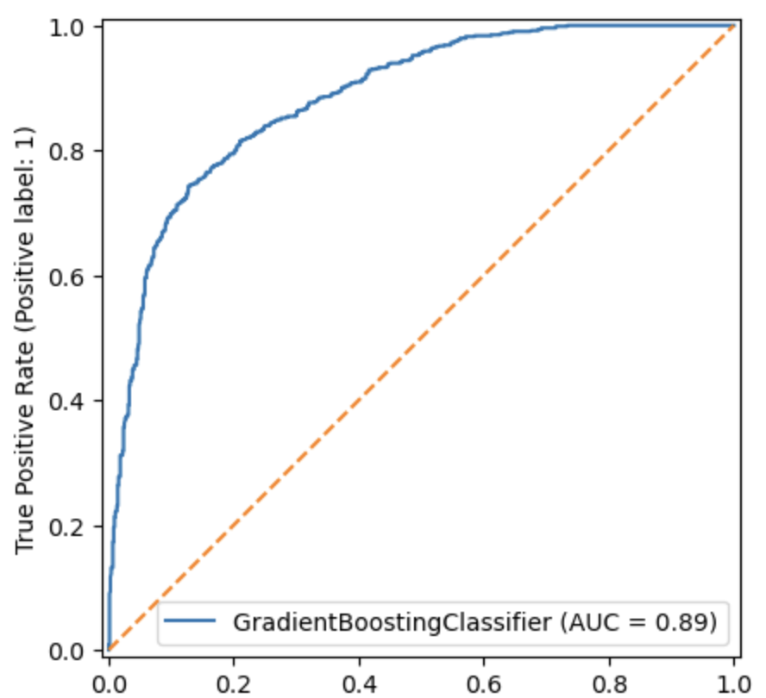

Slide 13
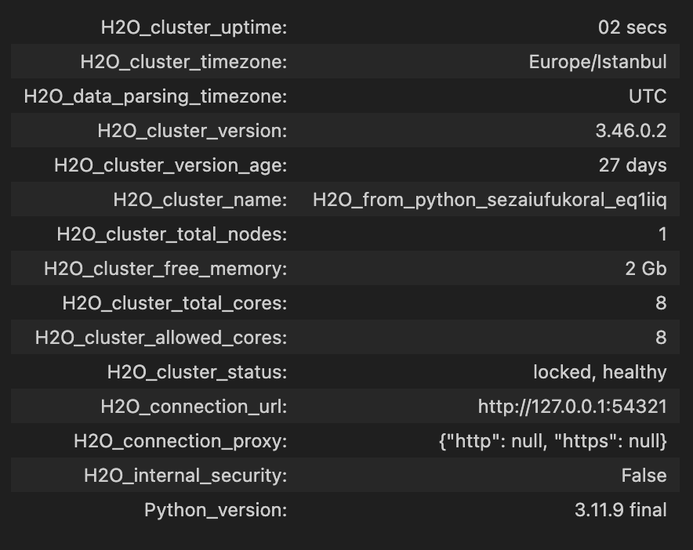
Best Model and Hyperparameter Tuning with AutoML
AutoML is a way to find ideal model and hyperparameter combinations for data.
We are going to use the H2O AutoML to find best hyperparameters and model to use.

Slide 14
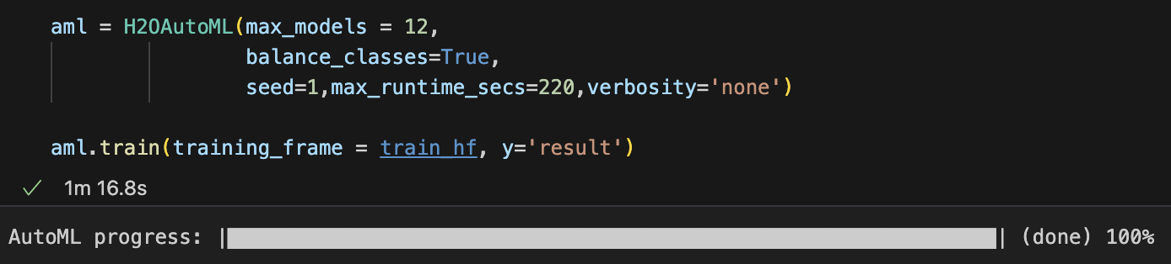

Slide 15
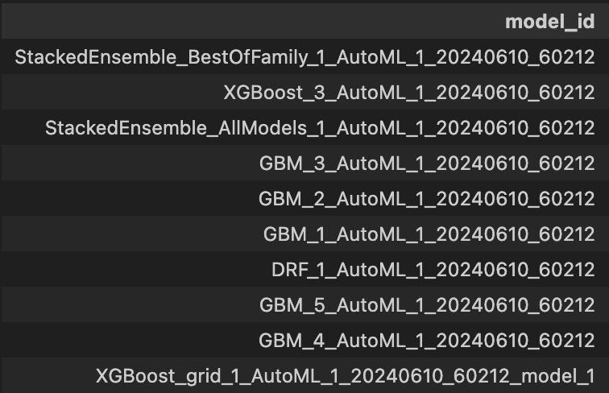

Slide 16

Choosing the final Model
We are going to test our models with a new, unseen data to check balanced accuracy scores and confusion matrices to choose our final model.

Slide 17


Vanilla Gradient Boosting Machines
Balanced Accuracy
Stacked Ensemble
Balanced Accuracy

Slide 18
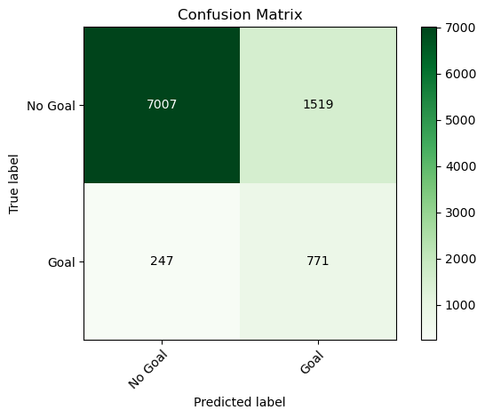
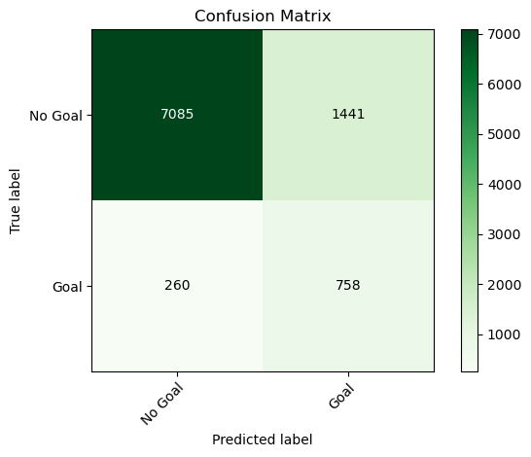
GBM
SE

Slide 19
Both the Stacked Ensemble and vanilla Gradient Boosting Machines algorithms' metrics show similar performance to each other. However, given that knowing if a shot results in a goal is the dominant information we want to obtain according to domain knowledge, also for the sake of process time, we choose our model to be vanilla Gradient Boosting Machines.

Slide 20

Thank you for your attention
https://github.com/ufukdev34

