Slide 1


The New Era of Prospecting: Mastering Social Selling
Move beyond interruptions. Learn how to attract, engage, and convert modern buyers by using personal authority, targeted outreach, and consistent value-driven engagement.
Name-Sezal
UID- 24BAI70653
Section-24AML-3B
.

Slide 2
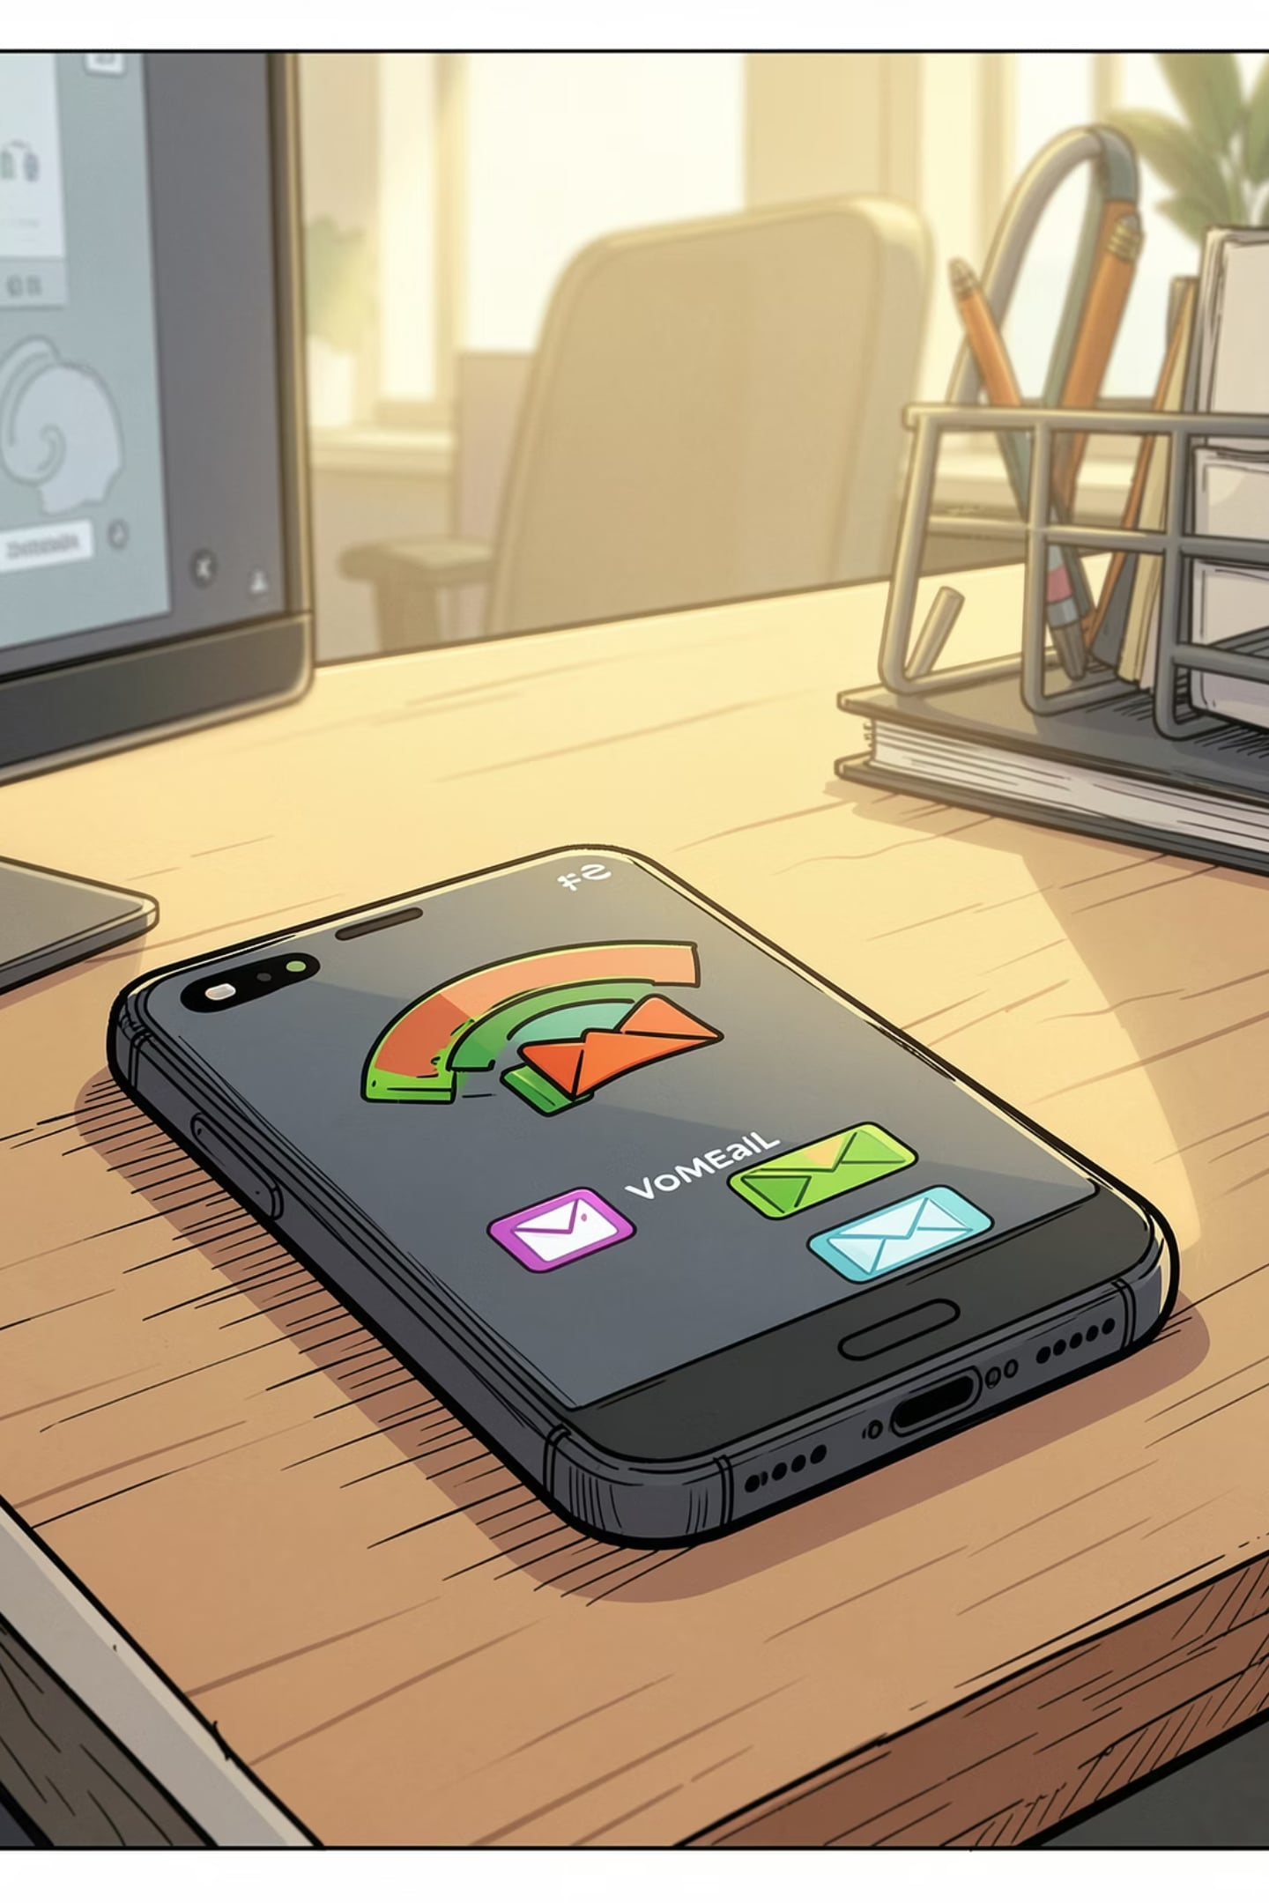

The Death of the Cold Call
1
2
Why cold calls fail
Social sellers win
90% of buyers ignore unsolicited calls — attention is scarce and distrust is high.
78% of reps using social platforms outperform peers — social proof and context matter.
3
Buyers research first
57% of the buying journey happens before prospects contact sales — meet them earlier online.
Shift effort from interruption to discovery: be present where buyers already research.

Slide 3


The Power of the Human Brand
In B2B the relationship is person-to-person. Individual credibility — expertise, consistency, and authenticity — often matters more than corporate marketing.
Personal authority creates trust faster than logo recognition.
Prospects are 5x more likely to engage through a mutual connection.
Consistent content turns passive visitors into warm leads.
Action: Audit your profile — headline, photo, and value-focused summary.

Slide 4

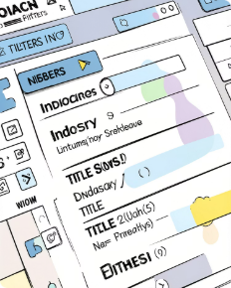


The 4 Pillars of Success
Build an Expert Brand
Find the Right People
Engage with Insights
Build Relationships
Optimize your profile, showcase case studies, and publish short insights that demonstrate domain knowledge.
Use advanced search, boolean queries, and saved lists to identify true decision-makers and influencers.
Share timely ideas, commentary on industry news, and practical tips — add context, not a sales pitch.
Follow up with personalized value, celebrate milestones, and convert conversations into advisory relationships.

Slide 5
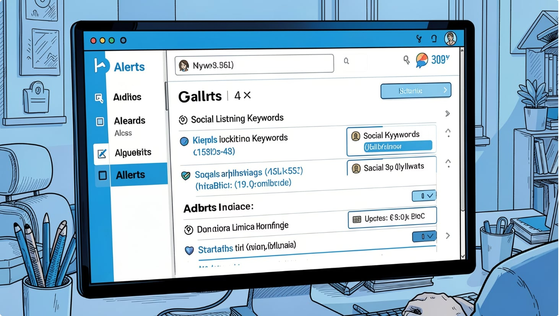

Tools of the Trade
Blend platform power with process. The right tools make social selling scalable and measurable.
Tip: Integrate alerts with your workflow to act within 24 hours of a trigger event.
LinkedIn Sales Navigator
Social Listening
CRM Integration
Precision prospecting: account lists, lead recommendations, and real-time updates.
Monitor hashtags, industry news, and trigger events to engage at the right moment.
Capture social interactions, score engagement, and convert signals into actions inside your CRM.

Slide 6


The Path Forward
Transform from seller to trusted advisor: answer problems, not product questions. Prioritize depth of relationship and consistent micro-engagements.
Show Up
1
Be present where prospects research — post, comment, and share useful ideas weekly.
Add Value
2
Offer insights, templates, or quick audits that solve immediate pain points.
Measure What Matters
3
Track engagement quality (conversations, introductions) over vanity metrics.
Repeat
4
Social selling compounds: consistent effort builds reputation and fills the pipeline.
Ready to start? Pick one pillar this week and create a 30-day plan around it.

Slide 7
THANK YOU

