Slide 1
THE LANDAU–LIFSHITZ–GILBERT EQUATION
Foundations of Magnetization Dynamics in Spintronics
Precession, Dissipation, and the Dynamics of a Macrospin

Slide 2
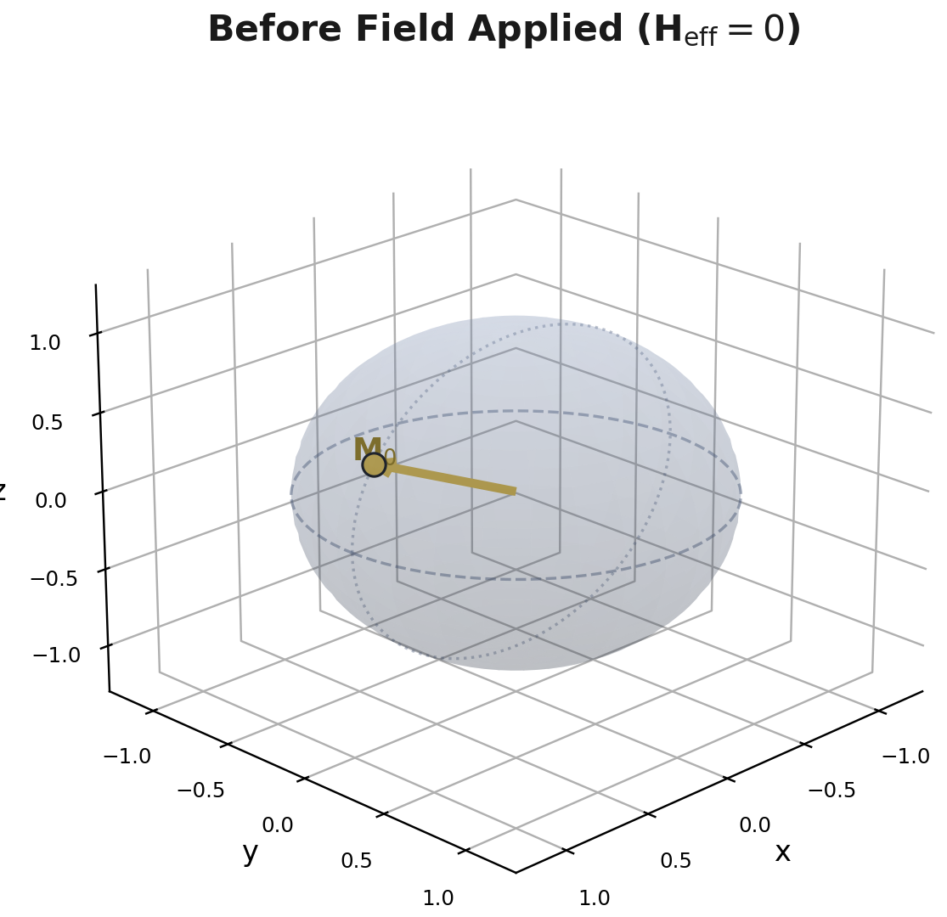
Introduction
Spintronic devices — magnetic memory, spin-torque oscillators, magnonic logic — rely on the controlled dynamics of magnetization.
The central question: given a magnetization vector M in an effective field H_eff, how does M evolve in time?
The Landau–Lifshitz–Gilbert (LLG) equation is the governing equation of motion for M — the magnetic analogue of Newton's second law.
Figure 1. Initial orientation of M prior to the application of an effective field.
The Landau–Lifshitz–Gilbert Equation
2

Slide 3
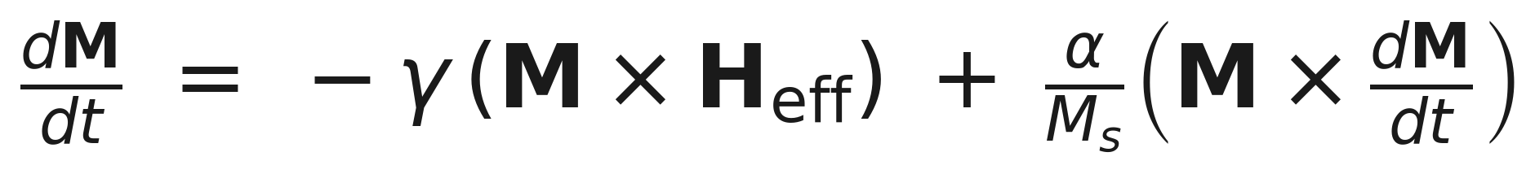
The Governing Equation
Implicit (Gilbert) form:
QUICK REFERENCE
M — magnetization vector (|M| = M_s)
H_eff — effective magnetic field
Term 1 — Precession: rotates M about H_eff, conserving |M| and energy.
Term 2 — Damping (Gilbert, 1955): a phenomenological dissipative torque that relaxes M toward H_eff.
The equation is implicit: dM/dt appears on both sides. For numerical work it is recast into an explicit form (Slide 7).
γ — gyromagnetic ratio
α — Gilbert damping constant
M_s — saturation magnetization
Full definitions follow on the next slide.
The Landau–Lifshitz–Gilbert Equation
3

Slide 4
Definition of Terms
Symbol | Name | Definition
M | Magnetization vector | The macrospin's magnetic moment per unit volume; a vector of fixed length |M| = M_s whose direction evolves in time.
H_eff | Effective field | The net field felt by M — sum of the applied, anisotropy, exchange, and demagnetizing fields.
γ | Gyromagnetic ratio | Couples angular momentum to magnetic moment; sets the natural precession frequency ω = γH_eff.
α | Gilbert damping constant | Dimensionless parameter (typically 10⁻³–10⁻¹) quantifying energy dissipation to the lattice/electron bath.
M_s | Saturation magnetization | The (constant) magnitude of M; ensures dimensional consistency of the damping term.
The Landau–Lifshitz–Gilbert Equation
4

Slide 5
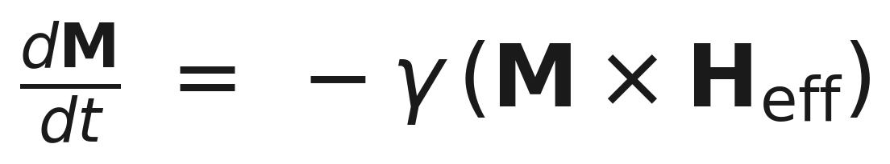
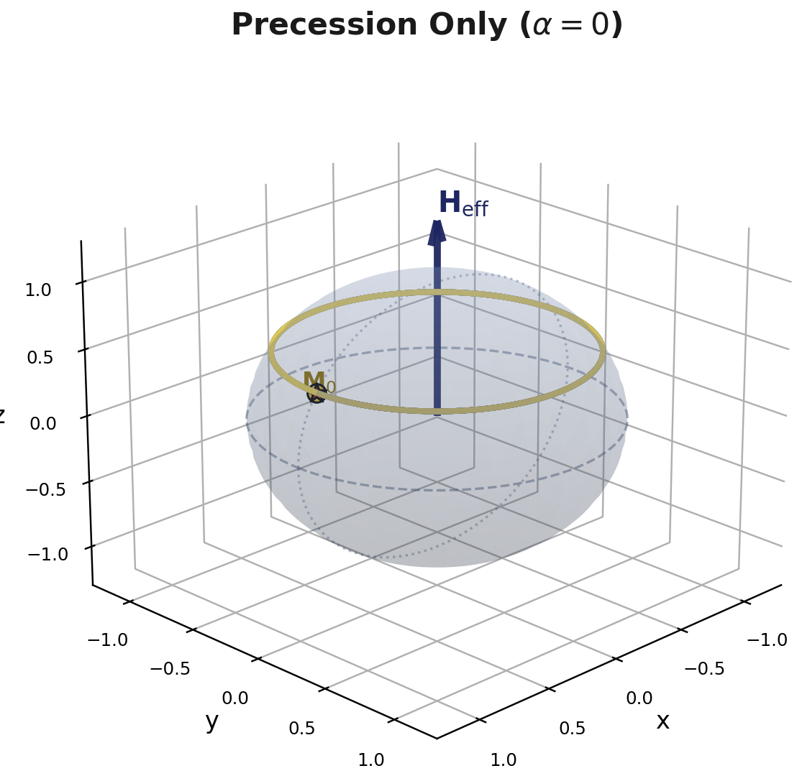
The Precession Term
Isolated by setting α = 0 — no dissipation.
The cross product M × H_eff is, by construction, perpendicular to M — so |M| is conserved exactly.
M sweeps out a circular orbit at constant polar angle around H_eff, at the Larmor frequency ω = γH_eff.
This is a conservative, energy-preserving torque — mathematically identical to gyroscopic precession under gravity.
Figure 2. Closed circular precession orbit of M about H_eff (α = 0); numerically integrated (RK45).
The Landau–Lifshitz–Gilbert Equation
5

Slide 6
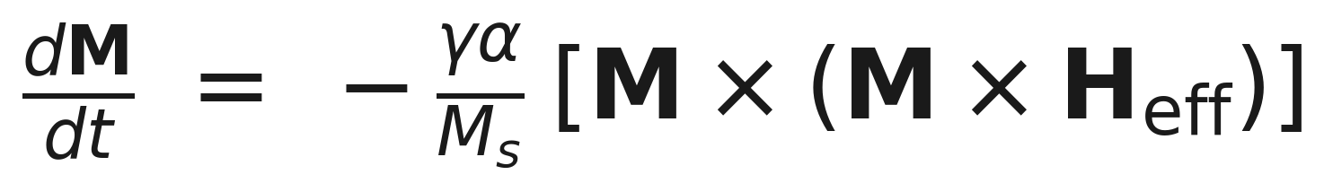
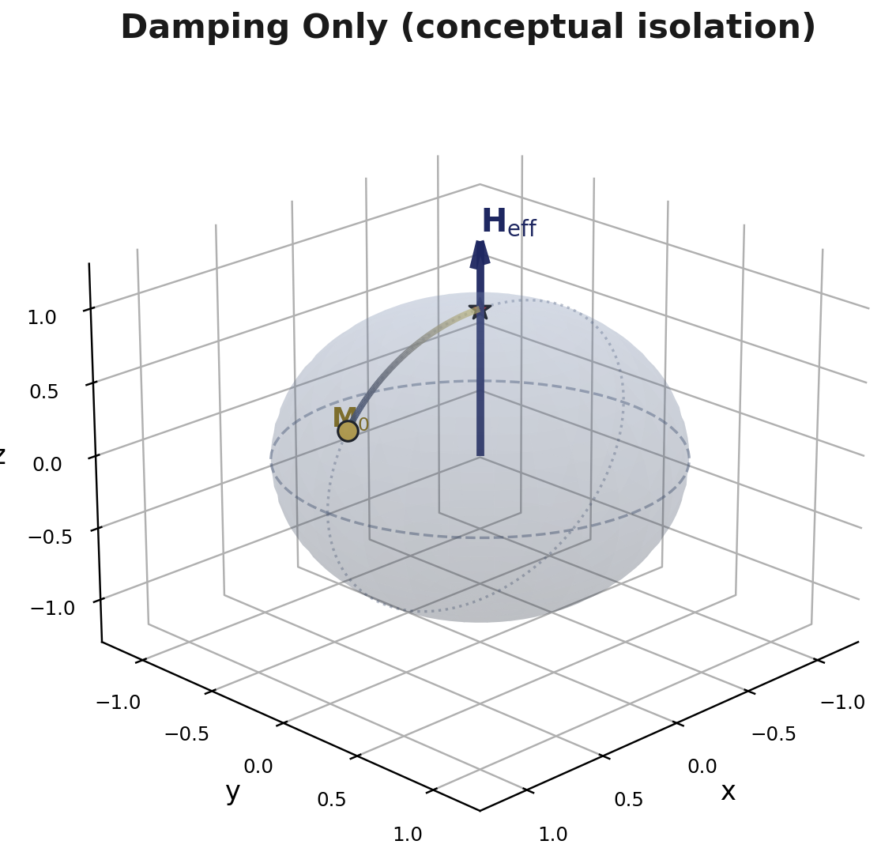
The Damping Term
Introduced by T. L. Gilbert (1955) as a phenomenological dissipative torque.
The double cross product M × (M × H_eff) points from M toward H_eff along the shortest path — a great-circle arc.
Physically represents energy loss to the lattice, conduction electrons, or spin-wave bath.
Shown here in isolation (precession suppressed) purely to illustrate its relaxing character — not a physically separate regime.
Figure 3. Direct relaxation of M toward H_eff under the isolated damping torque.
The Landau–Lifshitz–Gilbert Equation
6

Slide 7
The Explicit (Landau–Lifshitz) Form
The implicit Gilbert form contains dM/dt on both sides. Substituting it into itself yields an algebraically equivalent, explicit equation suitable for direct numerical integration:
First term: precession, rescaled by 1/(1+α²).
Second term: damping, acting perpendicular to both M and (M × H_eff) — pulling M directly toward H_eff.
This is the form solved numerically (SciPy solve_ivp, adaptive RK45) throughout this work.
The Landau–Lifshitz–Gilbert Equation
7

Slide 8
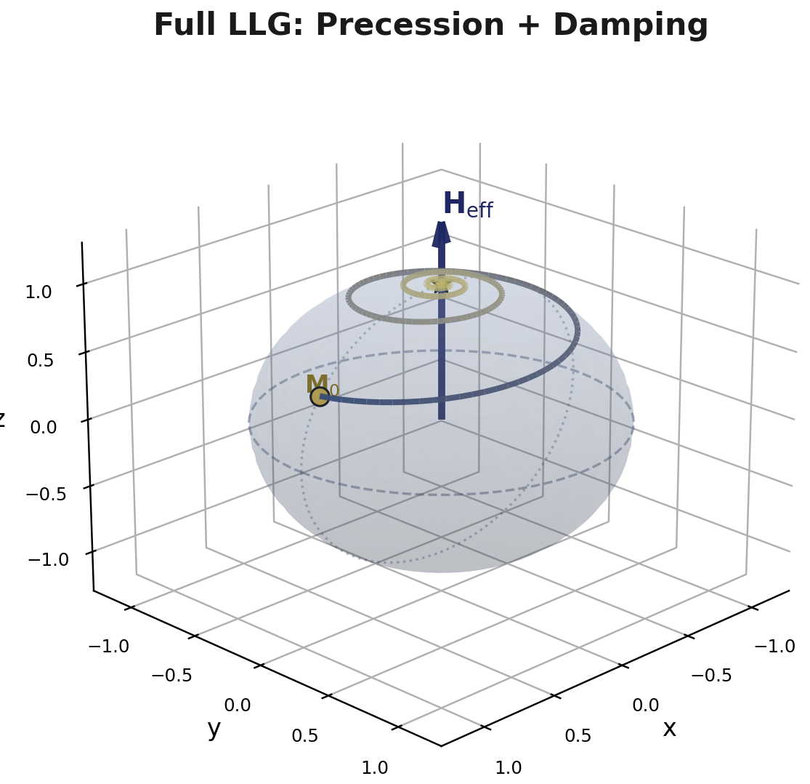
Full Dynamics: Precession + Damping
With both torques active, M no longer traces a closed circle — the orbit contracts on every revolution.
The result is a spiral trajectory on the unit sphere, winding around H_eff while decaying toward it.
As t → ∞, M → H_eff / |H_eff| — the system reaches its minimum-energy equilibrium.
This spiral relaxation underlies field- and current-induced switching in magnetic memory (MRAM) devices.
Figure 4. Spiral relaxation of M under the full LLG equation (α = 0.15); gold marker = initial state, red marker = final state.
The Landau–Lifshitz–Gilbert Equation
8

Slide 9
Summary
Precession:
Conservative torque −γ(M×H_eff); conserves |M| and energy; produces circular orbits.
Damping:
Dissipative torque ∝ α; drives M toward alignment with H_eff; models energy loss.
Full LLG:
Combination yields spiral relaxation — the physical basis of magnetization switching.
Numerical form:
Explicit Landau–Lifshitz form used for RK45 integration; equivalent to Gilbert's implicit form.
Landau, L. D. & Lifshitz, E. M. (1935); Gilbert, T. L. (1955, IEEE Trans. Magn. 2004)

