Slide 1
DOCUMENT ON DIGITAL CLOCK
The document is about the scripting behind the digital clock!

Slide 2


new Date() creates a new Date object that contains the current date and time.
This defines a function called update Clock.
Later, we will use this function to update the time on the webpage.
This gives us access to the hours, minutes, and seconds of the current moment.
We need the current time to display it in the digital clock.

Slide 3
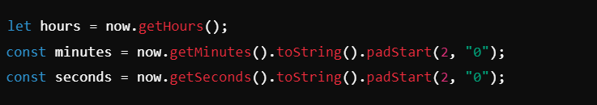
now.getHours(): This extracts the hours from the now object (0–23 format).
now.getMinutes(): This extracts the minutes (0–59) and converts it to a 2-digit string using.padStart(2, "0") (e.g., 5 becomes "05").
now.getSeconds(): This extracts the seconds (0–59) and also converts it to a 2-digit string.

Slide 4
Further Explanation:
Why we used .padStart(2, “0”);
The time needs to be formatted properly for a clean digital display (e.g., 03:09:05 instead of 3:9:5).
.padStart(2, "0") ensures that single-digit values are displayed with a leading zero
It ensures that single-digit numbers like 3 appear as 03.

Slide 5
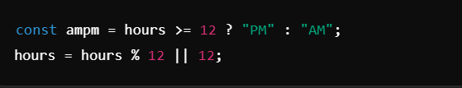
The ternary operate: If the hour is 12 or more than 12 it will set AM. But if the condition is false (Hour is less than 12) it will set PM.
hours = 0 (midnight), hours % 12 would be 0, so || 12 ensures it displays as 12.
This ensures the hours are in 12-hour format (1–12 instead of 0–23).

Slide 6
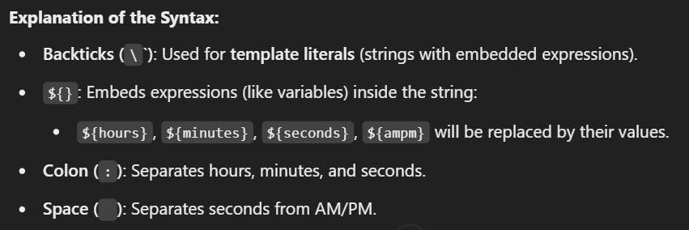
This syntax let us easily combine variables into a string without needing complex concatenation.

Slide 7

document.getElementById("clock") selects the element with the id="clock“
.textContent = timeString; updates the content of that element with the formatted time
(timeString)
The function was called to instantly show the current time on the page when it first loads.

Slide 8

