Slide 1
Main Software Slides

Slide 2
Overview
OSPRE will be running on two Linux OS machines
OSPRE processes will be split between Zed Board (Simulated Spacecraft) (2 core) and onboard (SOM) processor (4 core)
All OSPRE processes will be event driven server processes
OSPRE will be running on multiple processes
OSPRE will consist of 5 processes ( Camera Controller, Image Processing, GNC, SCComms, and WatchDog)
There will be an additional external process that we will also build called S/C which will run on the Zed Board and act as the Spacecraft
All processes communication will occur over TCP/IP non-blocking sockets

Slide 3
Further Detail
OSPRE needs multiple processes in order to take advantage of two separate cpu’s
The OSPRE system was designed to be modular
If the camera or S/C change only the Camera Controller or SCComms process need to change
All processes will be derived from an abstract server class containing the common elements of all OSPRE’s server processes

Slide 4
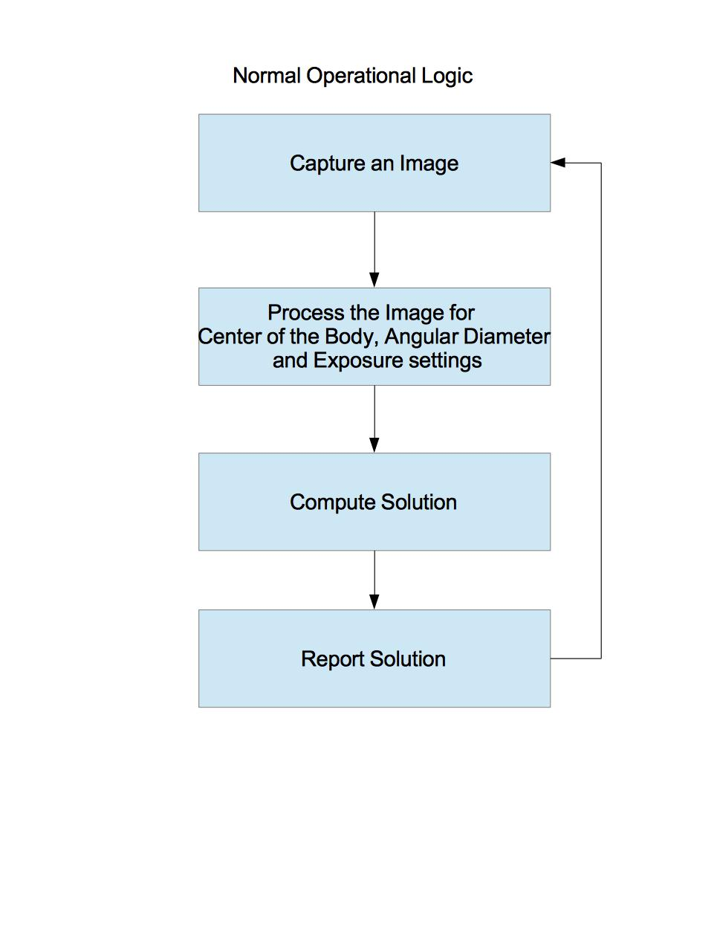

Slide 5
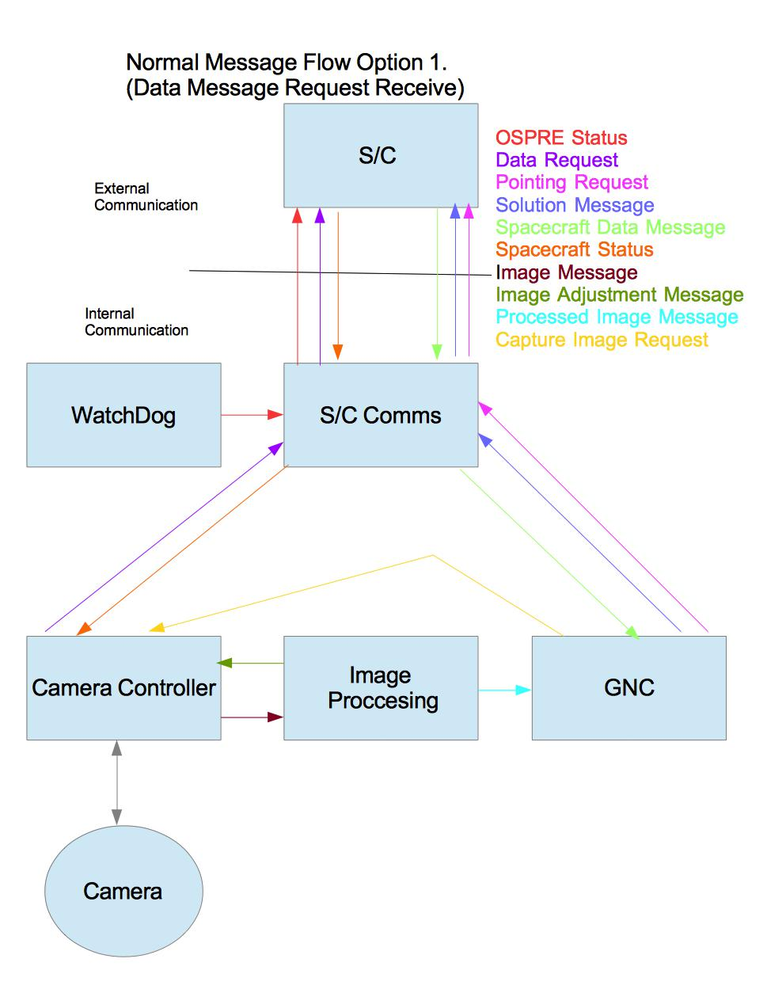

Slide 6
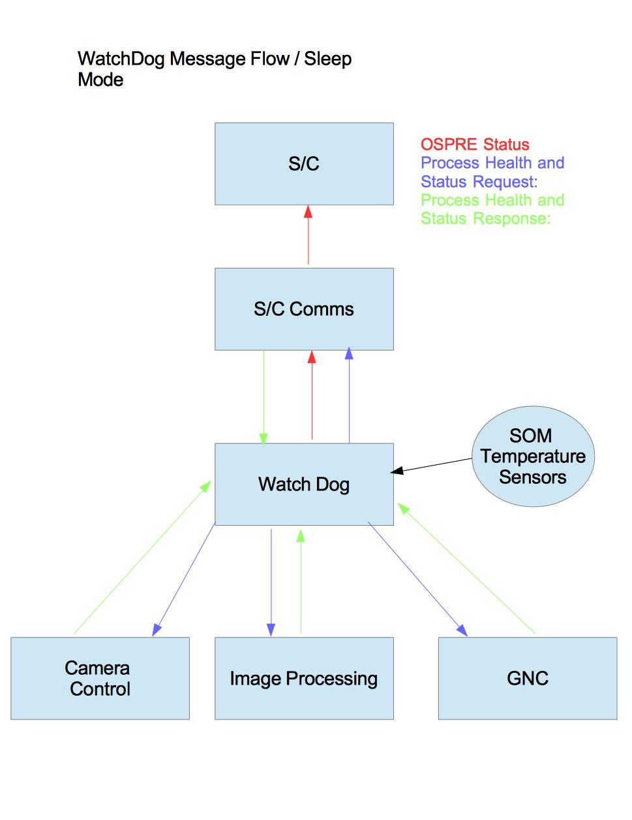

Slide 7
Backup Software Slides

Slide 8
Startup
When the OSPRE sensor package receives power, the microprocessor onboard will turn on and boot up Linux OS. On startup, a script will be run to start our OSPRE system processes residing on SOM.
OSPRE will have another startup script for the Zed Board to start the OSPRE server processes on the Zed Board

Slide 9
Server Processes 1
All processes will listen at a defined port number for new connection requests
Each process will have a defined number of connections
All processes will be accepting connections
Processes will connect to each other in a predefined manner
Only WatchDog will be written to support N connections

Slide 10
Server Processes 2
Servers will be using a call to select and registering for read and write events when interested in them
The select call will be using timeouts to allow for the handling of error cases
SIGPIPES are ignored so that the Server doesn’t quit when the client disconnects
In the event that two processes lose a connection, the process acting as the client will attempt to reconnect to the process acting as the Server

Slide 11
Server Process 3
OSPRE Servers will not follow the classic Server to Client relationship. OSPRE Servers will act as both a Server and Client.
All Processes will be listening on a dedicated socket for connection requests (Typical Server). Specific processes will connect to others processes because they need information from said process (Typical Client).
An abstract OSPRE server class will be written in C++ from which all process classes will be derived from.
The server class will contain a virtual run method, which each individual process class will implement.
The Server class will implement generic methods that all derived classes need such as init(), openServerSocket(), and connectToServer()
The Server class will be built by composition and have instances of other classes to deal with intra-process communication (details below)

Slide 12
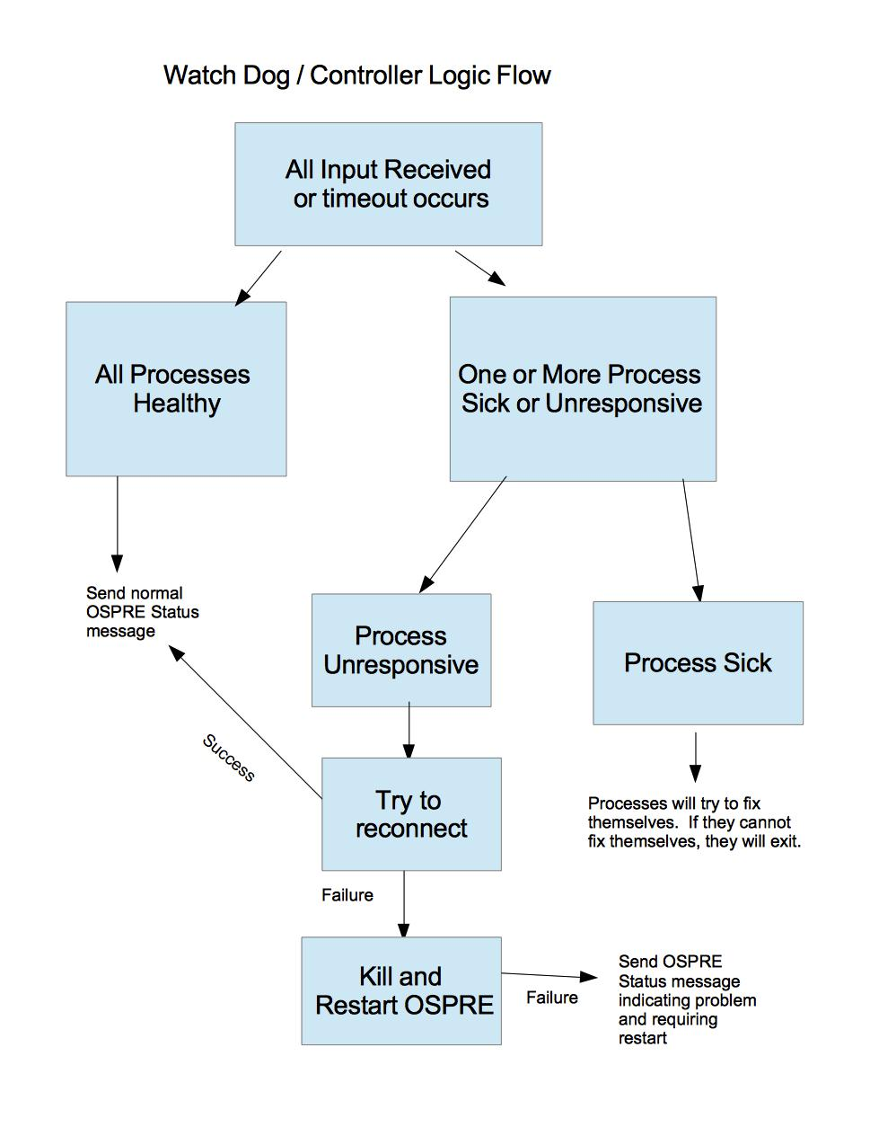

Slide 13
Error Cases
Error: Process Failure
Action: Restart OSPRE system (Power on/ Off), (S/C responsibility)
Error: GNC cannot achieve accurate solution to within error bounds
Action: Report solution to current error
Error: Image Processing cannot find body (Earth / Moon) in the picture
Action: Report status to with error message S/C, attempt to change Camera setting, keep trying
Error: Not pointing at the right targets (Earth / Moon)
Action: Send additional pointing request to S/C and wait

Slide 14
Shutdown
Complicated due to using two different CPUs
Cut power to OSPRE sensor package
Send SIG_KILL signals to processes on ZedBoard

