Slide 1


BIP
Data retention short time
or another TSDB
Data retention long time

Slide 2
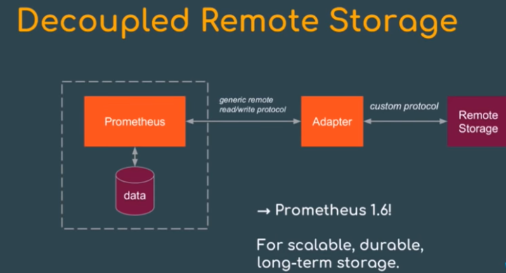

Slide 3
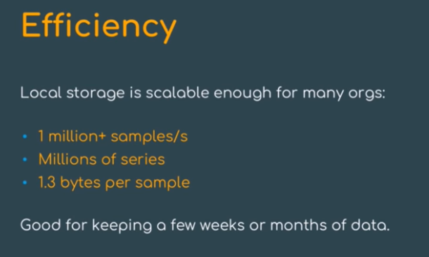

Slide 4
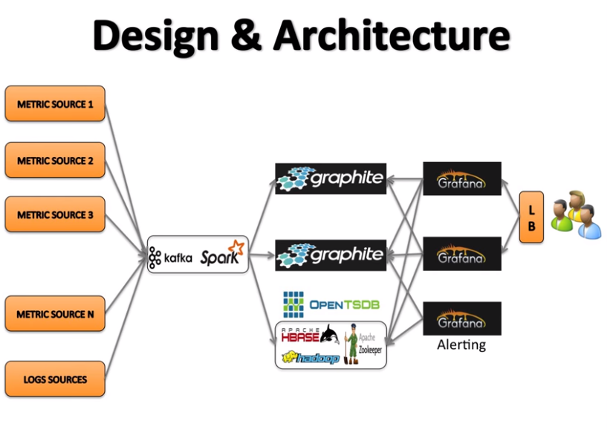

Slide 5
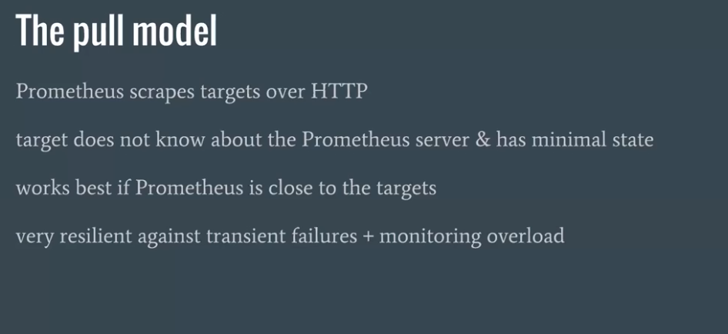
Given a 10-seconds scrape interval and 700 time series per host, this allows you to monitor over 10,000 machines from a single Prometheus server.

Slide 6
https://developer.lightbend.com/guides/monitoring-at-scale/monitoring-architecture/architecture.html

