Slide 1
Protocols without QoS Support
INF 5071 – Performance in Distributed Systems
29/9 - 2006

Slide 2
Requirements for Continuous Media
Acceptable continuity
  Streams must be displayed in sequence
  Streams must be displayed at acceptable, consistent quality
Acceptable delay
  Seconds in asynchronous on-demand applications
  Milliseconds in synchronous interpersonal communication

Slide 3
Requirements for Continuous Media
Acceptable synchronity
  Intra-media: time between successive packets must be conveyed to receiver
  Inter-media: different media played out at matching times
Acceptable jitter
  Milliseconds at the application level
  Tolerable buffer size for jitter compensation
  Delay and jitter include retransmission, error-correction, ...

Slide 4
Basic Techniques
Delay and jitter
  Reservation (sender, receiver, network)
  Buffering (receiver)
  Scaling (sender)
Continuity
  Real-time packet re-ordering (receiver)
  Loss detection and compensation
  Retransmission
  Forward error correction
  Stream switching (encoding & server)
Synchronity
  Fate-sharing and route-sharing (networks with QoS-support)
  Time-stamped packets (encoding)
  Multiplexing (encoding, server, network)
  Buffering (client)
  Smoothing (server)

Slide 5
QoS vs. Non–QoS Approaches
Internet without network QoS support
  Internet applications must cope with networking problems
    Application itself or middleware
    "Cope with" means either …
      … “adapt to” which must deal with TCP-like service variations
      … “don’t care about” which is considered “unfair” and cannot work with TCP
Internet with network QoS support
  Application must specify their needs
  Internet infrastructure must change – negotiation of QoS parameters
  Routers need more features
    Keep QoS-related information
    Identify packets as QoS-worthy or not
    Treat packets differently keep routing consistent

Slide 6
Overview
Non-QoS protocols
  Download applications
    Defining application for good Internet behavior
    Total download time
  On-demand streaming applications
    Fairness to download applications
    Sustain application quality after streaming start
  Interactive applications
    Fairness to download applications
    Achieve a low latency

Slide 7
Protocols for Non–QoS Approaches
Complete freedom
Compatibility is an application
issue
Application Layer
TCP/IP Protocol stack
Has only 4 layers
IP is central
Nothing must compete with IP at the network layer
There is no QoS support
Routing is transparent for the application
Transport-unrelated functions are application-layer tasks
Limited flexibility
UDP
TCP
New developments
Transport Layer
No flexibility – IP is THE protocol
IPv4
IPv6
Network Layer
Various
Not a concern
Physical Layer

Slide 8
Download Applications
Bandwidth sharing problem

Slide 9
TCP Friendliness:
The definition of good Internet behavior
TCP Congestion Control
TCP limit sending rate as a function of perceived network congestion
  little traffic – increase sending rate
  much traffic – reduce sending rate
Congestion algorithm has three major “components”:
  additive-increase, multiplicative-decrease (AIMD)
  slow-start
  reaction to timeout events

Slide 10
TCP Congestion Control
sender
receiver
Initially, the CONGESTION WINDOW
is 1 MSS (message segment size)
round 1
Then, the size increases by 1 for each
received ACK (until threshold ssthresh is reached or an ACK is missing)
sent packets
per round
(congestion window)
round 2
16
round 3
8
4
round 4
2
1
time

Slide 11
TCP Congestion Control
Normally, the threshold is 65 K
Losing a single packet (TCP Tahoe):
threshold drops to halve CONGESTION WINDOW
CONGESTION WINDOW back to 1
sent packets
per round
(congestion window)
Losing a single packet (TCP Reno):
threshold drops to halve CONGESTION WINDOW
CONGESTION WINDOW back to new threshold
80
75
70
ssthresh
65
16
60
55
50%
50
45
40
35
ssthresh
8
30
25
20
4
15
2
10
1
5
time

Slide 12
TCP Congestion Control
Slow Start
TCP will always return to a slow start when a packet loss is detected by timeout (instead of duplicate ACKs). That means that it starts from scratch with only one segment per RTT, then 2, then 4, etc.
sent packets
per round
(congestion window)
80
Multiplicative decrease
75
Congestion avoidance
phase
70
ssthresh
65
60
55
50
45
40
Slow-start phase
35
ssthresh
30
Additive Increase
One more segments sent after 1 RTT without loss in congestion avoidance phase
25
20
15
Multiplicative Decrease
Performed when loss is detected in slow-phase and in congestion avoidance phase
10
5
time

Slide 13
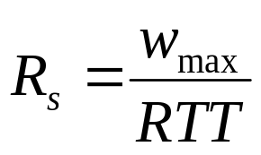
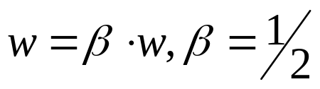

TCP Friendliness:
The definition of good Internet behavior
A TCP connection’s throughput is bounded
w_{max} - maximum retransmission window size
RTT - round-trip time
The TCP send rate limit is
Congestion windows size changes
AIMD algorithm
additive increase, multiple decrease
In case of loss in an RTT:
In case of no loss:
That’s not generally true
Bigger RTT
  higher loss probability per RTT
  slower recovery
Disadvantage for long-distance traffic
TCP is said to be fair
Streams that share a path will reach an equal share

Slide 14
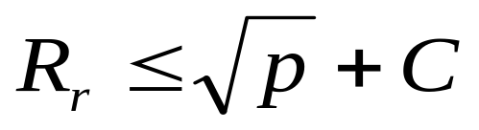
TCP Friendliness:
The definition of good Internet behavior
A protocol is TCP-friendly if
  Colloquial: It long-term average
  throughput is not bigger than TCP’s
  Formal: Its arrival rate is at most
  some constant over the square root
  of the packet loss rate
P – packet loss rate
C – constant value
R_{r} – packet arrival rate
Thus, if the rule is not violated …
  … the AIMD algorithm with α ≠ 1/2 and β ≠ 1 is still TCP-friendly
  … TCP-friendly protocols may
    probe for available bandwidth faster than TCP
    adapt to bandwidth changes more slowly than TCP
    use different equations or statistics, i.e., not AIMD
    not use slow start (i.e., don’t start with w=0)

Slide 15
TCP Congestion Control Alternatives
Why alternatives?
  Improve throughput and variance
    Early TCP implementations did little to minimize network congestion
    Loss indication forces setting new congestion window threshold to half of the last congestion window size
    But …
      … what else to conclude from the loss?
      … which packets to retransmit?

Slide 16
TCP Congestion Control Alternatives
Original TCP
  not in use
TCP Tahoe
TCP Reno
TCP New-Reno
  standard TCP headers
TCP SACK (Selective Acknowledgements)
TCP FACK (Forward Acknowledgements)
  must use a TCP option
  RFC 2018 “TCP Selective Acknowledgment Options”
TCP Westwood+
  use bandwidth estimate for congestion events

Slide 17
TCP Congestion Control Alternatives
TCP/IP Header Format for TCP Tahoe, Reno and New Reno
Version
IHL
Type of service
PRE
ToS
Total length
Identification
D
M
Fragment offset
Time to live
Protocol
Header checksum
IP header
Source address
Destination Address
Options
Source port
Destination port
Sequence number
Piggyback acknowledgement
TCP header
THL
unused
U
A
P
R
S
F
Advertised window
Checksum
Urgent pointer
Data
THL – TCP header length
U: URG – urgent
A: ACK – acknowledgement
P: PSH – push
R: RST – reset
S: SYN – sync
F: FIN – finalize

Slide 18
TCP Congestion Control Alternatives
TCP/IP Header Format for TCP SACK and FACK
5
SACK opt. len.
Left edge 1st block
Right edge 1st block
Version
IHL
Type of service
PRE
ToS
Total length
…
Identification
D
M
Fragment offset
Right edge last block
Time to live
Protocol
Header checksum
IP header
Source address
Destination Address
Left edge: first sequence number of a block of received packet after a lost
packet
Options
Source port
Destination port
Sequence number
Right edge: first sequence number AFTER
that block
Piggyback acknowledgement
THL
unused
U
A
P
R
S
F
Advertised window
Only 40 bytes TCP options allowed, therefore never more than 4 blocks reported at once
Checksum
Urgent pointer
TCP header
5
SACK opt. len.
Left edge 1st block, bits 31-16
Left edge 1st block, bits 15-0
Right edge 1st block, bits 31-16
Sequence number of packet that triggered ACK must be in first block unless it is in the sequence number field
Right edge 1st block, bits 15-0
Left edge 2nd block, bits 31-16
Left edge 2nd block, bits 15-0
…
…
Right edge last block, bits 15-0
Always use as many blocks as possible
Data

Slide 19
TCP Congestion Control Alternatives
Feature | Original TCP | Tahoe | Reno | New-Reno | SACK |  | FACK
Retransmission strategy | Go back-n | Retransmit lost packet, continue after last sent |  |  | By SACK blk
Slow start | No | Yes | Yes | Yes | Yes |  | Yes
Congestion avoidance | No | Yes | Yes | Yes | Yes |  | Yes
Fast retransmit | No | Yes | Yes | Yes | Yes |  | Yes
Fast recovery | No | No | Yes (3 duplicate ACKs)
Stay in f. rec. | No | No | No | Yes | Yes | Consider gaps
In flight packet estimation | By TCP sequence number |  |  |  |  |  | By 1st SACK blk
Cong. window halving | Immediately |  |  |  |  |  | Linear decrease
Notes:
See comments on next slide

Slide 20
TCP Congestion Control Alternatives
Feature | Original TCP | Tahoe | Reno | New-Reno | SACK |  | FACK
Retransmission strategy | Go back-n |  | Retransmit lost packet, continue after last sent |  | By SACK blk
Slow start | No | Yes | Yes | Yes | Yes |  | Yes
Congestion avoidance | No | Yes | Yes | Yes | Yes |  | Yes
Fast retransmit | No | Yes | Yes | Yes | Yes |  | Yes
Fast recovery | No | No | Yes (3 duplicate ACKs)
Stay in f. rec. | No | No | No | Yes | Yes | Consider gaps
In flight packet estimation | By TCP sequence number |  |  |  |  |  | By 1st SACK blk
Cong. window halving | Immediately |  |  |  |  |  | Spread out
Notes:
Slow start: start sending 1 packet per RTT, increase number of packets sent per RTT for each ACK received until threshold.
Congestion avoidance: halve congestion window for each loss.
Fast retransmit: after receiving 3 duplicate ACKs, the indicated sequence number is considered lost, and the packet is retransmitted
Fast recovery: special state entered after fast retransmit. For every additional duplicate ACK received, a new packet is sent out (in excess of the congestion window!!!!). When a different ACK arrives, the special state is left. If there was another loss but the detected one, the new ACK will not shift the send window forward by a complete congestion window. The sender has now sent too much and is blocked because it must now consider the congestion window.
Staying in fast recovery: Tahoe and Reno leave fast recovery when the first non-duplicate ACK arrives. New-Reno and younger interpret each ACK as a report of one packet having arrived at the sender. They remember the last packet that was unacknowledged when they entered fast recovery, and stay in that state until that packet is acknowledged.
In-flight packet estimation means that the TCP sender tries to guess how many packets are received and how many packets are still in the network. It is used to comply with the receiver’s advertised window (try not to flood the receiver with packets that it must drop due to exceeded buffers). Older implementations assume that one packet has arrived at the receiver ACK that they receive (or per two ACKs in special cases).
Spreading out the congestion window halving means that FACK continues to send packets after the congestion window has been halved. Older implementations consider the number of outstanding packets and stop sending until ½ congestion window has been acknowledged. This will take approximately ½ RTT. In the other half of the RTT, they send the number of packets allowed by the new congestion window. FACK spreads this out over the entire RTT by reducing the congestion window gradually.

Slide 21
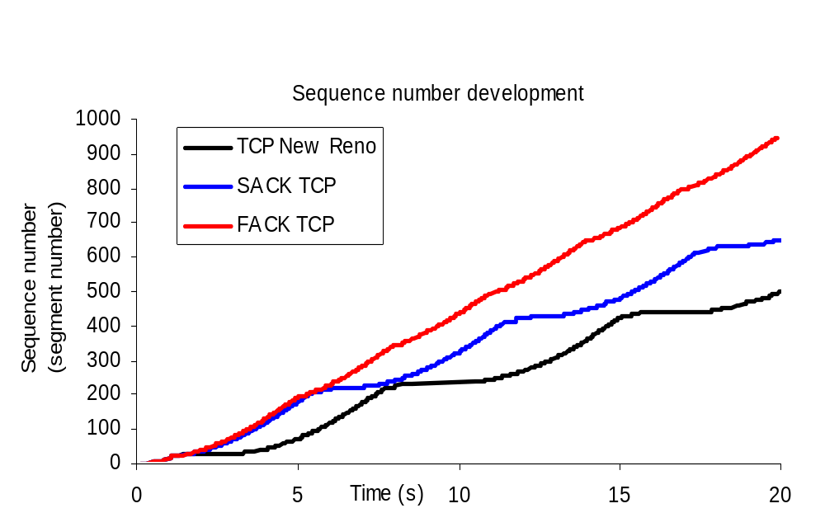
Simulation results
Lossy transfer with small delays (link: 500kbps, 105ms delay):

Slide 22
TCP Westwood+
Very recent
Developed for wireless networks with many losses
  Losses in wireless networks are often non-congestion losses: corruption losses
Side effect
  Less unfair against long round-trip times
Implemented in Linux
  With SACK extensions
Procedure
  TCP Westwood uses ACK packets
  provide a bandwidth estimate
“Faster recovery”
  After loss indication by a triple-ACK go into faster recovery
    Use bandwidth estimate to set new congestion window size and new slow start threshold

Slide 23
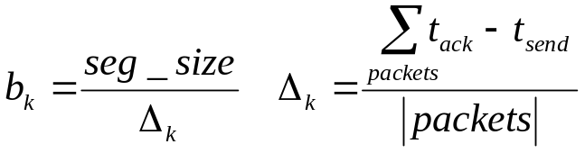
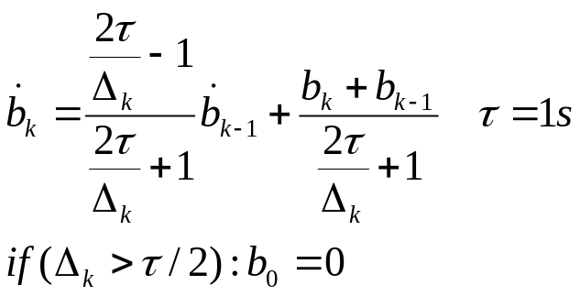
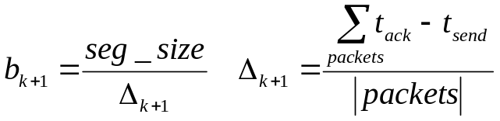
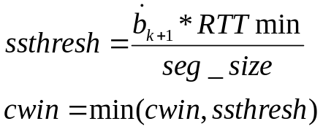
TCP Westwood+
sender
receiver
Low pass filter for available bandwidth
estimate:
new RTTmin
7
6
5
Westwood
ssthresh
4
3
Reno ssthresh
2
DUPACKs
1
time

Slide 24
TCP Westwood+
TCP Westwood assumption
  Immediately before the loss, TCPW was very close to its fair share. Therefore, on triple ACKs and DUPACKs, a state of congestion is reached and the previously used bandwidth is used for the congestion window size (not halving!)

Slide 25
TCP Westwood+
200
50 ms Reno
150
50 ms Westwood
Sequence number in segments/100
100
50
200 ms Reno
200 ms Westwood
0
0
50
100
150
200
Time (sec)
(approximation of a perf. eval. figure)

Slide 26
TCP Westwood+
TCP senders
TCP receivers
bottleneck link:
packet loss
limited bandwidth

Slide 27
TCP Westwood+
Uniformly distributed errors at the bottleneck link: 0.5% loss
2.5
2
Westwood
1.5
Throughput (Mbit/s)
1
0.5
TCP Reno
TCP SACK
0
1
2
3
4
5
6
7
Speed of the bottleneck link (Mbit/s)
(approximation of a perf. eval. figure)

Slide 28
Random Early Detection (RED)
Random Early Detection (discard/drop) (RED) uses active queue management
Drops packet in an intermediate node based on average queue length exceeding a threshold
  TCP receiver reports loss in ACK
  sender applies MD
Why?
  if not, many TCPs loose packets at the same time
  many TCP streams probe again at the same time
  oscillating problems

Slide 29
Early Congestion Notification (ECN)
Early Congestion Notification (ECN) - RFC 2481
  an end-to-end congestion avoidance mechanism
  implemented in routers and supported by end-systems
  not multimedia-specific, but very TCP-specific
  two IP header bits used
    ECT - ECN Capable Transport, set by sender
    CE - Congestion Experienced, may be set by router
Extends RED
  if packet has ECT bit set
    ECN node sets CE bit
    TCP receiver sets ECN bit in ACK
    sender applies multiple decrease (AIMD)
  else
    Act like RED

Slide 30
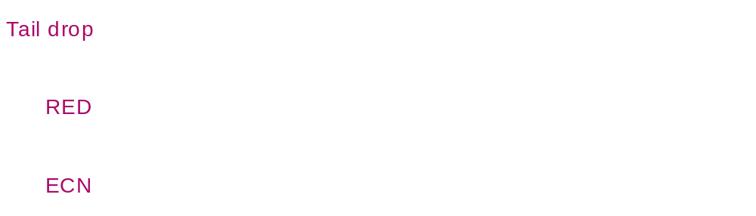
Early Congestion Notification (ECN)
Effects
  Congestion is not oscillating - RED & ECN
  ECN-packets are never lost on uncongested links
  Receiving an ECN mark means
    TCP window decrease
    No packet loss
    No retransmission

Slide 31
Download applications
Loss is worst …
  … because it must be corrected
  … because it must be interpreted as congestion, and
  TCP-friendliness demands that bandwidth consumption is reduced
Non-QoS problem
  Transport layer can share bandwidth only fairly
  End-users can tweak this: performance isolation
Other TCP variants (that you find in Linux)
  BIC
  CUBIC
  Vegas
  High-speed TCP
  Fast TCP
  H-TCP
  …

Slide 32
On–demand Streaming Applications
Stable bandwidth problem

Slide 33
TCP Congestion Control
TCP congestion control is based on the notion
that the network is a “black box” –
congestion indicated by a loss
Sufficient for best-effort applications, but losses might severely hurt traffic like audio and video streams
→ congestion indication can enable features like
quality adaptation

Slide 34
UDP
The classical solution
  Send data at playout speed
  Write loss-tolerant audio-video codecs
  Ignore all kinds of loss
Problem
  Does not back off at bandwidth bottlenecks
  TCP connections suffer
Approach is no longer accepted

Slide 35
Comparison of Non-QoS Philosophies
Pro UDP | Pro TCP
Scalable due to multicast | Proxies, caches and reflectors are beneficial anyway, can replace multicast
 | ISPs dislike multicast
Faster only one end-to-end delay for packet delivery | Existing optimization is for TCP routers, firewall, OS network stacks
Application controls retransmission | No need to handle retransmissions
Scalable codecs are needed anyway | Lossless codecs don’t need additional loss resistance
Small buffers possible if loss is handled gracefully
TCP-friendliness can be implemented (end-to-end) variations of the algorithm possible | TCP-friendly without additional work
 | Works through firewalls
One-fits-all protocol possible on-demand, quasi-broadcasting, conferencing | Most applications are on-demand

Slide 36
Using Standard Protocols
Over UDP | Over TCP | Alternative Transport
RTP Real Time Protocol IETF std, supported by ITU-T & Industry | RTP in RTSP over TCP standardized worst-case fallback firewall-friendly | SCTP Stream Control Transmission Protocol IETF RFC, supported by telephone industry
RLM TCP-friendly, needs fine-grained layered video | "Progressive Download" or "HTTP Streaming" application-level prefetching and buffering trivial, cheap, firewall-friendly | DCCP Datagram Congestion Control Protocol IETF RFC, driven by TCP-friendliness researchers
SR-RTP TCP-friendly with RTP/UDP needs special encoding (OpenDivX)
VDP Video Datagram Protocol Research, for Vosaic | Priority Progress Streaming needs special encoding needs special routers for ’multicast’ | PRTP-ECN Partially reliable transport protocol using ECN Research, Univ. Karlstad
MSP Media Streaming Protocol Research, UIUC

Slide 37
Progressive Download
In-band in long-running HTTP response
  Plain file for the web server
  Even simpler than FTP
  No user interactions – start, stop, ...
If packet loss is ...
  ... low – rate control by back-pressure from client
  ... high – client’s problem
Applicability
  Theoretical
    For very low-bit-rate codecs
    For very loss-intolerant codecs
  Practical
    All low-volume web servers

Slide 38





Progressive Download
Web server
Backpressure !
Decoder
Receive buffer
TCP Stack
TCP Stack
Can recreate timing from media file
Accepts buffer underruns
Serves requested files as quickly as possible
Network (uncongested)

Slide 39
Progressive Download
Web server
Retransmission Timeout
Decoder
Receive buffer
TCP Stack
TCP Stack
Network (congested)

Slide 40
Priority Progress Streaming
Unmodified TCP (other transports conceivable)
Unmodified MPEG-1 video-in (other encoding formats conceivable)
Real-time video processing
  Convert MPEG to Spatially Scalable MPEG (SPEG) – 10-25% overhead
  Packetize SPEG to separate by frame and by SNR quality step
    More variations conceivable: color, resolution
  Assign priorities to SPEG packets
    Dynamic utility curves indicate preference for frame or SNR dropping
  Write SPEG packets in real-time into reordering priority progress queue
Queues are long
  Much longer than TCP max window
  Dynamically adjustment allows fast start and dynamic growth
  With longer queues
    Total delay is increased
    High priority packets win more often

Slide 41
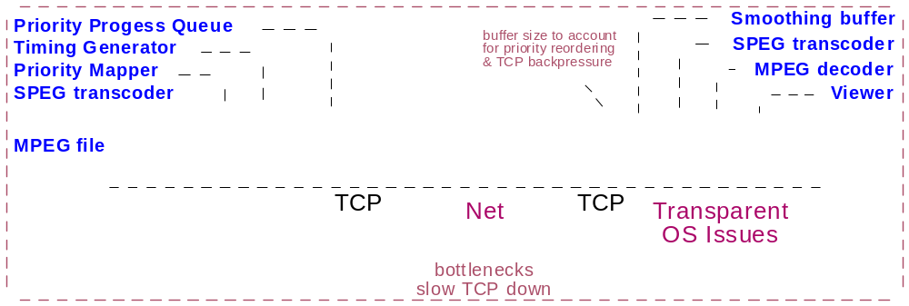
Priority Progress Streaming
Packets to send
High priority
Medium priority
To TCP
Low priority
Priority Progress Queue

Slide 42
Selective Retransmission–RTP (SR−RTP)
Features
  Relies on a layered video codec
  Supports selective retransmission
  Uses congestion control to choose number of video layers
Congestion Manager
  Determines the permitted send rate at the sender
  Uses TCP-friendly algorithm for rate computation
Knowledge about encoding
  Required at sender to select video layers to send
  Required at receiver to
    decode at correct rate
    send NAKs

Slide 43
Selective Retransmission–RTP (SR−RTP)
MPEG-4 server
Transmission schedule of
a layered video
Decoder
Update allowed
Bandwidth
for stream
RTCP report
Includes loss information
Smoothing buffer
SR-RTP
RTCP
SR-RTP
RTCP
Congestion
Manager
UDP Stack
UDP Stack
Retransmission demand
Forwarding to the
Congestion Manager
Network

Slide 44
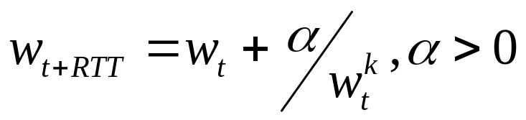
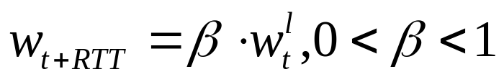
Selective Retransmission–RTP (SR−RTP)
Binomial Congestion Control
  Provides a generalization of TCP AIMD
  Congestion window size w_{t} depends on losses per RTT
  TCP’s AIMD: α = 1, β = .5, k = 0 and l = 1
  k + l = 1: binomial congestion control is TCP friendly
Increase
Decrease
Nick Feamster and Hari Balakrishnan

Slide 45
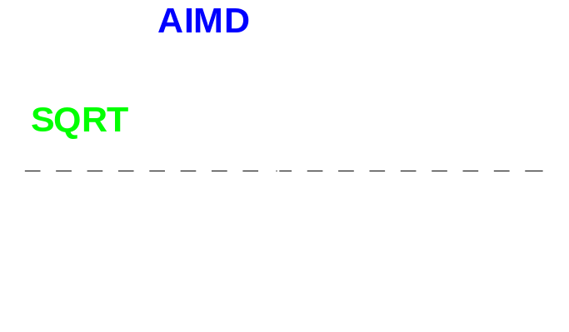
Selective Retransmission–RTP (SR−RTP)
SQRT
  Special case of binomial congestion control
  k=0.5, l=0.5
  Name because w^{0.5} = sqrt(w)
Effect of SQRT
  Average bandwidth is like TCP’s
  Maximum is lower
  SQRT covers a step function with
  less steps
AIMD
SQRT

Slide 46
Datagram Congestion Control Protocol (DCCP)
Datagram Congestion Control Protocol
Transport Protocol
  Offers unreliable delivery
  Low overhead like UDP
  Applications using UDP can easily change to this new protocol
Accommodates different congestion control
  Congestion Control IDs (CCIDs)
    Add congestion control schemes on the fly
    Choose a congestion control scheme
    TCP-friendly Rate Control (TFRC) is included
  Half-Connection
    Data Packets sent in one direction

Slide 47
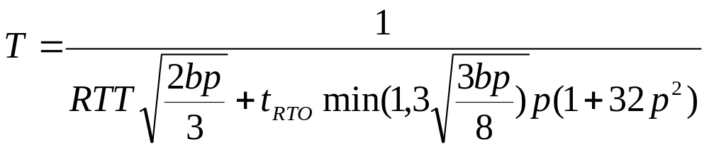
Datagram Congestion Control Protocol (DCCP)
Congestion control is pluggable
  One proposal is TCP-Friendly Rate Control (TFRC)
    Equation-based TCP-friendly congestion control
    Receiver sends rate estimate and loss event history
    Sender uses models of SACK TCP to compute send rate
Steady state TCP send rate
Loss probability
Retransmission timeout
Number of packets ack’d by one ACK
Padhye’s TCP New Reno estimation formula

Slide 48
On-demand streaming applications
Smoothness is key
  Use a lot of buffering
  Don’t surprise the application
  Consume a limited amount of buffers
  Try to make congestion control as smooth as possible
Adaptive applications
  Can by improved by this

