Slide 1
CENG 241
Object orıented programmıng

Slide 2
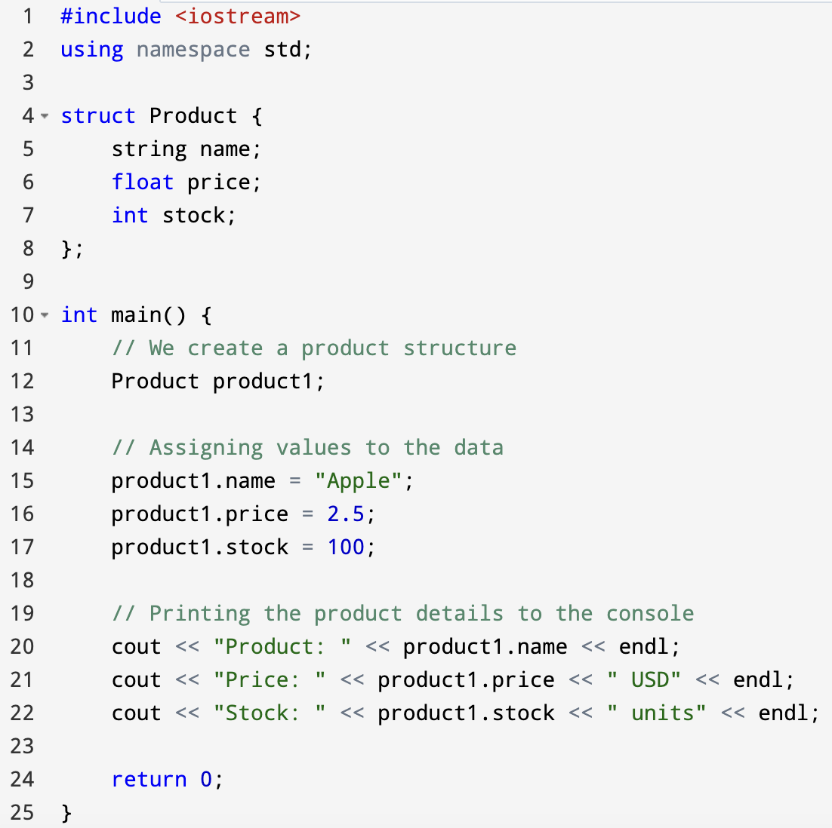
struct
Notes:
#include <iostream>
using namespace std;
struct Product {
string name;
float price;
int stock;
};
int main() {
// We create a product structure
Product product1;
// Assigning values to the data
product1.name = "Apple";
product1.price = 2.5;
product1.stock = 100;
// Printing the product details to the console
cout << "Product: " << product1.name << endl;
cout << "Price: " << product1.price << " USD" << endl;
cout << "Stock: " << product1.stock << " units" << endl;
return 0;
}

Slide 3
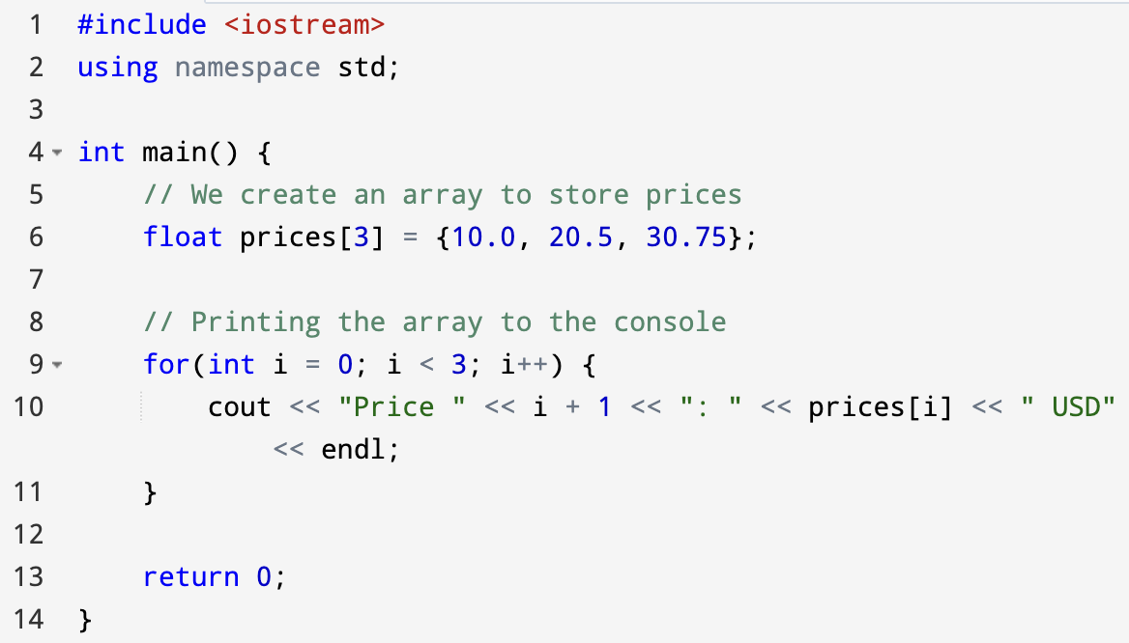
ARRAY
Notes:
#include <iostream>
using namespace std;
int main() {
// We create an array to store prices
float prices[3] = {10.0, 20.5, 30.75};
// Printing the array to the console
for(int i = 0; i < 3; i++) {
cout << "Price " << i + 1 << ": " << prices[i] << " USD" << endl;
}
return 0;
}

Slide 4
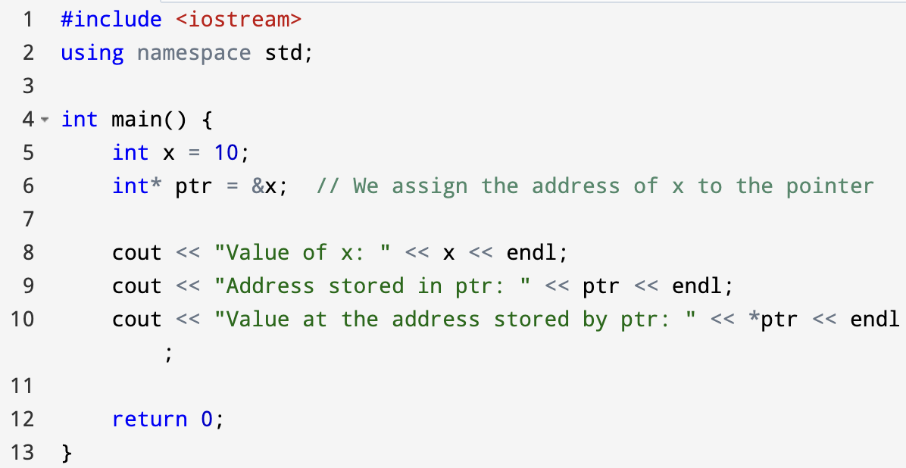
POINTER
Notes:
#include <iostream>
using namespace std;
int main() {
int x = 10;
int* ptr = &x; // We assign the address of x to the pointer
cout << "Value of x: " << x << endl;
cout << "Address stored in ptr: " << ptr << endl;
cout << "Value at the address stored by ptr: " << *ptr << endl;
return 0;
}

