Slide 1


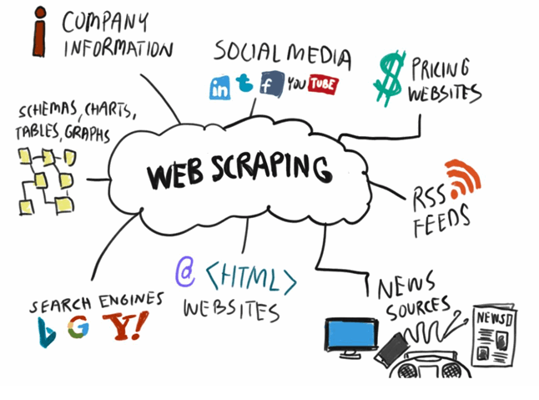
CENG 464 – DATA MINING
Presenter: Res. Asst. Sezer UĞUZ

Slide 2
What is the HTTP?

Slide 3
What is the HTTP?
HTTP stands for “HyperText Transfer Protocol (Hiper Metin Transfer Protokolü)”.
HTTP is a protocol used for communication between computers over the internet and for the transmission of web pages.
It is based on the client-server model, facilitating the exchange of information between a client and a server.
The primary purpose of HTTP is to send client requests to web servers and receive responses from them. Web browsers (clients) send HTTP requests to servers to request and display web pages, while web servers return appropriate responses to these requests.

Slide 4
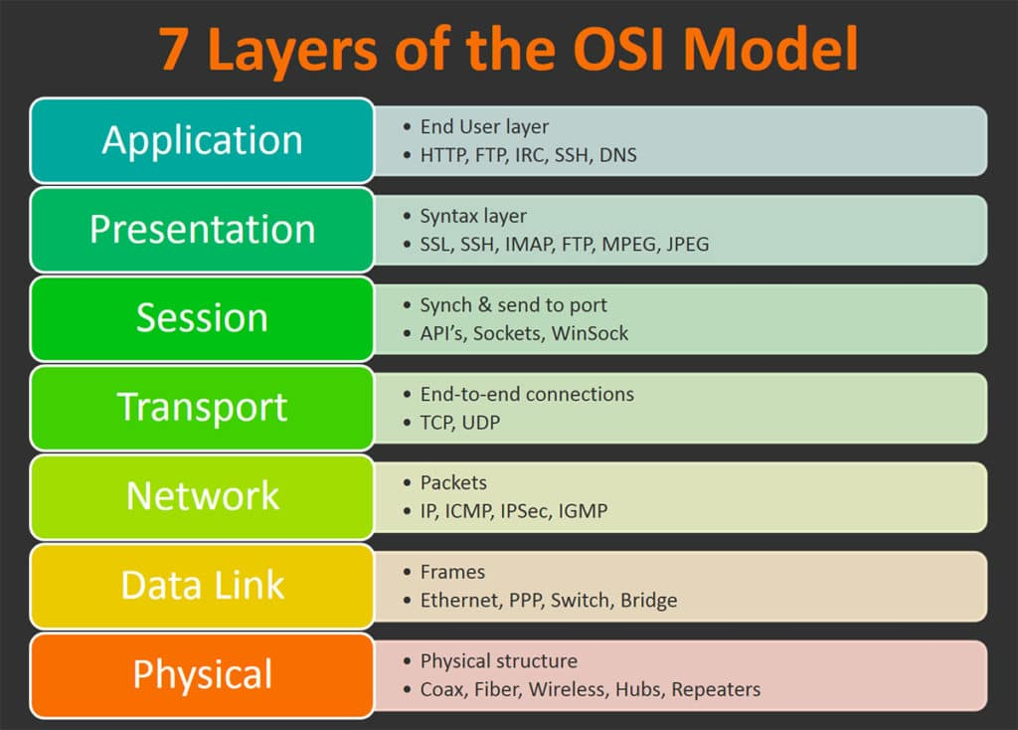
What is the HTTP? Hiper Metin Transfer Protokolü
HTTP works over TCP/IP (Transmission Control Protocol/Internet Protocol) and uses port 80 by default.
Additionally, it has a secure version called HTTPS (HTTP Secure), which uses port 443.
HTTP transfers requests (HTTP requests) sent by a client and responses (HTTP responses) sent by a server in a specific format.
HTTP requests and responses consist of two main parts: the header and the body. The header contains information about the request or response, while the body includes the requested resource or transmitted data.
HTTP supports various operations, such as displaying web pages via web browsers, data exchange, file downloads, and form submissions. Furthermore, HTTP forms the foundation of RESTful APIs and is widely used for data exchange.

Slide 5
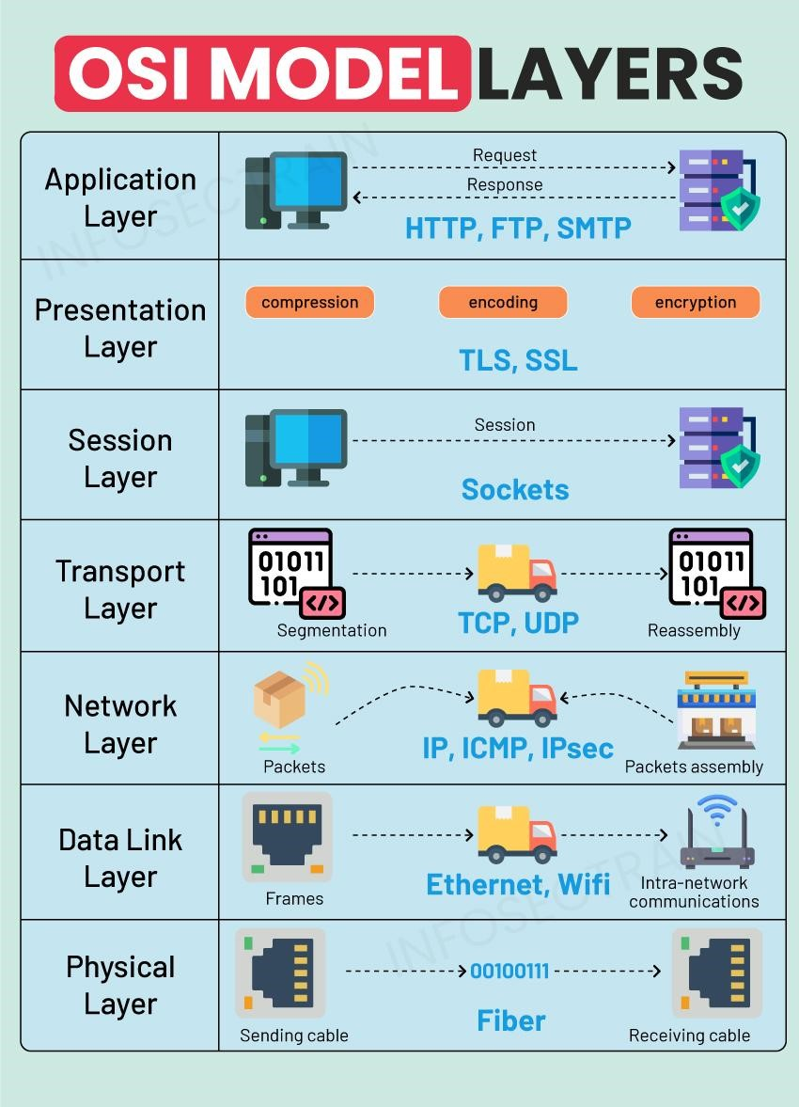
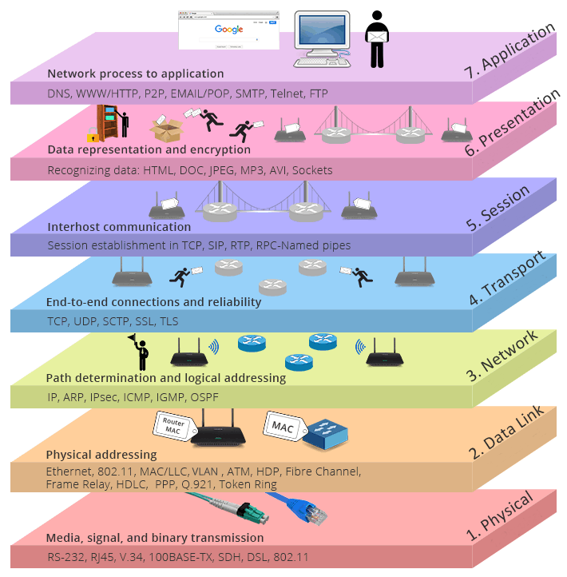

Slide 6
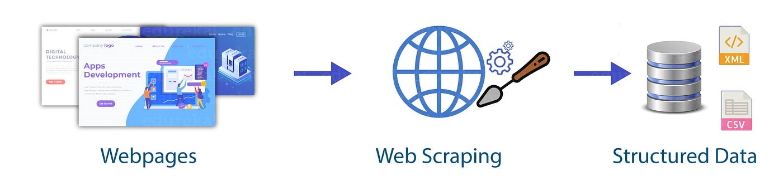
What is the Web Scraping?
Web scraping is a process that allows us to automatically and efficiently extract data from web pages on the internet.
This process involves analyzing the HTML or XML structure of web pages to retrieve the desired data in a specific format.
If there is no API providing the data we need, or if the API does not offer all the desired data, the only solution is “Web Scraping.”

Slide 7
What are the use cases of Web Scraping?
Market research: Extracting data such as competitor analysis, price comparisons, and consumer reviews.
Job listings and career data: Extracting data such as job positions and company information from job listing sites.
Financial data analysis: Extracting financial data such as stock prices, exchange rates, and economic indicators.

Slide 8
What are the Use Cases of Web Scraping? – cont.
News and social media analysis: Extracting and analyzing content from sources such as news websites and social media platforms.
Real estate and immobilization: Extracting data such as housing prices and listings for sale/rent from real estate websites.
Scientific research: Extracting data from scientific sources such as academic papers, research data, and statistics.

Slide 9
Things to Know Before Web Scraping
Web scraping allows us to analyze the HTML structure and select specific elements to extract data.
When performing web scraping, it is important to consider the website’s terms of use and legal restrictions.
Web scraping performed without permission or in violation of the law can lead to legal issues. Therefore, it is necessary to follow ethical guidelines when carrying out web scraping activities.

Slide 10
What is the HTML?

Slide 11
What is the HTML?
HTML is an English abbreviation formed from the phrase HyperText Markup Language (Hiper Metin İşaretleme Dili). The primary function of a markup language is to contain rules that define the structure, format, and overall appearance of the text within a document and allow for their implementation.
To run HTML files, simply add the .html extension to the files you create and open them in a web browser. This way, you can view the website created with the HTML code you wrote.

Slide 12
What is the HTML?
An HTML document consists of two main parts:
1. Head section
2. Body section
The Head section contains elements related to the page’s title and other meta-information.
The Body section contains the actual content of the HTML document, which includes:
• Paragraphs,
• Lists, and
• Other elements.

Slide 13
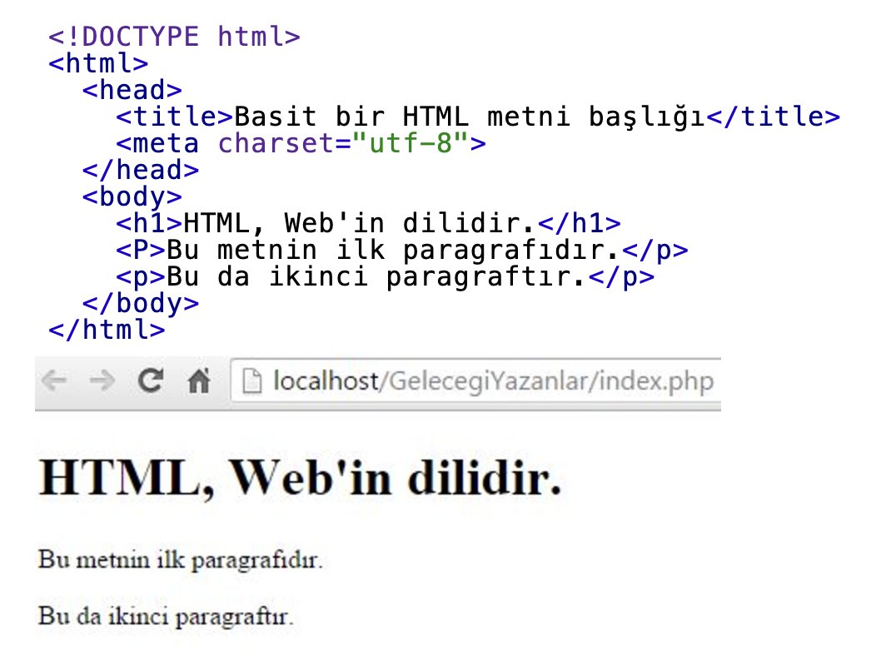
What is the HTML?
An HTML document consists of components called tags. The basic component in the HTML structure is an element. To explain elements, everyday things like headings, paragraphs, and lists are examples of elements. These elements are separated and made meaningful by using tags.
The structure of HTML tags is very simple. They are indicated by the < (less than sign) and > (greater than sign) symbols. For example, to define a paragraph, we use the <p> tag. When we want to close the paragraph tag, we simply add a / symbol after the < sign, like this: </p>.

Slide 14

What is the HTML?
HTML tag
An HTML tag tells your browser that the file contains HTML code. The .html extension in the file name indicates that the file is an HTML document.
HEAD tag
The HEAD tag defines the first part of an HTML document. It must contain the TITLE element, which specifies the title of the document.
Let’s look at the HEAD section in the HTML code example below:
<html>
<head>
<title>BASİT BİR HTML METNİ</title>
</head>
</html>
In this example, the text “BASİT BİR HTML METNİ” between the <TITLE> and </TITLE> tags will be displayed as the page title.

Slide 15
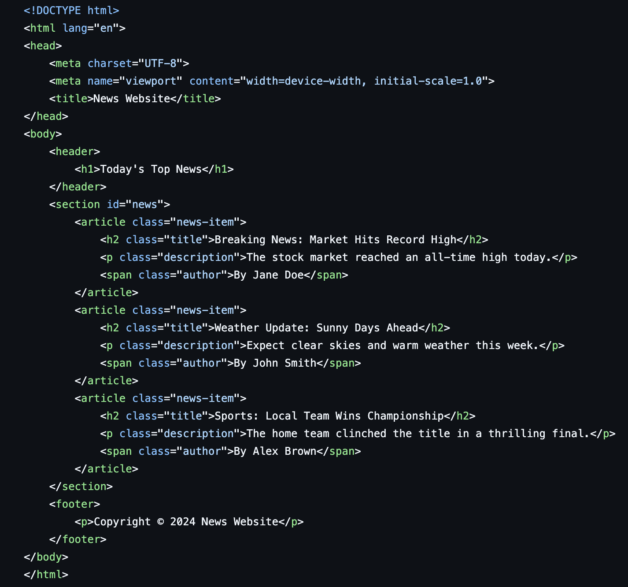
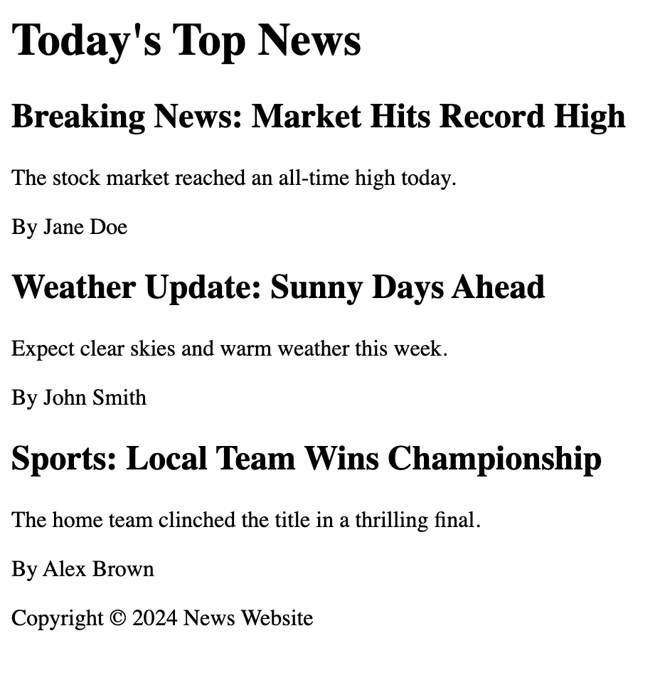
Sample HTML

Slide 16
Let’s do some practice!

