Slide 1
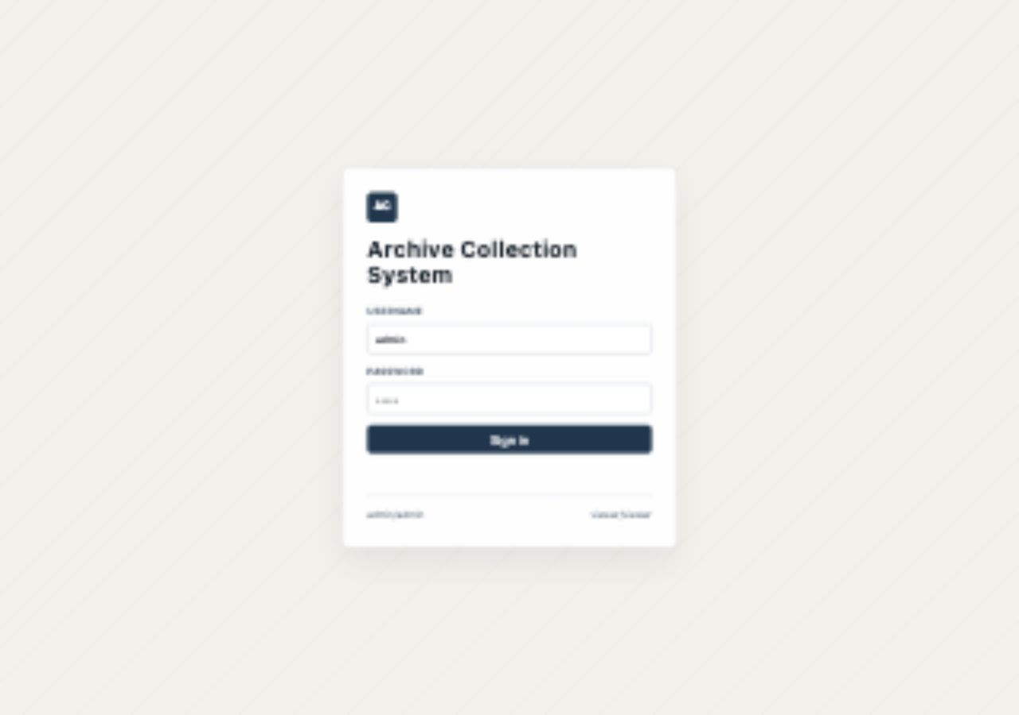
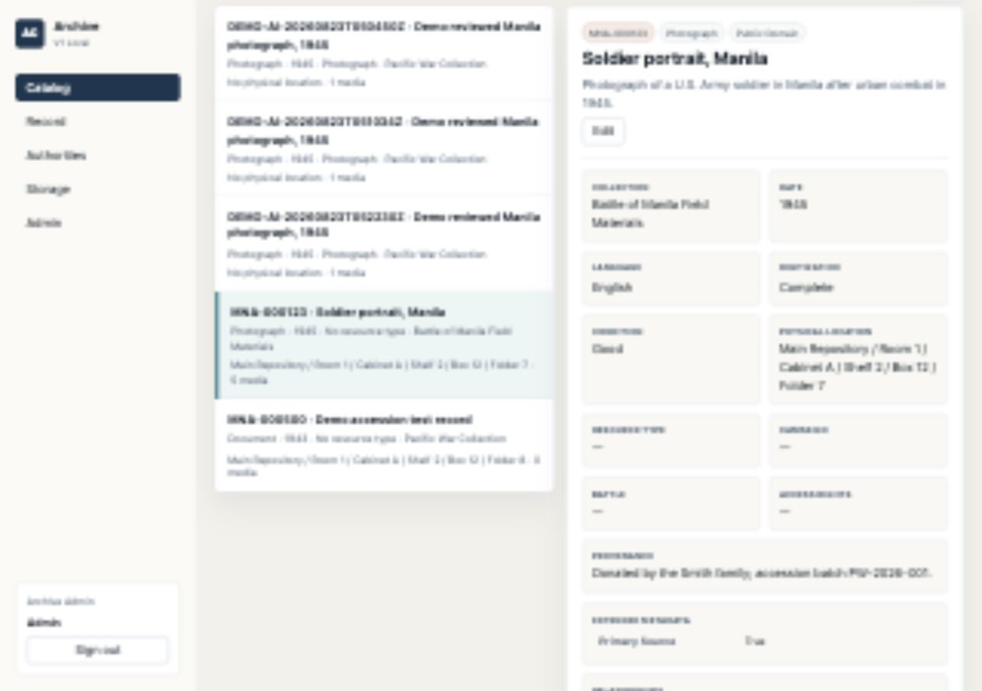
LOCAL V1 DEMO
Archive Collection System design + demo walkthrough
Use this deck to explain the design principles and technical model first, then run the live demo with screenshots from the running system.
Validated: 89 / 89 feature checks passed
Archive Collection System demo walkthrough
01

Slide 2
DESIGN SECTION
The demo is a local proof of a larger DAM and metadata platform
The first section explains the product principles, design choices, technical architecture, metadata model, AI intake workflow, and backlog before the click-by-click demo begins.
Source documents
Product technical design
Metadata user manual
Taxonomy reference
Architecture backlog
Archive Collection System demo walkthrough
02

Slide 3
Design principles keep the archive useful and safe
These are the rules behind the local V1 implementation and the larger DAM roadmap.
Preserve before publish
Separate knowledge from files
Canonical files, checksums, derivative types, and backups are modeled before public delivery features.
Objects, authorities, taxonomy, storage, media, audit, and intake stay distinct so each can evolve independently.
Human review owns metadata
Viewer access is useful but bounded
AI can draft, but curator review controls titles, rights, authority links, provenance, and submit decisions.
Public-style users can search and read safe metadata while storage paths, checksums, notes, and admin actions stay hidden.
Archive Collection System demo walkthrough
03

Slide 4
Design choices make V1 local but production-shaped
The local app intentionally avoids cloud dependencies while preserving the architecture boundaries that matter.
Target product shape
Local V1 implementation
DAM manages source files, derivatives, rights, and versions.
Metadata service manages items, collections, entities, schemas, and review state.
Search and viewer services support facets, full text, maps, timelines, IIIF, citation, and export.
Python http.server backend and static HTML/CSS/JS frontend.
SQLite database for catalog, users, sessions, taxonomy, audit, media, and intake.
Local folders for archive-master, intake staging, and backup exports.
Google Drive URL fields act as demo links, not canonical storage.
Archive Collection System demo walkthrough
04

Slide 5
The technical design separates five responsibilities
The full design can grow toward DAM, search, IIIF, and workflow services without changing the curator-facing mental model.
UI
API / BFF
Metadata
Asset Layer
Governance
Catalog
Record
Authorities
Storage
Admin
Auth
RBAC
JSON APIs
Upload handlers
Objects
Collections
Authorities
Taxonomy
Local files
Drive links
Checksums
Derivative types
Viewer-safe payloads
Audit logs
Backups
Admin-only APIs
Future-ready services: ResourceSpace or asset API, PostgreSQL/JSONB, OpenSearch, IIIF viewer, OCR/transcription workers, vector or graph search.
Archive Collection System demo walkthrough
05

Slide 6
Metadata is layered so archives do not become tag soup
The model keeps display fields, controlled vocabularies, real-world entities, and preservation data separate.
Core object
Permanent ID, title, type, date, rights, collection
DCMI / export
publisher, source, relation, coverage, extent, medium, citation
Pacific War domain
theater, campaign, battle, unit, vessel, wartime jurisdiction
Authorities
Person, Organization, Place, Event relationships
Taxonomy
Object Type, Subject, Rights, Condition, Digitization Status
Digital media
filename, provider, derivative type, MIME type, checksum
Admin stewardship
storage path, internal notes, preservation notes, metadata JSON
Archive Collection System demo walkthrough
06

Slide 7
Interoperability is designed in, even before V2 services exist
The local profile supports simple discovery now and richer export paths later.
Dublin Core baseline
Richer local profile
Future preservation path
Title, creator, subject, description, date, type, format, identifier, relation, coverage, and rights all have local mappings.
UNTL-inspired Pacific War fields preserve campaign, battle, theater, collection, source, ARK, IIIF URL, and sidecar metadata JSON.
PREMIS-style events, METS packaging, IIIF manifests, OAI-PMH, and JSON-LD can layer onto the same object and media model.
Quality gates: unique permanent ID, readable title, controlled object type, collection, normalized date range, authority separation, rights state, storage path, media derivative type, and SHA-256 checksum.
Archive Collection System demo walkthrough
07

Slide 8
AI Intake is a reviewed staging lane, not auto-ingest
The workflow uses AI to accelerate description while keeping formal catalog writes under curator control.
Upload
Stage
Draft
Review
Submit
Persist
Admin uploads images or PDFs
File lands in storage/intake/{id}
Mock analyzer suggests metadata from filename, type, size, checksum
Curator edits title, rights, places, events, notes
Create new object or attach to existing object
Copy file to archive-master and log audit trail
Data captured in V1
Next design step
intake status, original filename, media type, staged path, checksum, AI suggestion JSON, edited JSON, submitted object ID, audit rows.
Preserve which fields came from AI, which were curator-reviewed, and the confidence or evidence package after submit.
Archive Collection System demo walkthrough
08

Slide 9
Vision and backlog clarify what V1 proves next
The demo validates the core model while leaving production portal and preservation depth for later phases.
Access policy enforcement
Drive public delivery from access_rights, review state, and publication state, not only descriptive rights.
Review and publication state
Add object-level review_status, publication_status, and sensitivity for future public search/export.
AI provenance
Keep AI-origin, curator-reviewed fields, confidence, and evidence after an intake draft becomes a catalog object.
Preservation events
Add PREMIS-style ingest, checksum, fixity, derivative, migration, and provenance events.
Public portal scale
Layer in OpenSearch, OCR/transcripts, IIIF/PDF/AV viewer, OAI-PMH, citation/export, maps, and timelines.
Archive Collection System demo walkthrough
09

Slide 10
Start at the local URL and sign in as admin
操作
• Open http://127.0.0.1:8787
• Use admin / admin
• Keep viewer / viewer ready for the permission check
实现 / Return
• Login form is visible
• Both demo credentials are shown
• Successful sign-in opens the Catalog tab
为什么这样设计
• Start with the simplest happy path
• Admin session unlocks write workflows
• Viewer login tees up the boundary test
Archive Collection System demo walkthrough
10

Slide 11
Catalog proves seeded records are searchable
操作
• Set Place to Manila
• Set Event to Battle of Manila
• Select MNA-000123 in the result list
实现 / Return
• Filtered list includes Soldier portrait, Manila
• The selected detail panel opens on the right
• Summary metrics remain visible above the workspace
为什么这样设计
• First demo claim is retrieval
• Filters mirror curator research habits
• Known seed record anchors the story
Archive Collection System demo walkthrough
11

Slide 12
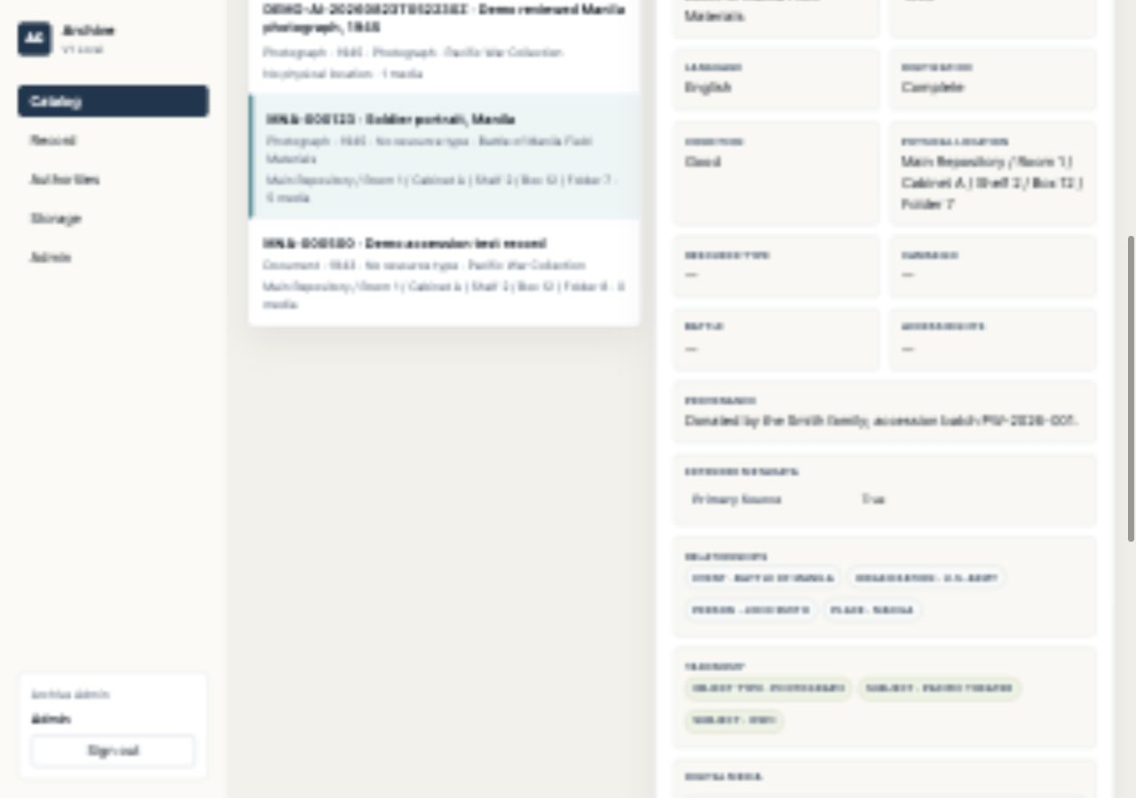
Record detail separates metadata families
操作
• Stay on MNA-000123
• Point to Physical Location, Relationships, and Taxonomy
• Call out that this is the admin view
实现 / Return
• Physical location is visible to admin
• Relationships show Event, Organization, Person, and Place
• Taxonomy shows Object Type and Subject terms
为什么这样设计
• Detail page groups evidence by job
• Admin sees stewardship-only fields
• Checksums prove file-level integrity
Archive Collection System demo walkthrough
12

Slide 13
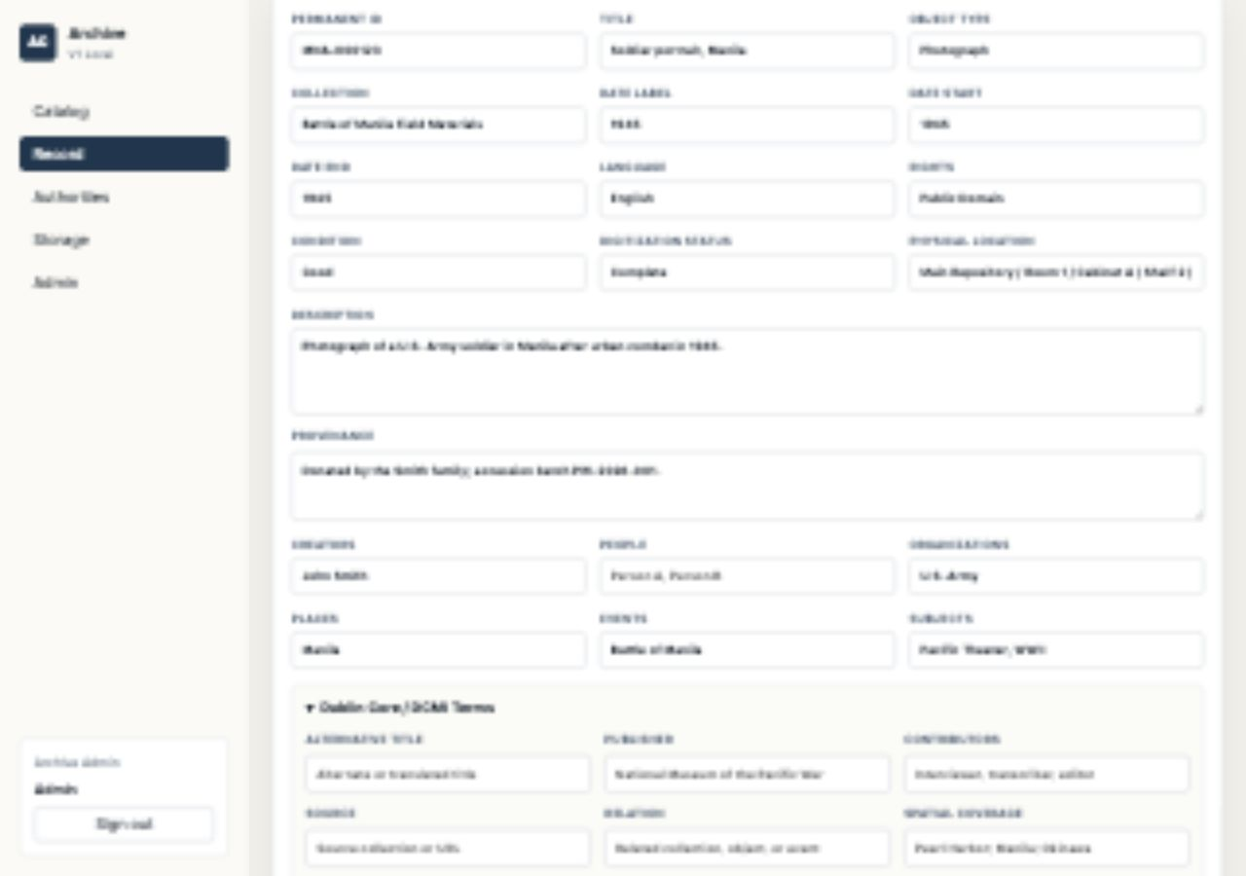
Edit opens the full record form
操作
• Click Edit from the detail panel
• Review required fields: Permanent ID, Title, Object Type
• Show DC and Pacific War sections below
实现 / Return
• Record tab opens with populated values
• Admin controls are enabled
• The form preserves structured metadata fields
为什么这样设计
• Editing stays close to the record
• Required fields protect identity
• Domain sections keep long metadata scannable
Archive Collection System demo walkthrough
13

Slide 14
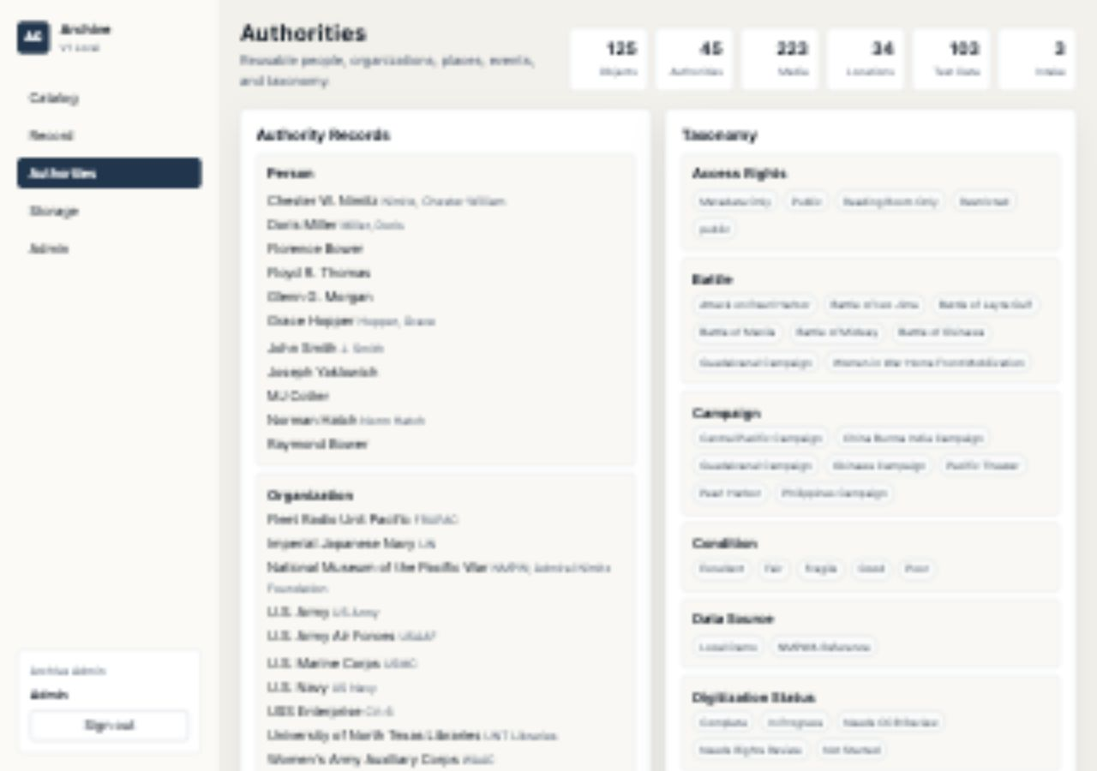
Authorities and taxonomy keep terms controlled
操作
• Open Authorities tab
• Inspect John Smith, U.S. Army, Manila, and Battle of Manila
• Scan taxonomy vocabularies
实现 / Return
• Authorities are grouped by type
• Subject terms such as WWII remain taxonomy terms
• Pacific War vocabularies are available
为什么这样设计
• Names and subjects have different jobs
• Controlled terms reduce drift
• The model supports archive-specific vocabularies
Archive Collection System demo walkthrough
14

Slide 15
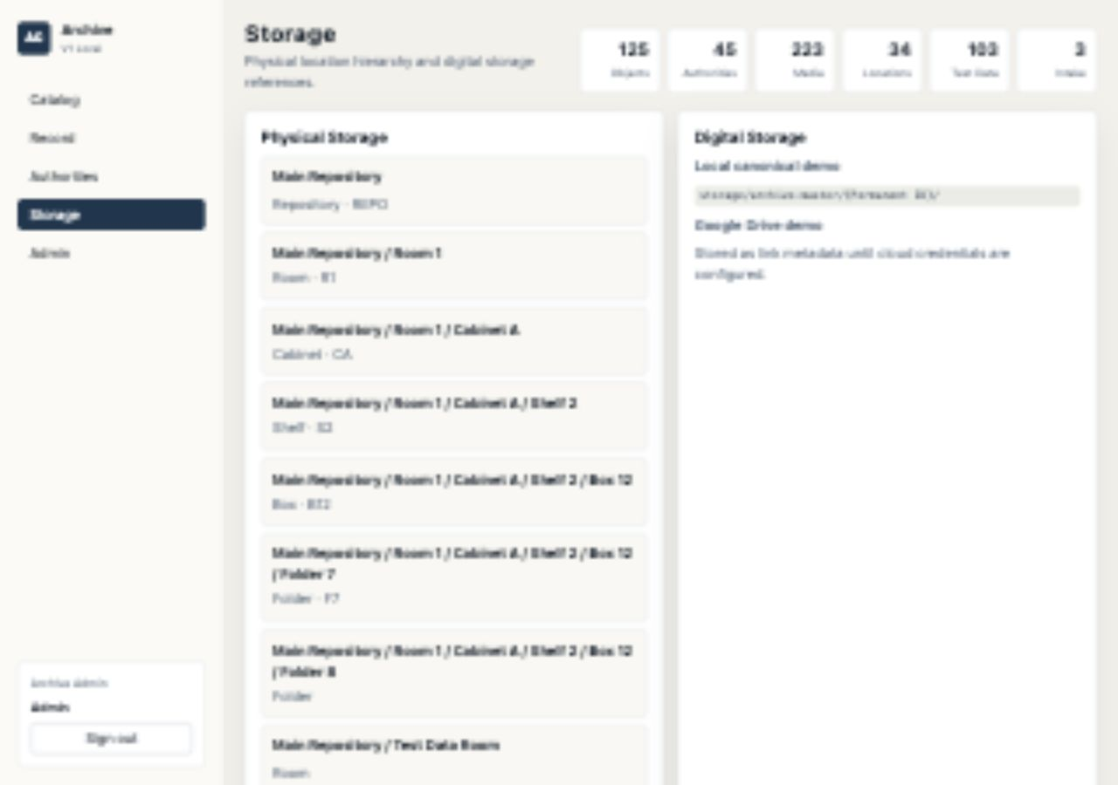
Physical storage is a structured admin view
操作
• Open Storage tab as admin
• Point to Main Repository hierarchy
• Explain that viewer cannot access this API
实现 / Return
• Locations render as paths
• Canonical local storage convention is shown
• Storage is treated separately from public description
为什么这样设计
• Physical custody is operational data
• Path rendering is fast to verify live
• Viewer boundary protects internal logistics
Archive Collection System demo walkthrough
15

Slide 16
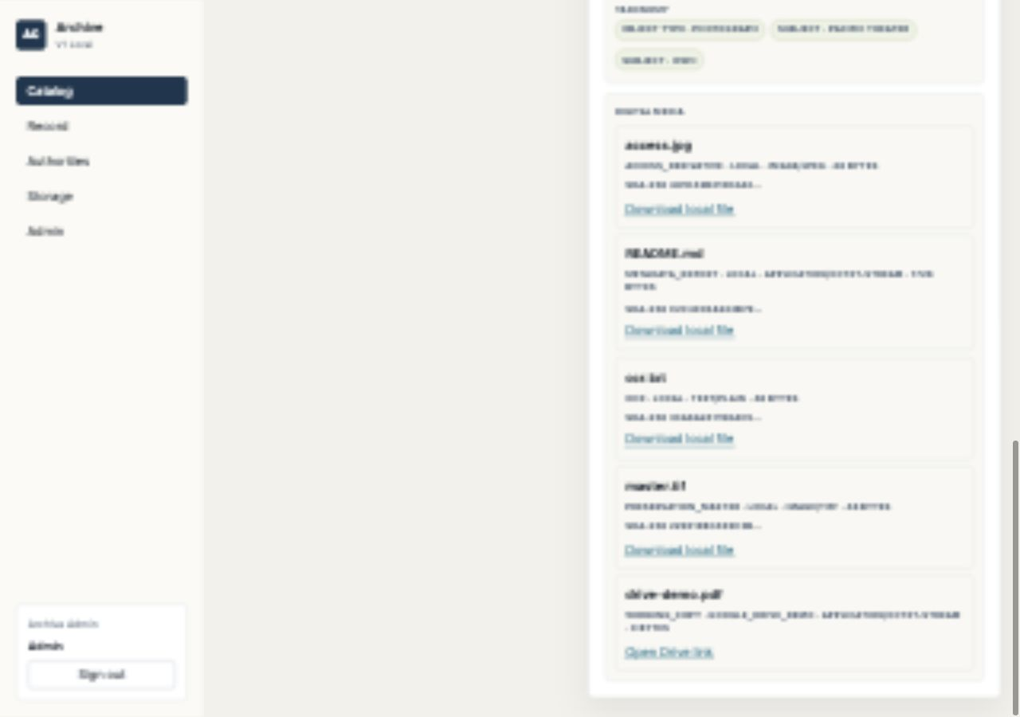
Digital media separates files and links
操作
• Return to the MNA-000123 detail
• Point to derivative type and provider
• Show local download versus Google Drive demo link
实现 / Return
• Local rows show derivative type, provider, media type, and checksum
• Drive demo link appears as google_drive_demo
• Actions distinguish local download from Drive open link
为什么这样设计
• Media is modeled separately from object text
• Provider field explains storage source
• Rights logic can hide restricted downloads
Archive Collection System demo walkthrough
16

Slide 17
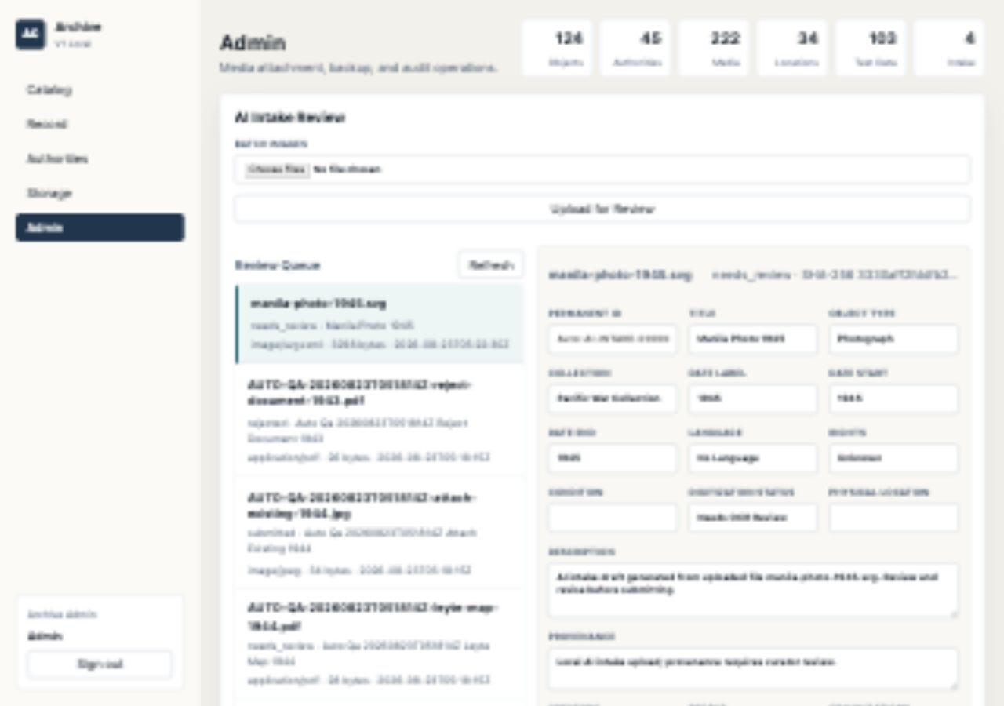
AI Intake upload returns a review draft
操作
• Open Admin tab
• Upload manila-photo-1945.svg
• Select the newest needs_review draft
实现 / Return
• Review Queue shows manila-photo-1945.svg selected
• Draft title shows Manila Photo 1945
• Status remains needs_review before curator submit
为什么这样设计
• AI suggestions are staged, not final
• Checksum is captured before ingest
• Curator review remains the control point
Archive Collection System demo walkthrough
17

Slide 18
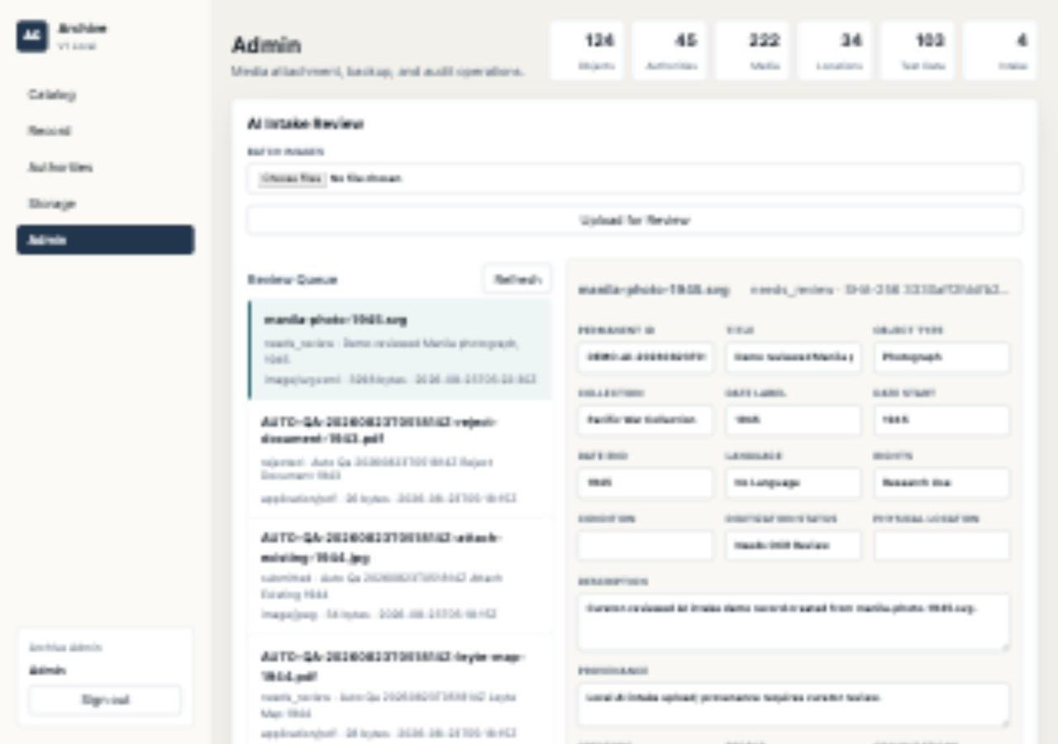
Curator review keeps suggestions accountable
操作
• Save a curator-reviewed title
• Set Research Use, Manila, and Battle of Manila
• Keep the draft in needs_review
实现 / Return
• Reviewed title is Demo reviewed Manila photograph, 1945
• Rights field shows Research Use
• Place and Event show Manila / Battle of Manila
为什么这样设计
• The human owns final metadata
• Draft saving separates review from ingest
• Authority matching happens from reviewed values
Archive Collection System demo walkthrough
18

Slide 19
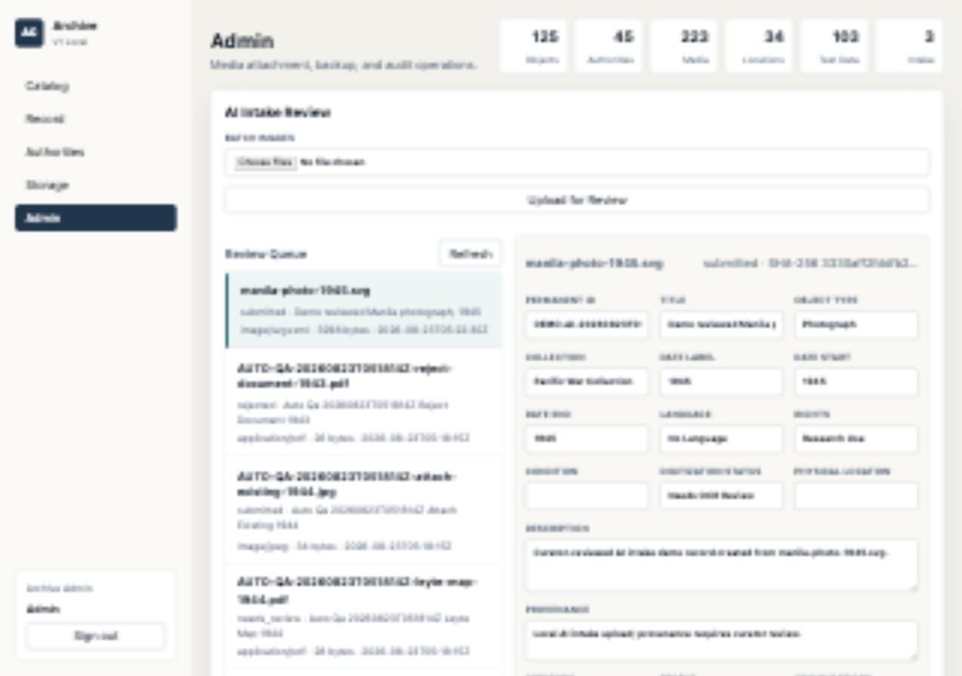
Submit creates the catalog object and media
操作
• Submit as Create new object
• Use preservation_master derivative type
• Keep the submitted draft row visible in the runbook
实现 / Return
• Selected draft status changes to submitted
• Permanent ID field shows DEMO-AI-20260823T052230Z
• Reviewed rights still show Research Use
为什么这样设计
• Formal catalog write happens after approval
• The intake row keeps submit provenance
• Media is copied into archive-master storage
Archive Collection System demo walkthrough
19

Slide 20
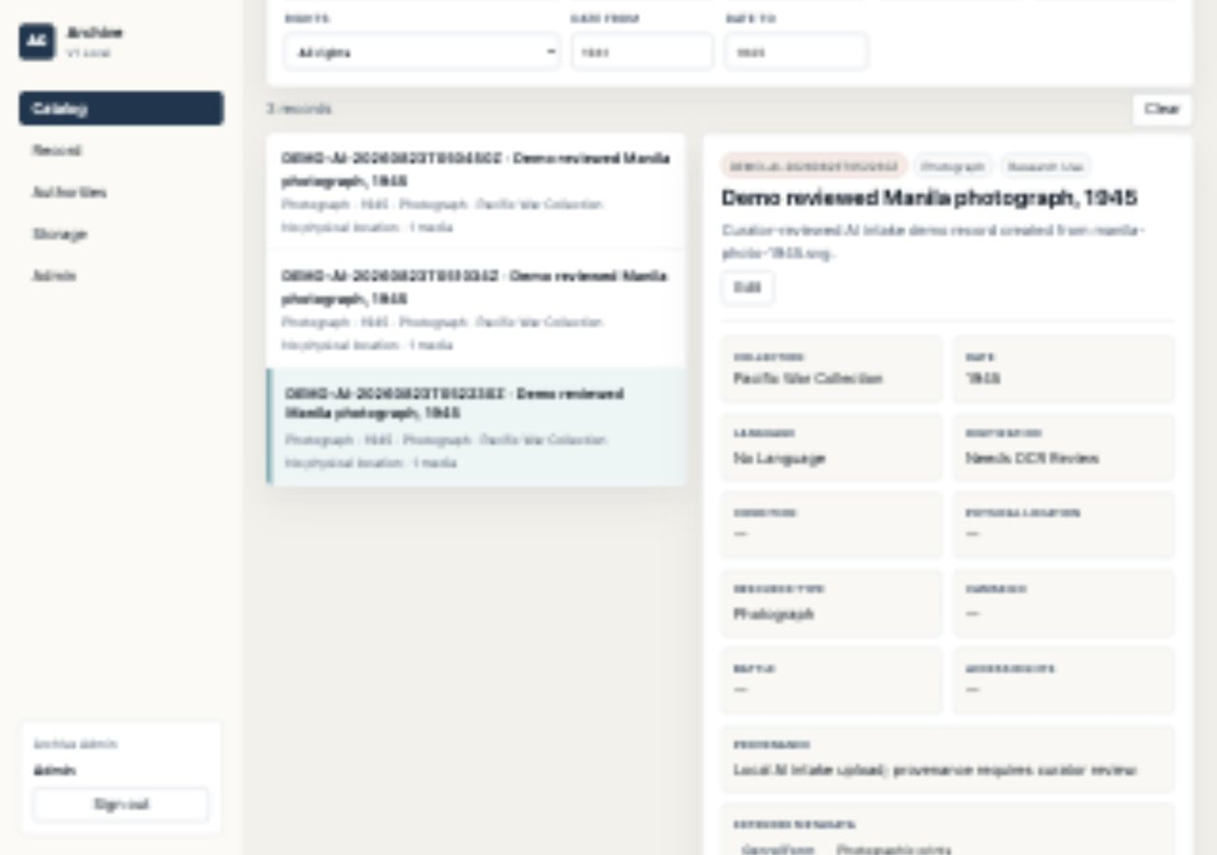
Catalog confirms intake became searchable
操作
• Open Catalog
• Filter Subject to AI Intake Demo
• Select the new permanent ID
实现 / Return
• Detail title: Demo reviewed Manila photograph, 1945
• Permanent ID: DEMO-AI-20260823T052230Z
• Object type and rights pills show Photograph / Research Use
为什么这样设计
• Intake-created records use the same catalog surfaces
• Facets update from the new subject term
• Media attachment is visible from detail
Archive Collection System demo walkthrough
20

Slide 21
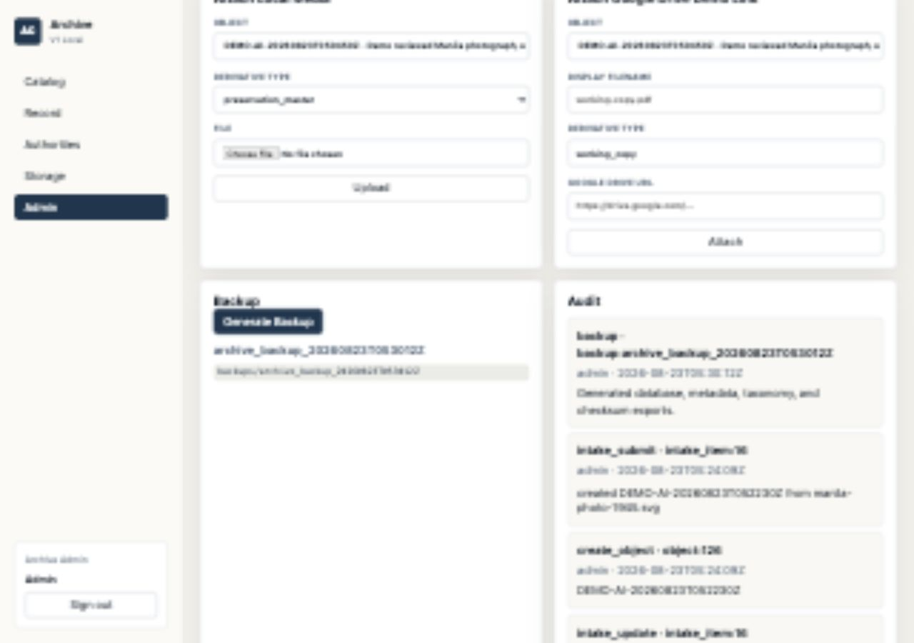
Backup and audit prove admin actions persisted
操作
• Click Generate Backup
• Inspect the Audit list
• Name the backup folder and recent intake actions
实现 / Return
• Backup panel shows a generated archive_backup folder
• Audit list shows a backup row with actor and timestamp
• Audit detail names database, metadata, taxonomy, and checksum exports
为什么这样设计
• Audit is the demo's accountability layer
• Backup proves export readiness
• Both are admin-only operations
Archive Collection System demo walkthrough
21

Slide 22
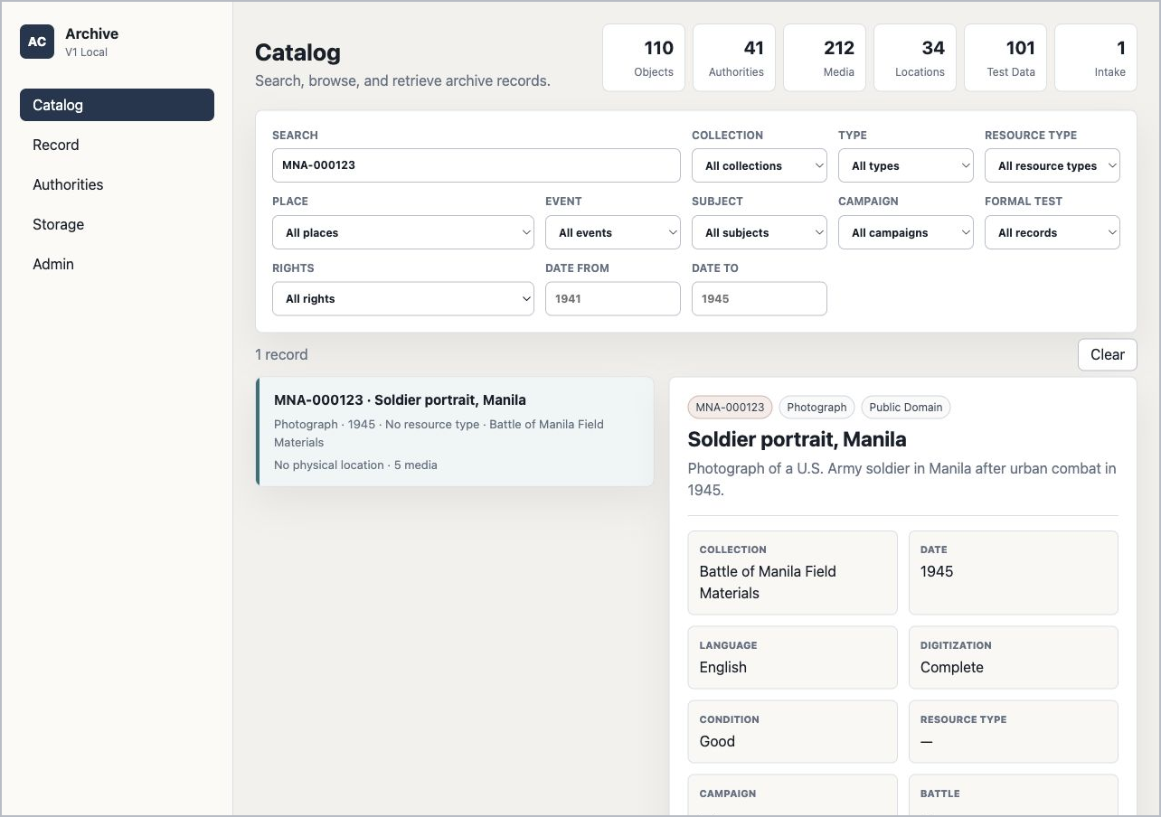
Viewer detail confirms safe public metadata
操作
• Sign out
• Sign in as viewer / viewer
• Search MNA-000123
实现 / Return
• No Edit button is shown
• Storage path, checksum, internal note, and preservation note are hidden
• Permitted descriptive metadata remains searchable
为什么这样设计
• Viewer mode is useful, not broken
• Sensitive stewardship fields stay hidden
• Search/detail reuse the same catalog model
Archive Collection System demo walkthrough
22

Slide 23
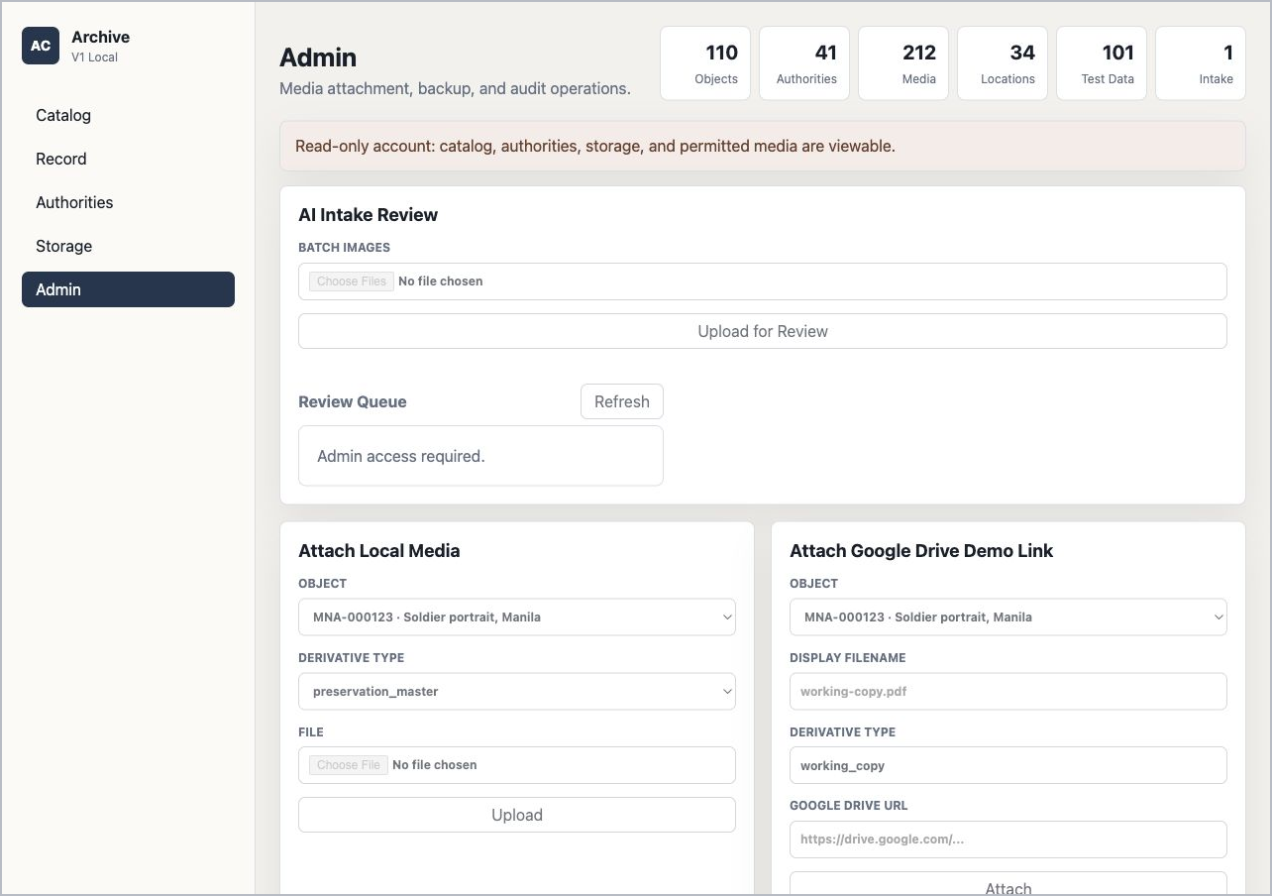
Viewer admin access is blocked
操作
• Stay logged in as viewer
• Open Admin tab
• Try to locate upload, backup, or intake controls
实现 / Return
• Read-only account message appears
• Review Queue says Admin access required
• Upload and attach controls appear disabled
为什么这样设计
• UI and API enforce the same boundary
• Disabled controls reduce demo ambiguity
• Automated tests also cover Admin permission required
Archive Collection System demo walkthrough
23

Slide 24
End with proof points, not another click
Admin can write
Create/edit records, upload media, intake files, generate backup.
Viewer is safe
Search and detail work, but admin data and actions are blocked.
Metadata is structured
Objects, authorities, taxonomy, storage, media, audit, and backup are separate.
Current build passed
The latest automated run passed all 89 checks.
Archive Collection System demo walkthrough
24

Slide 25
APPENDIX
Full raw screenshot outputs
These are the complete raw screenshots behind the demo steps, scaled to fit one slide each. Long pages are intentionally included in full.
Use these pages when a live demo audience asks to see the full output beyond the cropped main walkthrough view.
Archive Collection System demo walkthrough
25

Slide 26
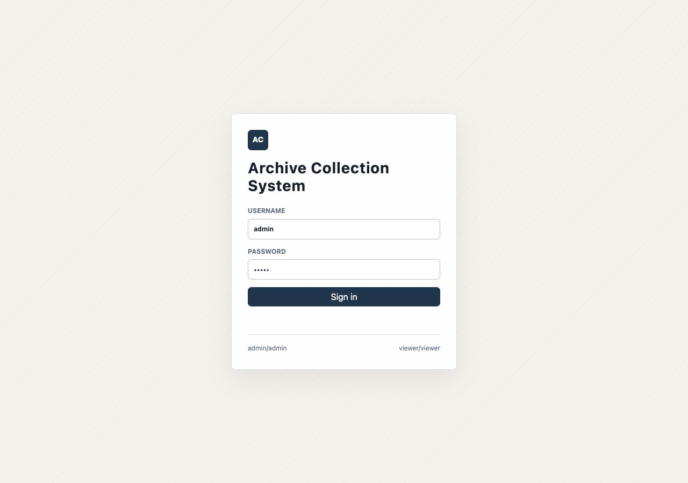
Raw 01: Login page
raw-01-login.png
Archive Collection System demo walkthrough
26

Slide 27
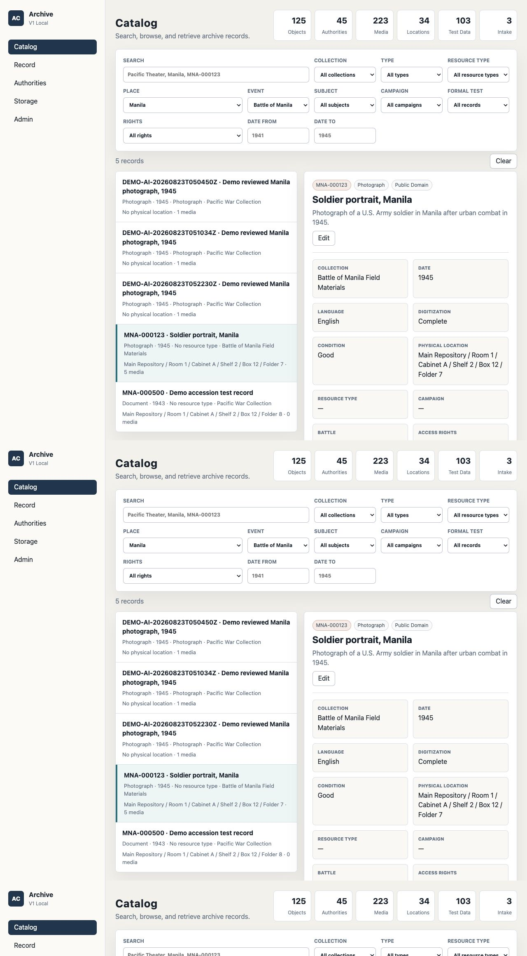
Raw 02: Catalog filter and selected detail
raw-02-catalog-filter-detail.png
Archive Collection System demo walkthrough
27

Slide 28

Raw 03: Record detail full page
raw-03-record-detail-full.png
Archive Collection System demo walkthrough
28

Slide 29
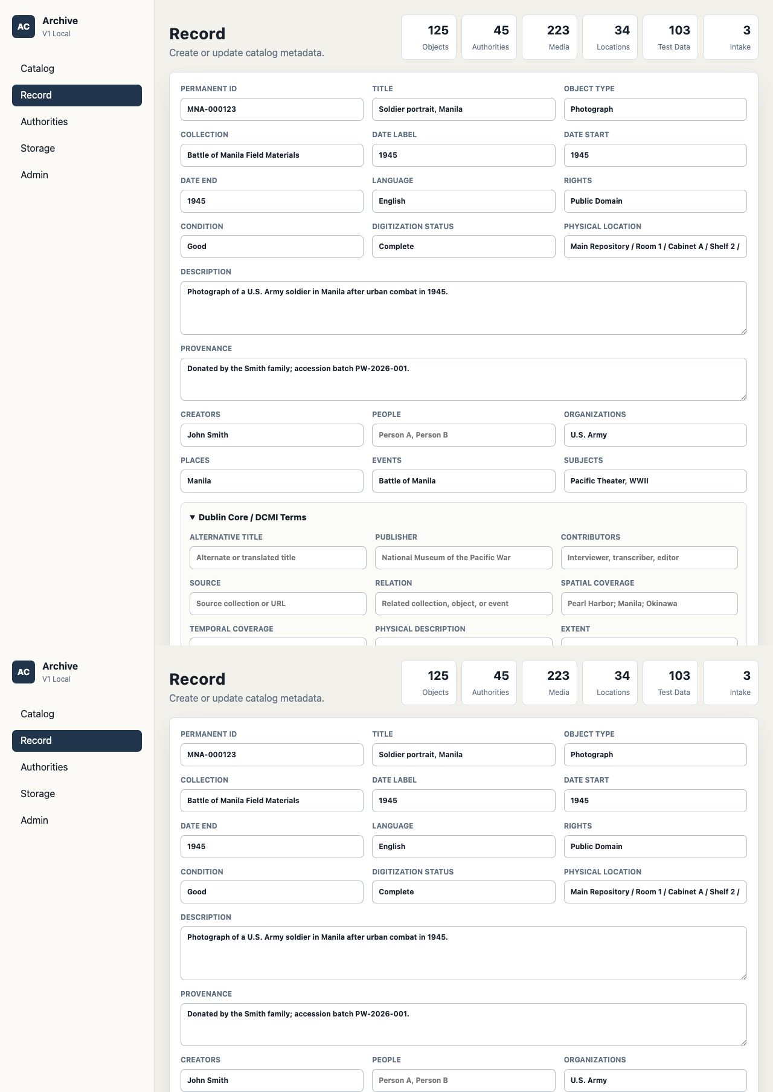
Raw 04: Record edit form
raw-04-record-edit.png
Archive Collection System demo walkthrough
29

Slide 30
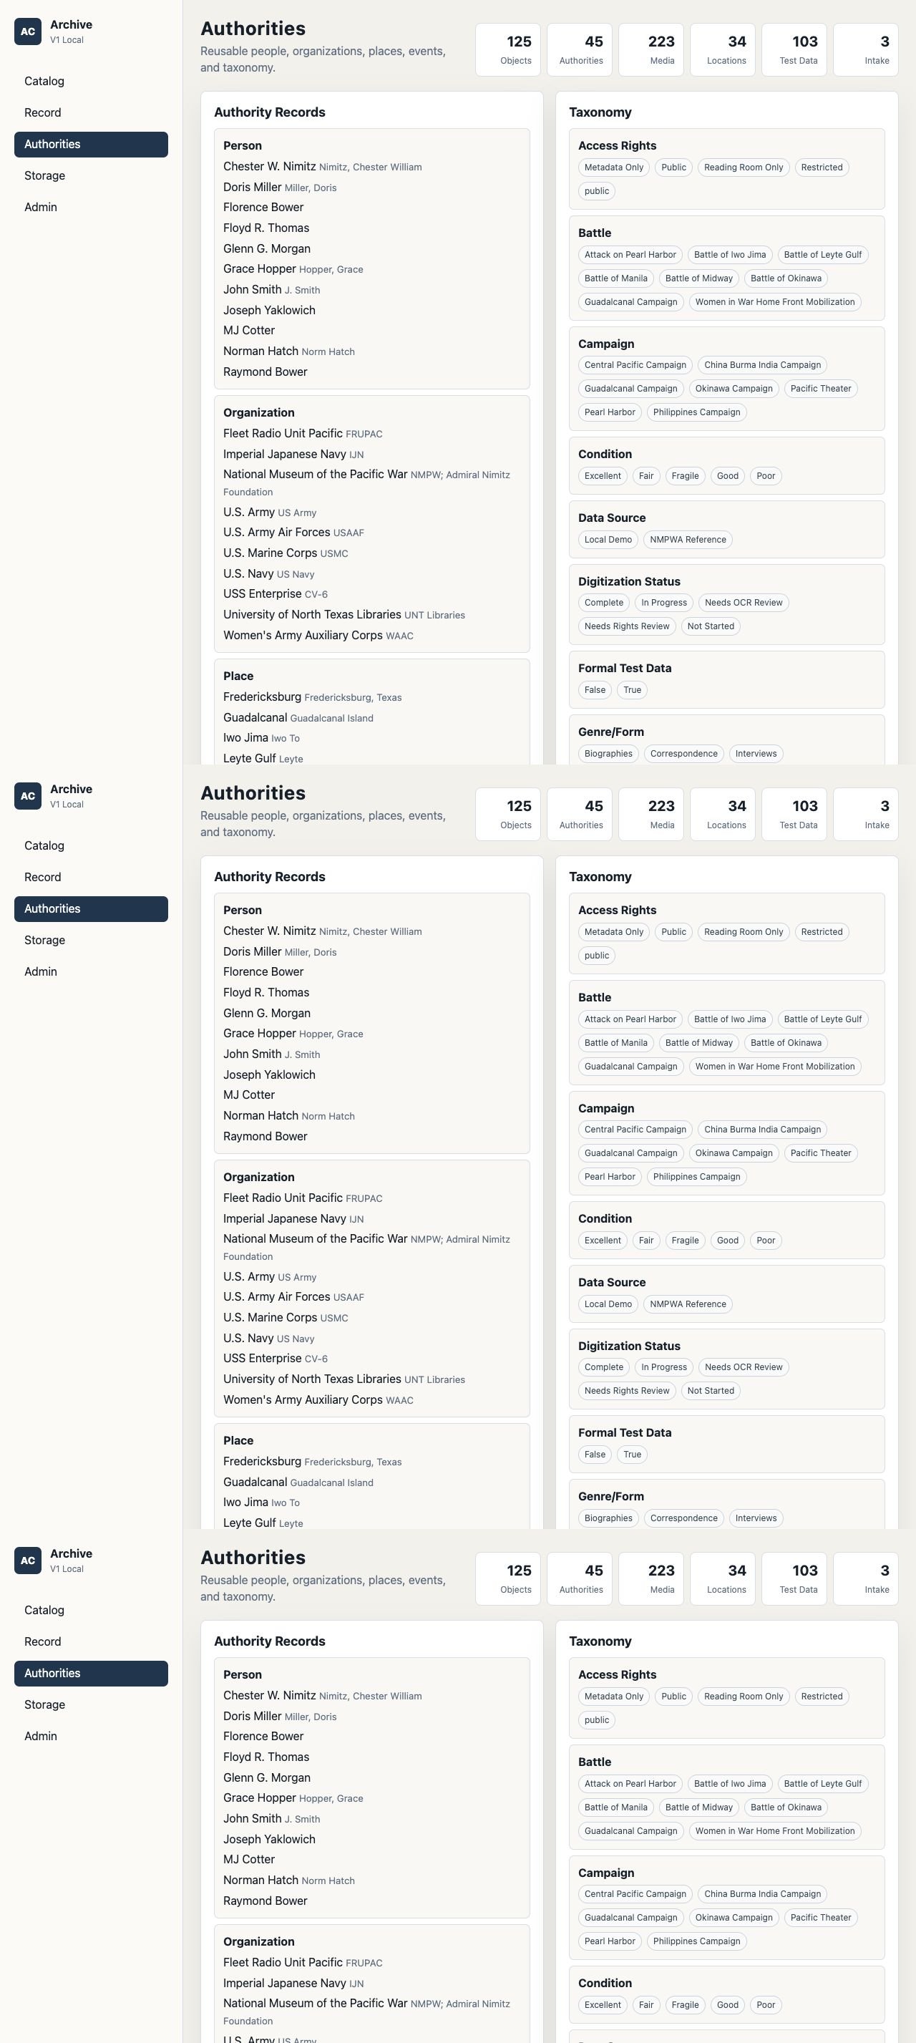
Raw 05: Authorities and taxonomy
raw-05-authorities-taxonomy.png
Archive Collection System demo walkthrough
30

Slide 31
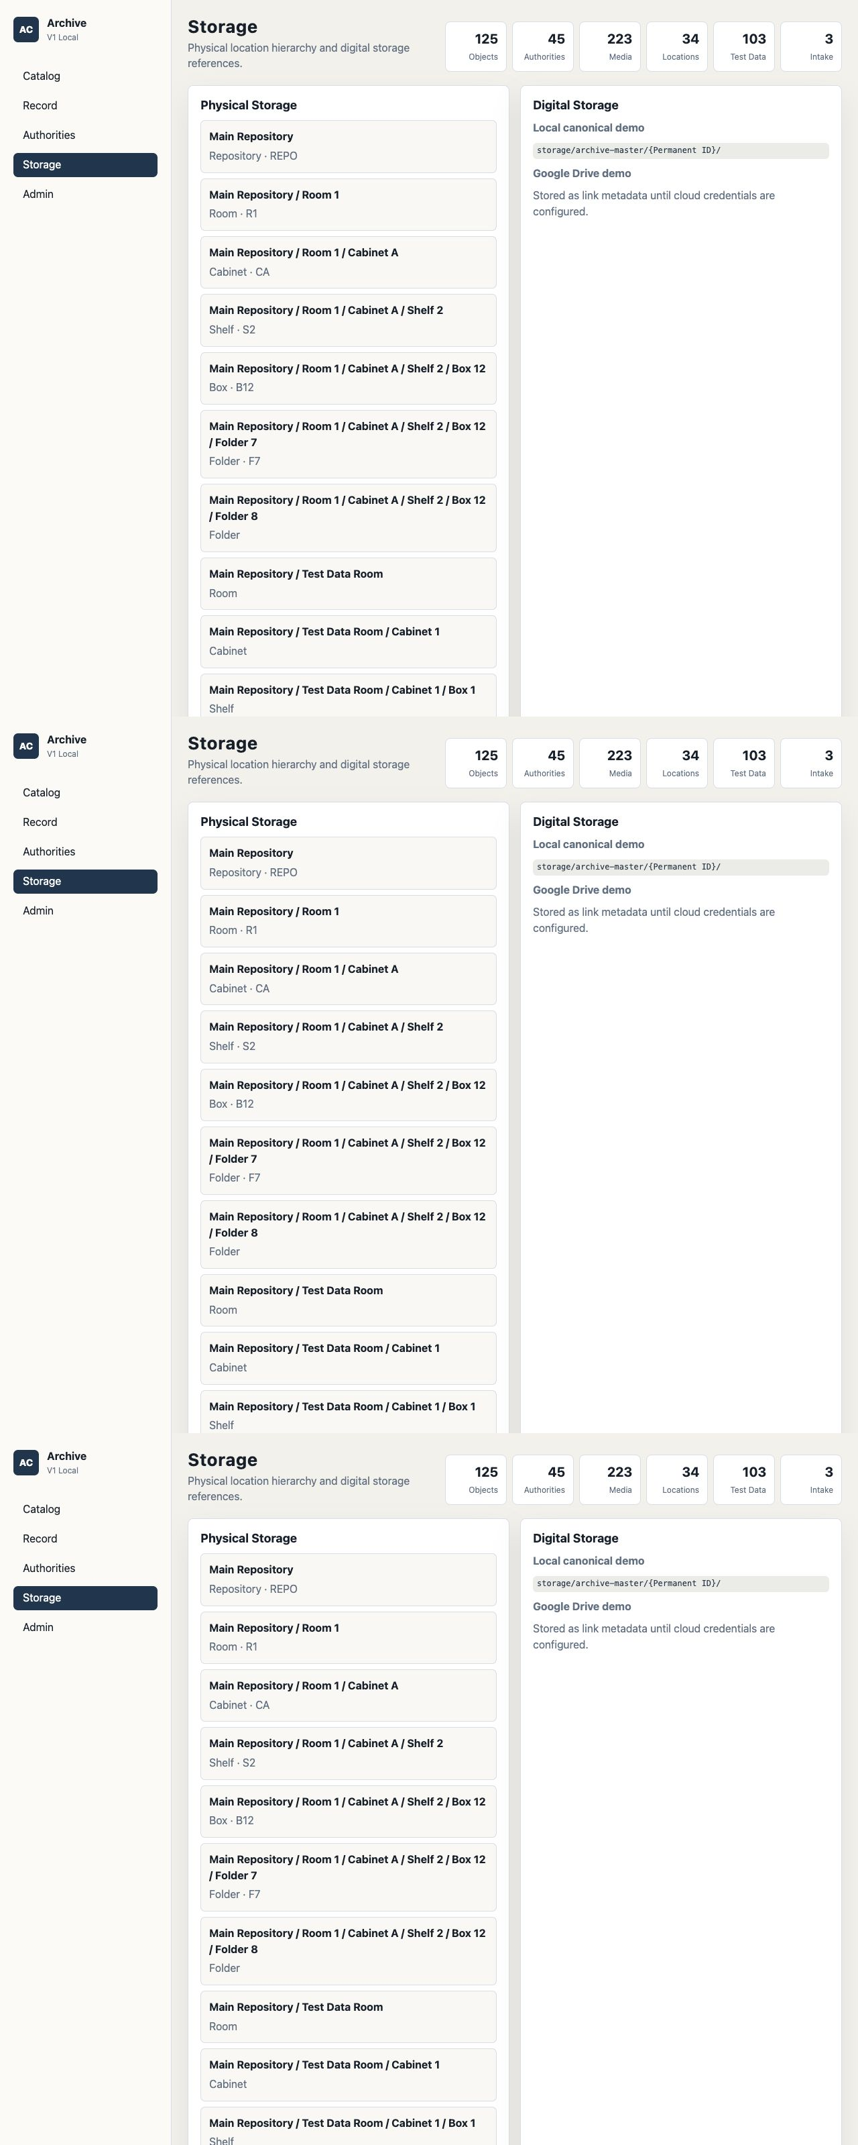
Raw 06: Storage admin
raw-06-storage-admin.png
Archive Collection System demo walkthrough
31

Slide 32
Raw 07: Digital media detail
raw-07-digital-media.png
Archive Collection System demo walkthrough
32

Slide 33
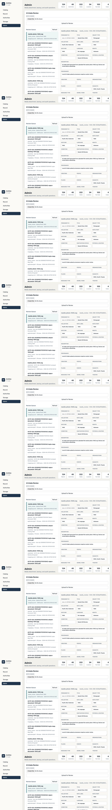
Raw 08: AI intake upload review
raw-08-ai-upload-return.png
Archive Collection System demo walkthrough
33

Slide 34
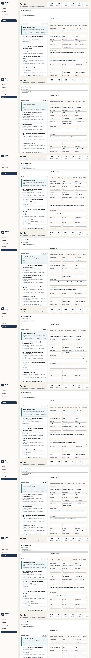
Raw 09: AI intake save draft
raw-09-ai-save-draft-return.png
Archive Collection System demo walkthrough
34

Slide 35
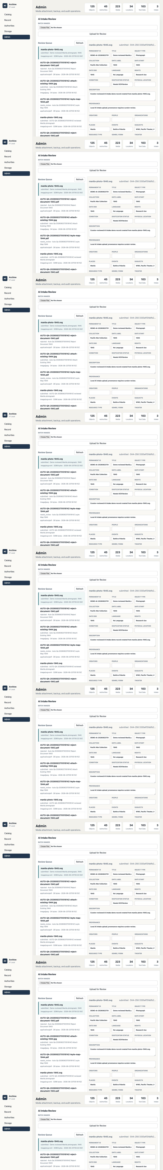
Raw 10: AI intake submit
raw-10-ai-submit-return.png
Archive Collection System demo walkthrough
35

Slide 36
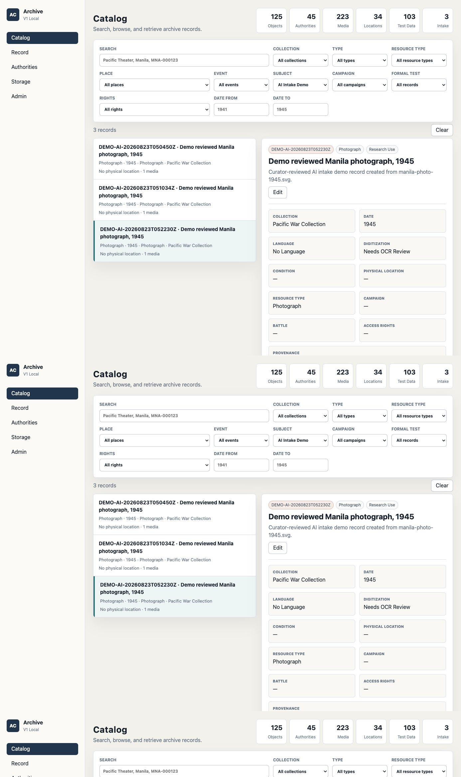
Raw 11: AI-created catalog result
raw-11-ai-catalog-result.png
Archive Collection System demo walkthrough
36

Slide 37
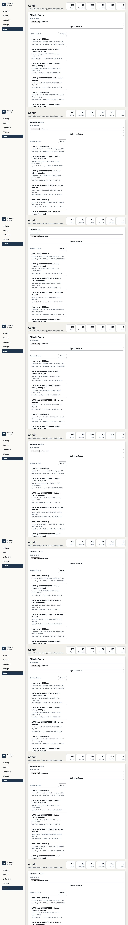
Raw 12: Backup and audit
raw-12-backup-audit.png
Archive Collection System demo walkthrough
37

Slide 38
Raw 13: Viewer detail boundary
raw-13-viewer-detail.png
Archive Collection System demo walkthrough
38

Slide 39
Raw 14: Viewer admin blocked
raw-14-viewer-admin-blocked.png
Archive Collection System demo walkthrough
39

