Slide 1
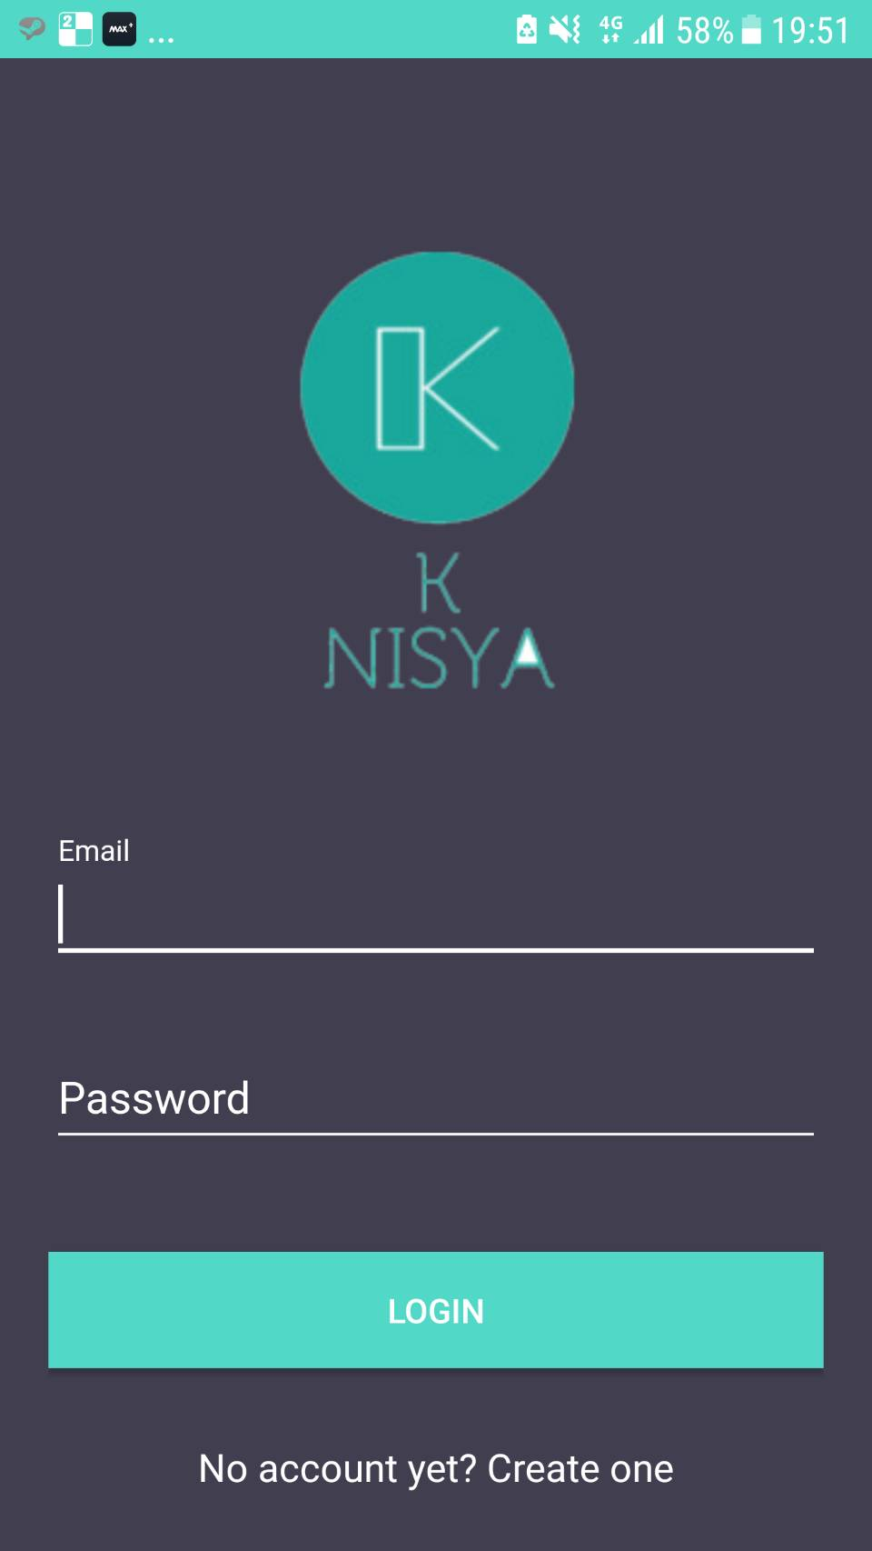
Willi SeptiansyaH (1801431201) Shidiq Febrianto (2001584401) Zahrina AMALIA Hakim (2001588936)

Slide 2


Introducing Knisya
An e-commerce app specialized for Muslim Fashion
Sign up and Log in Feature

Slide 3


Abundant list of products with pictures and prices
Choices of available sizes

Slide 5
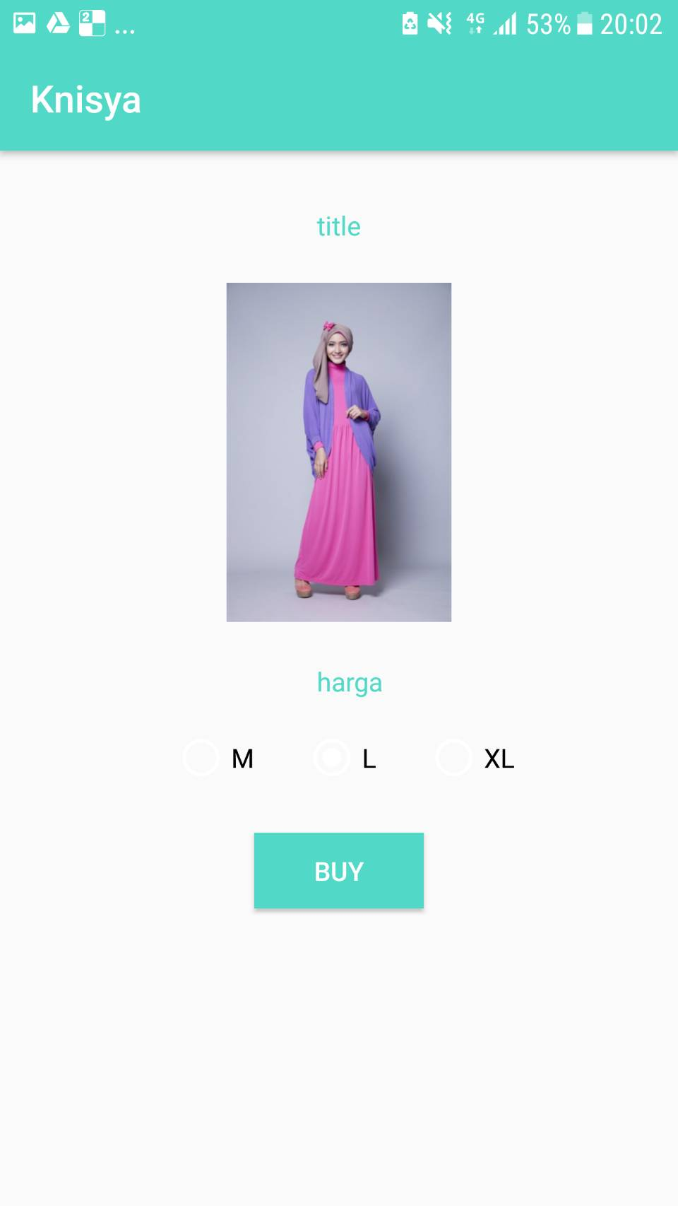
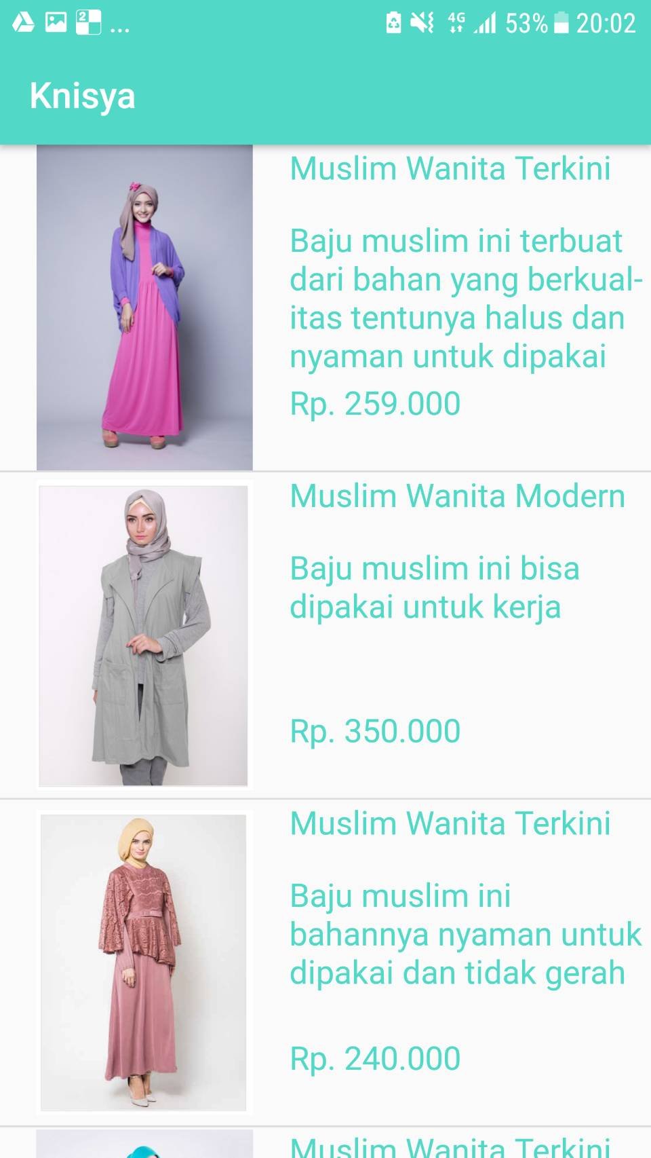

Slide 6
Object-Oriented Aspect
We used the concept of inheritance in our class source code
Inheritance allows us the ease to make subclass with similar features like clothes price value and sizes.

