Slide 1

Wi-fi Protected Access 3 (WPA3)

Slide 2
What is WPA3?
In June 2018, Wi-Fi Alliance introduce wi-fi certified wpa3
enhance wi-fi protection in personal and enterprise network
Simplify wi-fi security
Enable robust authentication
Increase cryptographic strength
Notes:
Why we need wpa3?
WFA(wi-fi alliane) keep some confedintiality until the protocol become standarlized.
Next generation of wi-fi security
Especially for haighly sensitive data market
Successor to wpa2 which security expert describe as broken
Wpa2 enhancement
Wpa basically security protocol for wifi. To secure the connection between your device and the wifi router. And the passcode will encrypt the connection so that no body spy on you
History for protecting wifi start in the 90s we had wep then in 2003 we got wpa and in 2004 we got wpa2
And now after 12 y it seems the era of wp2 has come to the end
Hidden flaw has been discovered in protocol implementation

Slide 3
Wpa3 features
More secure handshake
Replacement of wi-fi protected setup
Unauthenticated encryption
Bigger session key sizes

Slide 4
More secure handshake
Simultaneous authentication of equals (SAE) protocol
Aka Dragonfly handshake
Require a new network interaction every time
Slow down the rate of an attempted attack
Make password resistance to dictionary and brute force
Prevent offline decryption
Notes:
Require a new interaction with the network every time a device require an encryption key
Secure key establishment protocol
Sae has to do with protecting you against stupid password
Brute force protection
Limit how many time you can guess the password so it will be slow to find out the right password
It utilize sae secure key establishment device between devices, which allow fro stronger protection against password guessing attempt.

Slide 5
Replacement of wi-fi protected setup
Using Device Provisioning Protocol (DPP)
Secure way to add device to a network
Instead of password, use QR code or NFC tag
Make setup easy for IoT device
Notes:
Another huge enhancenmnet in this annoncenment is dpp to replace the readily exploitable wi-fi protected setup(wps)
Introduced wi-fi certified easy connect
A new program that reduce the complixirt of onboarding wi-fi devicewith limited or no display interface
QR: quick response
In the past we had to rely on using smartphone
Easier wi-fi device connection: makes it easier for device with small screen or no screen at all to connect to wi-fi hotspot
Use nfc you hold your phone near to the device and it will get the password automatically and will be connected to the network
With dpp, device can be authenticated to join the network without password: use QR or NFC
Dpp make it easy to perform mutual authentication without password

Slide 6

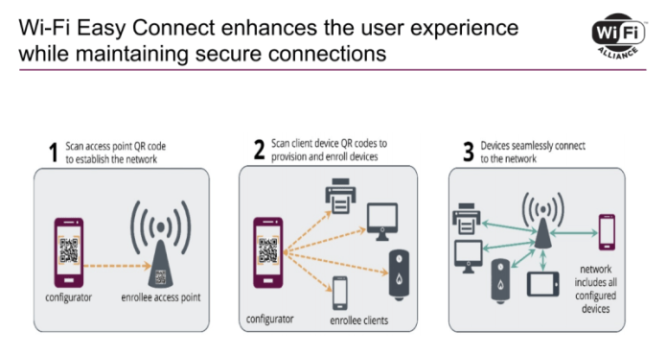

Slide 7
Unauthenticated encryption
Better protection for using public hotspots
Opportunistic Wireless Encryption (OWE)
Replace the old 802.11 open authentication standard
Encrypted data transfer on network that don’t use password
Use Individualized Data protection (IDP)
Notes:
For safer hotspot surfing
Protect users in public
Prevent eavesdropping
Still not
IDP: each authorized session has its own encrypted token: each users data is protected in its own vault. It worked on password-protected network
Giving some protection for open ssid. So the negotiation happened between access point and the client and there will be diffee hellman exchange so you will actually have a key . That is not exchanged by any human and therefore potentially more secure.
Even with public hotspot without password your connecting still encrypted
Even if many ppl using the same password with individualized encryption, every single person will have their own encryption key so you gonna be secure no matter what
owe is a type of authentication free encryption technology that will be used between each device and access point
IDP: each device receive its own key providing idp

Slide 8
Bigger session key sizes
Enterprise edition
Using 192-bit key
During authentication stage
Harder to crack
Notes:
Additional protection for network transmission sensitive data
Such as government and finance
Feature 4: wpa3 will have stronger encryotion that use 192 bt wich stronger than the current one wich id 128 bit

Slide 9
Conclusion
More secure handshake
Replacement of wi-fi protected setup
Unauthenticated encryption
Bigger session key sizes
Notes:
It will take a while to implemented and upgrade wpa3

