Slide 1
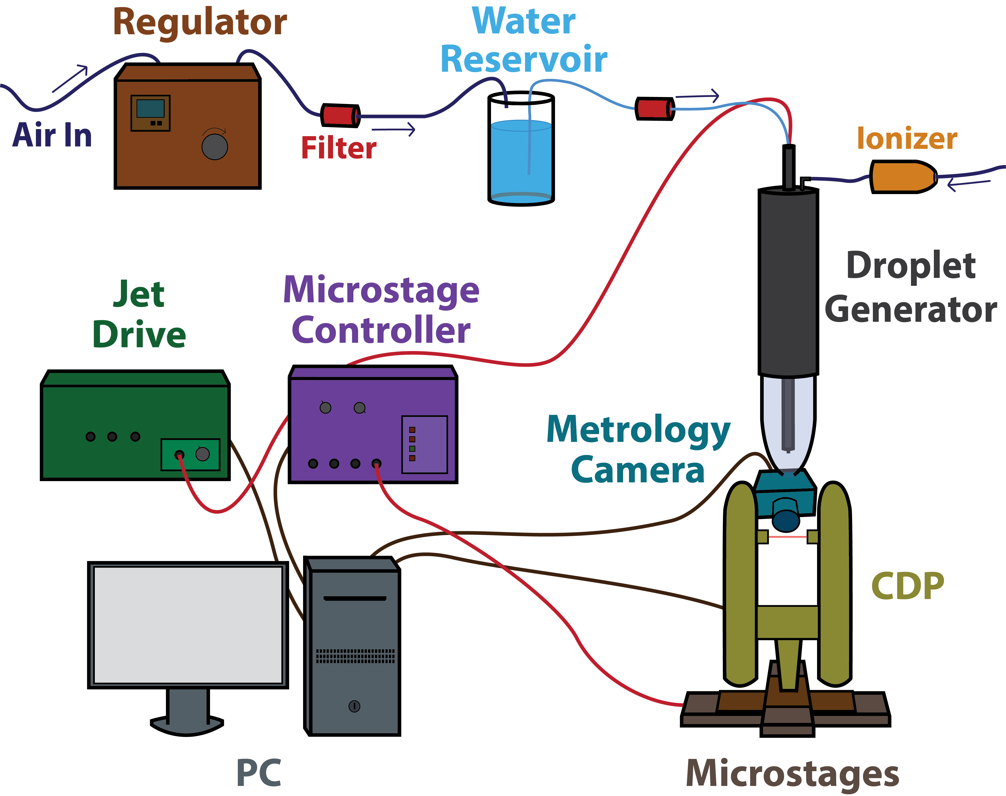
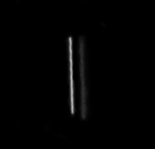
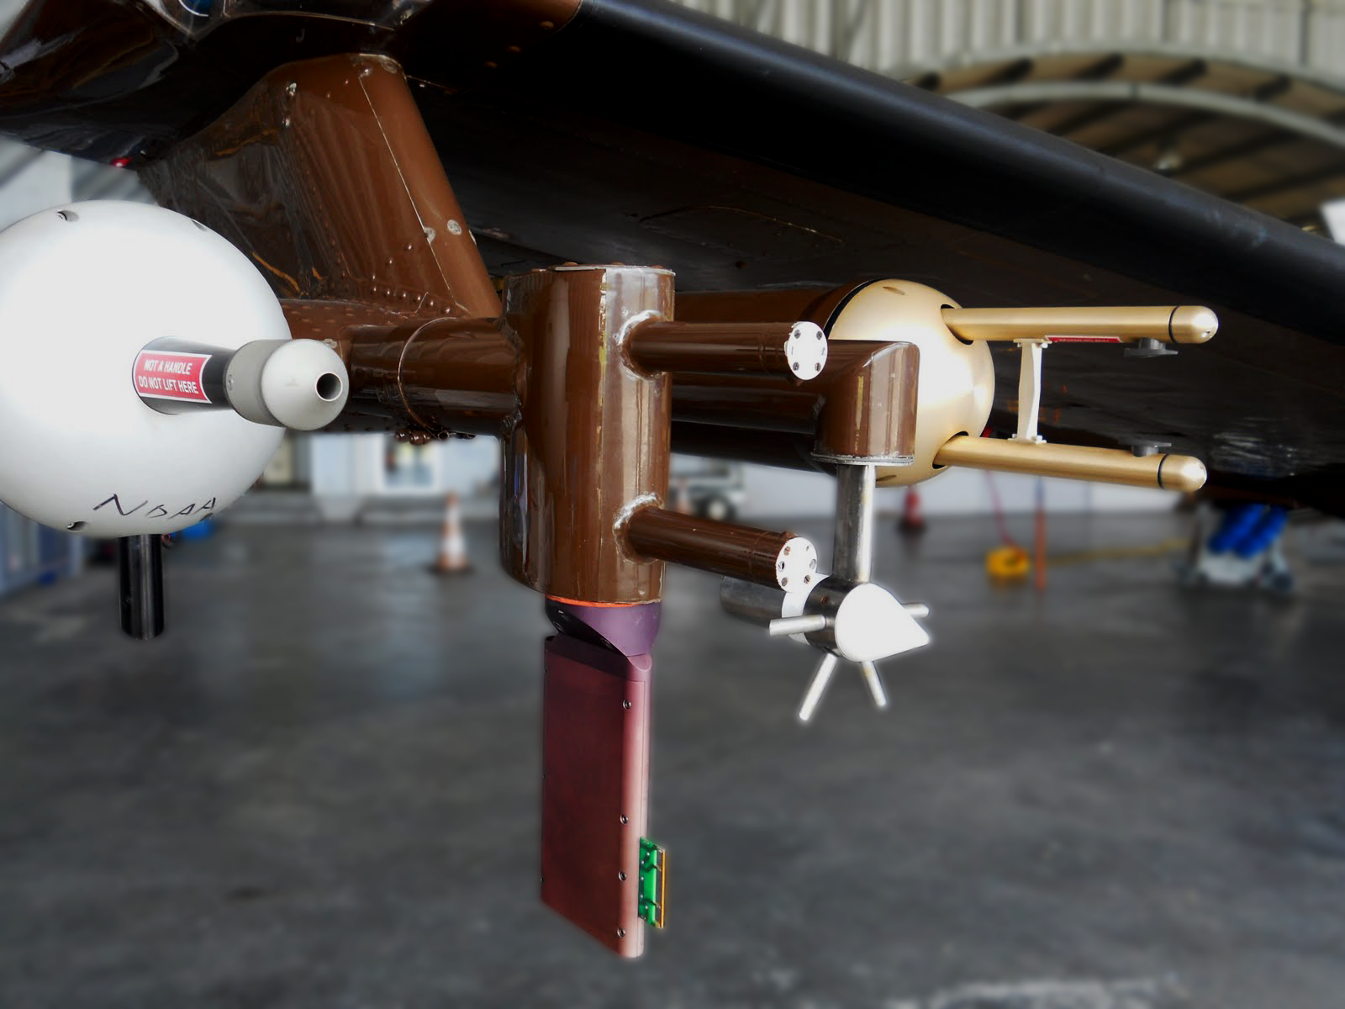
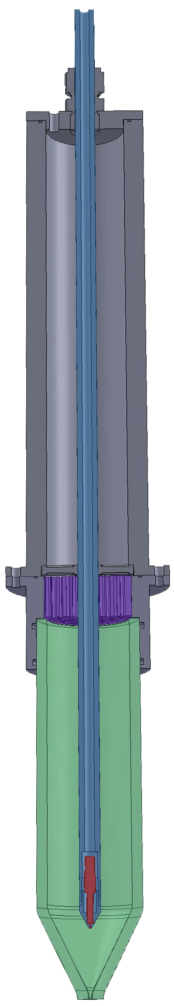
Cloud Particle Probe Calibration Using Pure Water Droplets
Development of a Water Droplet Generating Cloud Particle Probe Calibration Device
Cu indoctum accusamus expetendis ius, his fabellas honestatis at. No dicit saepe melius per. Qui vidisse admodum consequat ad.
Dropgen specific background
BACKGROUND
SYSTEM DESIGN
Generator cutaway CAD diagram
MOTIVATION
Sub-precipitation to precipitation sized (2 um – 1 mm diameter) DSDs are commonly measured with two airborne instrument classes; forward scattering and optical array probes. Both classes are subject to significant uncertainty due to coincidence error, sample volume uncertainty, and inhomogeneous sizing response (1). Error sources artificially broaden DSDs and compromise derived liquid water content (LWC) values.
Brenguier, J. L., T. Bourrianne, A. A. De Coelho, J. Isbert, R. Peytavi, D. Trevarin, and P. Weschler, 1998: Improvements of droplet size distribution measurements with the fast-FSSP (Forward Scattering Spectrometer Probe). J. Atmos. Ocean. Technol., 15, 1077–1090, doi:10.1175/1520-0426(1998)015<1077:IODSDM>2.0.CO;2.
http://domex2011.blogspot.com/2011/04/wyoming-king-air.html
Droplet Verification
**Drawbacks of traditional Calibration techniques**
**Overview of streaks technique**
Swap out photo with something more relevant
40 um drop streak captured at 1/4000 second
In-situ instruments aboard The UWYO King Air. From left to right – Passive Cavity Aerosol Spectrometer, LWC-100 Hotwire Device, Reverse Flow Temperature Probe, Cloud Imaging Probe (2)
GENERATOR ASSEMBLY
*Inner* Tube
Position adjustable for varying droplet velocity and diameter (through evaporation)
Flow Straightener
OBJECTIVES
Develop an optical probe water droplet calibration system.
Creates droplets of repeatable size, velocity, and concentration
Produces a range of droplet diameters, velocities, and concentrations
Uses particles of probe’s target media (eliminates refractive index complications)
Incorporates independent droplet diameter and velocity verification
Positioning controlled by high precision digital micropositioning stages
Initially compatible with CDP with capability to expand to several forward scattering and optical array probes
Glass Flow Tube
Print head
REMANING WORK
Incorporate micropositing stages
Develop droplet verification image analysis software
Develop beam mapping algorithms (incorporating stage position and CDP data)
REFERENCES
**Acknowledge DMT**
**(no grant)**

