Slide 1
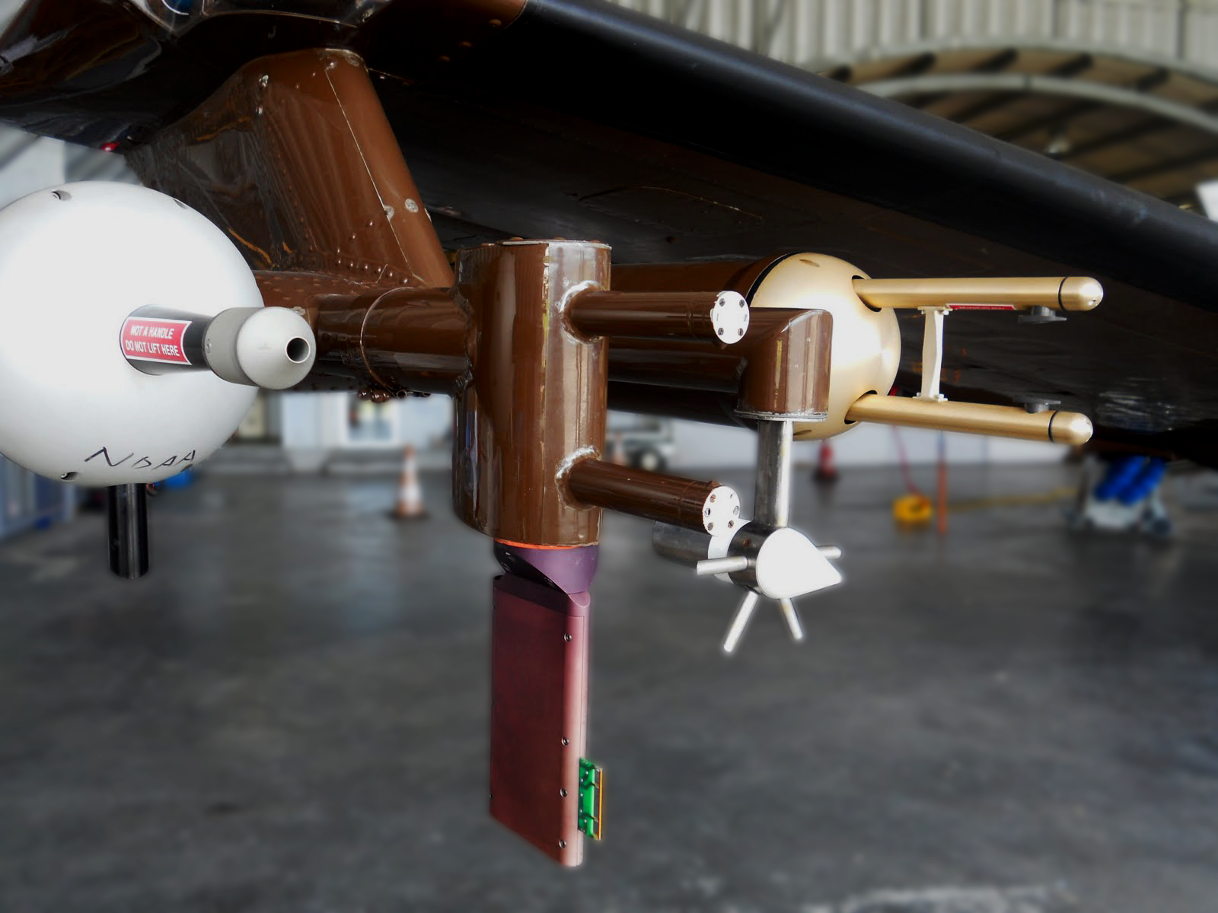
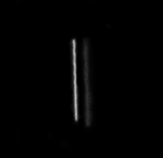
Title
Cu indoctum accusamus expetendis ius, his fabellas honestatis at. No dicit saepe melius per. Qui vidisse admodum consequat ad.
Background
System Design
Generator cutaway CAD diagram
Motivation
Sub-precipitation to precipitation sized (2 um – 1 mm diameter) DSDs are commonly measured with two airborne instrument
classes; forward scattering and optical array probes. Both classes are subject to significant uncertainty due to coincidence error, sample volume uncertainty, and inhomogeneous sizing response. Error sources artificially broaden DSDs and compromise derived liquid water content (LWC) values.
**Explain select component purposes**
**Outline drop size/velocity verification methods (metrology cam/drop image streaks**
http://domex2011.blogspot.com/2011/04/wyoming-king-air.html
In-situ instruments aboard The UWYO King air. From left to right – Passive Cavity Aerosol Spectrometer, LWC-100 Hotwire Device, Reverse Flow Temperature Probe, Cloud Imaging Probe
40 um drop streak captured at 1/4000 second
Generator Assembly
Objectives
**Detail about main generator assembly components and their
CAD droplet generator cutaway diagram w/ main components color coded
Develop a laboratory-based optical probe water droplet calibration system.
Uses particles of probe’s target media (eliminates refractive index complications)
Creates droplets of highly repeatable size, velocity, and concentration
Independent droplet diameter and velocity verification
Positioning controlled by high precision digital micropositioning stages
Initially compatible with CDP with capability to expand to a range of forward scattering and optical array probes
Major system component flowchart
Met Cam drop images?
Remaining Work
References
**Remember grant**

