Slide 1
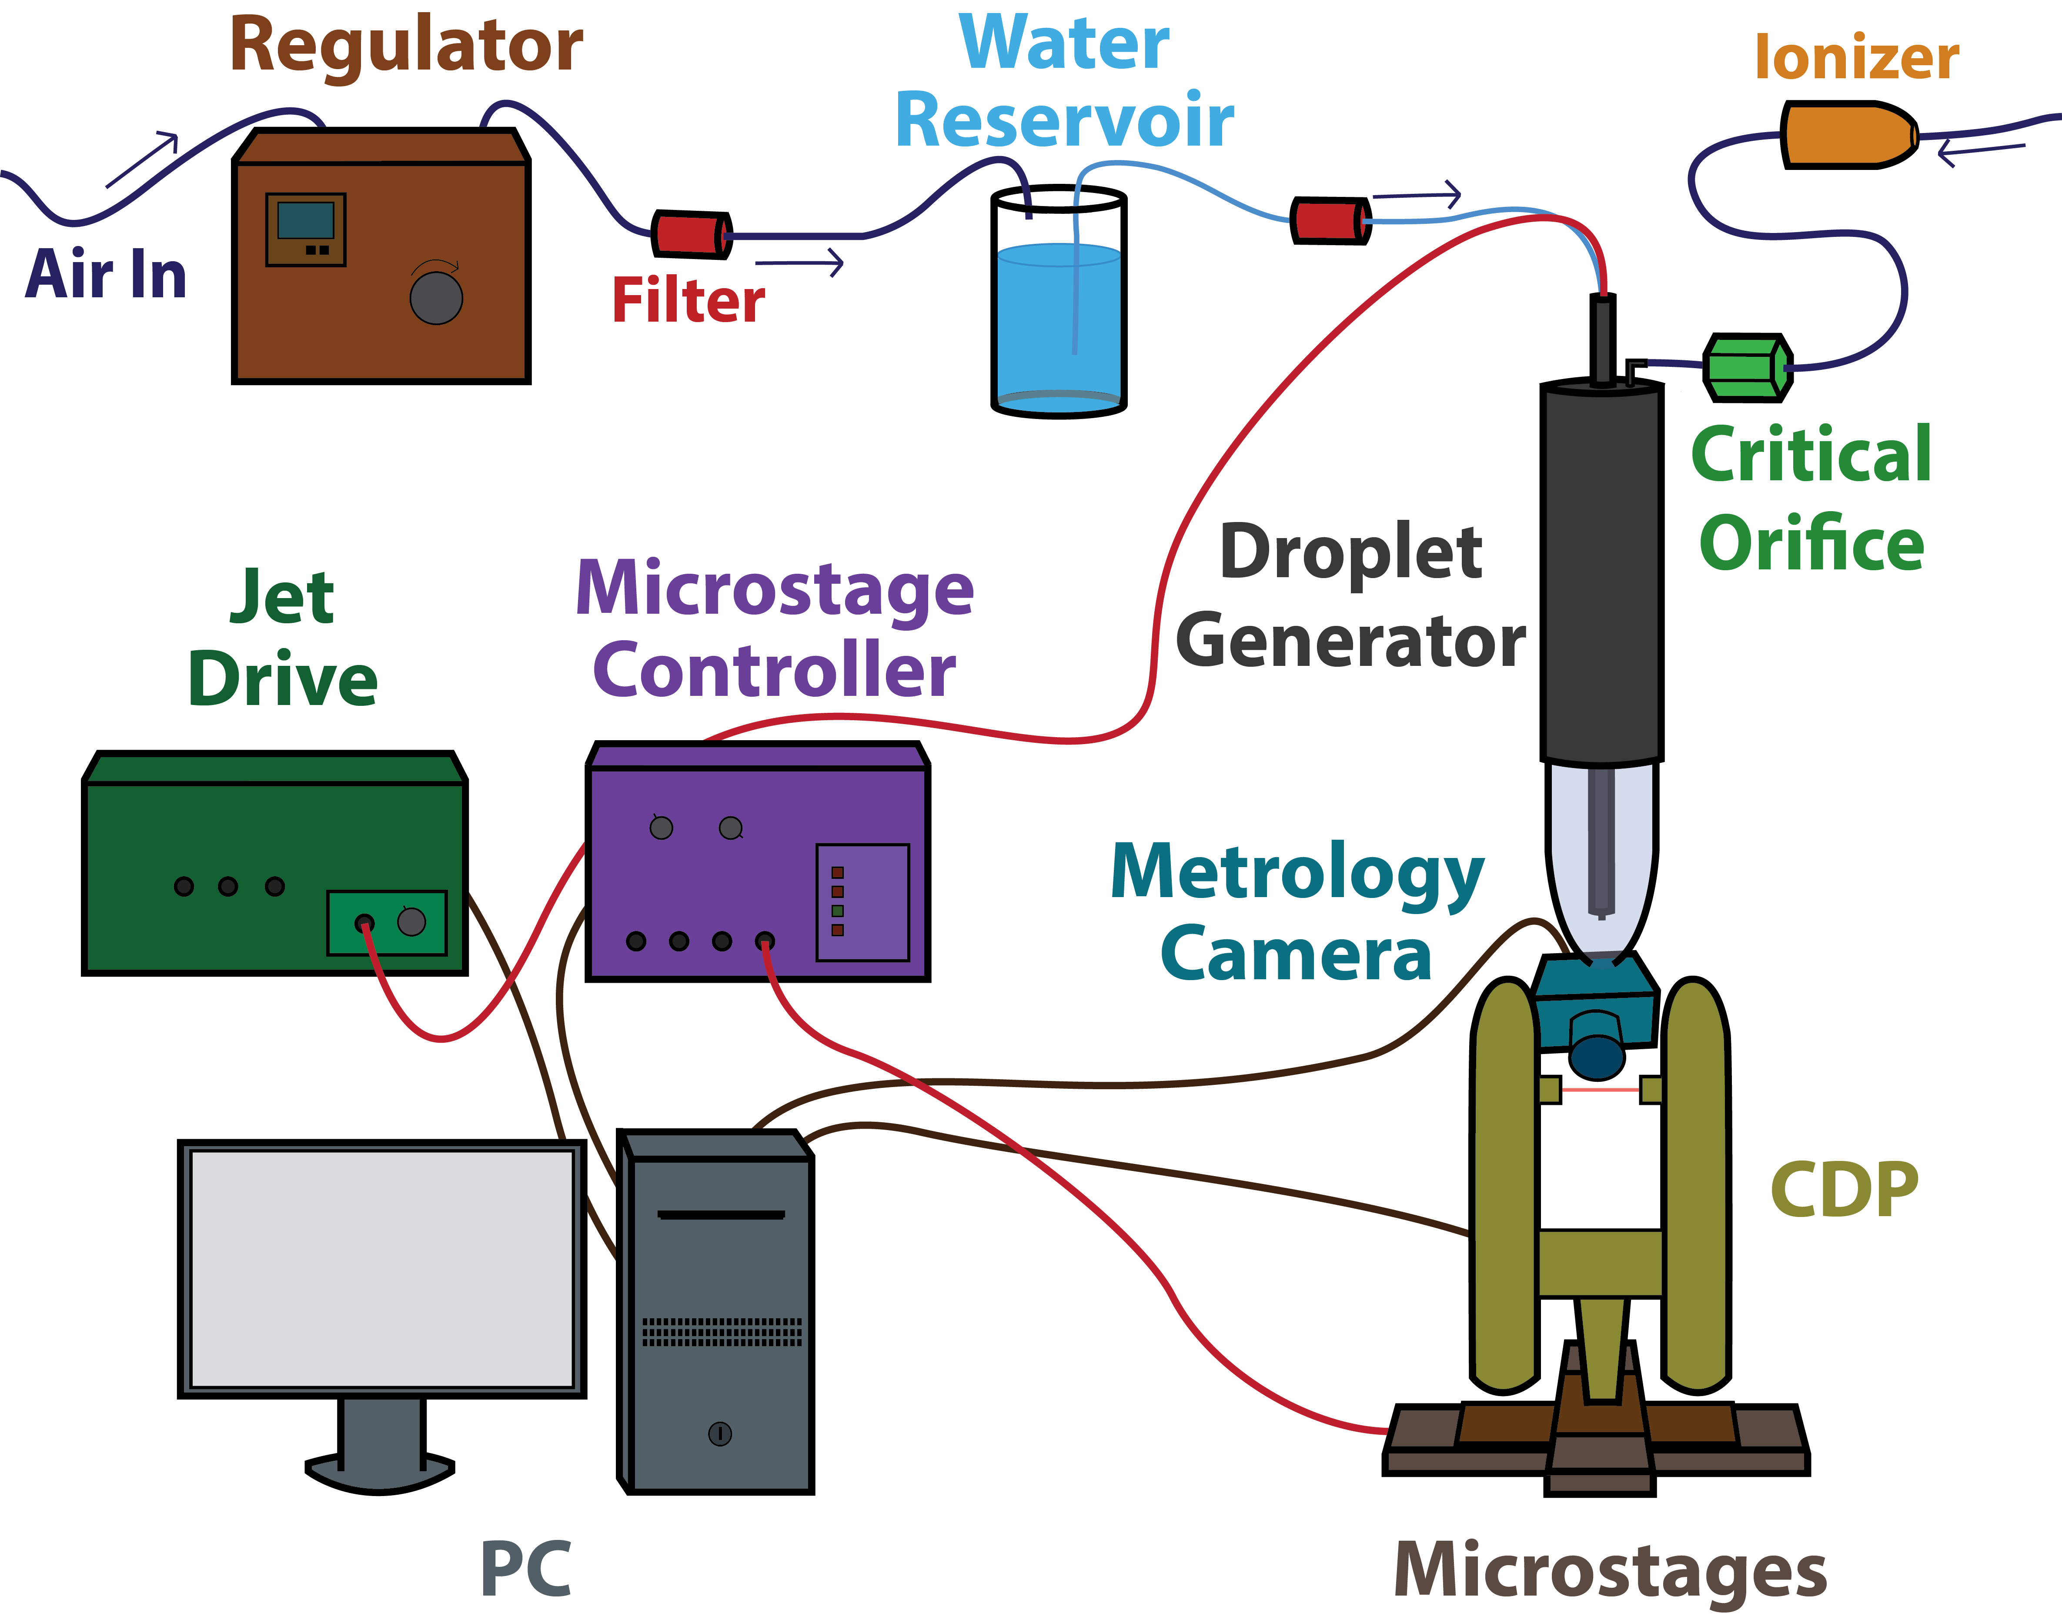
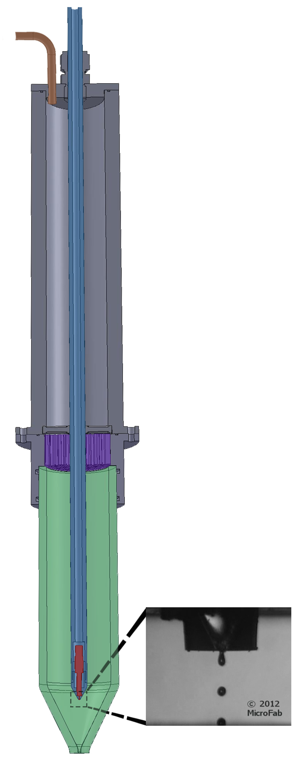
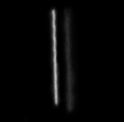
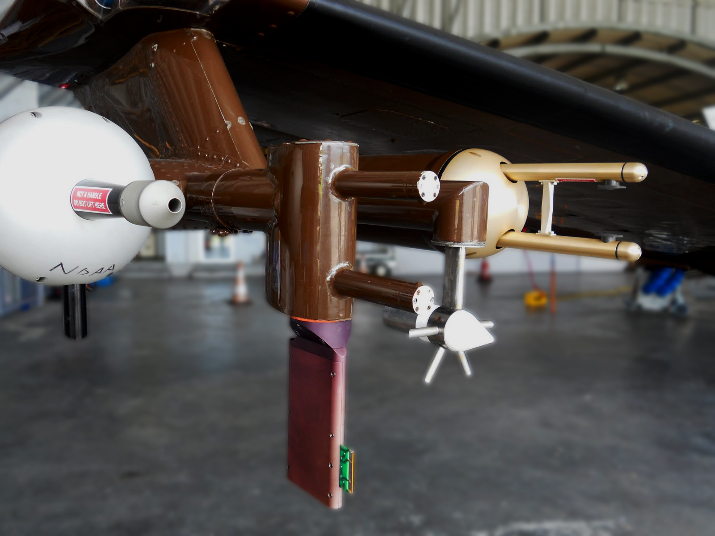
Cloud Particle Probe Calibration Using Pure Water Droplets
Development of a Water Droplet Generating Cloud Particle Probe Calibration Device
Cu indoctum accusamus expetendis ius, his fabellas honestatis at. No dicit saepe melius per. Qui vidisse admodum consequat ad.
MOTIVATION
OBJECTIVES
Sub-precipitation to precipitation sized (2 um – 1 mm diameter) DSDs are commonly measured with forward scattering or linear optical array probes. Both instrument classes are subject to coincidence error, sample volume uncertainty, and inhomogeneous particle sizing response (1).
Traditionally, optical probes are calibrated using glass microbeads or
Develop an optical probe water droplet calibration system.
Creates droplets of repeatable size, velocity, and concentration
Produces a range of droplet diameters, velocities, and concentrations **Add theoretical drop size/velocities?**
Uses particles of probe’s target media (eliminates refractive index complications)
Incorporates independent droplet diameter and velocity verification
Droplet placement controlled by high precision digital micropositioning stages
Initially compatible with CDP with capability to expand to several forward scattering and optical array probes
polystyrene latex spheres; both of which exhibit poor sizing precision and refractive index complications. Typical calibration devices also lack the precision required for detailed performance investigations.
Probe Image
Probe Image
Korolev, A. V., S. V. Kuznetsov, Y. E. Makarov, and V. S. Novikov, 1991: Evaluation of measurements of particle size and sample area from optical array probes. J. Atmos. Ocean. Technol., 8, 514–522, doi:10.1175/1520-0426(1991)008<0514:EOMOPS>2.0.CO;2.
**Probe image captions**
Brenguier, J. L., T. Bourrianne, A. A. De Coelho, J. Isbert, R. Peytavi, D. Trevarin, and P. Weschler, 1998: Improvements of droplet size distribution measurements with the fast-FSSP (Forward Scattering Spectrometer Probe). J. Atmos. Ocean. Technol., 15, 1077–1090, doi:10.1175/1520-0426(1998)015<1077:IODSDM>2.0.CO;2.
SYSTEM DESIGN
GENERATOR ASSEMBLY
Flow Inlet
Flow Straightener
Print head
Print head Positioning Rod
Height adjustable for varying droplet velocity and diameter (through evaporation)
BACKGROUND
Glass Flow Tube
DROPLET VERIFICAITON
**Critical Orifice/Ionizer/Print Head info?**
Droplet diameter and velocity independently measured using “glares” technique (2)
Metrology camera images capture droplet glares illuminated by instrument laser
MOTIVATION
Characteristics calculable using distance/pixel conversion and camera geometry
Sub-precipitation to precipitation sized (2 um – 1 mm diameter) DSDs are commonly measured with two airborne instrument classes; forward scattering and optical array probes. Both classes are subject to significant uncertainty due to coincidence error, sample volume uncertainty, and inhomogeneous sizing response (1). Error sources artificially broaden DSDs and compromise derived liquid water content (LWC) values.
1/4000 sec exposure
45 um droplet glares
Print head droplet ejection sequence (3)
http://www.microfab.com/movies
**Drawbacks of traditional Calibration techniques**
REMANING WORK
Incorporate micropositing stages
Develop droplet verification image analysis software
Develop beam mapping algorithms (incorporating stage position and CDP data)
REFERENCES
**Acknowledge DMT**
**(no grant)**
In-situ instruments aboard The UWYO King Air. From left to right – Passive Cavity Aerosol Spectrometer, LWC-100 Hotwire Device, Reverse Flow Temperature Probe, Cloud Imaging Probe (2)

