Slide 1
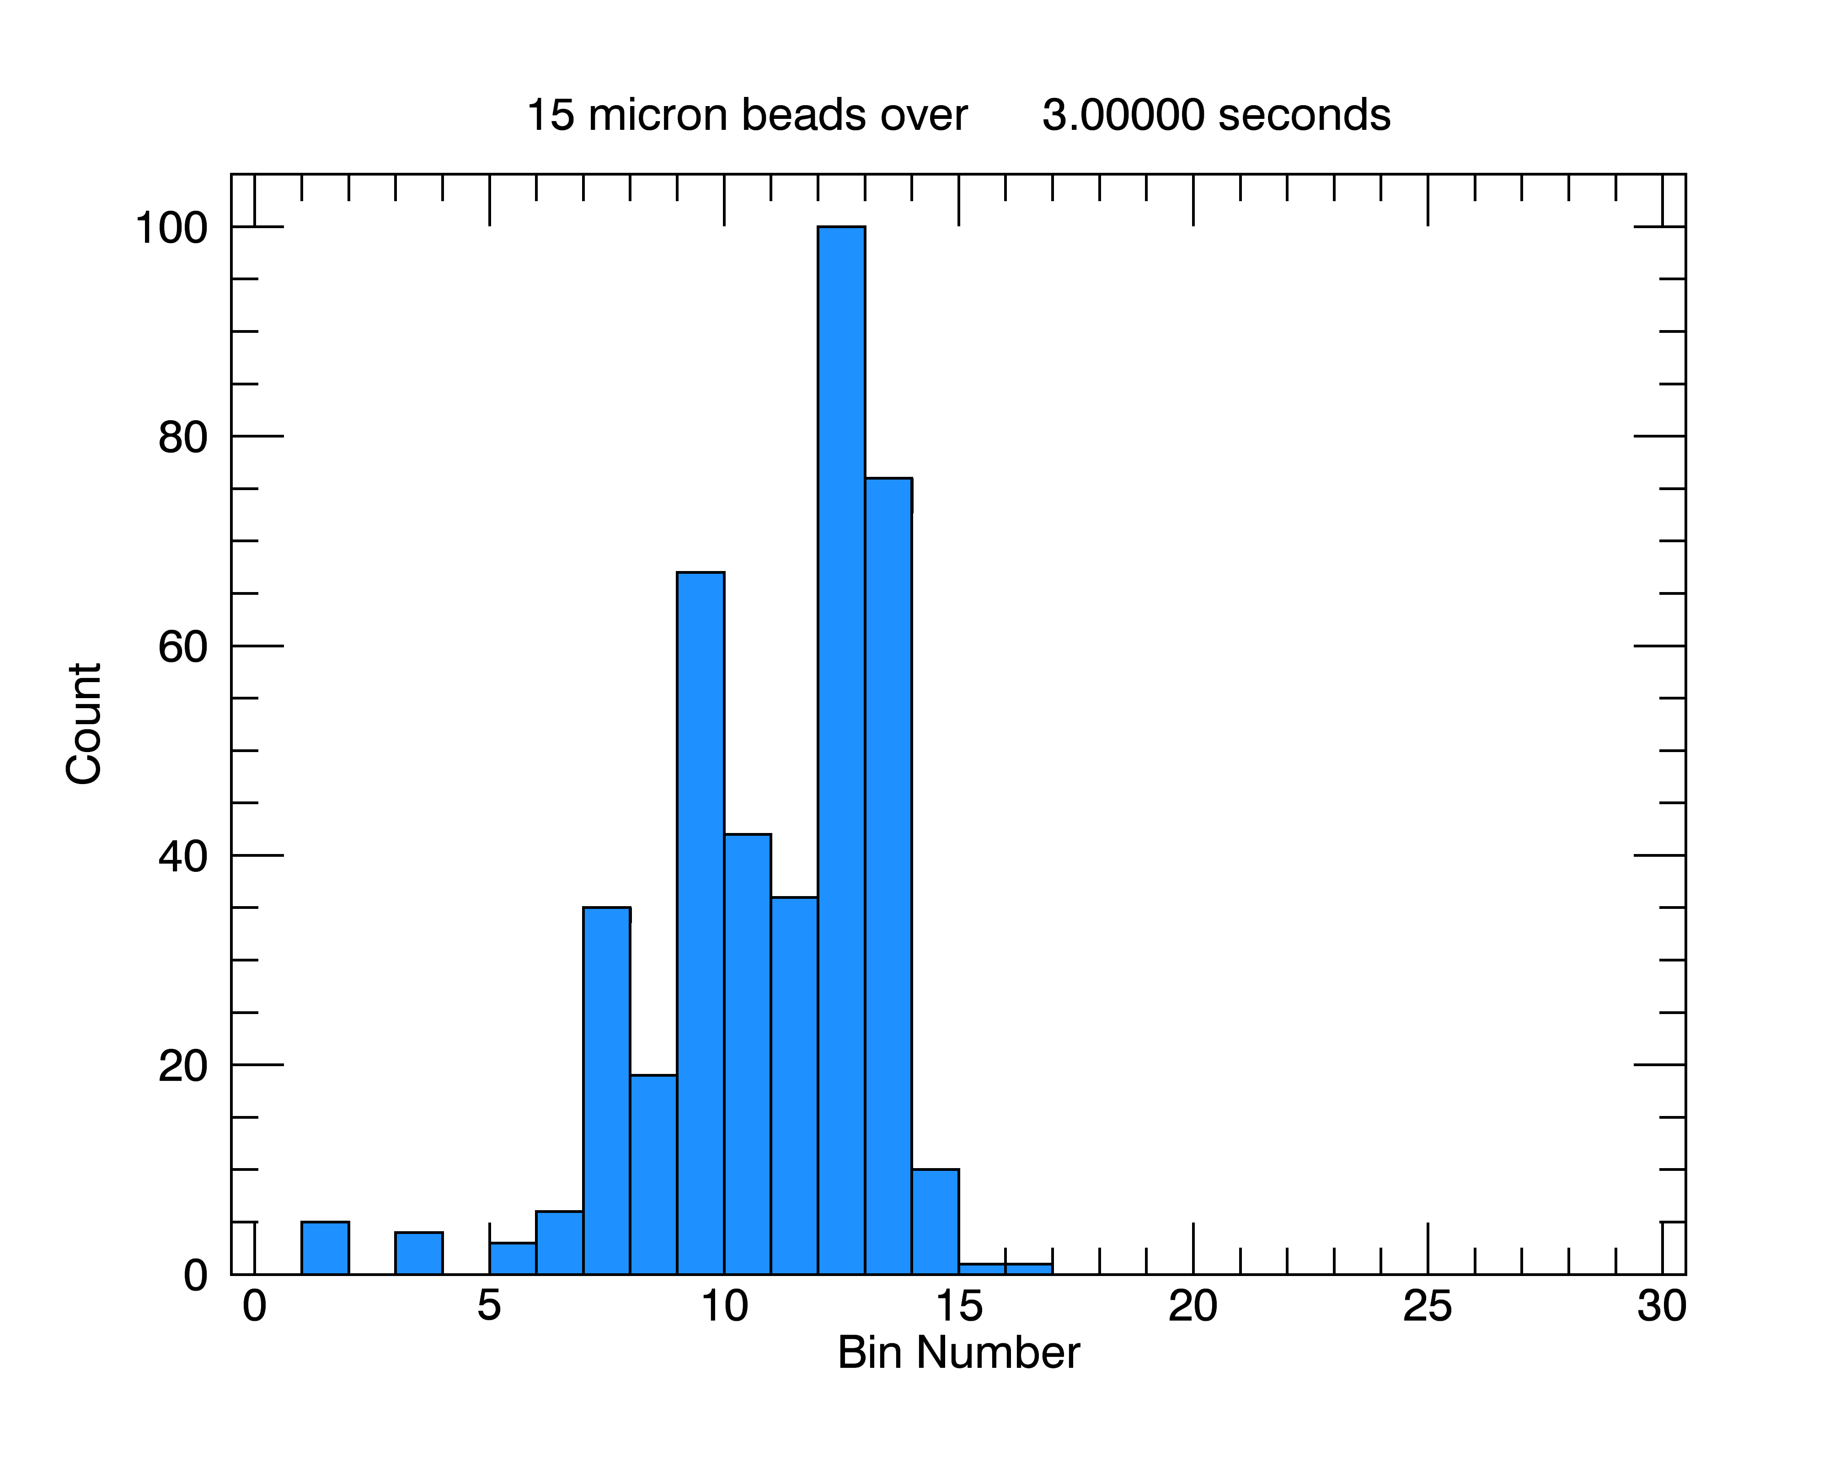
3
5
7
9
11
13
16
20
24
28
32
36
40
44
48
50
t
Upper Bin Size [um]

Slide 2
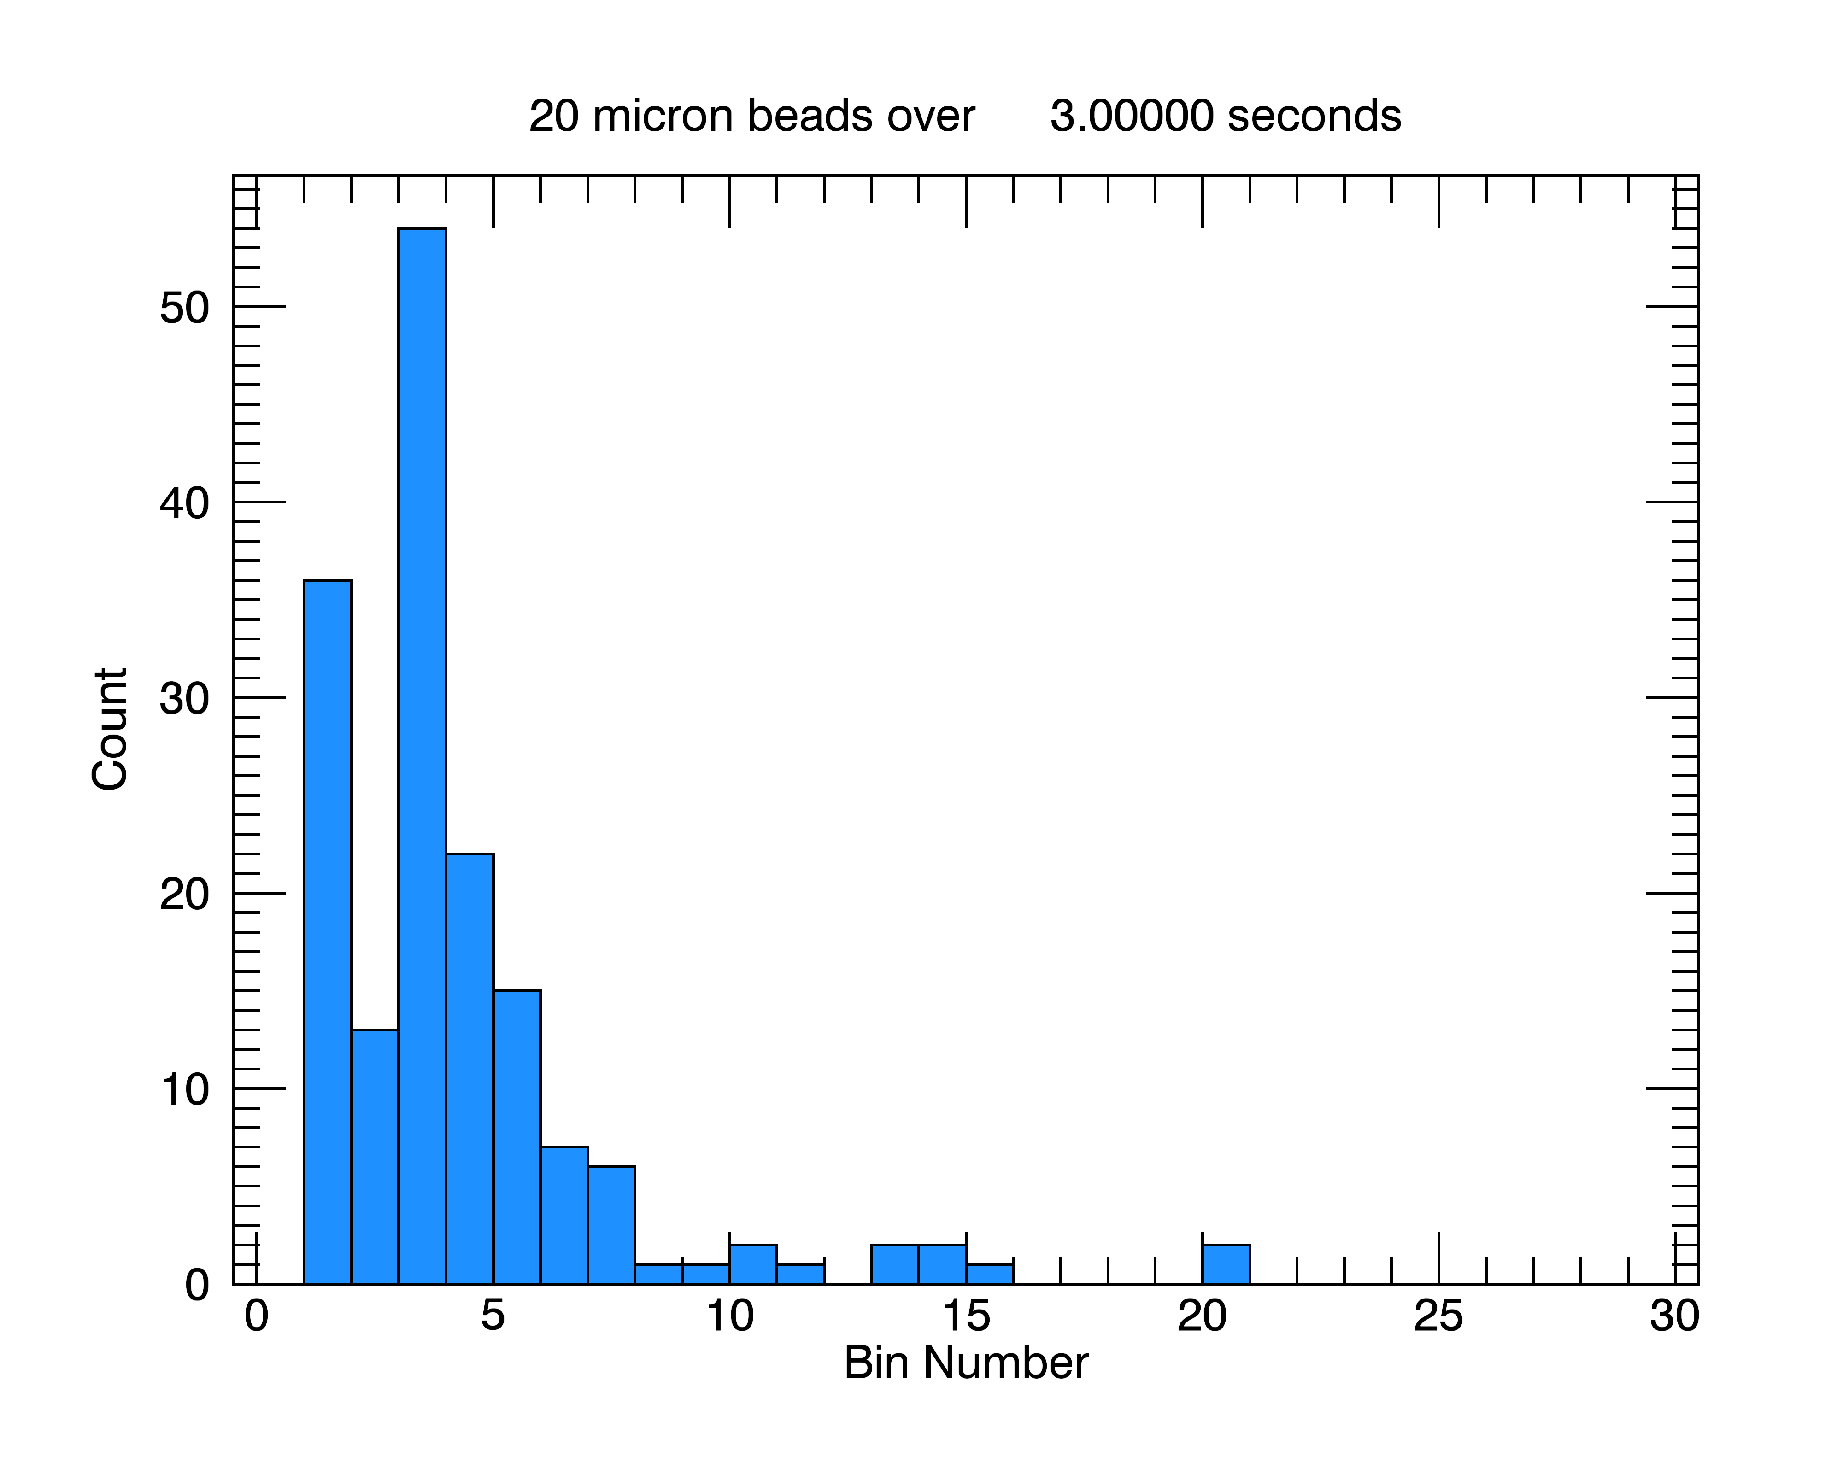
3
5
7
9
11
13
16
20
24
28
32
36
40
44
48
50
t
Upper Bin Size [um]

Slide 3
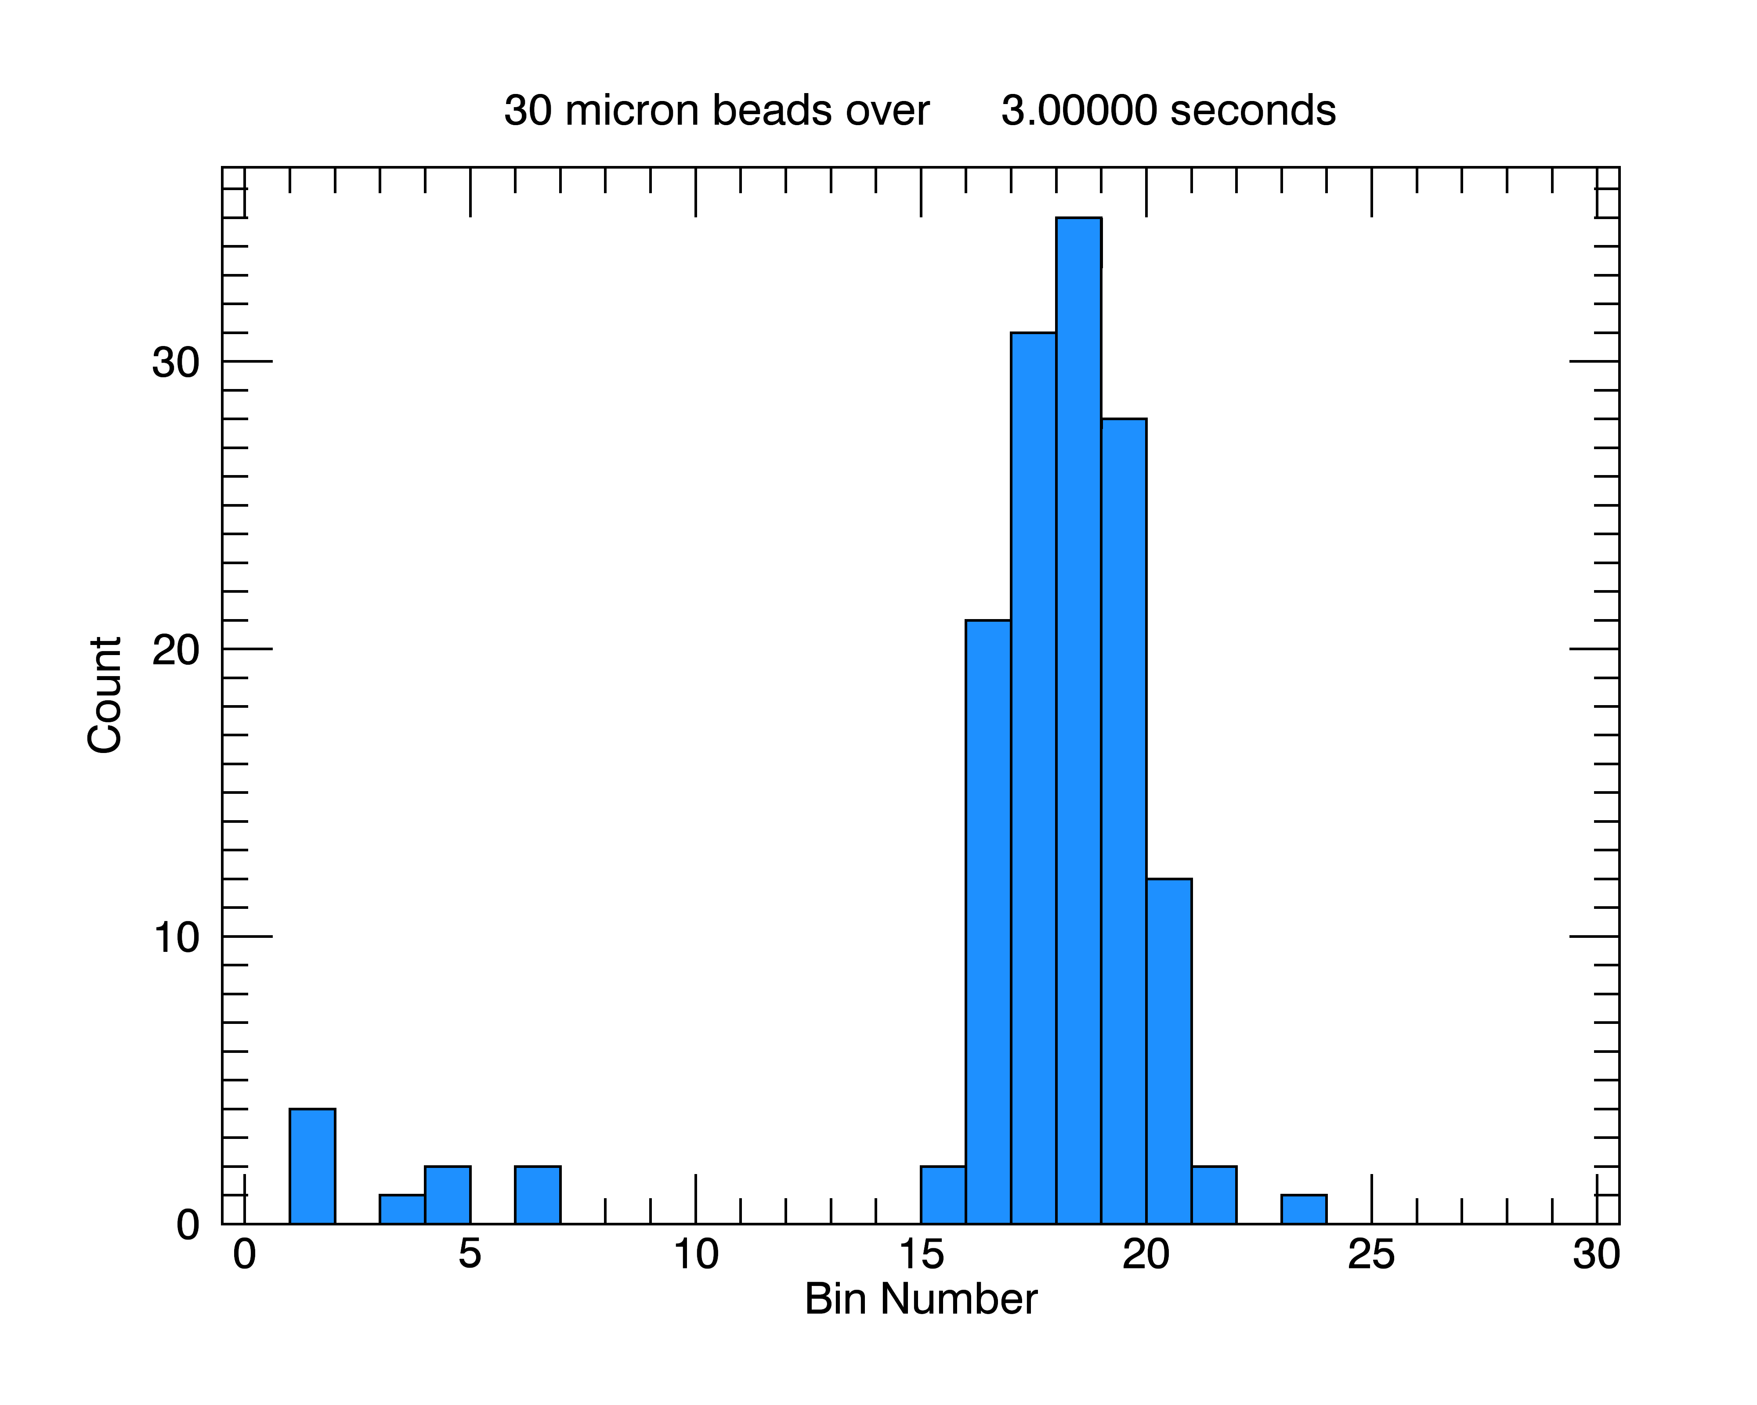
3
5
7
9
11
13
16
20
24
28
32
36
40
44
48
50
t
Upper Bin Size [um]

Slide 4
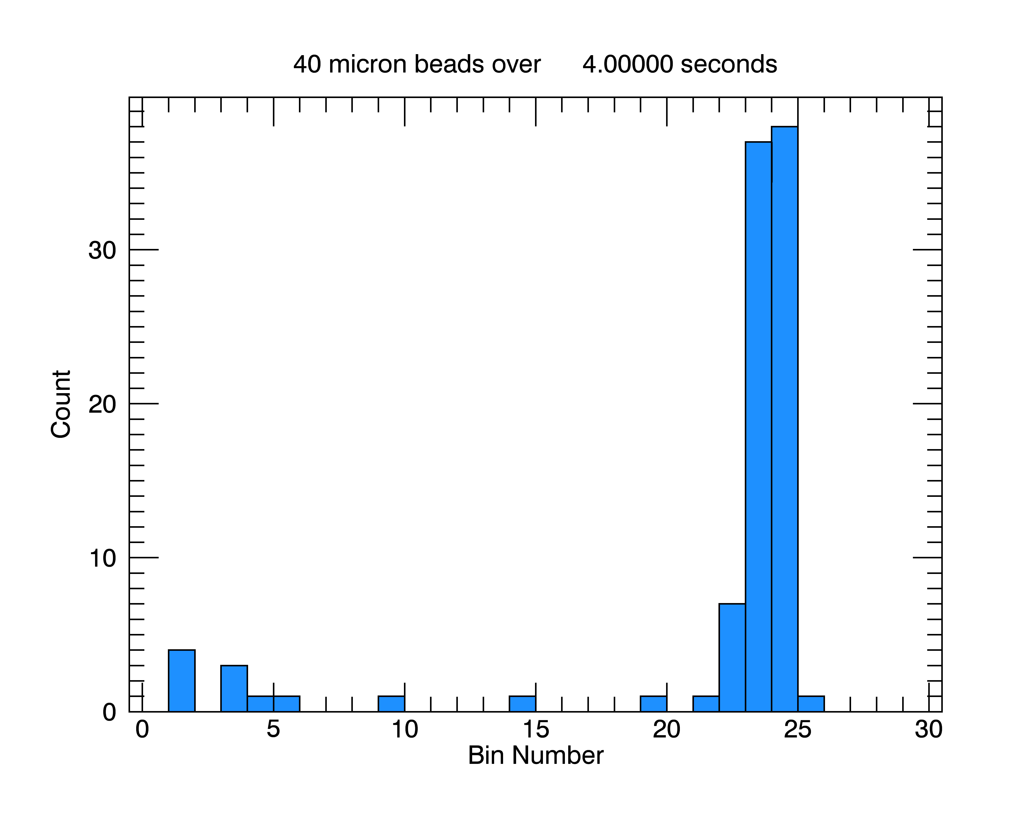
3
5
7
9
11
13
16
20
24
28
32
36
40
44
48
50
t
Upper Bin Size [um]

Slide 5
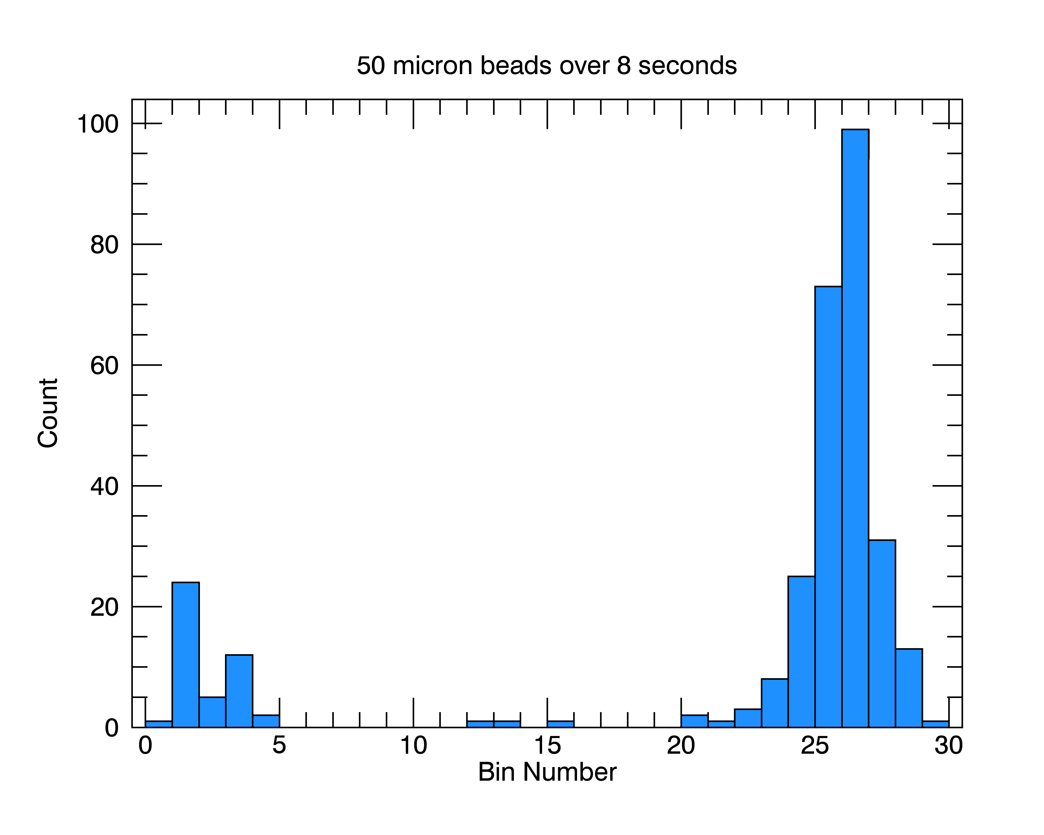
3
5
7
9
11
13
16
20
24
28
32
36
40
44
48
50
t
Upper Bin Size [um]

