Slide 1
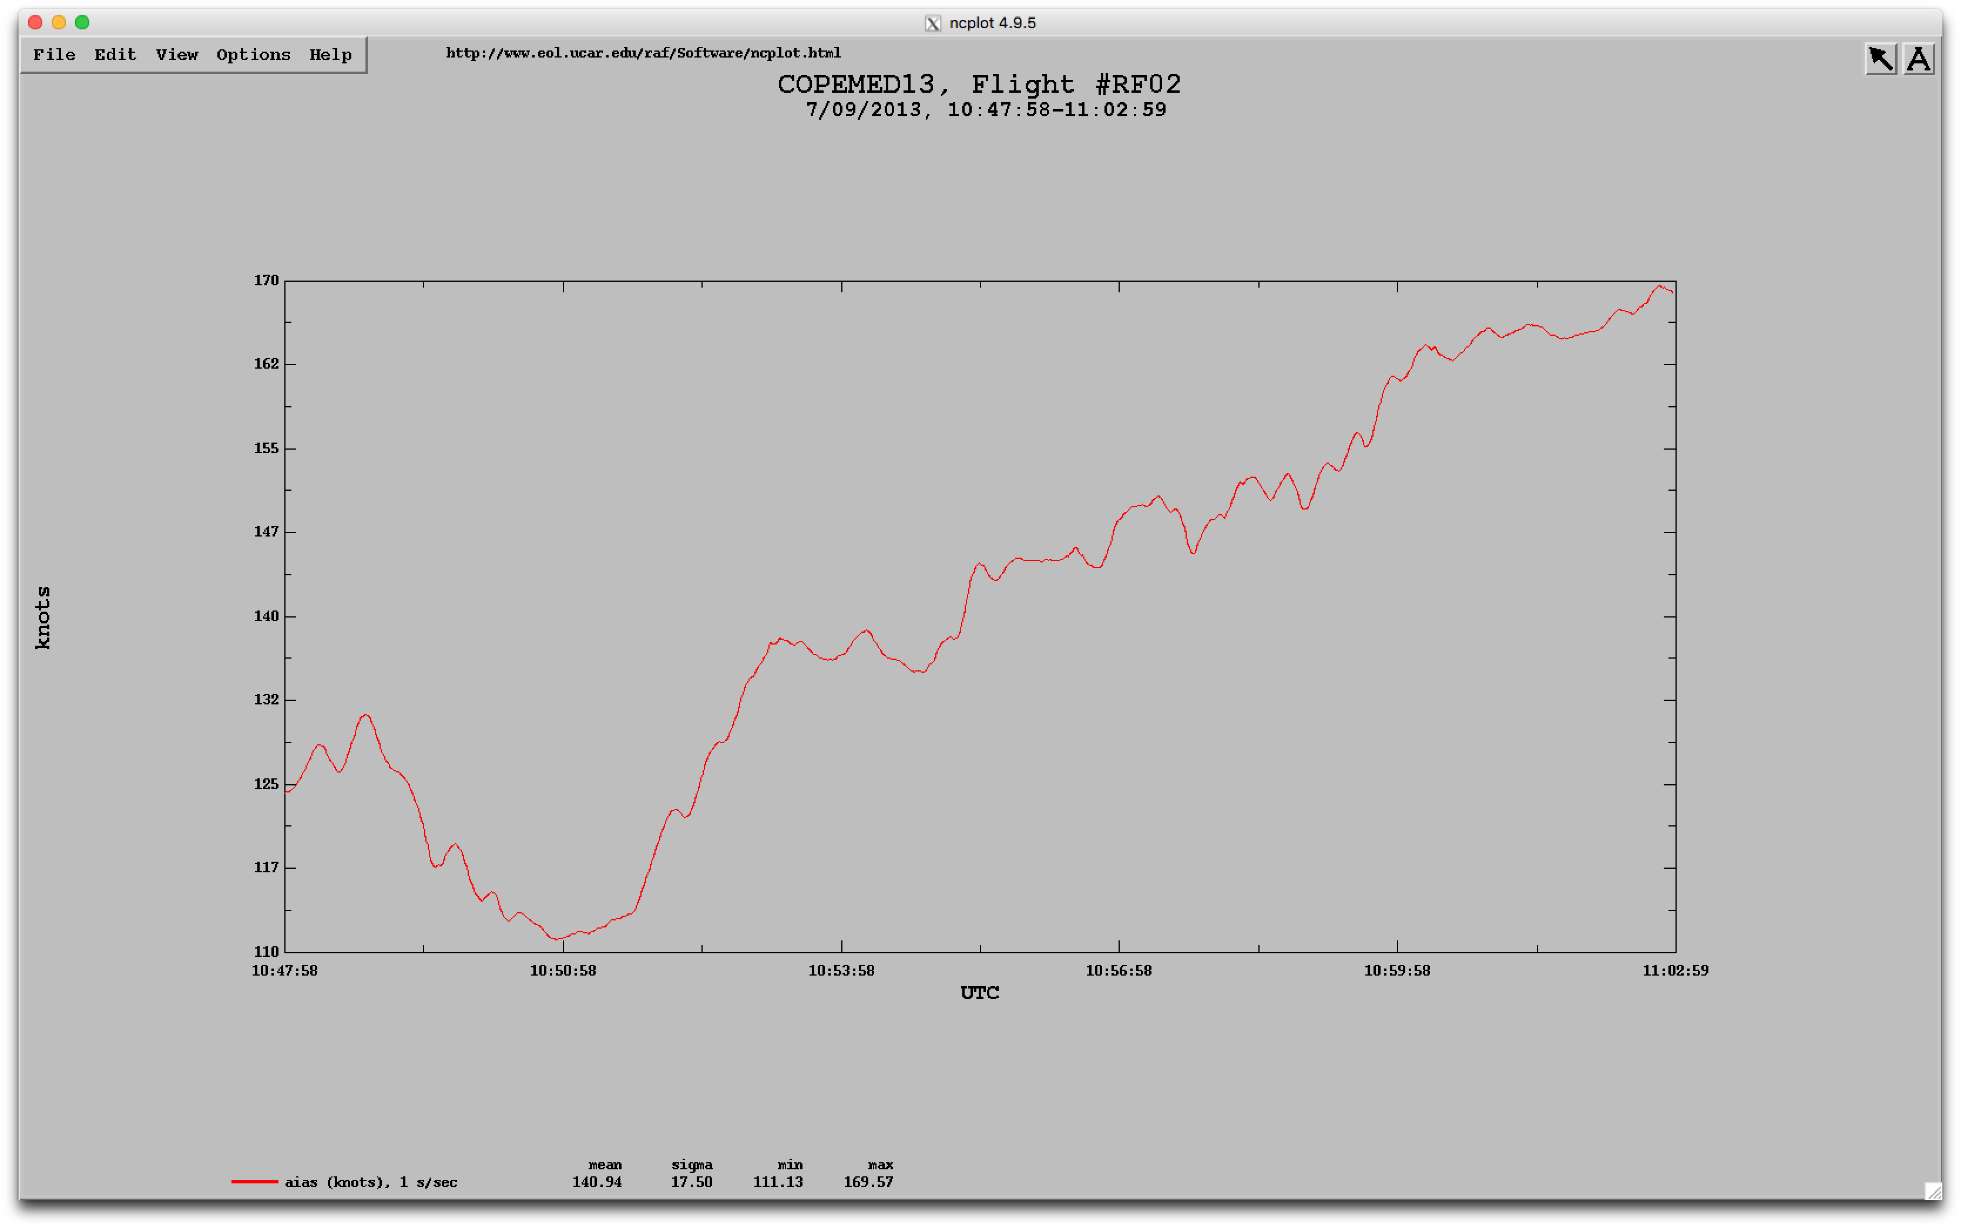
Nevzorov Liquid Water Content Airspeed Dependence Correction
Copemed 07/09/13 Calibration Flight

Slide 2
Nevzorov Liquid Water Content Pressure Dependence Correction

Slide 3
Nevzorov Liquid Water Content Pressure Dependence Correction

Slide 4
Nevzorov Liquid Water Content Pressure Dependence Correction

Slide 5
Nevzorov Liquid Water Content Pressure Dependence Correction

Slide 6
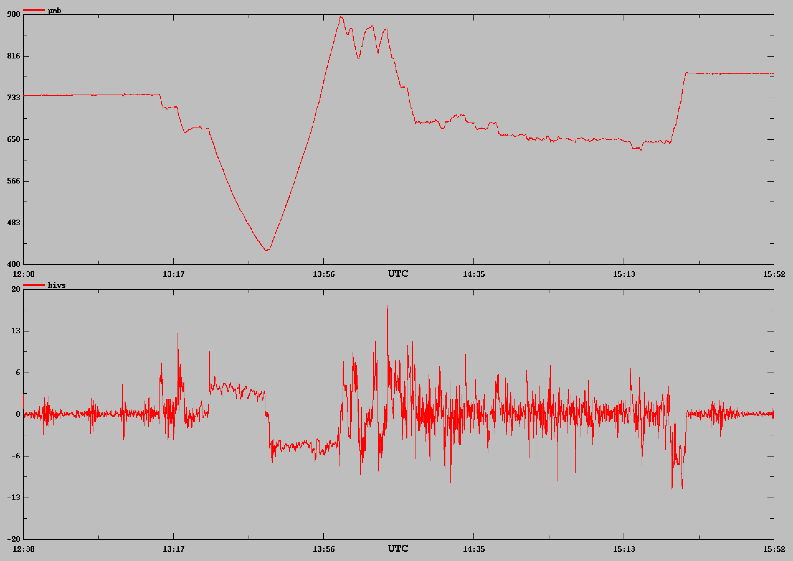


Nevzorov Liquid Water Content Pressure Dependence Correction

Slide 7
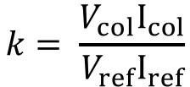
Nevzorov Liquid Water Content Airspeed Dependence Correction
$$k= \frac{V_{col}I_{col}}{V_{ref}I_{ref}}$$

