Slide 1
The Impact of School Wellness Policies
Looking for meaningful relationships between
Health and Academic Achievement

Slide 2
Looking at School Wellness Policies and Standardized Test Scores
Stanford’s SEDA data archive (released May 2016)
https://cepa.stanford.edu/seda/overview
District level means in state-referenced units, which are comparable within states. Multiple observations per district; one for each year, grade and subject.
Kansas School Wellness Policies
http://www.kn-eat.org/snp/snp_menus/snp_guidance_wellness_policies.htm
Only state in the US to develop standard guidance for wellness policies, and a “grading system” to compare
Basic (+, -)
Advanced (+, -)
Exemplary (+, -)

Slide 3
The Datasets:
SEDA included (in csv file):
District name
ID number
Year
Standardized test scores for each grade (3-8), averaged by district
Math
English Language Arts
Standard Error for each score
Kansas data from 2010:
259 districts
5,472 individual observations

Slide 4
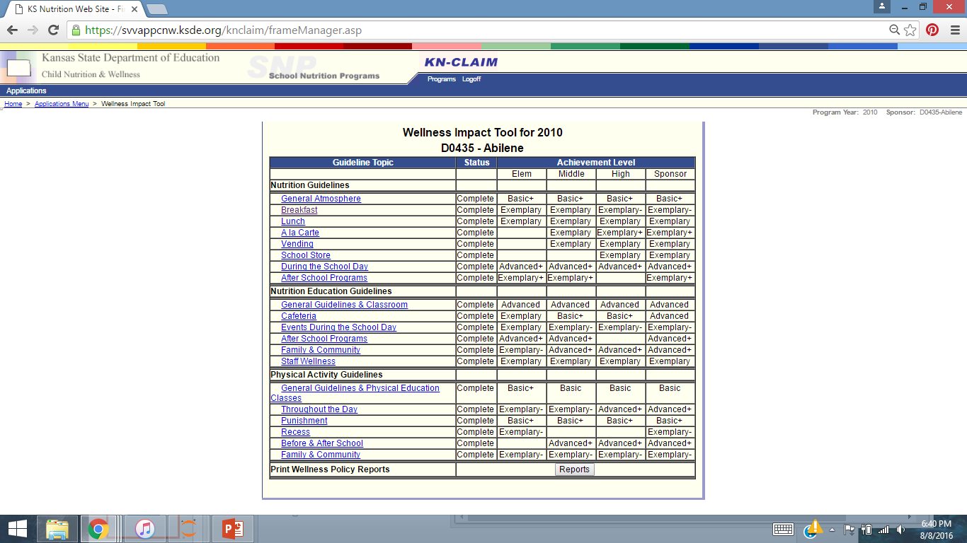
District WP Data on Web:

Slide 5
My Project: To determine whether the quality of a school’s wellness policy was related to a school’s standardized test scores.
Build Dataset
Kansas wellness policy data from web
Stanford SEDA free to download
Eliminate NaN values
Replace string scores (ex. ‘Basic +’) with a number
Begin looking at relationships
40+ variables
Look for correlation
Draw a bunch of regression lines with Seaborn

Slide 6
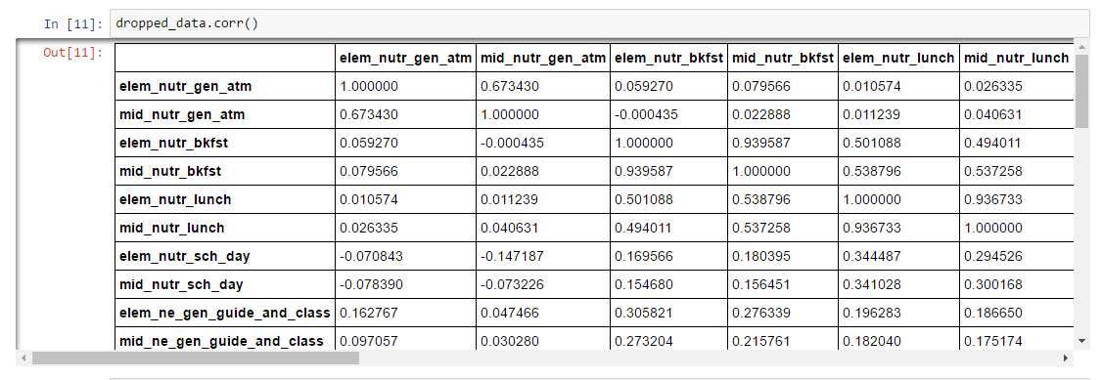
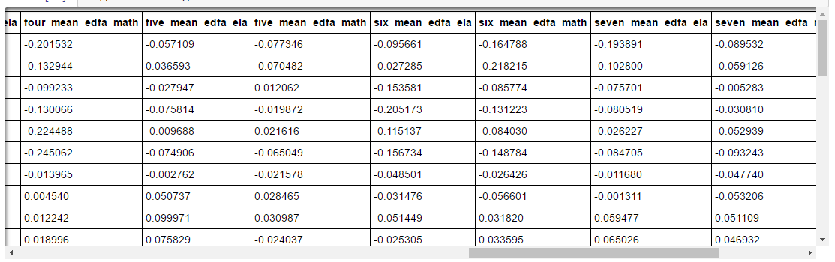
Correlation Table:

Slide 7
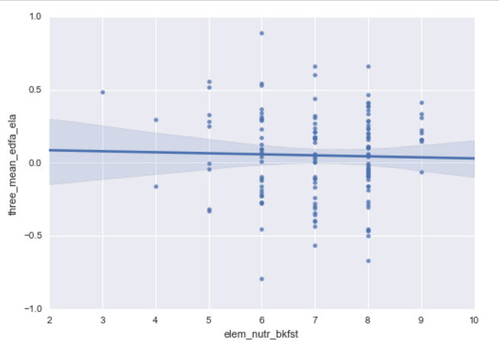
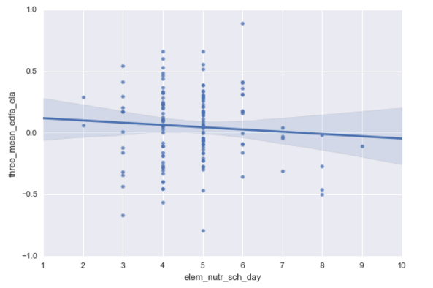
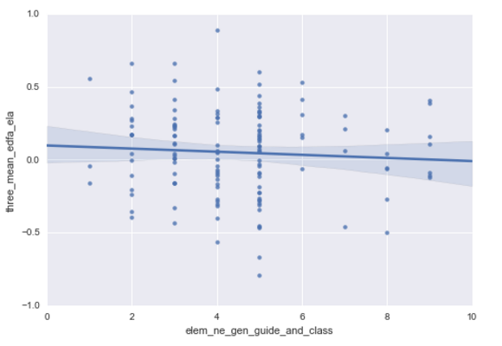
Minimal Correlation

Slide 8
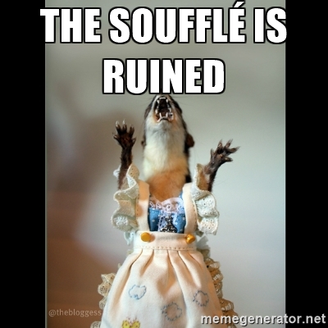

Slide 9
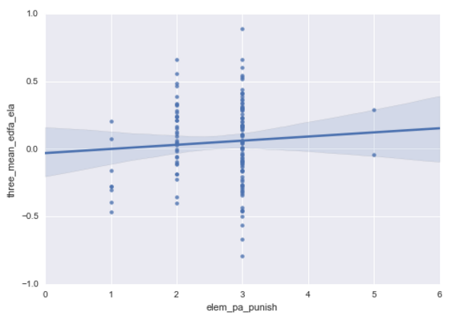
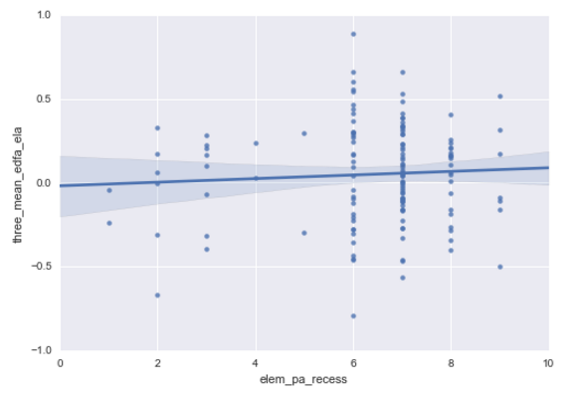
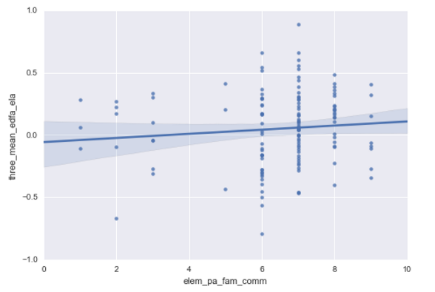
Slight Correlation with some Physical Activity Policies:

Slide 10
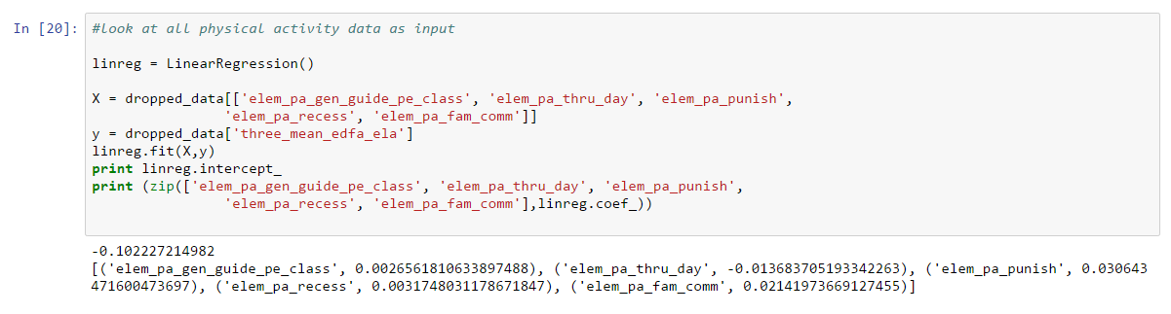
Linear Regression:

Slide 11
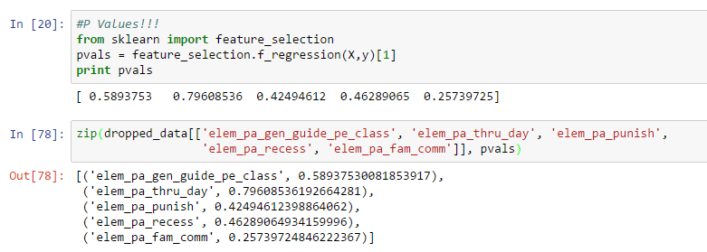
P Values Show Linear Regression Is Not Significant

Slide 12
Maybe the whole is greater than the sum of its parts:
Added total wellness policy scores:
Total nutrition
Total nutrition education
Total physical activity
Total for entire wellness policy
Compared with test scores

Slide 13
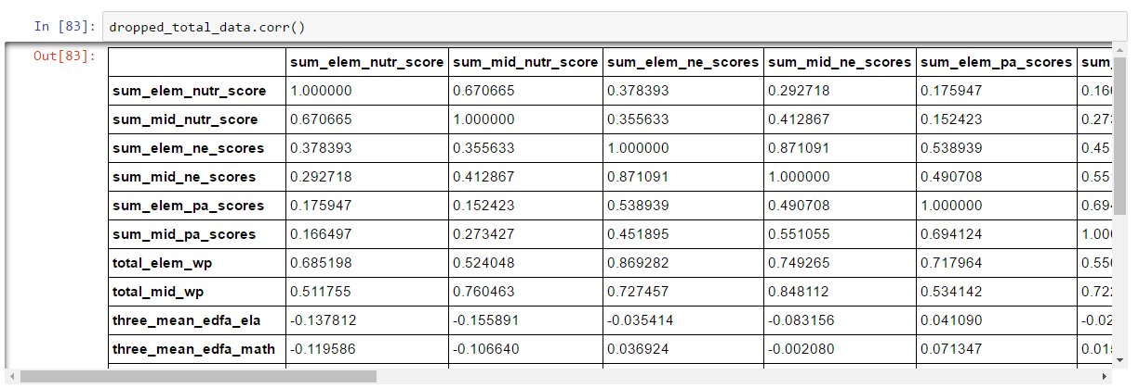
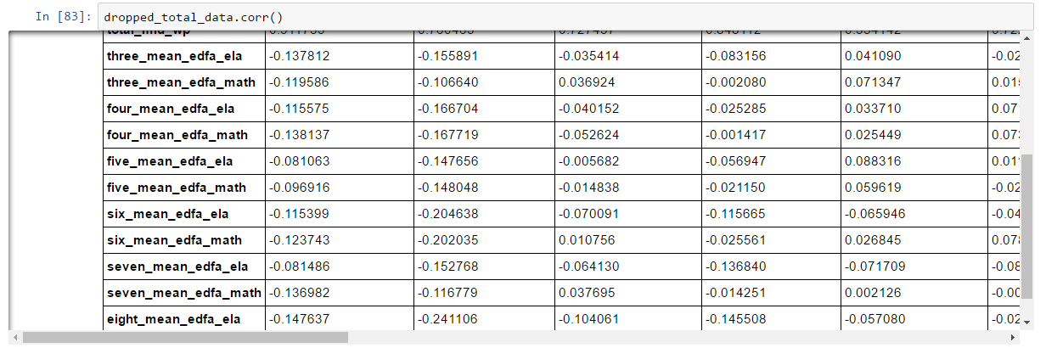
No meaningful correlation

Slide 14
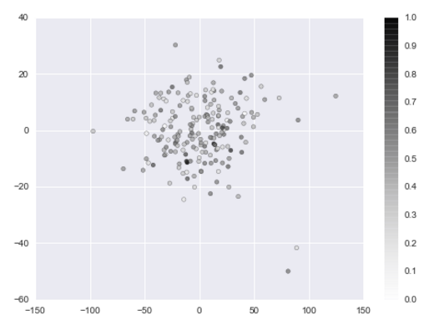
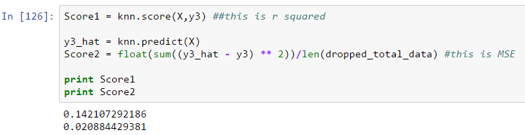
Principal Component Analysis
Standardized data
PCA, then KNN

Slide 15
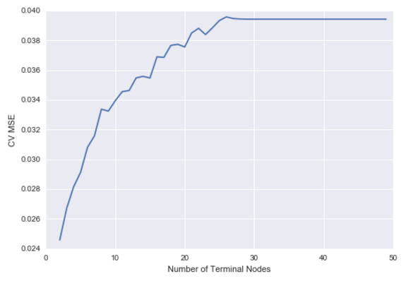
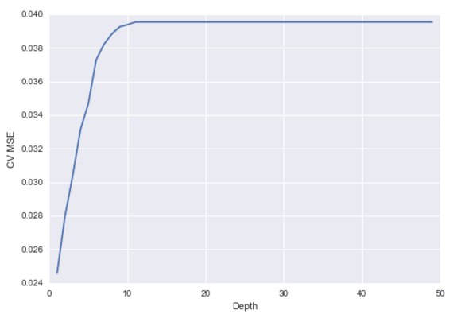
Decision Trees and Random Forest
More nodes = greater error
Greater depth = greater error

Slide 16
Lessons Learned:
Finding and assembling a unique dataset was significantly more time consuming than I had anticipated
Need to control for variables known to influence scores:
Socioeconomic factors
Racial/ethnic factors
Break down dataset into smaller pieces (elementary and middle school)
Great Python practice for me, though!

Slide 17
Resources:
Sean F. Reardon, Demetra Kalogrides, Andrew Ho, Ben Shear, Kenneth Shores, Erin Fahle. (2016). Stanford Education Data Archive(Version 1.1 File Title). http://purl.stanford.edu/db586ns4974.
Kansas School Wellness Policy Data: http://www.kn-eat.org/snp/snp_menus/snp_guidance_wellness_policies.htm
Contact me:
Allison Marseille
allisonmarseille95@gmail.com
https://www.linkedin.com/in/allisonmarseille

