Slide 1
Airbnb analyses: website behavior on booking outcomes
Tricia Tulipano
August 2016

Slide 2
agenda
Background
Methods
Results
Conclusion
Appendix

Slide 3
background

Slide 4
Dataset
The dataset I am using is part of the ‘Airbnb User Pathways Challenge’ that Airbnb provides to the broader data science community to improve methods for addressing challenges.
The objective of the challenge is to use a sample of user session website data to help guests find listings and better design their user experience.
The data is a sample representing user sessions from 2014-2015 in a US city. Here is an overview of the data:
Number of records in data: 7,756 Date span of the data: ['2014-05-05', '2015-04-23'] Number of unique users in data: 630 Number of unique sessions in data: 7,756 Percent of sessions with search: 15.9% Percent of sessions with sent message: 16.5% Percent of sessions with booking request: 1.9%
Note:
-Click here for more information about the ‘Airbnb User Pathways Challenge’
-User session data is the time users spend on the Airbnb website

Slide 5
Data dictionary
Here is the ‘Airbnb User Pathways Challenge’ data dictionary:
Column | Type | Null | Partition Key | Description
id_visitor | varchar | true | false | id of the visitor
id_session | varchar | true | false | id of the session
dim_session_number | bigint | true | false | the number of sessions on a given day for a visitor
dim_user_agent | varchar | true | false | user agent of the session
dim_device_app_combo | varchar | true | false | parsed out device/app combo from user agent (Android, iPhone)
ds | varchar | true | false | date stamp of session
ts_min | varchar | true | false | time of session start
ts_max | varchar | true | false | time of session end
did_search | bigint | true | false | binary flag indicating if the visitor performed a search during the session
sent_message | bigint | true | false | binary flag indicating if the visitor sent a message during the session
sent_booking_request | bigint | true | false | binary flag indicating if the visitor sent a booking request during the session

Slide 6
Key Questions
Do any of the variables have an impact on the outcomes provided?
Does the type of device have an impact in sending a booking request?
Does seasonality (month) play a role in sending a booking request?
Does the duration of a user session have an impact on sending a booking request?
Does searching the Airbnb website have an impact on sending a booking request?

Slide 7
Methods

Slide 8
Methods
Curated data (how I cleaned the data)
Dropped missing data (7.7k to 6.7k total rows)
Deleted columns not relevant for analyses
Session variables
“Next” activities
Created dummy variables for:
Device type: Android Phone - Android, Android Phone - Moweb, Android Phone - Web, Android Tablet - Android, Android Tablet - Moweb, Android Tablet - Web, Desktop – Chrome, Desktop - Firefox, Desktop - IE, Desktop - Safari, Other - Other, Unknown - Moweb, iPad - Web, iPad - iOS, iPhone - Moweb, iPhone - Web, iPhone - iOS, Desktop
Device Type Category: Desktop, Tablet, Phone
Month/Year: May 2014-April 2015 (12 months)
Converted timestamp into new variables for analyses:
String to categorical
Month/Year/Time to Month/Year
Time into duration (minutes)

Slide 9
Methods
Provide descriptive statistics to frame the data:
Percent of booking requests by device type
Percent of booking requests by month
Average time spent in minutes if sent a booking request
Use models to predict and interpret variables on outcome:
Logistic regression for interpreting website usage behavior vs. sending a booking
KNN to understand if there is a pattern in website usage behavior
Decision Trees to predict importance of variables

Slide 10
Results

Slide 11
Descriptive statistics
Desktop drove the highest percentage of sent booking requests as compared to Tablet and Phone devices
Device Type | Number of Booking Requests | Total N | Percentage Booked
Desktop | 100 | 1,947 | 5%
Tablet | 9 | 748 | 1%
Phone | 26 | 3,932 | 1%
Other | 1 | 152 | 1%
Unknown | 0 | 2 | 0%
Grand Total | 136 | 6,781 | 2%

Slide 12
Descriptive statistics
May 2014 generated the highest percentage of bookings as related to the total observations in May
Month | Number of Booking Requests | Total N | Percentage Booked
May 2014 | 5 | 109 | 4.6%
June 2014 | 3 | 215 | 1.4%
July 2014 | 5 | 385 | 1.3%
August 2014 | 12 | 628 | 1.9%
September 2014 | 18 | 1,117 | 1.6%
October 2014 | 12 | 710 | 1.7%
November 2014 | 15 | 733 | 2.0%
December 2014 | 22 | 1,040 | 2.1%
January 2015 | 15 | 747 | 2.0%
February 2015 | 18 | 670 | 2.7%
March 2015 | 9 | 343 | 2.6%
April 2015 | 2 | 84 | 2.4%
Grand Total | 136 | 6,781 | 2.0%

Slide 13
Descriptive statistics
Average time spent for those who sent a booking request was 41 minutes
Average time spent for those who did not send a booking request was 10 minutes
Sent Booking Request | Average Time Spent
Yes | 41 Minutes
No | 11 Minutes

Slide 14
Descriptive statistics
64% searched and sent a booking request
36% did not search and sent a booking request
Searched | Sent Booking Request | Percentage
Yes | 87 | 64%
No | 49 | 36%
Grand Total | 136 | 100%
15% searched and did not send a booking request
85% did not search and did not send a booking request
Searched | Did Not Send Booking Request | Percentage
Yes | 973 | 15%
No | 5,672 | 85%
Grand Total | 6,645 | 100%

Slide 15
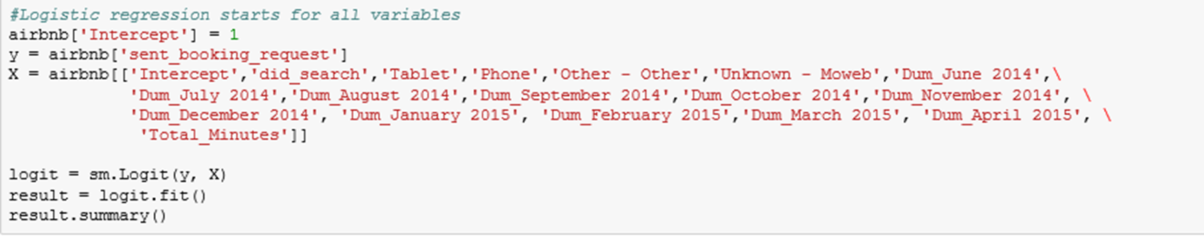
Logistic regression
A logistic regression was used to describe data and to explain the relationship between sending a booking request and device type, duration of time on website, searching on the website, and month/year booked
First, reviewed all variables (X) vs. send the booking request (y)

Slide 16
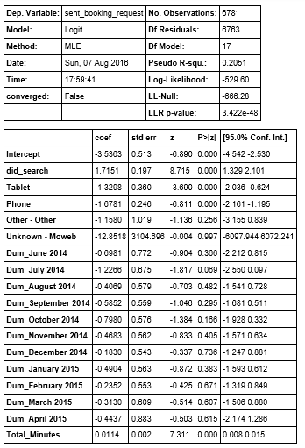
Logistic regression
I reviewed each of the variable p-values and found that ‘months’ were not significant at the .05 confidence level
‘Search,’ ‘Tablet,’ ‘Phone,’ and ‘Total Minutes’ were significant at the .05 confidence level
Months were not significant so I dropped all months and reran the model

Slide 17

Logistic regression
10-fold cross validation was used to understand how accurate the model will perform – the accuracy was 98%
To understand the model further, I reviewed the confusion matrix and found the following:
6,664 - Truly negative - predicted no actual no
135 - Falsely negative - predicted no actual yes
1 - Falsely positive - Predicted yes actual no
1 - Truly positive - Predicted yes actual yes
The confusion matrix showed that the model needed to be tuned

Slide 18

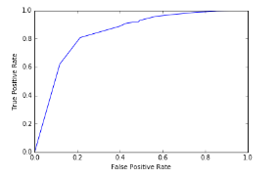
Logistic regression
I tuned the model with various numbers until the matrix maximized the number of truly negative and positive observations:
4,124 – True negative - predicted no actual no
16 – False negative - predicted no actual yes
2,521- False positive - Predicted yes actual no
126 – True positive - Predicted yes actual yes
After tuning, the model became more interpretable

Slide 19
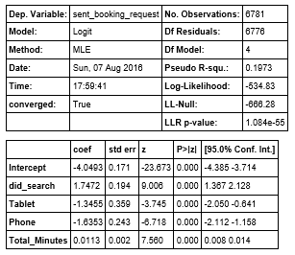
Logistic regression
Results
For device, the odds of booking with a tablet is 134% less than booking on a desktop. A phone is 163% less than booking on a desktop. This is not surprising as sending a booking request is easier on a desktop.
The odds that people who searched are 174% more likely to send a booking request than those that did not search. Again, not surprising as you search when you are in the mindset of booking.
The odds increase 1% in sending a booking request for each minute you spend on the website. The longer you are on the site, the more likely you will send a booking request. Note: interestingly searching and duration was not correlated.

Slide 20
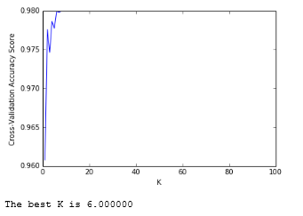


K Nearest Neighbors (KNN)
The next model I tested was KNN. I standardized the data and found that the best K was 6. The misclassification error was 2% (i.e., 98% accurate).
In looking at the confusion matrix for KNN I found that the model was not a good fit:
6,645 - Truly negative - predicted no actual no
136 - Falsely negative - predicted no actual yes
0 - Falsely positive - Predicted yes actual no
0 - Truly positive - Predicted yes actual yes
Results
I trained/tested the data again with KNN = 6 and found the model did not capture the data. I believe the model was not a fit because there were so few sent bookings and data were unbalanced. KNN degraded to the prevalence of ‘false’ – did not send booking.

Slide 21
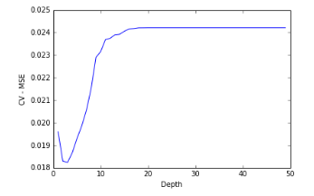
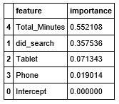
Decision Trees
The next model I reviewed was Decision Trees.
Looking at the Decision Tree classifier with a depth of 50 and using 10-fold CV to test and train the data.
The best depth was 3 with a low MSE of .01 which I used to interpret the importance of the variables.
I used the best depth to calculate the importance of the variables
Results
From the decision trees, ‘Total Minutes’ and ‘did search’ were the most important variables in comparison to the devices

Slide 22
Conclusion

Slide 23
conclusion
Logistic regression was the most interpretable model
KNN did not fit the data
Decision trees predicted importance of the variables

