Slide 1
Project 9: Content-Sensitivity-Aware Deepfake Detection
Andrea Liviero – Nicolò Locurcio
Computer Vision Project Fall 2026

Slide 2
Index and preliminary informations
We’ll speak about:
Sensitivity Scale
Procurement of images and labelling
The classification model
Results and conclusion
Each Level has 100 images, 50 Real / 50 Fake
Satire was also took in consideration but later dropped

Slide 3

Level L0: Abstract images
Abstract images, procedural and creative art
Extremely low
Impact / easy to spot
Only real danger is from art counterfeit,
althoughart experts can discern real piece
from fake and fakes have been around
since the start of the commercialisation of it
Real: Unsplash API
Fake: Bing Image Generator / Stable Diffusion
True or fake?

Slide 4
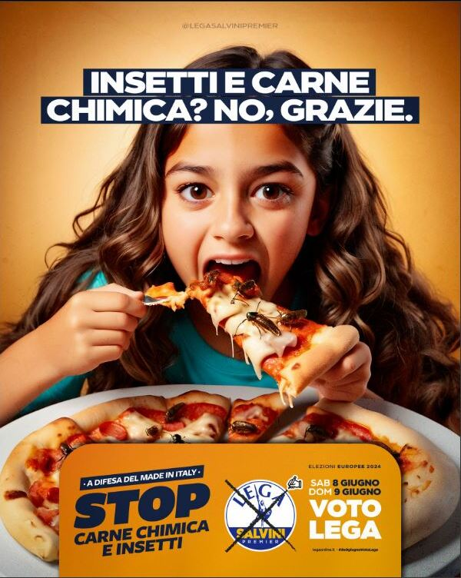
Level L1: Everyday images
Images about everyday scenes and people
Low Impact /Danger
of political manipulation
Images from everyday life may be innocent, and already before AI
The market was full of «stock» picture used in several application
The danger is from limited political manipulation
Real: COCO database and FFHQ
Fake: thispersondoesnotexist.com / StyleGAN2
Example of political manipulation
censored for par condicio

Slide 5
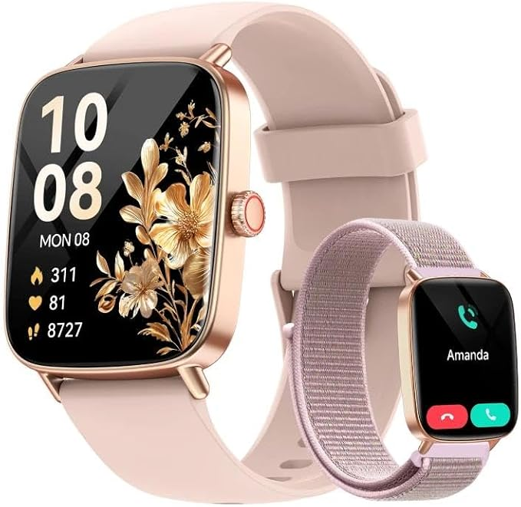
Level L2: Commercial images
Images about commercial product and companies
Medium Impact /Danger
of scam and falsification
Images from product, companies, and objects which do not exist
or have their characteristics changed and altered. Damage of
Image to companies and unlawful (Art. 473)
Real: Amazon Berkley Database (
Fake: Stable Diffusion on Amazon Database / Aliexpress scraping
Seems like an Apple watch
but costs 1/10…

Slide 6
Level L3: National, Internal Risks
Images which can cause national unrest and security risks
High Impact /Danger
of national unrest and reaction
Images (and videos) of prominent figures or event that can
create unrest and have an impact on national security or
decisional process. Those are culture-specific-influenced,
therefore harder to regionalize
Real: LFW dataset / scraping of news agency (ANSA, AGI)
Fake: Celeb DB dataset -> stable diffusion on news agency portrait
Only one is the original
Which one?

Slide 7

Level L4/L5: International, military Risks
Images which can cause International turmoil and military unrest
Extremely High Impact /Danger
of national unrest and reaction
Images (and videos) which try to catch on generate reaction from
other countries, spark military reactions and exacerbate relations
Between countries. L4 and L5 later merged for simplicity.
Real: Wikimedia Commons scarping with keyworld
Fake: OpenFake -> stable diffusion on database + Wikimedia
President Donald J. Trump
Truth post 7.09.2026

Slide 8
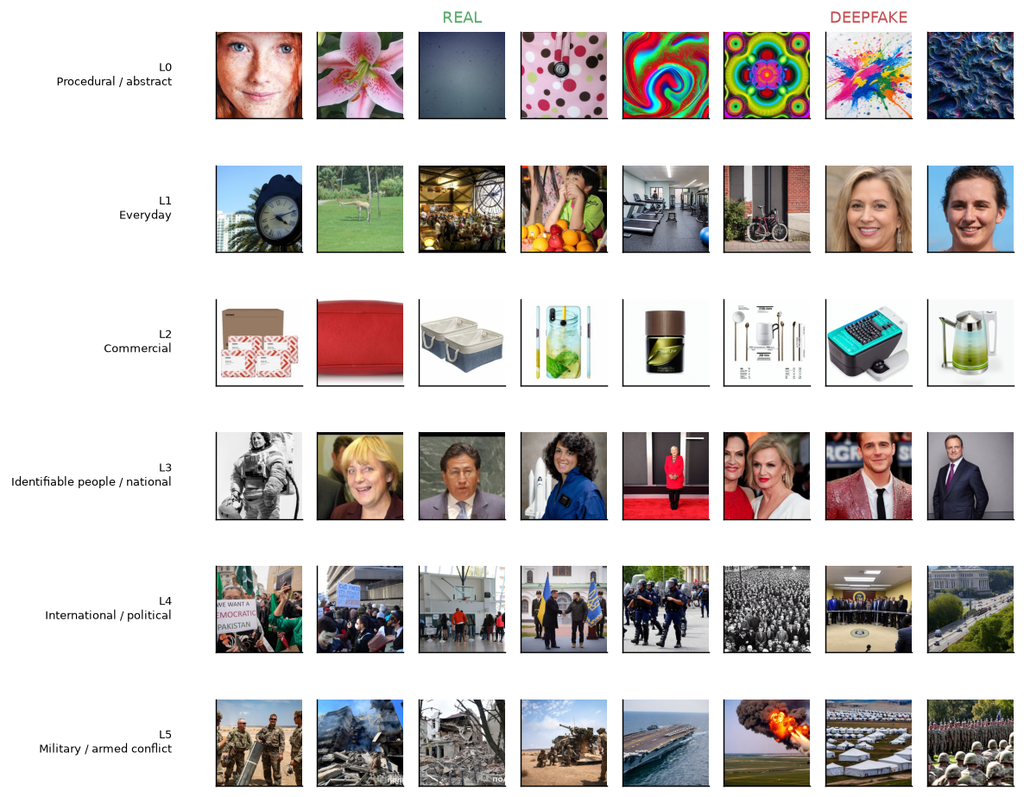
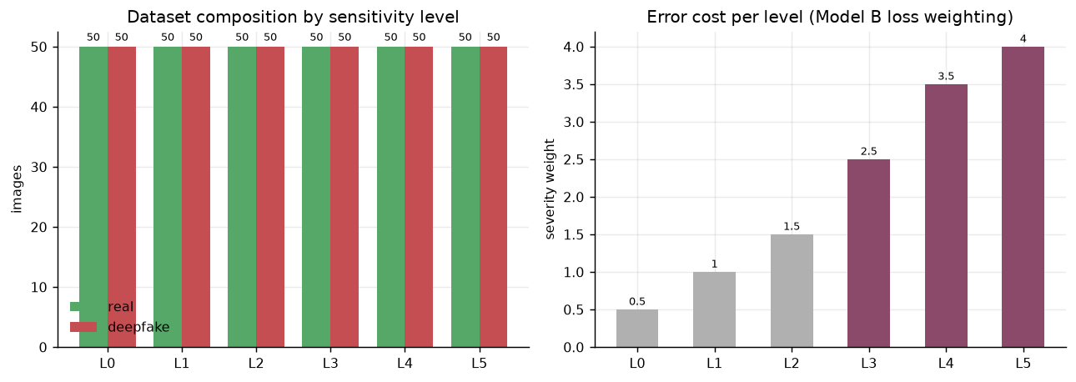
Labeling and training
Each image has been manually and
Automatically labelled (2 times) using
the script in the notebook and an automatic
label in the generation phase
All images have been individually seen and categorized
Model trained in a 50/50, penalty weights for each increase of category, L4-L5 heavily penalised

Slide 9
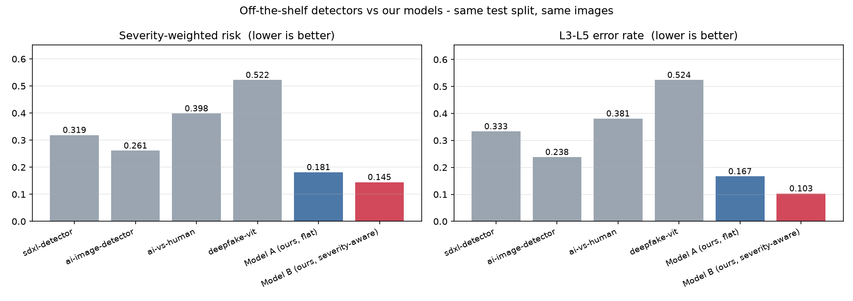
Baseline: pre-trained detectors
Four public AI-image detectors run zero-shot on our benchmark — same images, same splits, nothing fine-tuned. Stratified by sensitivity level, scored with severity-weighted risk.
Best off-the-shelf (SwinV2): 0.821 AUC, but 1 in 4 errors on L3–L5. A face-deepfake ViT sits at chance — it has nothing to say about textures or conflict photos.

Slide 10
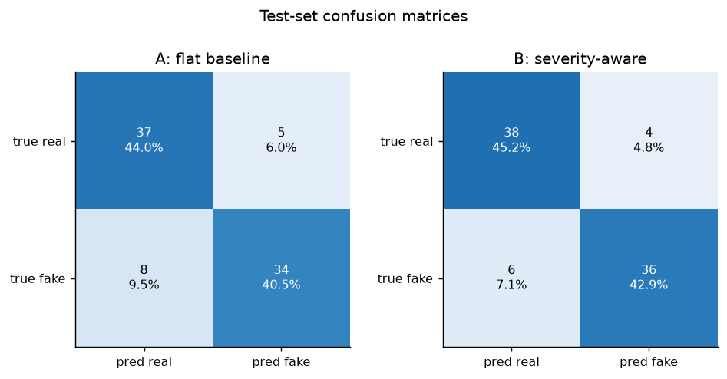
Results #1
A deepfake image detector using ResNet-18 trained on 600 images across and 5 sensitivity level. A is the model without the sensitivity, B with.

Slide 11
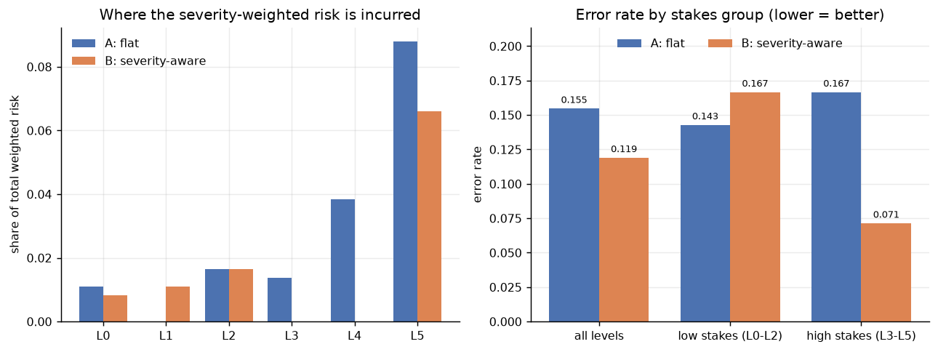
Results #2
A and B were not different in accuracy overall, however the sensitivity allowed for more precision in B on higher risk category
not better in general, but better in high risk area

Slide 12
Ethics of a sensitivity-aware detector
The taxonomy is policy, not measurement — our scale is a Western, journalistic reading of harm; another scale moves the model's attention elsewhere
The error cost is asymmetric on purpose — fewer mistakes on L5 means more on L1, so ordinary people's images get the less careful model. A stated trade, not a silent default
Flagging is one step from ranking — a score for “politically sensitive” is trivially repurposed. This belongs behind a human reviewer, never in front of an automatic takedown
The synthetic images depict no real person, event or brand, and are EXIF-marked as synthetic

Slide 13
Conclusion and future development
Sensitivity is not a panacea for solving the deepfake problems, but allows for focus on high risk images and better results in dangerous and riskier fields
More images could obviusly help, but many fields lack (for now) large scale deepfake images
Ideally this could be applied in videos, although audio could be a challenge

